Slide 1
User interface design
xkcd

Slide 2
UI Design: Monday Sept 19
Dr. Jillian Aurisano
Plan for today:
Announcements/Course logistics
Javascript
Coding activity
Notes:
So welcome to engineering visual interfaces for data science. I'm Dr Aurisano.
Thanks for finding the class on Zoom. Hopefully we will be in person again soon.
If anyone out there is comfortable turning on their cameras, that is lovely- then I feel like I am talking to students, rather than to myself.
Here’s our plan for today:
First I’m going to introduce myself, so you know a bit about me
Then we are going to get to know each other, in Zoom breakout rooms. This will give us a chance to make sure that Zoom breakout rooms work, and we all know how to access them.
Then, I am going to walk through the structure, and plan for the course. I want to make sure everyone knows how the course will work, and what to expect, and also a bit about why the course is designed this way.
Then I am going to introduce the class, and what the class is about. Since this is a new class, and one of just a few classes in human centered computing here at UC, I wanted to give an overview of the topic.
Then I have an introductory activity, which we will do in breakout rooms, and which I think will help motivate the discussion on Wednesday, and getting into the meat of the class.

Slide 3
Announcements
Project suggested timeline posted
START WORKING ON IT
Tell me which smart object you are working on
Thanks for turning in sketching work
Turn in what you did last week- posted
There will be a turn in for the work you do in class this week
Bonus opportunity: Learn something new that will help you be a better developer of UI’s for the web

Slide 4
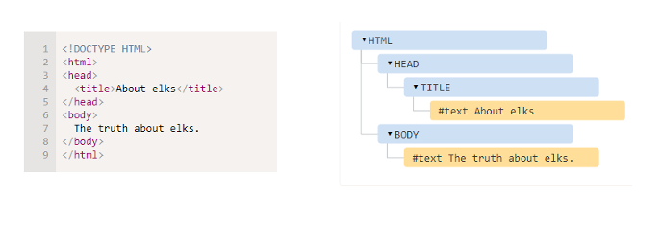
Recap
We can add elements onto our page in a tree-structure which is generally referred to as a View Tree
This view tree is parsed to create the Document Object Model (DOM), where visual elements are stored in a hierarchical tree of elements
There can be parent elements that have children- like a div that groups a set of elements together

Slide 5
Recap
You can manage the appearance of these elements using CSS+HTML
Put elements into classes
Create style rules in your css style sheet
background color, border colors, text color, padding, rounded edges …
You can add pseudo-class labels to have style rules update for a particular class
Selector:hover
Mouse hover changes the styling of elements in that selector
You can have multiple classes to create complex style rules for sets of elements
Use css to manage the layout of elements within a parent container
CSS Flexbox
CSS Grid

Slide 6
Stepping back…
In general, for any graphical user interface (GUI) library, developers can create their UI through
Procedural programming
Declarative programming
Direct manipulation

Slide 7
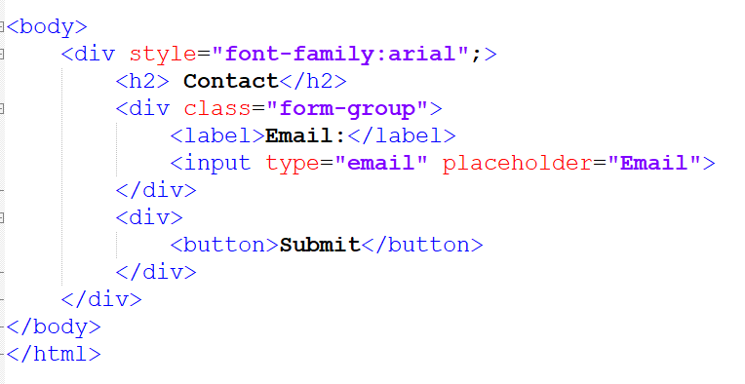
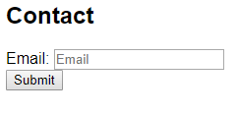
Declarative programming
Programmer writes code that directly represents the desired view tree
There is no explicit flow of control
You declare the elements. They are added to the tree. That’s it.
Mark-up language
HTML
XML
LaTeX
This is what we have done so far….

Slide 8
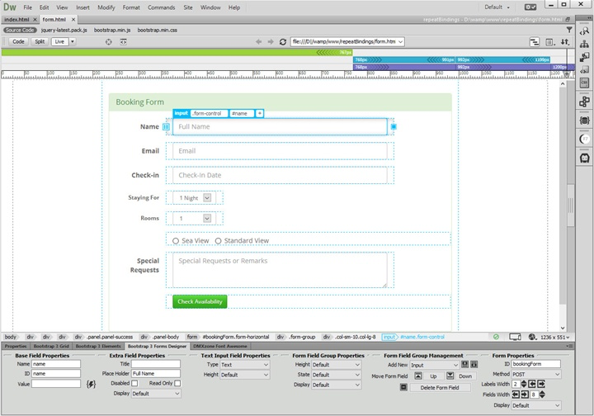
Direct manipulation
Libraries that let developers interact with an application, with its own UI
They can place elements on the page through drag and drop.
Example: Adobe Dreamweaver
Alternative route to declarative programming
BUT- still no flow of control
You put the elements on the page
That’s it

Slide 9
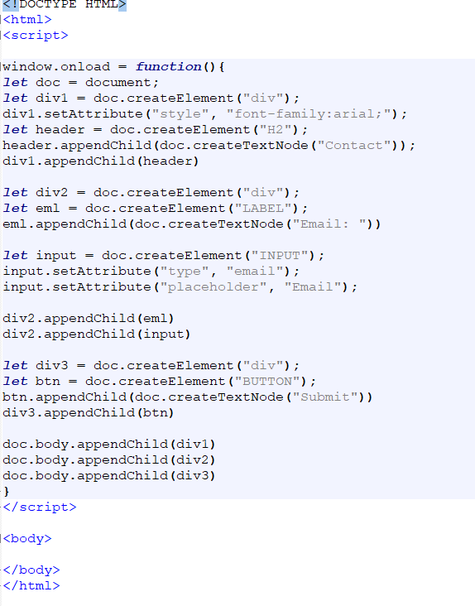
Procedural programming
You write code that allows you to define a process for creating the elements on the page
Has an explicit flow of control
Declarative:
Block A
Block B
Block C
Procedural
First put down block A
Then put block B
And finally put block C

Slide 10
Procedural programming
The programmer can write step-by-step how to reach the desired state
There is a thread of control
Javascript is an interpreted language, executed by the browser
You can call constructors to create elements
You can set properties of elements
You can build the tree step-by-step creating objects and appending them to other objects as children
Aside from the basic page elements- html tag, header and body tag
Anything you create in html and css, you could create with javascript

Slide 11
Comparison- procedural vs declarative
Declarative is more compact
You lean on the built-in parser, to take your declarations and translate them into the elements on the page
Declarative can be hard to debug
No break-points, no console messages
Debugging can be more trial and error
Procedural can do more
Processing data
Dynamically update

Slide 12
Javascript
Javascript can run on the client side (run on the browser along with your html and css)
Can also run server side, but we don’t have to worry about that now….
You can access elements in the DOM
create new elements or remove them
change their attributes
Also, with Javascript you can capture events- input events, timer events, data loaded events….
Which brings me to the listener pattern

Slide 13
2 ways to capture events
Remember the 2 options for creating a visual interface
Let the developer place visual elements freely and manage them
Tree based approach, with parents and children, and layout protocols
Tree based approach won
2 approaches for interaction and animation
Give the developers a ‘draw loop’, that runs on a loop continuously.
In the draw loop, the developer can check to see if there are keys pressed or if the mouse is pressed. They can manage updates or create their own animations
Out of sight of the developer, there is an event loop which captures inputs
Developers can ask for events using listeners
This won….

Slide 14
Listener design pattern
Common GUI library approach
Publish-Subscribe, Event, Observer….
An event source generates a stream of events
Like a mouse click, or a keyboard press
Developers express their interest in particular events on particular elements using listeners
I want to listen for mouse click events on this element in my view tree
When an event occurs, the event source distributes it to all interested listeners

Slide 15
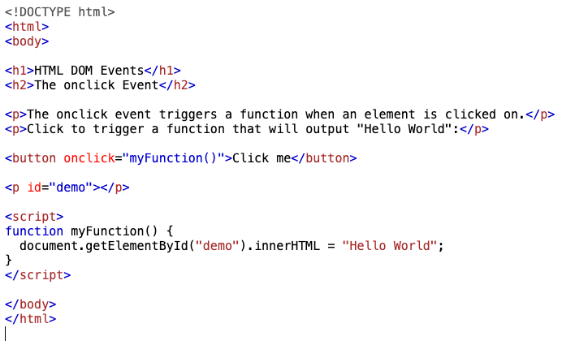
Example in Javascript
Suppose you want to change the displayed text when the user clicks on a button
You need a listener to detect mouse click events for that button
You need a function that is invoked on that mouse click
That function will find the element in the DOM that you want to change, and will change its text

Slide 16
Can I cover the basics of Javascript in 10 minutes?

Slide 17
But before I do…
Javascript is a Wild West language
It errs on the side of freedom and flexibility
You can often do what you want, even if it is a bad idea. Javascript won’t throw errors and stop you.
It can be very liberating!

Slide 18
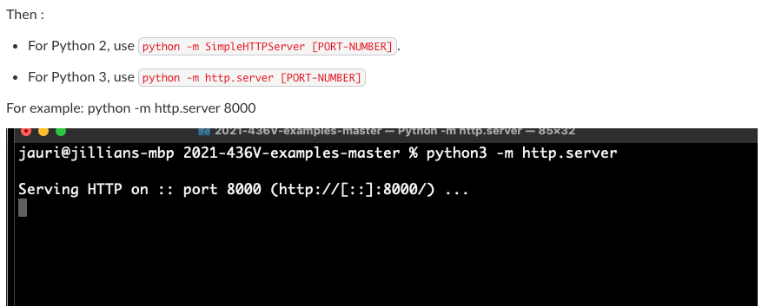
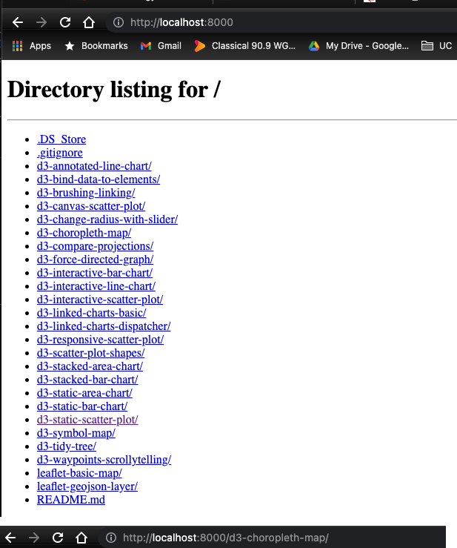
1. Preliminaries
Run a local server
You don’t always need to run a local server
But you probably will eventually (this has to do with loading external files that the Chrome browser wants to make sure are safe….)
How?
Terminal, navigate to my directory
Use python simple server
You can also use an IDE
Visual studio live server

Slide 19
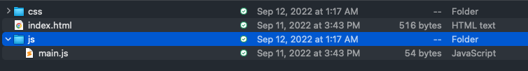
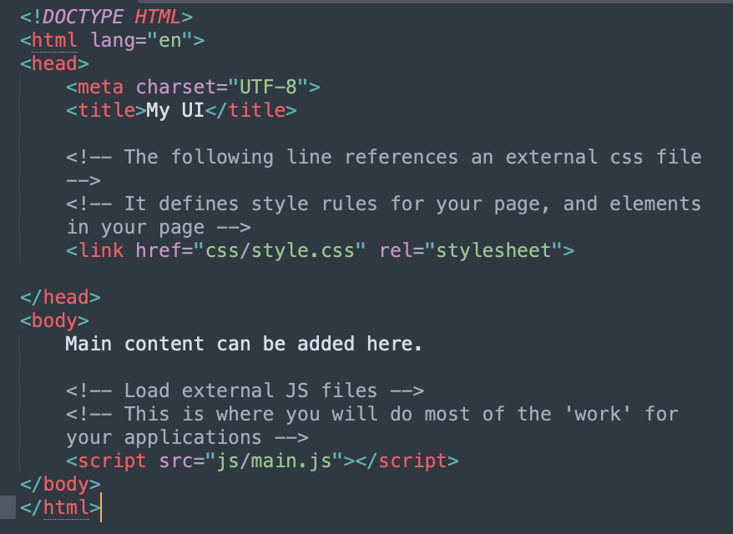

2. Where do I write my Javascript code?
2 Choices
Within the body of your page
Write in a separate file, and load it
Can also load in external javascript libraries by setting the path to them
Better

Slide 20
Ok let’s look at my tutorial…

