Slide 1
User Interface Design

Slide 2
UI Design: Monday Aug 29 (Day 4)
Dr. Jillian Aurisano
Plan for today:
Reminders, course logistics
Review last week
Let’s think about the user’s goals, tasks, and concept of the system
Activity about the first project
Notes:
So welcome to engineering visual interfaces for data science. I'm Dr Aurisano.
Thanks for finding the class on Zoom. Hopefully we will be in person again soon.
If anyone out there is comfortable turning on their cameras, that is lovely- then I feel like I am talking to students, rather than to myself.
Here’s our plan for today:
First I’m going to introduce myself, so you know a bit about me
Then we are going to get to know each other, in Zoom breakout rooms. This will give us a chance to make sure that Zoom breakout rooms work, and we all know how to access them.
Then, I am going to walk through the structure, and plan for the course. I want to make sure everyone knows how the course will work, and what to expect, and also a bit about why the course is designed this way.
Then I am going to introduce the class, and what the class is about. Since this is a new class, and one of just a few classes in human centered computing here at UC, I wanted to give an overview of the topic.
Then I have an introductory activity, which we will do in breakout rooms, and which I think will help motivate the discussion on Wednesday, and getting into the meat of the class.

Slide 3
Course logistics
Homework:
Still open- turn it in!
Syllabus:
Questions?
This week:
Building our 1st project requirements together
Bring a sketchbook or sketching device
Next week:
Let’s get technical- html, css, javascript

Slide 4
https://www.youtube.com/watch?v=yY96hTb8WgI

Slide 5
Most users learn by doing
Users don’t start using a system to learn it
User’s typically try to do what they want to do, they have a goal in mind
They explore the interface to see if they can figure out how to do it.
Users are more interested in achieving their goal than in learning your interface
As a UI designer your job is to clearly communicate how to use the UI, through the design, and help the user achieve their first goal
User expectation: getting things done, not learning the interface.

Slide 6
Lessons for UI Designers
We want to match the design to the user’s goals
So, we need to:
Know who the users are
Know the users’ goals when you design
Process for collecting this information -> user centered design process

Slide 7
But before we understand our users’ goals….

Slide 8
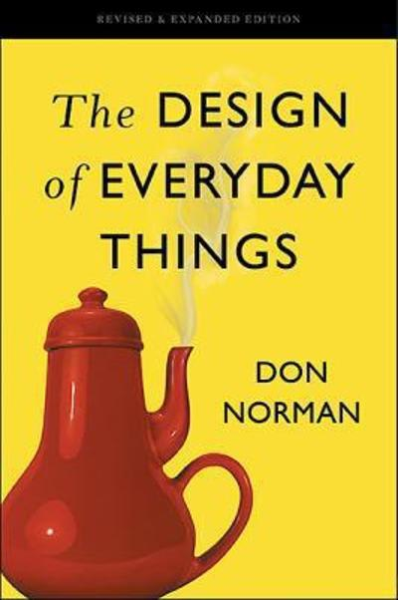
But before we understand our users’ goals….
Fundamental concepts about how people interact with things and discover what they do (Don Norman)
Affordances
Signifiers
Constraints
Mappings
Feedback
User’s conceptual model

Slide 9
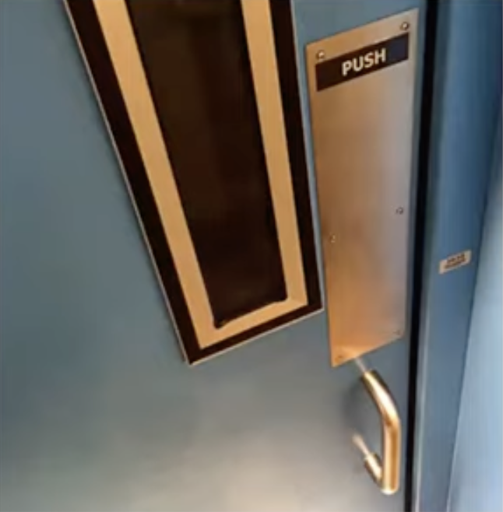
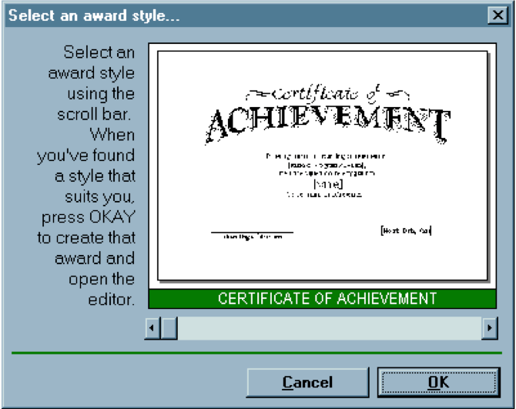
Affordance
Affordances are perceivable action possibilities
Affordance refers to the perceived and actual properties of a thing that determine how it is operated
Affordances are how an interface communicates non-verbally, telling you how to operate it
Handles have the affordance of being pullable
Scrollbars have the affordance of continuous scrolling

Slide 10
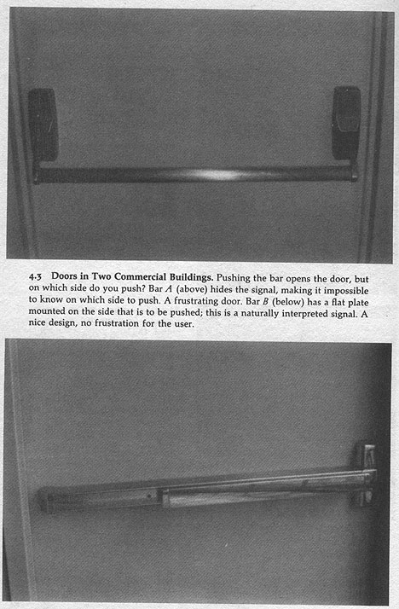
Signifiers: sometimes you need help to learn an affordance
Where do I push?

Slide 11
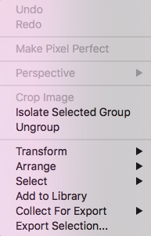
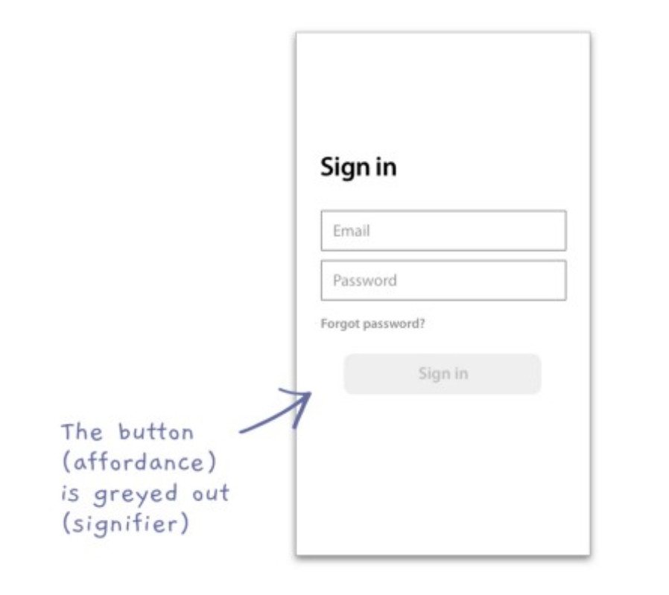
What are constraints
Constraints are about limiting the range of interaction possibilities for the user, to
Simplify the interface
Guide the user to the appropriate next action

Slide 12
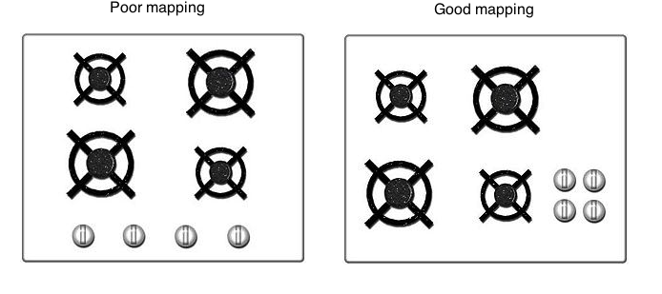
Mappings
How to communicate what an action will do
Considering the mapping – or relationship- from the controls and the impact real world

Slide 13
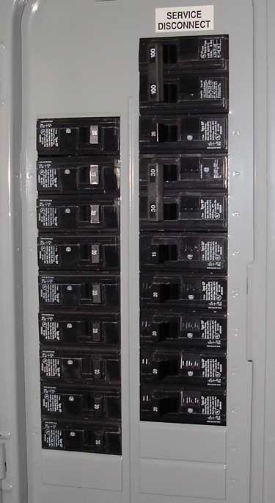
Bad mappings

Slide 14
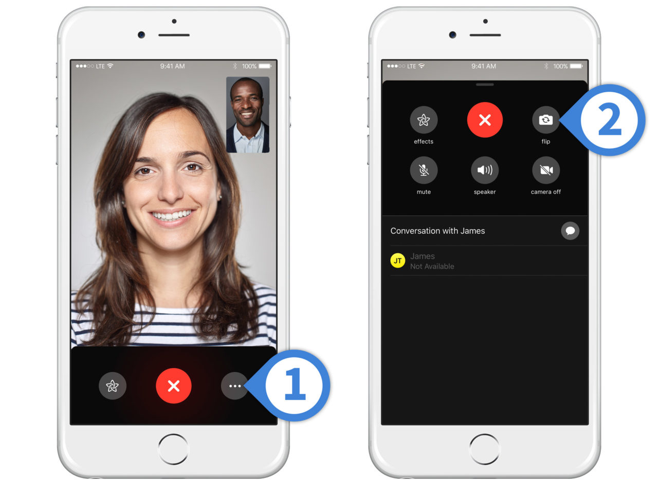
Feedback
Response- often visual, sometimes auditory- we get from performing an action
Serves as a confirmation that the action was performed
Anyone have examples of interfaces or controls with insufficient feedback
Did this work?
Did I press it?
Should I press it again?

Slide 15
Now’ lets get to the user’s conceptual model
Fundamental concepts about how people interact with things and discover what they do (Don Norman)
Affordances
Signifiers
Constraints
Mappings
Feedback
User’s conceptual model of the system (to cover today)

Slide 16
What is a conceptual model?
A conceptual model is an explanation (…simplified…) of how something works
Doesn’t need to be complete
Doesn’t need to be accurate
But- USEFUL!
Could also call this a mental model- it is held in our minds, and it is a simplification

Slide 17
Conceptual model example
The files and folders and icons of little documents on our desktops
Are there literal folders in the computer?

Slide 18
Conceptual model example
The files and folders and icons of little documents on our desktops
Are there literal folders in the computer?
No!
This interface design is there to help people create a conceptual model of documents and folders that they can open
This is there to make it easier for people use the operating system

Slide 19
Does this ever lead to problems?
Sometimes conceptual models that differ from how the system works introduces confusion
Example: When on your phone online and you are reading an email, it looks like it is ‘on’ your phone
Conceptual model: this email is on my phone
System model: this email is in the cloud and retrieved for the user only when they ask for it, and when they are online
Conceptual models are helpful, but the assumptions that support them need to hold true

Slide 20
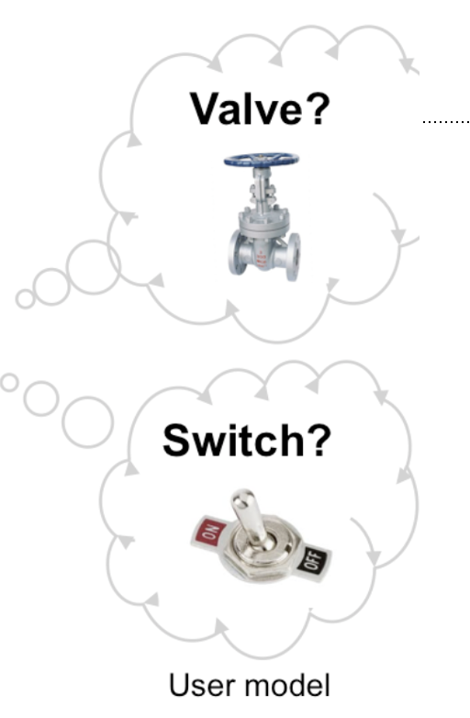
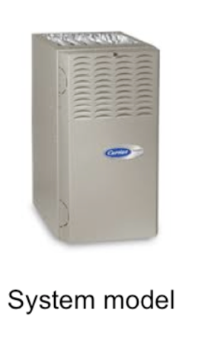
Example: Thermostat
2 conceptual models of the user:
Valve theory- thermostat controls how much heat comes out of the device
Turn it up, more heat is coming out
Turn it down, it’ll pump out less heat
Switch theory: the heat can be on, the heat can be off
System model: might use an internal temperature sensor to decide when to turn the heat on and off, but no variation in how much heat when it is on
What communicates this?

Slide 21
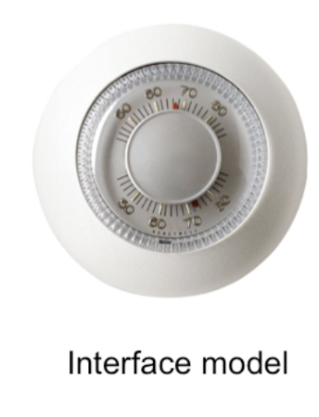
Interface model!
Interface model sits between the user’s model and the system model
Which should it conform to?
It depends…. It is complicated….
Look at the old thermostat
It does convey that you set a temperature
But not much else

Slide 22
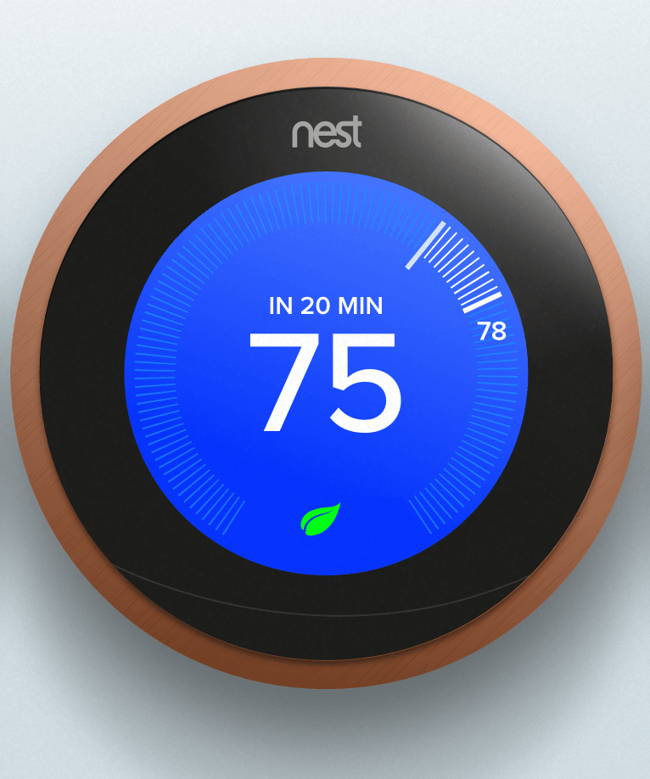
Interface model example
Nest interface
I set a desired temperature
It shows me how far I am from that range
When it is blue it is cooling. When red it is heating.
It turns gray when it isn’t heating or cooling, and shows me it is at that temperature
It informs me about the system enough so I can operate it, but in other ways fits my mental model

Slide 23
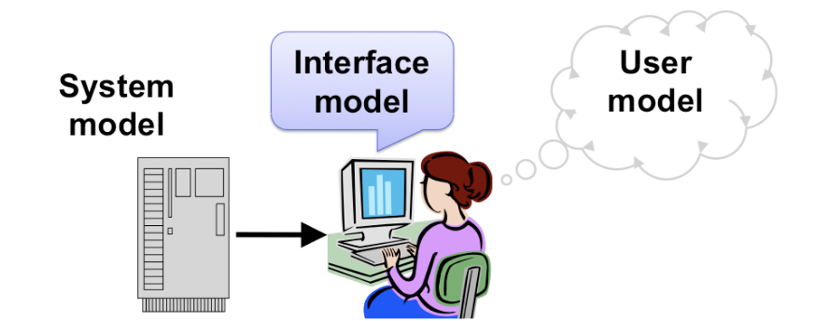
3 models
System model: how the system works
User model: their conceptual model of the system
Interface model: sits in between
It shouldn’t be ‘the system model’, because this may not make sense to me
It should reflect the user model somewhat, so I can find it intuitive to use
BUT- should bridge the gap, where it matters

Slide 24
Example: solar power
Solar power: My conceptual model
Sun shines on the panels, and makes electricity.
When I turn on the lightbulb, it draws from this power- think of flowing water.
If I generate more power than I am using right now, it goes into ‘the grid’ (flowing water image) and powers someone else’s light bulb.
They’ll monitor this flow and will then allow me to draw that same amount of flow at night. I have to pay for the rest.
Problem with my conceptual model:
In a blackout, why isn’t my power working?
Interface should help bridge this gap

Slide 25
Learning (or discovering) how to use an interface
How we discover the operation of something:
Affordances
Signifiers
Constraints
Mappings
Feedback
User’s conceptual model
And
Users learn by doing, trying to accomplish a task

Slide 26
Next class…
Gulf of execution and evaluation
Seven stages of action
Human-centered design
And now…. Let’s do some brainstorming for the first project

