Slide 1
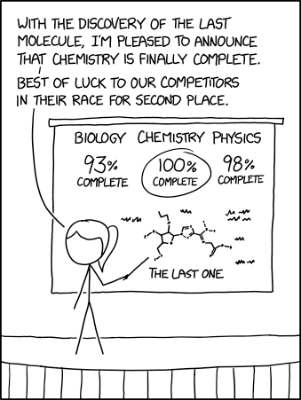
User interface design
xkcd

Slide 2
UI Design: Monday Sept 12
Dr. Jillian Aurisano
Plan for today:
Announcements/Course logistics
Project- questions?
Assignment turn in
The web, technical perspective
HTML, CSS, SVG
Coding activity
Notes:
So welcome to engineering visual interfaces for data science. I'm Dr Aurisano.
Thanks for finding the class on Zoom. Hopefully we will be in person again soon.
If anyone out there is comfortable turning on their cameras, that is lovely- then I feel like I am talking to students, rather than to myself.
Here’s our plan for today:
First I’m going to introduce myself, so you know a bit about me
Then we are going to get to know each other, in Zoom breakout rooms. This will give us a chance to make sure that Zoom breakout rooms work, and we all know how to access them.
Then, I am going to walk through the structure, and plan for the course. I want to make sure everyone knows how the course will work, and what to expect, and also a bit about why the course is designed this way.
Then I am going to introduce the class, and what the class is about. Since this is a new class, and one of just a few classes in human centered computing here at UC, I wanted to give an overview of the topic.
Then I have an introductory activity, which we will do in breakout rooms, and which I think will help motivate the discussion on Wednesday, and getting into the meat of the class.

Slide 3
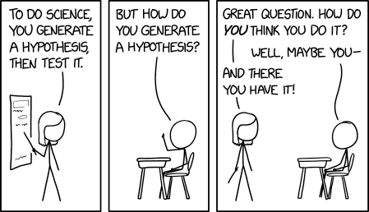
Questions about the project?

Slide 4
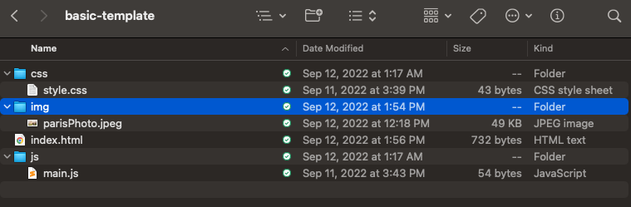
Components of our web applications?
HTML- defines the content of the page, and all the elements needed to display the content in the page
“Index.html”
Stylesheet- ‘CSS’
Style/style.css
Defines a set of rules for the appearance, behavior of elements on the page
This is where you can set fonts, or sizing or background colors
Can also do this in html or in javascript, but sometimes easier to put in one place
Javascript files
Link to these in html
Scripts that run, respond to user inputs, load data…

Slide 5
Today:
HTML to add elements on a webpage
CSS for some styling
SVG to create shapes and drawings

Slide 6
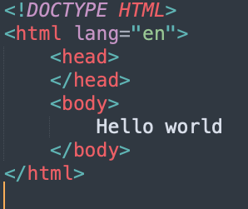
HTML Boiler plate- every page needs
First line: Doc type
Tells your browser that you are passing it an html file
Here it will get the most recent version of html
Html tag: Tells browser what follows is html
Head- optional. Not displayed in the browser. Titles, page description .
Body- all the information we want to display
Text, images videos etc

Slide 7
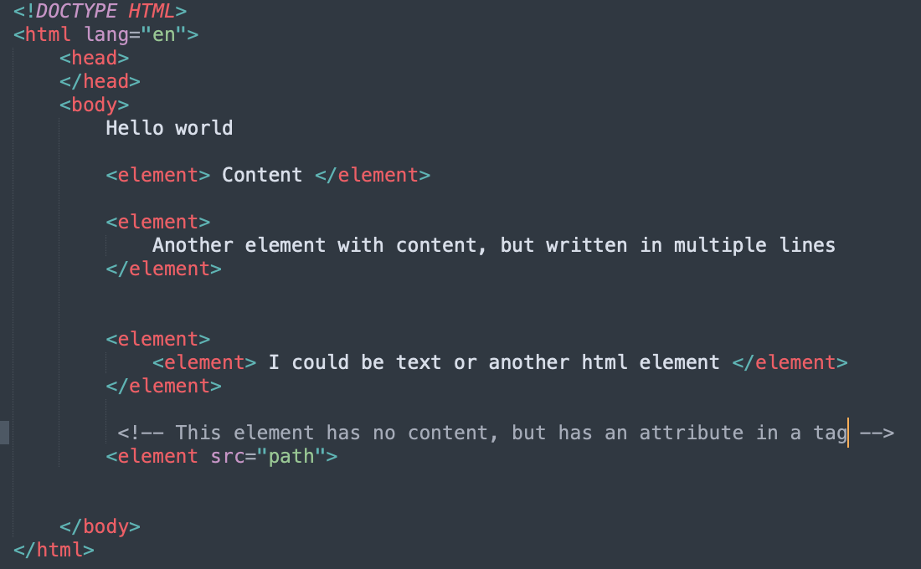
HTML element

Slide 8
Some elements: Buttons
Buttons with text
Buttons with Unicode symbols

Slide 9
What about layout?
HTML is mostly about content
CSS is mostly about how things are displayed
But- there are ways to specify groupings in html
And to put some indications of breaks and whether elements are
On the same line (inline)
On top of each (block)

Slide 10
In-line vs block
As you added elements- why are some of these elements on the next line vs on the same line?
Some elements are in-line by default
they will appear in the same line as the previous element
Example:
Some elements are block by default
they will appear on the next line
Example:
To force elements to be on different line: <br>
To add additional space: <br><br>
Can we do more?

Slide 11
Div and Span
Div:
Put items in a div to group them together
Different Div’s appear on different lines (block)
Span:
Use span tags to indicate that you want something that would normally be on a separate line, to be in the same line

Slide 12
Example

Slide 13
What does the rendering engine do?
Parses html
Imagine you are given this document and you have to write a parser in your favorite language to translate this into a tree-like data structure
Would you be able to do it?
Creates a tree of elements (content tree)
Parses css style rules and applies them to elements in the tree
Render tree, which decides the order in which things are displayed
Layout algorithm, which positions elements based on the rules
Painting function, which decides which pixels to fill in within the browser window

Slide 14
Last time
We added some elements to a page using html
Let’s dive a bit deeper….

Slide 15
Partitioning into divs

Slide 16
Styling a div using css

Slide 17
Styling elements

Slide 18
Creating style rules for specific items or for classes of items

Slide 19
From elements, to organization
How do I organize the elements I have added to my page
Let’s start with the approach without a css framework

Slide 20
Classes and Identifiers to help with styling

Slide 21
Structuring content within a div using css

Slide 22
CSS frameworks
It is hard to structure content in a div yourself
Writing style rules is a lot of work
Introducing: CSS frameworks

Slide 23
CSS Frameworks
CSS framework
Collection of css styles in a stylesheet
You can just bring this into your application
Bootstrap:
A common css framework
If you want to make a unique front end, bootstrap might not be the right choice
You may be working against bootstrap at points to get exactly what you want
If you want to get to a front end quickly, and are ok with generic look and layout
Bootstrap is a great choice

Slide 24
Flexbox

Slide 25
Last time, development process
Write html in a file
Refresh the page in the Chrome browser
Other options:

Slide 26
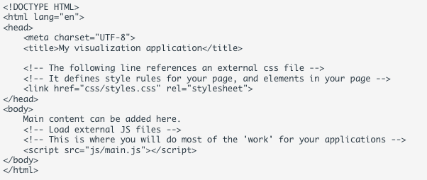
Let’s start
Html biolerplate

Slide 27
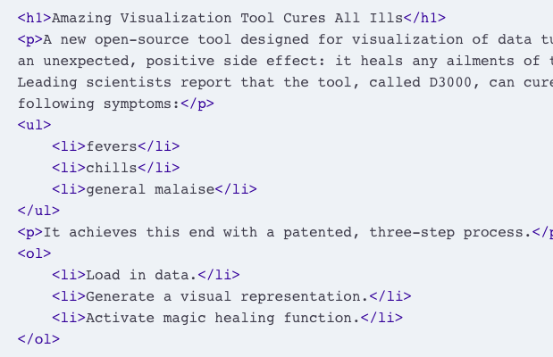
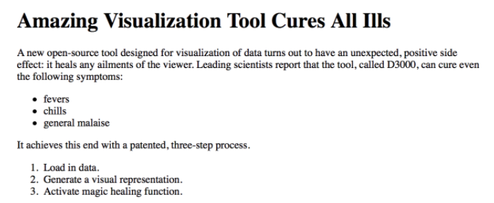
HTML
HTML can contain hierarchically organized elements
Text
Lists
Tables
Images
UI elements: buttons, checkboxes….
https://www.w3schools.com/html/default.asp

Slide 28
HTML: Identifiers and classes
As you create elements, you can add identifiers and classes
Allow you to later modify or apply style rules to selected elements.
There are 2 ways to do this:
classes, which reference a set of elements, and
ids, which uniquely reference one element

Slide 29
SVG
Important to understand how d3 uses the svg canvas and elements
SVG stands for 'scalable vector graphics’.
Allows developers to add graphical elements to their page- shapes, lines, etc.
D3, the visualization library we will use in this class, uses svg extensively to map data to graphical elements on the page.
You can also use svg independent of d3.

Slide 30
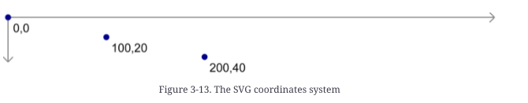
SVG: Coordinate system
Elements are placed within a canvas, with a coordinate system that goes from
Coordinate system goes from
Upper left is 0,0.
Lower right is width, height
How do you place something in the center of your svg?

Slide 31
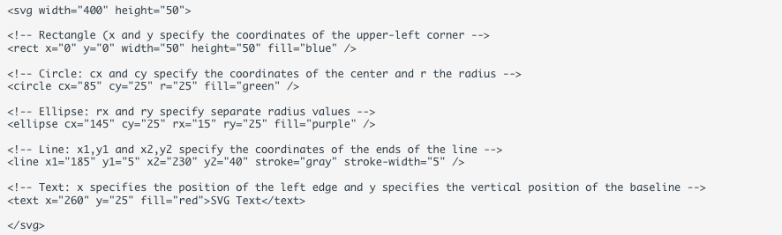

SVG examples

Slide 32
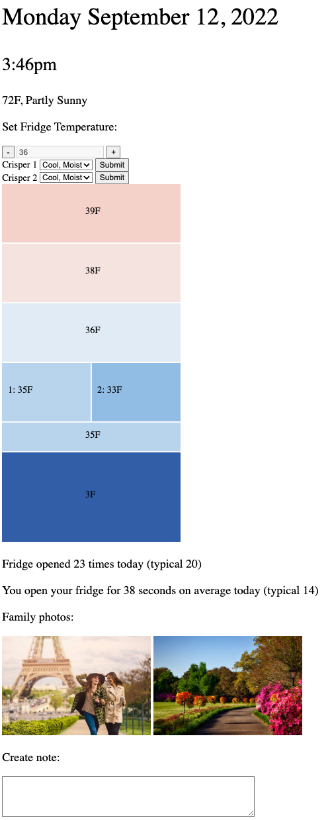
Now we are going to do an activity
Smart fridge UI
Not nicely designed and no nice layout
No styling
Just basic addition of elements to a page

Slide 33
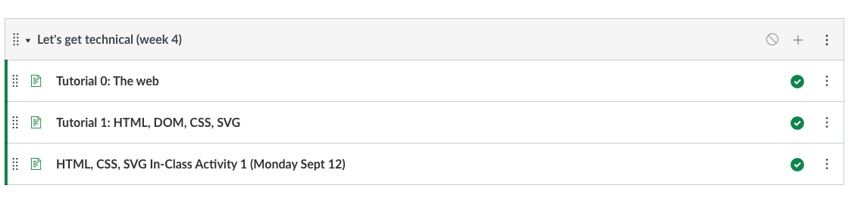
Find the materials

