Slide 1
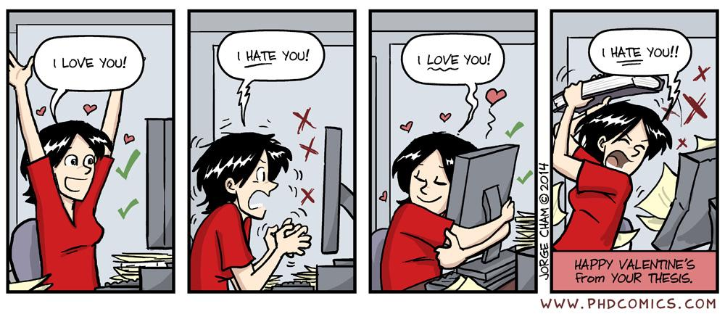
User interface design
xkcd

Slide 2
UI Design:
Dr. Jillian Aurisano
Plan for today:
Announcements/Course logistics
People- part 2
Activity- project activity
Notes:
So welcome to engineering visual interfaces for data science. I'm Dr Aurisano.
Thanks for finding the class on Zoom. Hopefully we will be in person again soon.
If anyone out there is comfortable turning on their cameras, that is lovely- then I feel like I am talking to students, rather than to myself.
Here’s our plan for today:
First I’m going to introduce myself, so you know a bit about me
Then we are going to get to know each other, in Zoom breakout rooms. This will give us a chance to make sure that Zoom breakout rooms work, and we all know how to access them.
Then, I am going to walk through the structure, and plan for the course. I want to make sure everyone knows how the course will work, and what to expect, and also a bit about why the course is designed this way.
Then I am going to introduce the class, and what the class is about. Since this is a new class, and one of just a few classes in human centered computing here at UC, I wanted to give an overview of the topic.
Then I have an introductory activity, which we will do in breakout rooms, and which I think will help motivate the discussion on Wednesday, and getting into the meat of the class.

Slide 3
Project deadline updates

Slide 4
Clarifying the project goals
What is a ‘C-level’ basic interface vs ‘More complex inputs’ (one of the A/B options)
How to go deeper on data or user profiles
No expectation that you develop complex data visualizations
But, you are free to use external visualization libraries
Or use svg to make simple graphics
How to simulate
Think of this as a test of your UI
It is ok to use a simplified example
Ex. Grocery store is a rectangle, with 50 products along that rectangle, user has a list of 5 items
Run under localhost, not served on your documentation portfolio site (wix, google sites)
Please keep asking questions!

Slide 5
Continue our discussion of people
We’ve talked about perception and attention
Let’s continue with processes that sit between low-level, unconscious perception and cognition
A bit more about reading
Influence
More on people to come…

Slide 6
How we read

Slide 7
Reading is unnatural
We are wired with an innate ability to develop speech and understand spoken language
We are not wired to read
Reading and writing comes from practice and instruction
Reading requires some degree of conscious attention and effort
Reading requires more cognitive effort than other processes
We want to make this as easy as possible

Slide 8
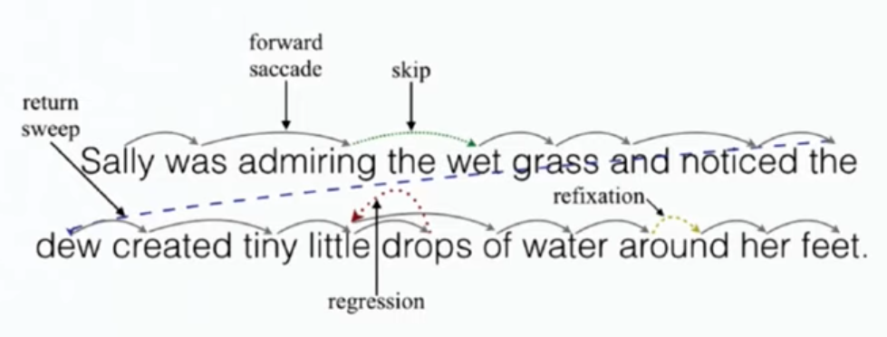
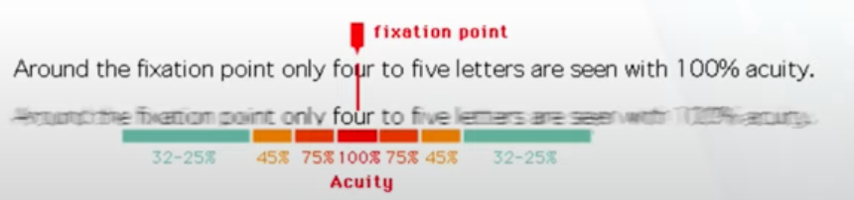
Process of seeing words
When we read, our eyes alternate between brief periods of fixation (250ms), and jumping between words (saccades)
During a saccade we can’t see words
Most saccades jump forward (over one or several words)
10-15% of the time saccades jump back, to reread or refocus on letters/words

Slide 9
Identifying letters and words in different fonts
Different fonts can be used to shape the association or mood within a piece of text
Classical, modern, serious, playful
When choosing a font it is important to select one that doesn’t meaningfully interfere with the brain’s ability to recognize and group symbols, and thereby identify words etc
Aside- serif and sans-serif fonts are not much different in terms of interpretability

Slide 10
Study
Song and Schwarz (2008)
Two groups of participants were given a series of instructions which differed only in the font that was used
One font was easy to read, the other was long
Participants were asked to estimate how long it would take to complete the instructions
The easy font group estimated 8 min
The hard font group estimated 15 min

Slide 11
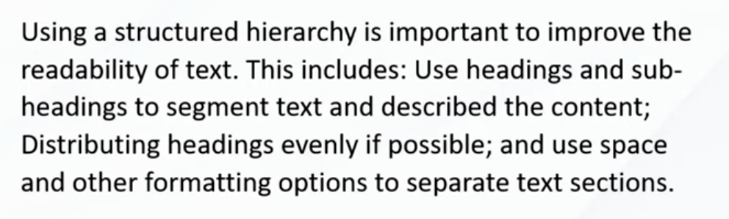
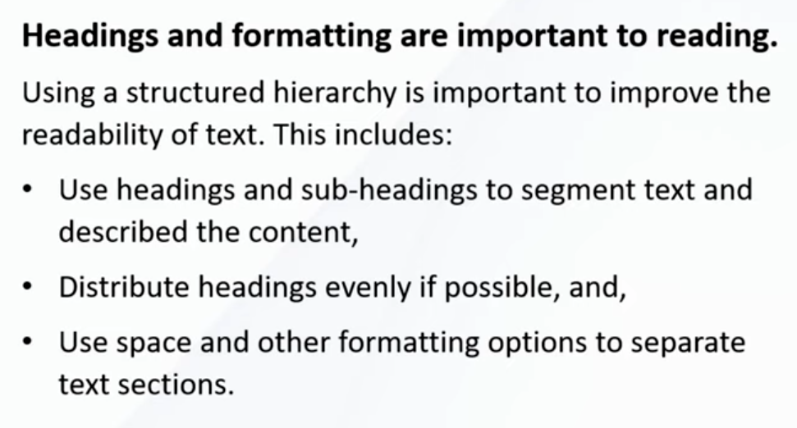
We discussed the value of using hierarchy to help people read

Slide 12
People read faster with long line lengths But prefer shorter line lengths
Longer line lengths (100 characters/line) are faster to read
Do not require the eye to jump back over the page to the next line as often
But, people prefer smaller line length
Takeaway- is reading speed an important characteristic? If not, favor shorter lines

Slide 13
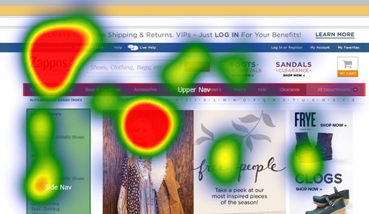
We scan, we don’t read
We scan
We look for things that catch our eye
We don’t want to waste time and effort

Slide 14
Take-aways
Make reading as effortless as possible
Use an easily readable font
Use a clear and consistent layout of text
Use plain language
Omit needless words
Do you really need a long welcome with informational overviews
Minimize instructions that need to be read

Slide 15
Influence

Slide 16
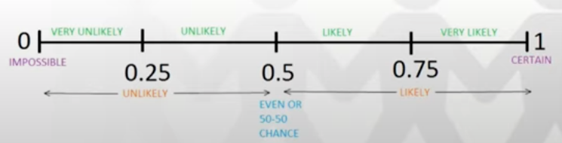
Write down an answer
Influence: exert some effect on people so that they are more likely to favor one outcome over another
What do you think?
Q1 : How easily are people, in general, influenced?
How easy is it to get people to favor one outcome over another?
Q2: How easily are you influenced?
0: impossible to influence <people, you>
…
1: certain: <people, you> are influenced all the time

Slide 17
Let’s look at some examples
1974 study
2 groups of high school students
Gave them 5 seconds to answer a complex mathematical question
Can’t solve it, but need to estimate
We are going to try this in class!
Everyone on one half of the room close your eyes.

Slide 18
Let’s look at some examples
1974 study
2 groups of high school students
Gave them 5 seconds to answer a complex mathematical question
Can’t solve it, but need to estimate
We are going to try this in class!
Everyone on one half of the room close your eyes.
Group 1: 1x2x3x4x5x6x7x8
Quick estimate

Slide 19
Let’s look at some examples
1974 study
2 groups of high school students
Gave them 5 seconds to answer a complex mathematical question
Can’t solve it, but need to estimate
We are going to try this in class!
Everyone on one half of the room close your eyes.
Group 2: 8x7x6x5x4x3x2x1
Group 1: 1x2x3x4x5x6x7x8
5 seconds!
Group 2: 8x7x6x5x4x3x2x1
Quick estimate!

Slide 20
Answers
Group 1:
400, 546, 1024, 1200, 2000, 5000, 40,000,
Group 2:
1000, 1800, 20000, 40320,
Did we replicate the study?

Slide 21
Answers
Group 1:
…
Group 2:
….
Did we replicate the study?
1x2x3x4x5x6x7x8
8x7x6x5x4x3x2x1
Same answer: 40,320
Median guess of the first group: 512
Median guess of the second group: 2,250
Why?

Slide 22
Anchoring bias
Cognitive bias
An initial piece of information *the anchor* impacts your subsequent thought process and decision making
Once set, future estimates, decisions, negotiations are conducted relative to the anchor value
Aspects that align with the anchor tend to further strengthen the anchoring effect
Aspects that are dissonate or less related tend to be more readily ignored or devalued

Slide 23
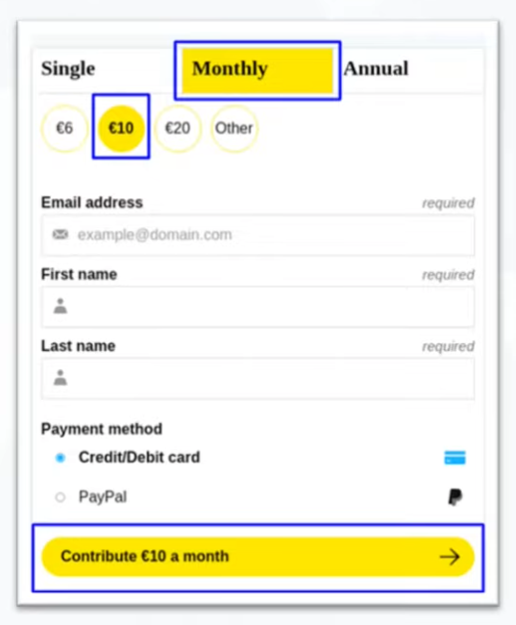

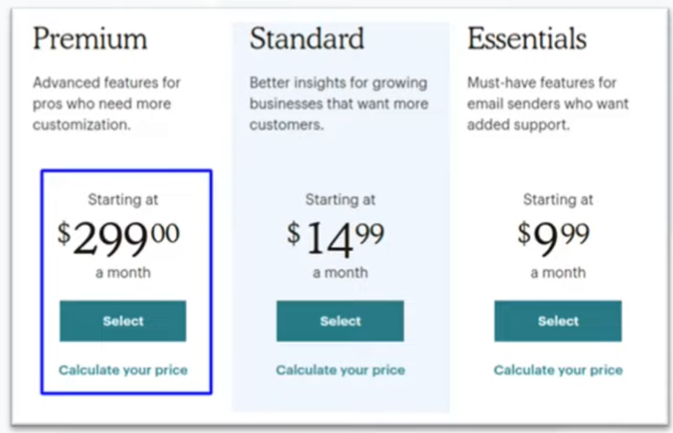
Anchoring is used all the time
Especially in marketing
Display original and discounted prices together
Providing a suggested value for a donation
Listing the most expensive option first

Slide 24
Surprising anchors
We are also influenced by anchors that seem irrelevant. Things that we would not expect to influence our decision
1998 study (Waksink) conducted an experiment selling soup
Modest reduction in prece was set alongside three different restrictions on the number of cans that can be purchased
(max 4 cans) (max 12 cans) (unlimited cans)
What do you think happened? Which resulted in the most purchases?

Slide 25
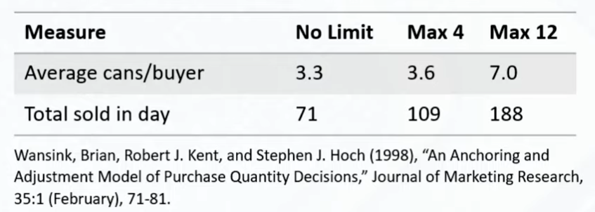
Results
The larger the anchor value for the purchase limit, the more people bought
We might have expected that having a low limit suggests high demand and high value
Oh we can only buy 4? People must really want this soup.
But the opposite was true
This anchor did have an impact

Slide 26
Another example
Everyone think to yourself- what is the last 2 digits of your social security number. You can write it down if you want to.

Slide 27
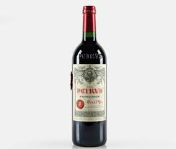
Another example
How much would you pay for this bottle of wine. Write down a number.

Slide 28
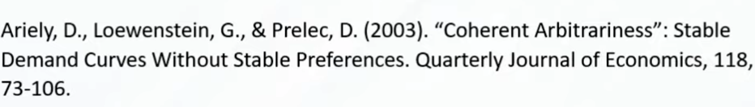
Another example
This is similar to a study done in 2003 (Ariely)
Participants asked to recall the last 2 digits of their social security number
After this, they were shown a bottle of wine and asked how much they would be willing to pay for it
The last 2 digits of your social security number strongly influenced how much people were willing to pay
Lowest 20% of social security numbers, offered $8.64
Top 20% of social security numbers, offered $27.91

Slide 29
Another example
1996 study (John Bargh)
Given a task to unscramble sets of words to make short sentences
She Belfast lives in → She lives in Belfast
Some people were given sets of words that contained words associated with being old (retired, elderly…)
Some people were given sets of words that contained words associated with being young (youth, energetic….)
After unscrambling the words they were told the experiment was done, and sent on their way.
But they measured how fast participants from each group walked down the hallway after the study
Those exposed to ‘old’ words walked much more slowly than those exposed to ‘young’ words.
They were asked if they felt influenced by the words in their sentences, and they say no
But of course, they were influenced

Slide 30
Impact of initial pieces of information
Related or unrelated pieces of information
You may think- well this doesn’t apply to you
Third person effect
Why don’t we think we can be influenced?

Slide 31
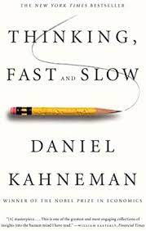
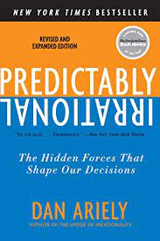
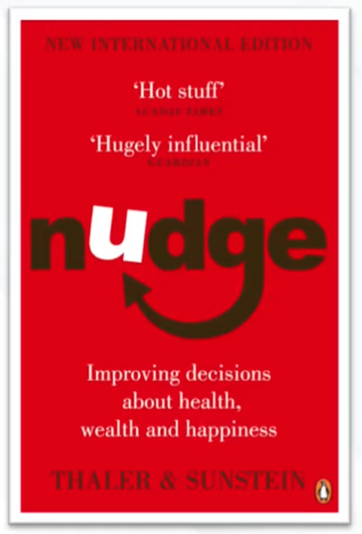
Lots of things impact our thinking
Books on this:

Slide 32
Cognitive biases
Anchoring effect is one cognitive bias, There are lots of others
Cognitive biases exist to help us think fast
We often aren’t making slow, rational decisions based on a complete understanding of the facts
We use shortcuts to help us make fast decisions
Heuristics- are one way, rules informed by experience which help us make decisions
Some of these can lead to errors in thinking- cognitive biases

Slide 33
Cognitive biases- for good, not for profit
Lots of the examples I found were in contexts where you wanted to get someone to spend money
Let’s just keep in mind, this effect could also be used for other goals
Getting people to….
Reach their goals
Care for others
Take care of themselves
Can we come up with an example of using anchoring effect in a UI to help someone:
Get more exercise
Find more time to study

Slide 34
Another cognitive bias: sunk cost fallacy
If we already invested resources in something, we’re going to keep investing more
We don’t want our efforts to go to waste
Examples:
Finishing a bad movie
Continuing to poor time and money into a project we don’t think is working out
Related to loss aversion
Losing $100 hurts more than gaining $100 satisfies
How does this relate to UI design

Slide 35
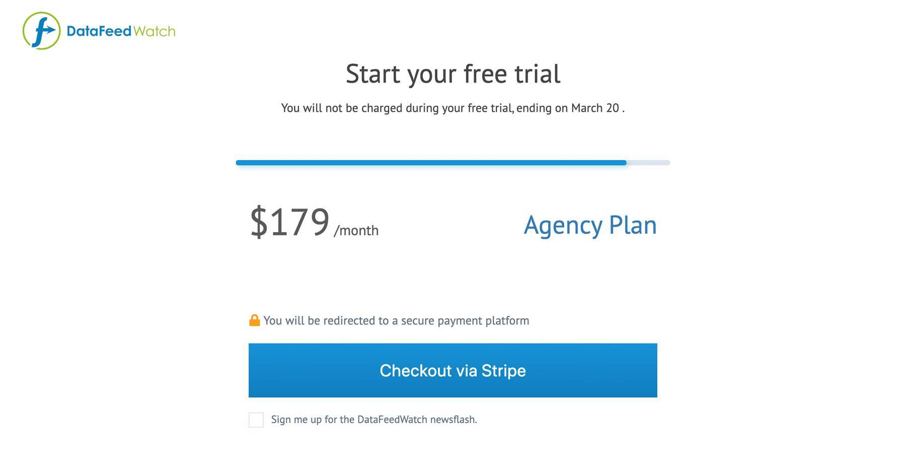
Sunk cost fallacy and UI design
The sunk cost bias may be part of the user flow
Suppose you are signing up for a service or making a purchase
Progress bar: encourage users to complete their actions
Suppose you want them to finish making the purchase
Show them this is the last step of the process
Once again- let’s think about how we could use this for helping someone….

Slide 36
Sunk rewards
Loyalty programs, sunk rewards encourage the user to stick to your product
“I don’t want to lose these potential rewards”

Slide 37
Note to self- sunk cost fallacy applies to our work too…
We may tend to stick to a less than great design because of the sunk cost fallacy
I’ve already put so much into this feature!
I can’t give up on it now!

Slide 38
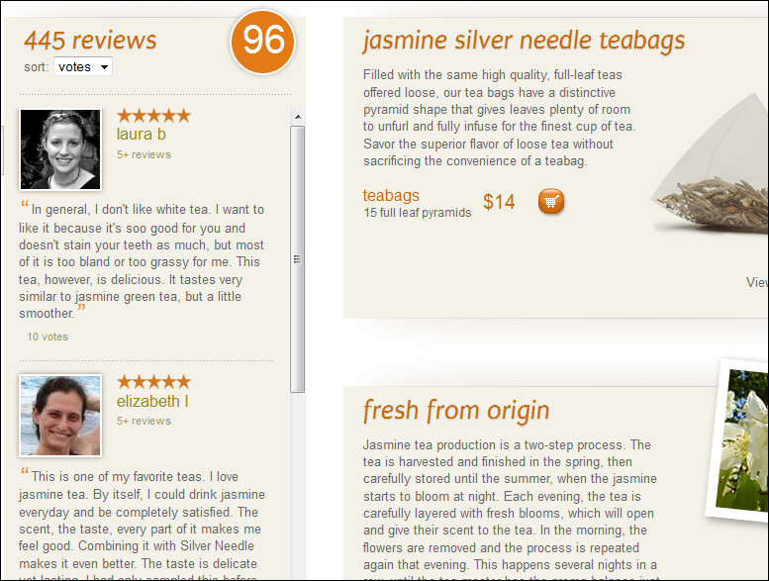
Social proof bias
We are guided by the behavior of others
This bias serves an important pro-social function
Example: Reviews
We think- other people want it and like it, it must be good

Slide 39
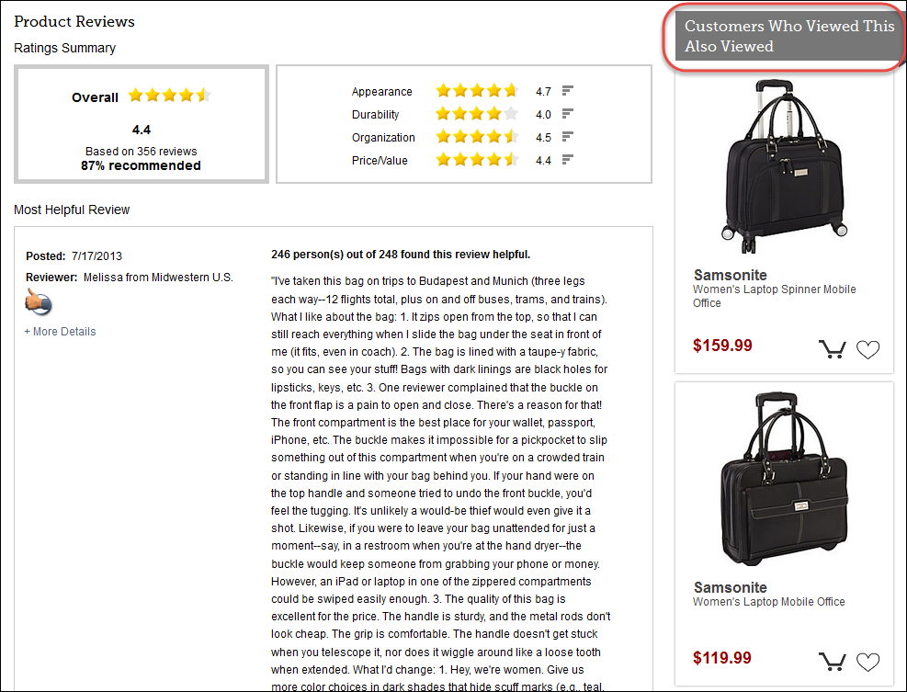
Social proof bias
Other people who viewed this, also viewed

Slide 40
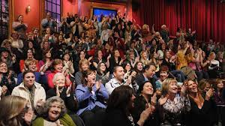
Social proof bias
Laugh track
We all think we hate it
But people laugh more and rate the material as more funny with a laugh track

Slide 41
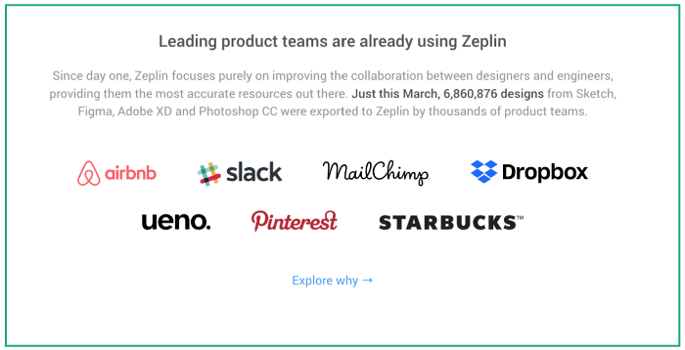
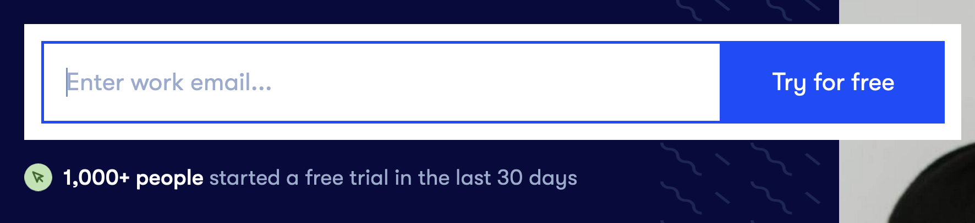
Bandwagon Effect
Herd behavior
Tendency to do or believe things many other people do or believe

Slide 42
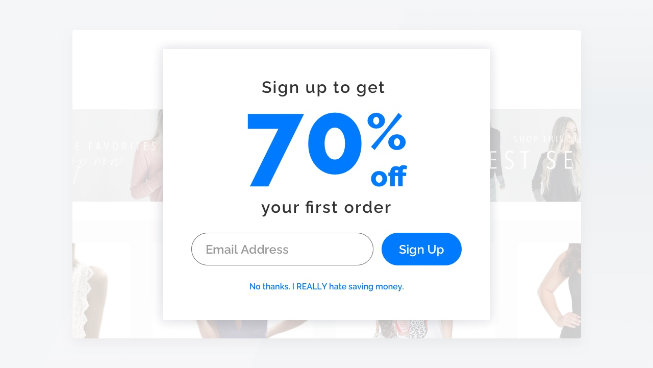
Confirm shaming
Making people feel like they aren’t in the ‘cool group’. They are missing out, not doing what others are doing….

Slide 43
Confirmation bias
When presented with new information, we tend to only selectively pay attention to information that confirms what we already think
You see this a lot in the news: If you present people with news articles that fit with their current entrenched beliefs, they are more likely to remember it
Everyone suffers from this…

Slide 44
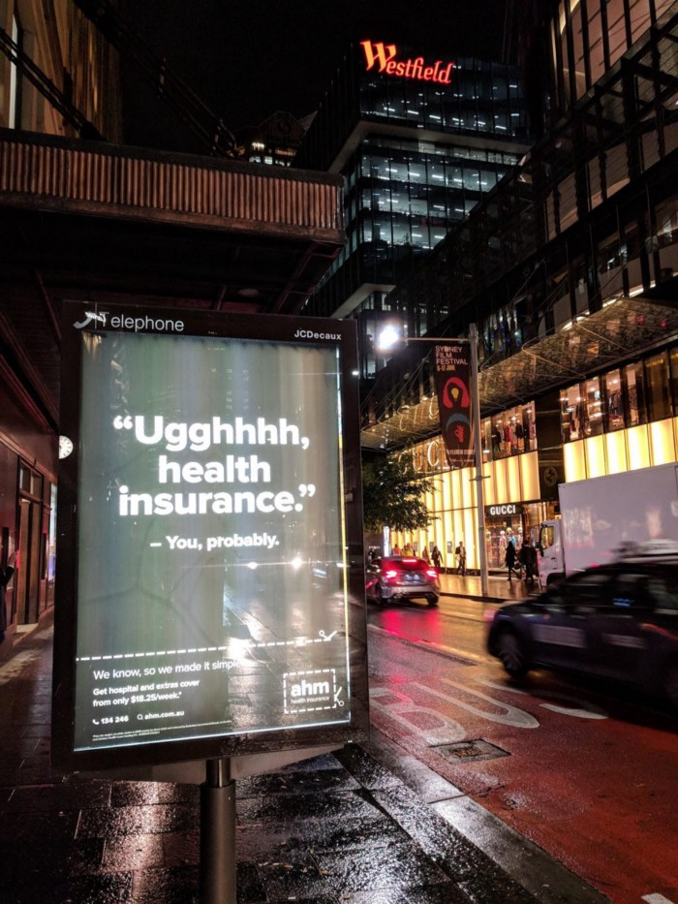
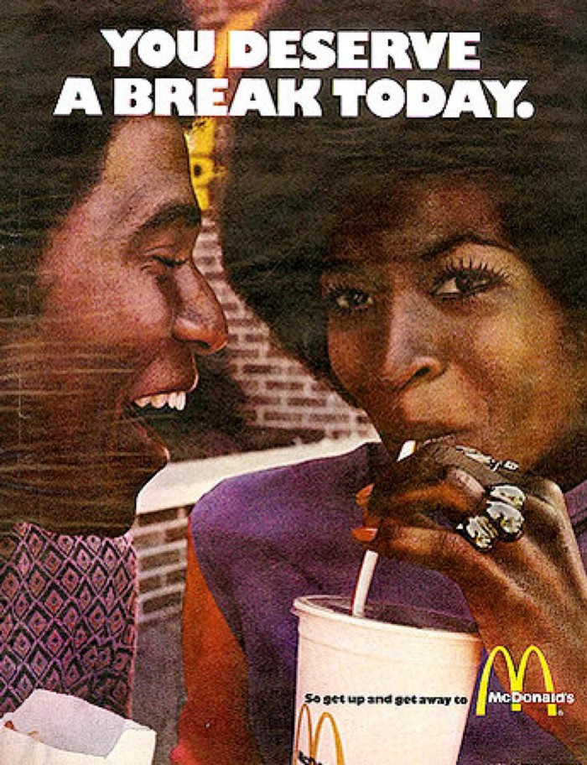
Confirmation bias and UI
Yes, I do!
Yes, I do hate health insurance

Slide 45
BIG issue in the design of personalized content
Do you want to inform people?
Are you just feeding people things they already believe?
We can discuss this more later…

Slide 46
Project work time
What’s your plan for the weekend
Which B or A goal might you try to accomplish?
What is hard right now?
What is going well?

