Slide 1
User interface design
xkcd

Slide 2
UI Design:
Dr. Jillian Aurisano
Plan for today:
Announcements/Course logistics
People- part 3
Activity- project activity
Notes:
So welcome to engineering visual interfaces for data science. I'm Dr Aurisano.
Thanks for finding the class on Zoom. Hopefully we will be in person again soon.
If anyone out there is comfortable turning on their cameras, that is lovely- then I feel like I am talking to students, rather than to myself.
Here’s our plan for today:
First I’m going to introduce myself, so you know a bit about me
Then we are going to get to know each other, in Zoom breakout rooms. This will give us a chance to make sure that Zoom breakout rooms work, and we all know how to access them.
Then, I am going to walk through the structure, and plan for the course. I want to make sure everyone knows how the course will work, and what to expect, and also a bit about why the course is designed this way.
Then I am going to introduce the class, and what the class is about. Since this is a new class, and one of just a few classes in human centered computing here at UC, I wanted to give an overview of the topic.
Then I have an introductory activity, which we will do in breakout rooms, and which I think will help motivate the discussion on Wednesday, and getting into the meat of the class.

Slide 3
Feedback on what was submitted on Monday
I offered some suggestions in my feedback
Not intended to derail you or lead to stress
If you can address these comments, that’s great

Slide 4
Code Jam, Code Party- after class today
Baldwin 643
Reserved until 6pm
I brought some snacks… I have extension cords
I have to leave to teach a class at 3:30… but I’ll stop back after
You can work together and solve problems together

Slide 5
Coming up
Friday- Code is due
Sunday- Documentation is due
Includes the design work
AND- descriptions of your final UI, screenshots (don’t forget to use screenshots !!!!), a demo video
Next week- presentations VIRTUAL (via Zoom)
Next Monday and Wednesday (and if necessary the next Monday)
I am posting a sign-up sheet
3 minute talks, I’ll post more details on Canvas
Note: Next Friday will be an asynchronous class. Details to follow.

Slide 6
Continue our discussion of people
Remembering
Thinking
Motivation
Decision making

Slide 7
How we remember

Slide 8
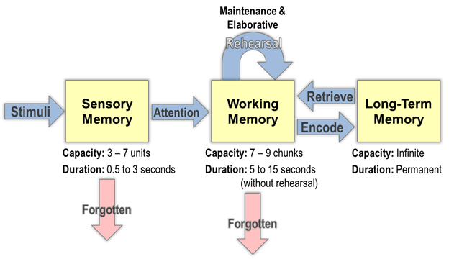
How does memory work?

Slide 9
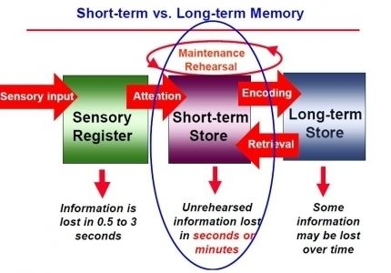
Working (short term) memory
When you focus your attention on certain pieces of information, you hold the information in your working memory
Working memory
Operates over a few seconds
Has a limited capacity- often measured by asking people to recall lists of numbers or words
When your attention gets directed elsewhere, whatever is held in working memory is unlikely to be retained.
You will forget that number or that random word, unless you continue to direct effort toward them

Slide 10
Goal: Minimize how much we require users to hold things in their working memory
Example- remembering settings or values between pages
If users must remember information, don’t ask them to do anything else until the task has been completed
Any tasks that are likely to be stressful to the user should not require the user to rely upon their working memory
Stress impairs the effectiveness of working memory
Transferring money
Dealing with a medical issue…

Slide 11
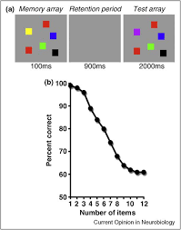
Working memory capacity
Working memory recall is limited and imperfect
The more information we try to hold, the worse our recall is
As a good rule of thumb, we can’t hold more than 4 things in working memory
We often rely upon aids (notes, lists, etc) to overcome the limitations of our working memory

Slide 12
Seeing beats memory
Displayed information that is visually available will always be easier for people to access than information they have to recall in their memory
Example:
Think about how it feels to switch between tabs in your browser
vs working with an external monitor where you can display more than one window next to each other
There is always a trade-off between the amount of space you have to work with as a designer, and this need to ensure people can ‘see’ the information they need

Slide 13
What can help us remember
Concrete words can be remembered more easily (cat, tree) than abstract words (freedom, justice)
Easier to remember visual items than words
So- if you want someone to remember something, it might be better to use visuals and concrete terms where possible

Slide 14
How we think

Slide 15
Mental models
Mental models encapsulate our thoughts around how something will behave, react or work
Our mental models shape our actions and behavior in terms of how we approach situations and interact with others
We refer to mental models when we interact with new interfaces
We create these models quickly based on prior experiences and assumptions
These can change
And they differ between individuals

Slide 16
We design using conceptual (Represented) models
We try to design using a conceptual model of how the user will interact
Conceptual models may differ from a particular user’s mental model
If there is a mismatch between the conceptual model the designer is using, and the mental model the user has, this will produce usability problems
We want to try to understand what kinds of mental models users are likely to use
To do this- we may want to model their goals, get into their personas, etc.
Novel products may need to have more training to shape and influence the development of a user’s mental model

Slide 17
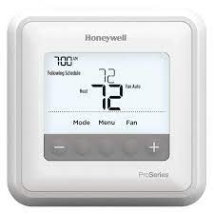
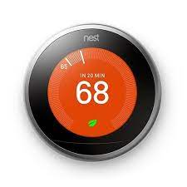
Example – from earlier
Mental model of a thermostat and heating system
When I turn this nob, does more heat come out?
OR, when I turn this nob, does the heat come on at a higher temperature, so it won’t let it go below a higher temperature

Slide 18
Cognitive load
As users interact with software, they do a range of activities
Cognitive activities- thinking about something, remembering something
Visual activities- looking to find a particular piece of information
Motor activities- moving a pointing, pushing a button
Each type of activity requires mental effort, which varies depending on the tasks
Cognitive tasks are more demanding than visual tasks followed by motor tasks
We want to minimize the overall cognitive load on the user
Example- requiring more mouse clicks (motor tasks) in order to minimize their thought and memory, might be a good tradeoff

Slide 19
Progressive disclosure
Progressive disclosure involves only providing information when it is needed or relevant
Avoid the risks of information overload
But, from a design point of view, the designer must understand and predict what the user will need at each particular stage

Slide 20
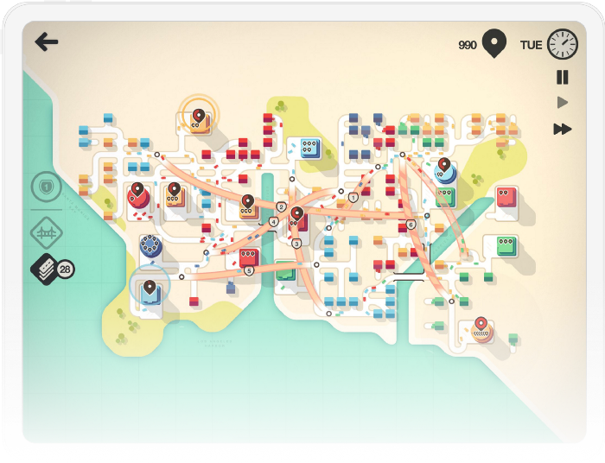
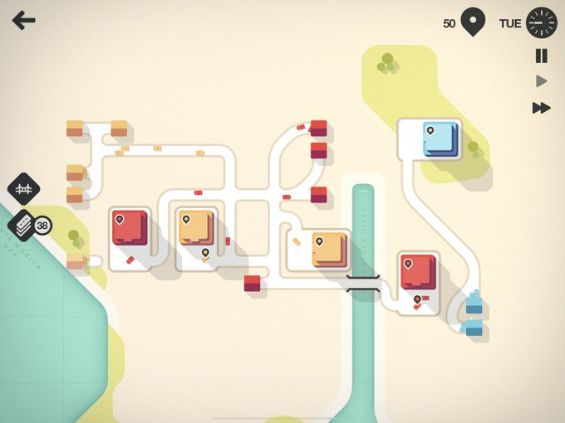
Progressive disclosure example
Game: Mini-motorways

Slide 21
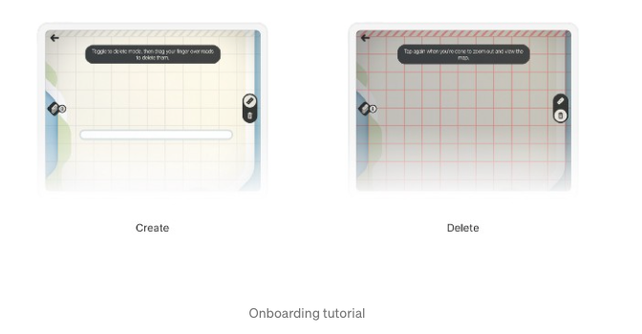
Progressive disclosure
Don’t start with creating the whole map, or all the functionalities and all the game play mechanisms
But, start with a few core steps
Create roads
Delete roads

Slide 22
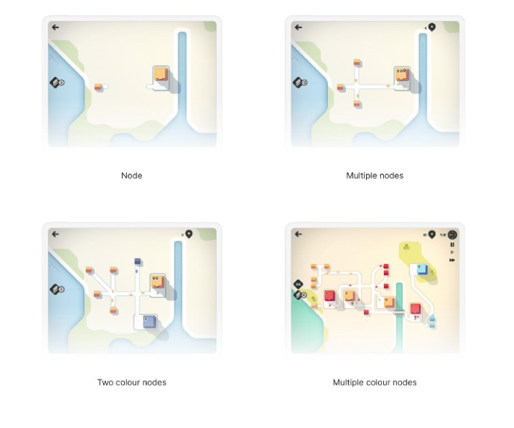
Progressive disclosure
Then teach the next step
And the next
Build a little area
Then they have the building blocks to play

Slide 23
Our minds wander a lot
Mind wandering is like day-dreaming
It arises when we stop doing a task and start thinking about something unrelated to that task
We ALL do this – studies have suggested we can only focus on something deeply for 10 minutes or so, before our minds wander
What should we do- we need to make sure we include elements that help the users orient themselves quickly
They open an application, get distracted and go on their phones, and then come back
Can they reorient?
More on attention later…

Slide 24
How we decide

Slide 25
Choice and control
We like to feel that we are in control
We think choice equates control
We favor having more options, even if this makes it more difficult to make an optimal (or satisfactory) choice
What presenting to the user how something will be done, good to offer some choice of approaches
Avoid taking choices away from users, even if there is an improved way of accomplishing a task
Can present a default, but don’t remove choices

Slide 26
How much choice?
We generally think that more choice is desirable compared to less choice
But too many choices can overwhelm our ability to make a decision
Iyengar and Lepper (2000) study
If asked to choose between 6 different jams or 24 different jams
Less choice-> greater sales
Limiting choices can actually make people happier
Progressive disclosure is one approach to limiting choices
Initial selection from a broad category, then a more narrow category

Slide 27
Uncertainty-> follow advice of others
The opinion of others can influence our decisions, especially when uncertain
Approaches to harness this: recommended options, reviews, testimonials

Slide 28
We settle
Most of the time (not always) we “satisfice” (satisfaction + sufficient)
When we are satisficing, we get a feel for the number of options, and then we feel content ‘ok there is a reasonable amount of choice’
Then we just go for something that is satisfactory and sufficient
Evolutionary perspective- making optional decisions can take time and require lots of cognition, but good enough+fast decisions require less time and effort

Slide 29
What this means from design perspective
Users will scan the screen and pick options that look ok
They will probably not read instructions
We want to make sure we have an idea for how users scan the screen

Slide 30
How are we motivated

Slide 31
Why motivation matters
As designers of interfaces we sometimes want to motivate specific behaviors or actions in our users
Also, lots of interests in tools that motivate people to reach their goals
Let’s think of some interfaces we have interacted with that aim to motivate us in different direction….

Slide 32
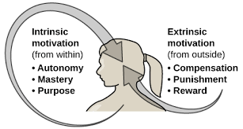
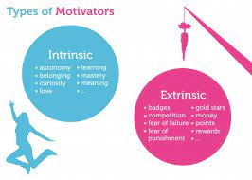
How are we motivated?
Intrinsic rewards- internal to the individual
I am motivated because I want to master this
Extrinsic rewards- external rewards you get for doing the task
Points, badges
Which is better?
Intrinsic motivation is a stronger long-term motivator
Better to care about mastery, rather than ‘points’
Think about how you learn when you want to master a skill vs when you just want a grade
Ideally, if your goal is to motivate, we want to encourage intrinsic rewards (mastery, new capabilities, curiosity)
More solid foundation for encouraging behavior

Slide 33
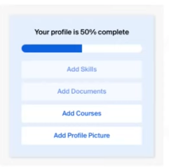
Progress, mastery and control are good motivators
Highlighting small steps that will result in increased progress or mastery
If it feels ‘big’, it is harder to motivate than if it feels small

Slide 34
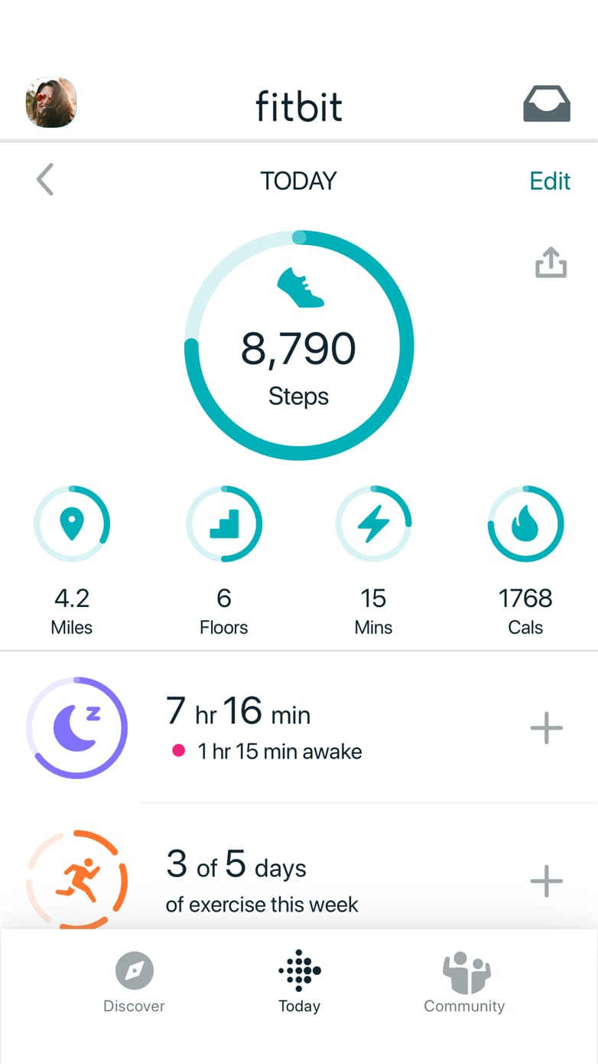
Progress, mastery and control are good motivators
If you want to encourage greater participation, it helps to:
enable and encourage users to set and track their own goals
enable them to track progress

Slide 35
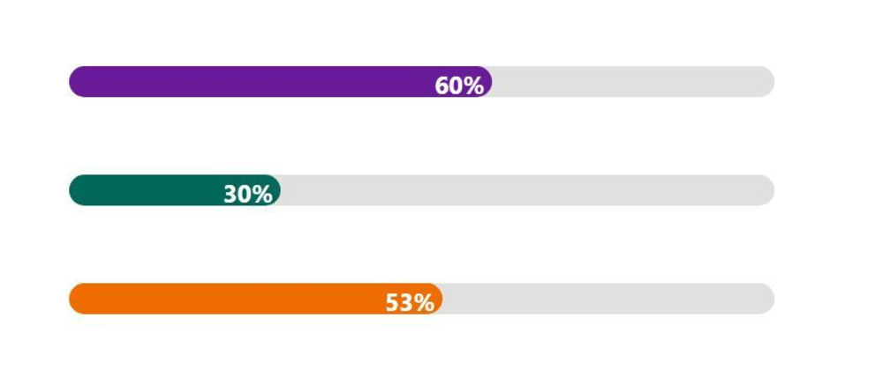
Distance to our goal
We tend to focus more on what’s left to do rather than what has already been done
Better to highlight what’s left to do rather than what has already been done
The closer we get, the more motivated we are to reach it
Visual representations of progress and closeness to a goal are often useful
Note- motivation can drop once the goal has been achieved
How to sustain motivation following this?

Slide 36
How does # of competitors impact motivation?
Garcia and Tor (2009) study.
Students brought into a private room
“Complete a short quiz as quickly as possible”
“The top 20% will get a prize”
Note- 20% is a relative number (if 10 students in the room, 2 students get a prize. 100,20 etc.)
One group was told they competed against 10 other students
A second group was told they competed against 100 other students
Which group completed the test the fastest?

Slide 37
How does # of competitors impact motivation?
Garcia and Tor (2009) study.
Students brought into a private room
“Complete a short quiz as quickly as possible”
“The top 20% will get a prize”
Note- 20% is a relative number (if 10 students in the room, 2 students get a prize. 100,20 etc.)
One group was told they competed against 10 other students
A second group was told they competed against 100 other students
Which group completed the test the fastest?
The group with fewer participants
Same chances of success… but if we feel we are up against a large number of other competitors, it lowers our motivation

Slide 38
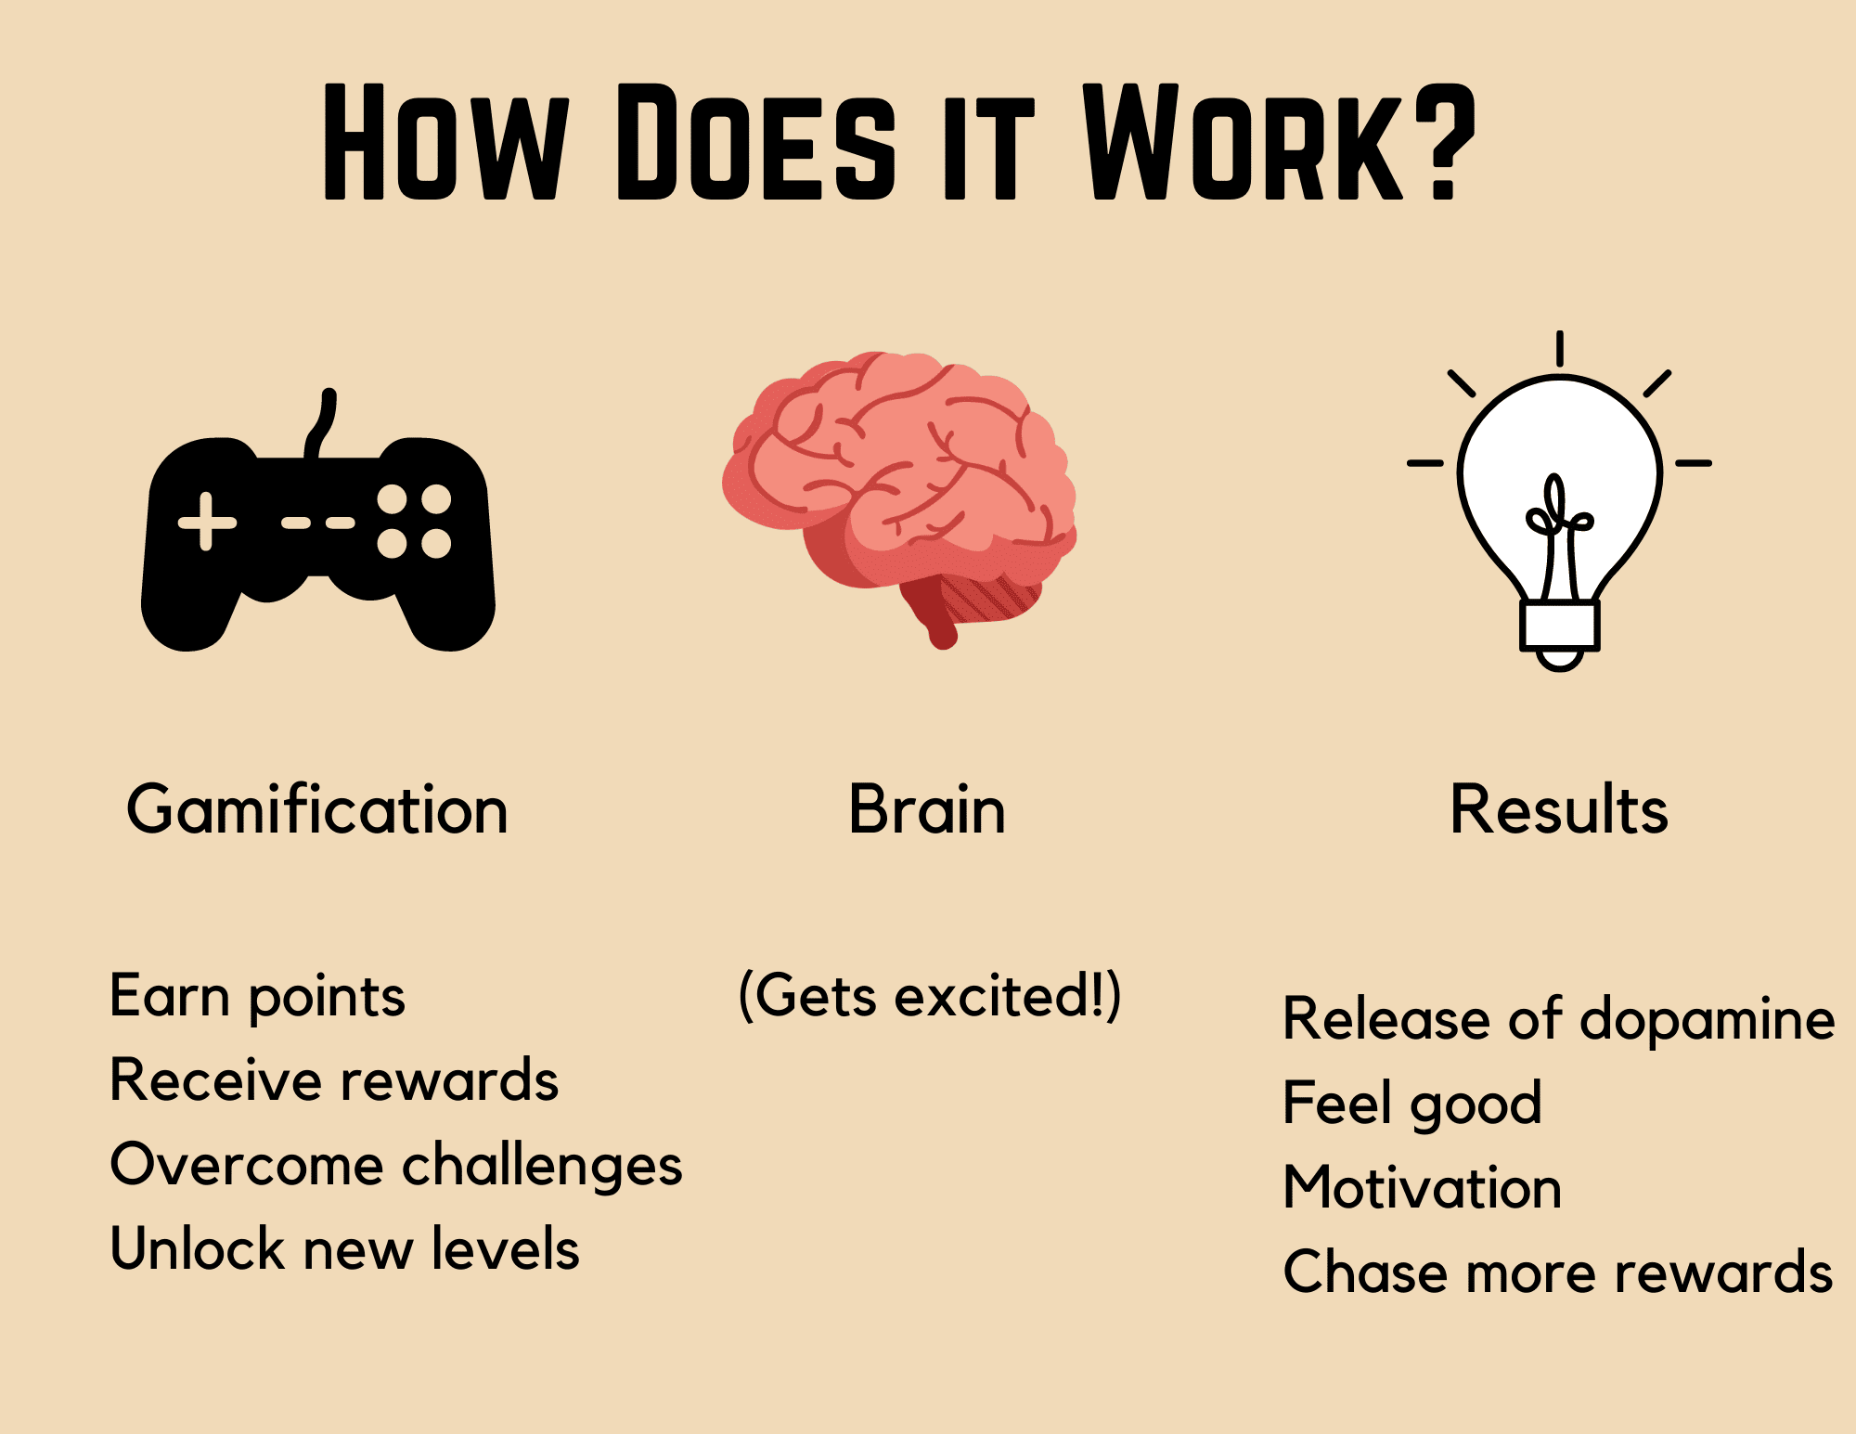
Gamification
Gamification: Take something that is not normally a game, and turn it into a game as a motivational tool

Slide 39
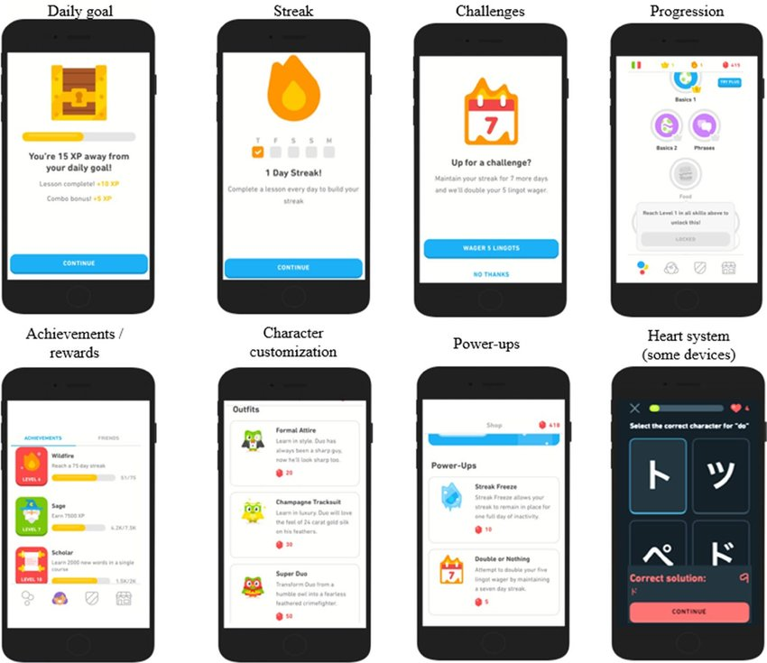
Gamification example: Duolingo

Slide 40
Activity

Slide 42
Attention is selective

Slide 43
Expectation of frequency impacts attention

Slide 44
Sustained attention lasts 10 minutes

Slide 45
People can’t multitask

