Slide 1
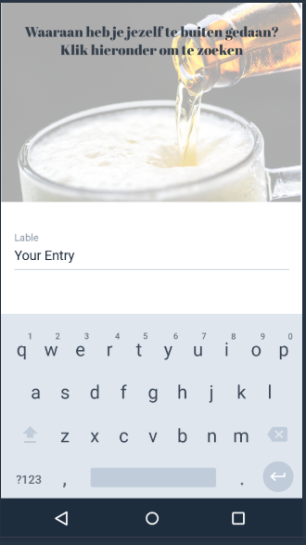
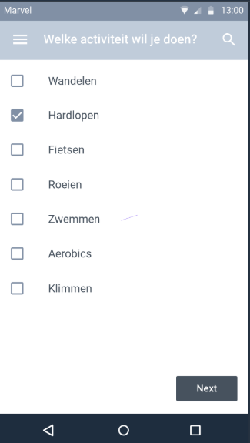
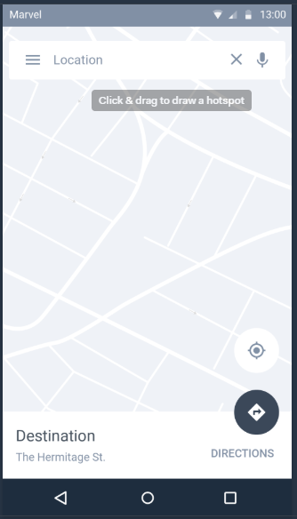
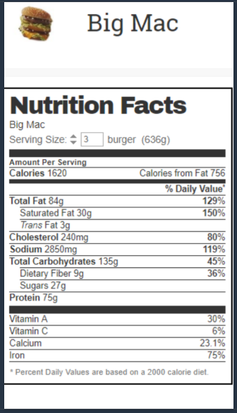

Nutritionix API
https://developer.nutritionix.com/admin
Maps API
InputActivity.java
Activity_input.xml
SportActivity.java
Activity_sport.xml
MapActivity.java
Activity_map.xml
ViewActivity.java
Activity_view.xml
SumActivity.java
Activity_sum.xml

