Slide 1
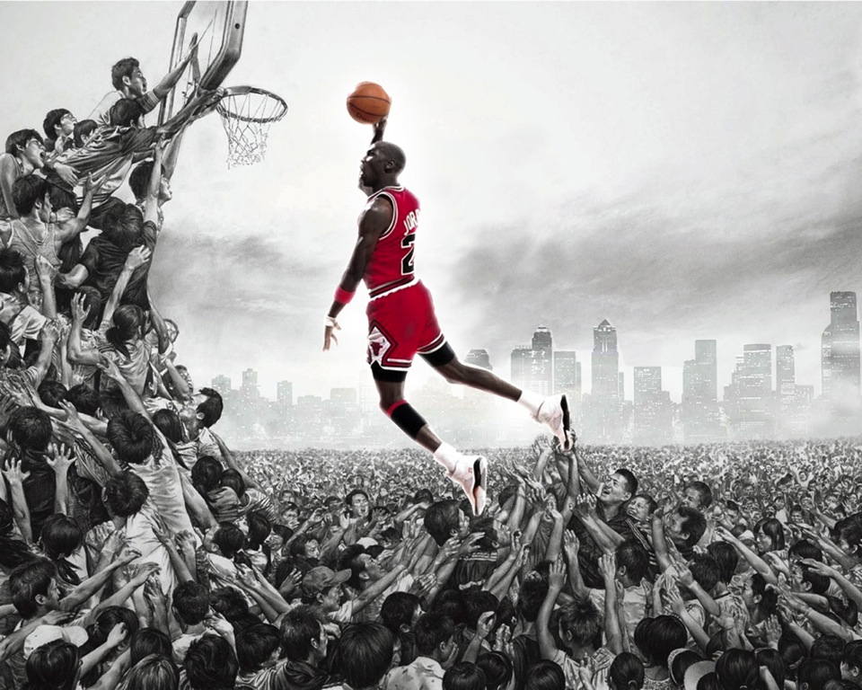
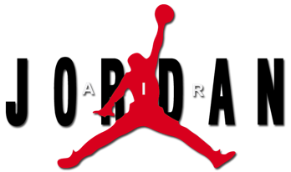
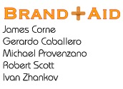

Slide 4
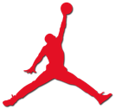

History of the Air Jordan
The beginning of the Air Jordan
1985: Adidas or Nike? – Michael Jordan signs with Nike
1988: Jordan’s influence on brand grows with the Air Jordan III
Michael Jordan’s success = Air Jordan’s success
1992: MJ & Olympic “Dream Team” win gold in Barcelona
Keeping the brand relevant
2003: Michael Jordan’s final retirement from the NBA – Nike continues to market Air Jordan with active NBA players
2008: Large campaign around Air Jordan XX3
Today: Many athletes in many sports part of “Jordan team”
1998: Derek Jeter signs with Air Jordan
1993: Bugs Bunny in Air Jordan commercials
Jordan fined for wearing shoes during NBA games
1989: Air Jordan IV distributed worldwide (1st in the line)
Notes:
Provide a quick over-view of the history behind Air Jordan. Max: 30 seconds.
Source: http://sneakernews.com

Slide 5
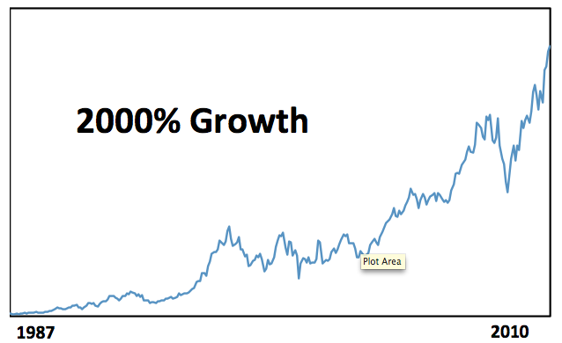
Stock Price History (87 – 10)
Source: yahoo.com
Notes:
A strong brand stimulates strong sales.

Slide 6
1. BRAND FOOTPRINT 2. PRODUCT POSITIONING 3. COMPETITIVE LANDSCAPE
Air Jordan Brand
Overview of Presentation Points
Notes:
Point 1: Brand Footprint.

Slide 7
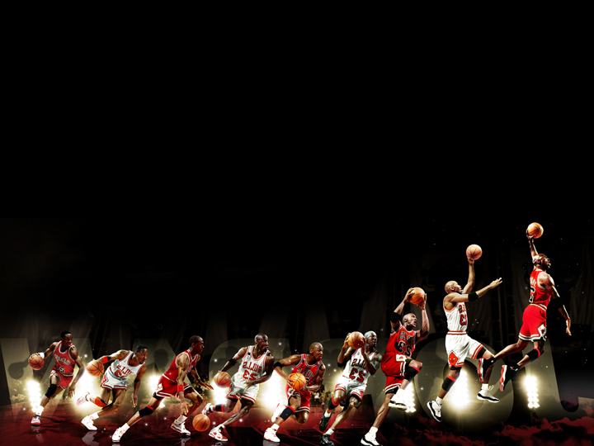















1985
TIMELINE
1987
87-92
92-96
97-98
99-00
2001
2005
2008
“Become Legendary”
“Let Your Game Speak”
“Will you be the one?”
“Who Says
Man is Not
Meant to Fly”
“ Much Respect to the Believers”
“It’s all in the Imagination”
Notes:
This image encapsulates how the various brand elements evolved over time, including the logo, product and slogan.

Slide 8
Brand Footprint
Footprint
Positioning
Competition
Core Values:
Work Ethic
Transcendence
Aspirational
Personality:
Exclusivity
Stylish & Attitude
Brand essence:
“Wearing Air Jordan’s makes me feel like a 6’0 Michael Jordan” – Chris Paul, New Orleans Hornets
Boldly Courageous
Notes:
From our research, on the surface 30% of consumers buy Air Jordan shoes for functionality and thus it means to them: “I feel like I can perform better on the court". The other 70% of people buy the brand for style and status.
Below the surface, the brand provides teenagers, in the most insecure period of their life, a sense of self-esteem and even superiority over fellow students. A way to elevate themselves in the eyes of their peers and feel more confident about themselves, on and off the court. They want to fight to transcend their situation; transcendence being a core theme to the brand. (Now relate to audience) Everyone in this room can relate to this desire to transcend, because no one here is perfect. We would not be going back to get our MBA if every one in this room was perfect. We all have weaknesses, though our personal ambition to grow and excel relates directly back to this brand.
(Next section is risky. It could strike a resonating cord or fall flat. Check with group before going forward.)
At the core, the theme of transcendence in the Air Jordan Brand goes deeper then social insecurities. This brand strikes at some of our most fragile fears as human beings. Sure we fight to become something greater, but we also fear our mortality and desire a path to transcend beyond it. This may sound like a far-fetched argument, but stay with me. Michael Jordan is someone who reached a level of greatness that seems everlasting in our minds. Even after Michael Jordan’s retirement, and we believe after his eventual death, the Jumpman logo will cement his legacy for all time. Remember the brand’s official capsule:” Become Legendary.” Thus, this theme of “transcendence” also insinuates “forever.” It insinuates a symbol that is everlasting. This strikes at a core animalistic motivator for consumers, as mentioned before: our desire to transcend our mortality. To make an analogy, Michael Jordan just might be the black Jesus of basketball. The jumpman logo is the holy cross on the court. (end on a joke) No wonder people buy his shoes so religiously!

Slide 9

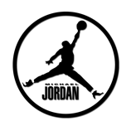
Drivers of Brand Health and Value
The 48 Image Attributes
Footprint
Positioning
Competition
Trustworthy
Friendly
Dynamic
Unapproachable
Distinctive
High Quality
Authentic
Innovative
Good Value
Cares for Customers
Original
Arrogant
Fun
Reliable
Prestigious
Unique
Different
Stylish
Straightforward
Up to Date
Traditional
Helpful
Progressive
Best Brand
Down to Earth
Daring
Intelligent
Upper Class
Eco-friendly
Simple
Trendy
Glamorous
Healthy
Charming
Visionary
Kind
Energetic
Leader
Rugged
Carefree
Community Minded
Gaining in Popularity
High Performance
Worth More
Socially Responsible
Social
Sensuous
Independent
Total: 28/48 Fit Jordan Brand

Slide 10
PYRAMID
CBBE Pyramid
Footprint
Positioning
Competition
Left-Brain
Logical
Pragmatic
Right-Brain
Intuitive
Emotional
RESONANCE
“It lets me play better”
“I feel like a 6ft tall Michael Jordan”
-Chris Paul
JUDGMENTS
FEELINGS
Zealous about
Functionality
Unseen Style, Color
& Originality
PERFORMANCE
IMAGERY
Highest
Performing
Basketball Shoe
“Elite, Exclusive, Rare”
SALIENCE
Notes:
This is a key slide. Many brands focus one side of the pyramid, either using a left brained or right brained approach to their brand’s value proposition. However, Air Jordan excels in both, which we believe to be one of the reasons for its success.

Slide 11
Score Board
Footprint
Positioning
Competition
10.8 % share of the overall US shoe market.
Second biggest brand in the country
More than twice the size of Adidas’ share!
75% of basketball shoes sold in UN
86.5 % of all basketball shoes sold > $100.
“The breadth and reach of this line will never be duplicated. …the next Michael Jordan isn’t Harold Miner, Kobe Bryant or LeBron James. There is no next Michael Jordan.”
-Matt Powell, SportsOneSource.

Slide 12
1. BRAND FOOTPRINT 2. PRODUCT POSITIONING 3. COMPETITIVE LANDSCAPE
Brand Management: Air Jordan

Slide 13




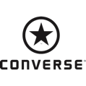

Competitive Position (1985)
COMPETITIVE POSITION
(1985)
Footprint
Positioning
Competition
Price
Perceived Benefit
(style, performance)

Slide 14



COMPETITIVE POSITION (2010)
Footprint
Positioning
Competition
Price
Perceived Benefit
(style, performance)

Slide 15
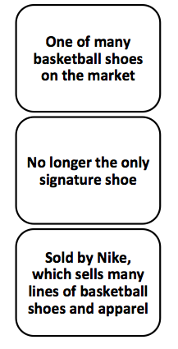
Points of Parity
Footprint
Capsule/
Elements
Positioning

Slide 16
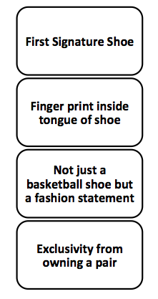
Points of Difference
Footprint
Capsule/
Elements
Positioning

Slide 17
Managing Brand Over Time
Footprint
Positioning
Competition
Line Extension: Parent brand used for new product that targets new segment in the category
Category Extension: Parent brand moves into new category.
Sneakers
Line Extension
Bags
Boxing Shoes
Football Cleats
Apparel
Baseball
Shoes
Hats
Jerseys
Basketball Shoes
Category Extension
Notes:
Extensions: Mobilize new offering to main brand
Products relevant to parent BrandScape
Capitalize on Firm’s Brand/competence
the equity of the parent brand to gain immediate resonance with target segment:
Same product, different form
New products with distinctive brand characteristics
Compare

Slide 18
Young and Rubikin The 4 Pillars of Brand Health
Footprint
Positioning
Competition
Differentiation
Relevance
Esteem
Knowledge
*Healthy brands have greater Differentiation
than Relevance

Slide 19
1. BRAND FOOTPRINT 2. PRODUCT POSITIONING 3. COMPETITIVE LANDSCAPE
Brand Management: Air Jordan

Slide 20
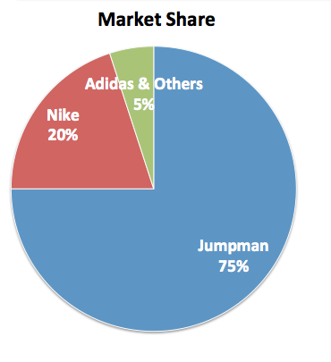
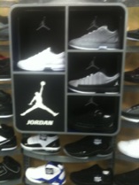
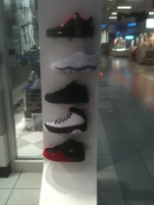
Current Market
Footprint
Capsule/
Elements
Positioning
3 out of 4 for basketball shoes sold are Air Jordans
“The Jordan brand has established itself as the premium ‘designer’ brand in athletic footwear”
Source: http://bit.ly/g3jjeH : SportsOneSource

Slide 21







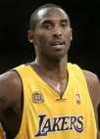
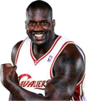
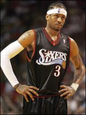
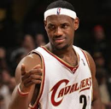
COMPETITION
Footprint
Capsule/
Elements
Positioning
Brands
Players

Slide 22
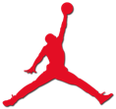
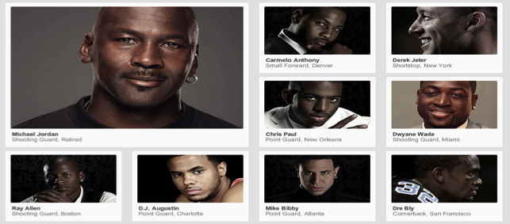
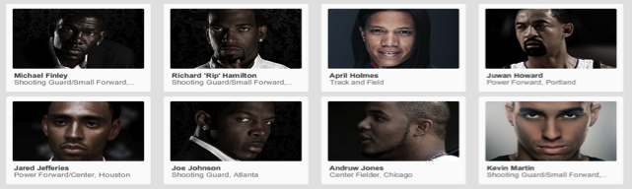

A Few Members of the Jordan Team
Footprint
Capsule/
Elements
Positioning

Slide 23

GROWING THE BRAND
Deep Emotional Bond
Footprint
Positioning
Competition
RESONANCE
Exceeds Expectations
IMAGERY
Bare Bones Functionality
PERFORMANCE
FEELINGS
JUDGMENTS
Indifferent, No Emotional Bond

Slide 24
1. BRAND FOOTPRINT 2. PRODUCT POSITIONING 3. COMPETITIVE LANDSCAPE
Air Jordan Brand
Recap of Presentation Points
Notes:
Point 1: Brand Footprint.

Slide 25
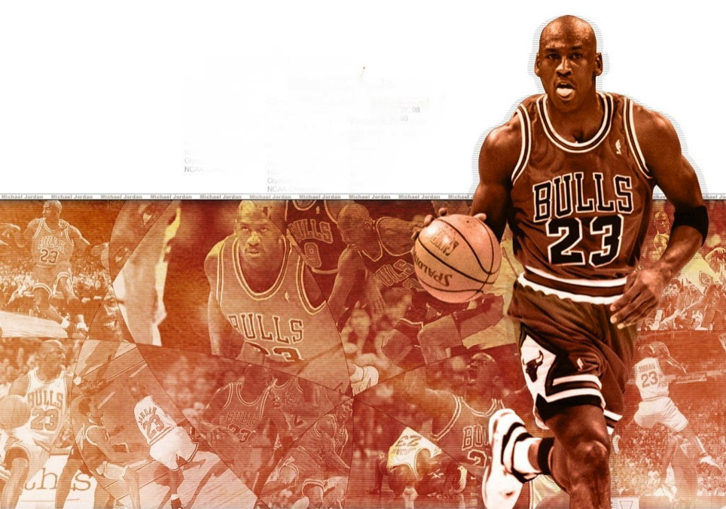
We have neither given, utilized, received nor witnessed unauthorized aid on this deliverable and have completed this work honestly and in accordance to the professors’ guidelines”.

Slide 26
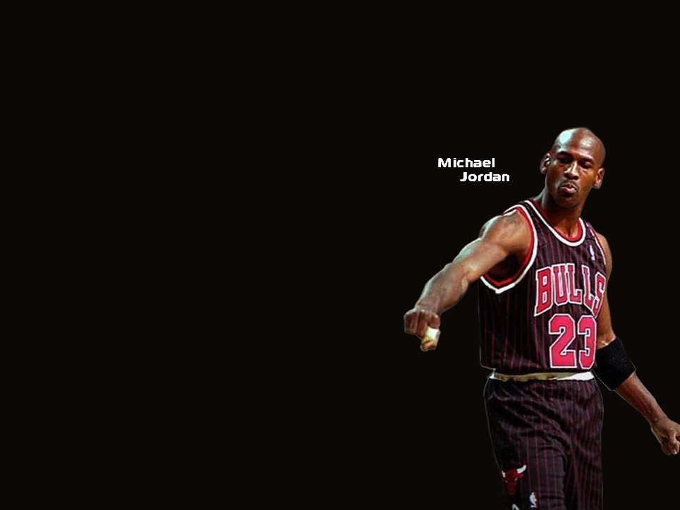
QUESTIONS
AND
ANSWERS

