Slide 1
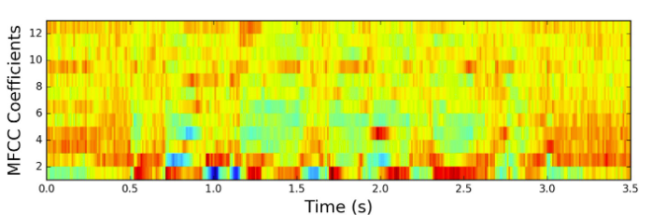

Machine Learning for Music Genre Classification
Final Presentation
Alvin Ng
Daniel Collins
Lawrence Lai
Matthew Rubino
Richard Robbins
Notes:
RICHARD
As you will recall, we worked on music genre classification.
That problem turned out to be much harder than we anticipated, for reasons that we will discuss.
So rather than coalesce around one winning model, we will share the contours of the broader journey which we tell through the lens of various models. At each point we will emphasize the things we found to be most significant.
Our notebook goes into much more detail – and even then, a lot of material remains on the cutting room floor.
[next slide please]

Slide 2

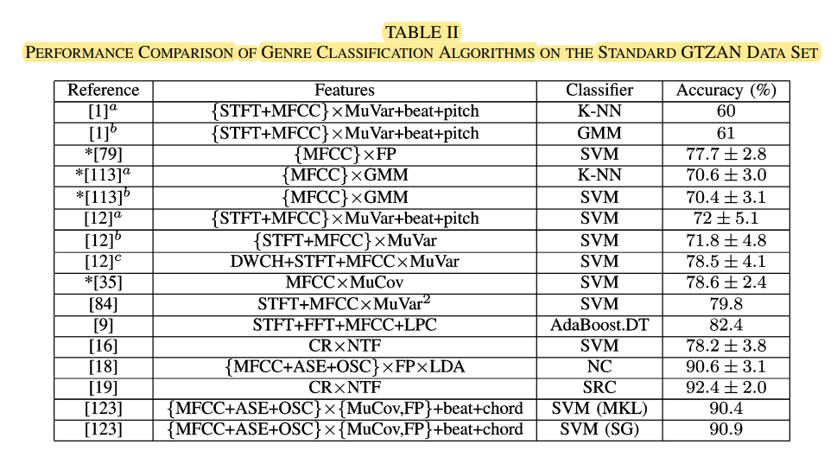
Another Look at the Music Genre Classification Problem
Need: To catalog, organize, and search large libraries of music by genre.
Challenge: Music classification is hard!
Goal: To build upon prior work, bringing a fresh look with a modern dataset and more current modeling techniques.
Notes:
RICHARD
People organize and search for music based on genres. And there is a lot of music!
Consistent genre classification is very hard (whether automated or not).
There are no generally accepted genre specifications.
Genres overlap.
Genre classification is subjective.
Many have used machine learning techniques to work on this problem, most often using the GTZAN dataset (it’s the MNIST dataset in this domain). We chose a larger, more complex dataset.
Results and models vary. The table on this slide is taken from one survey of prior work. It is just one sampling. It is not exhaustive. And, to repeat, more often than not, prior work is done on GTZAN.
We considered ten genres, so a random guess would be right only ten percent of the time.

Slide 3


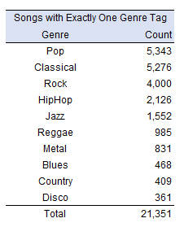
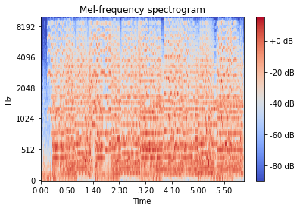
Our Data Set
Source MTG-Jamendo Dataset - ~55k songs crowd sourced by uploaders
500+ Precomputed statistics (500+) for the different types of audio descriptors (e.g. low-level, rhythm and tonal) as extracted by various signal processing algorithms. E.g.
Spectral kurtosis - is frequency distribution heavy or light tailed
Spectral skewness - is frequency distribution symmetrical
Lowlevel loudness - short def
(can't define them all here)
Precomputed mel-spectrograms (55,000+): Two-Dimensional representation of a song along the frequency and time axes
Notes:
RICHARD
Before we dive into our work, let’s take a moment and talk about our dataset.
Our dataset is the MTG-Jamendo dataset, which is a more modern open-source dataset for music auto-tagging. This dataset contains over 55,000 full audio tracks with 195 labels comprised of 87 genre tags, 40 instrument tags, and 56 mood/theme categories. Once arrays are flattened, we have 2,664 features per sample.
Again, we limited ourselves to ten genres.
As you can see, our dataset is quite imbalanced. It is important to note that we only used tracks with exactly one genre tag for our models. We addressed the imbalance issue with various techniques such as balanced weighting as well as SMOTE, which we will cover later.
Most of our models used the full feature set but, as we will describe, our CNN model uses precomputed melspectrograms in lieu of the feature set.

Slide 4
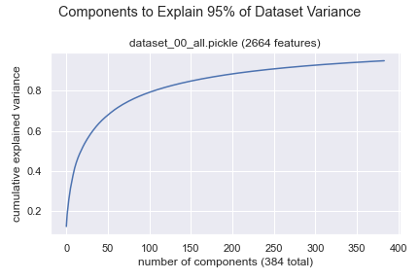
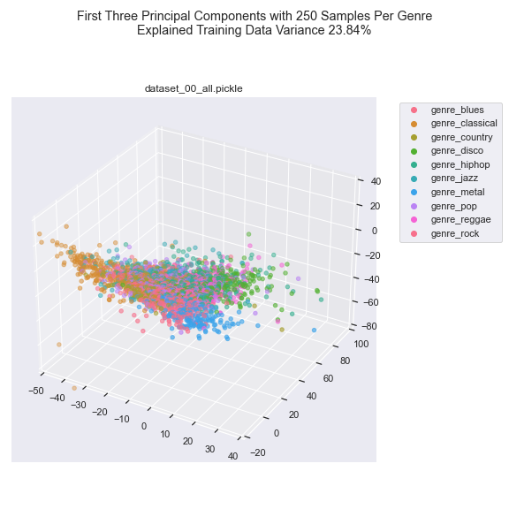
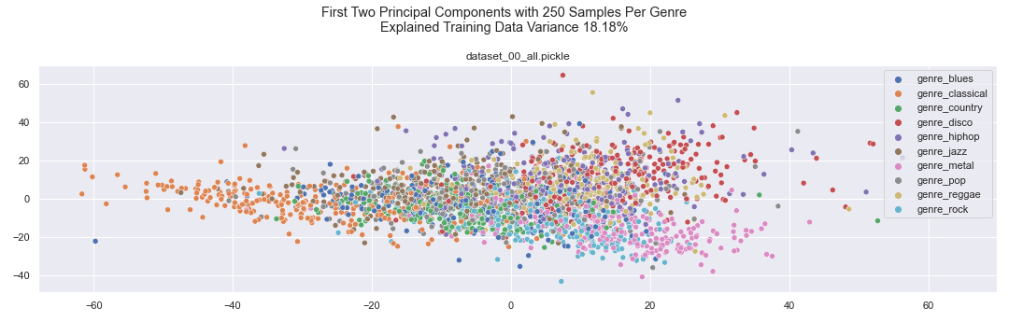
PCA
Notes:
RICHARD
With 2,664 features per sample, we struggled to visualize our data. We use PCA to help on that front. We also used PCA for dimensionality reduction, which we discuss later. The two dimensional scatter plot relates the first two principal components (about 18% of the underlying variance) to our labels, while the three dimensional scatter plot captures just under 24% of the variance. These plots, while rough, help us understand some of our results. Some genres are reasonably well clustered (classic and metal in particular), others (blues) are not.
The charts gave us a hint of the challenges ahead.
LAWRENCE, Take it from here . . .

Slide 5
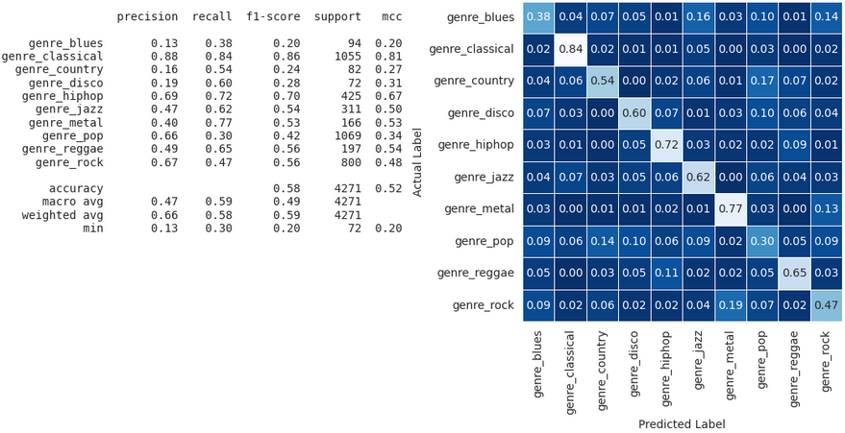
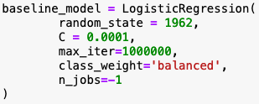
Baseline – Logistic Regression
Notes:
LAWRENCE (60 sec)
Script:
Thank you Rich!
For our baseline model, we wanted to go with the most basic algorithm - logistic regression and all of the features available to us along with very limited hyperparameter tuning on the L2 regularization strength.
We grid-searched thru 10 different values of C, which is the inverse regularization strength and immediately observed an overfitted model as we increased the value of C. For the final baseline model, we used the iteration that gave us the least amount of overfitting. The results are shown here.
A quick reminder of our evaluation metric Matthews Correlation Coefficient (MCC) - MCC is generally considered to be a reliable metric for multiclass classification with imbalance datasets.
As we can see, our baseline model achieved a test MCC of 52%, which is not great. Our baseline model performed the best at identifying the classical genre and the worst at identifying the blues genre.
One notable observation was that our baseline model performed quite poorly in identifying the pop genre, which was the majority class in our dataset.
Keep this in mind as we go thru the rest of the presentation - This is a pattern that we see recurring throughout our work. Classical always good, blues usually poor and pop also poor. The fact that pop was is also our majority class hurt us too.

Slide 6
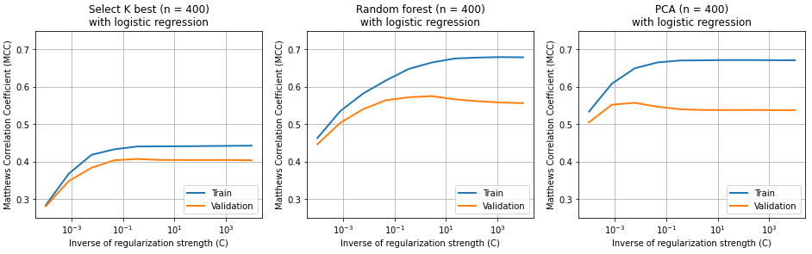
Feature Selection / Dimensionality Reduction
Key takeaways from experimenting with Select K Best, Random Forest and PCA:
Random Forest and PCA work better than Select K Best in general (even at other number of features/dimensions)
Helps a lot with reducing the complexity of a model and compute time (esp. with SVM)
More features = more complex model → overfitting → Increasing need to regularize (trade off!)
No one-size-fits-all regularization strength that we could apply to all our experiments
Notes:
LAWRENCE (60 sec)
Script:
We then turned our attention to feature selection and dimensionality reduction techniques to see what else we can do by sticking with logistic regression.
We experimented with Select K Best, Random Forest and PCA. We treated the number of features or dimensions and the regularization strengths as our hyperparameters.
In this illustration, we set the number of features for each of the algorithms to 400, which is around 15% of the original number of features, while grid-searching across the 10 values of inverse regularization strength.
Here are couple of key takeaways based on our experiments:
Helps a lot with reducing the complexity model and compute time
The more features or dimensions we have, the more complex the model becomes and the model becomes more likely to overfit. Which then requires more regularization
There’s no one size fit all regularization strength across all these three algorithms
With these lessons in mind, we ultimately landed on a more refined logistic regression model, which is on the next slide

Slide 7
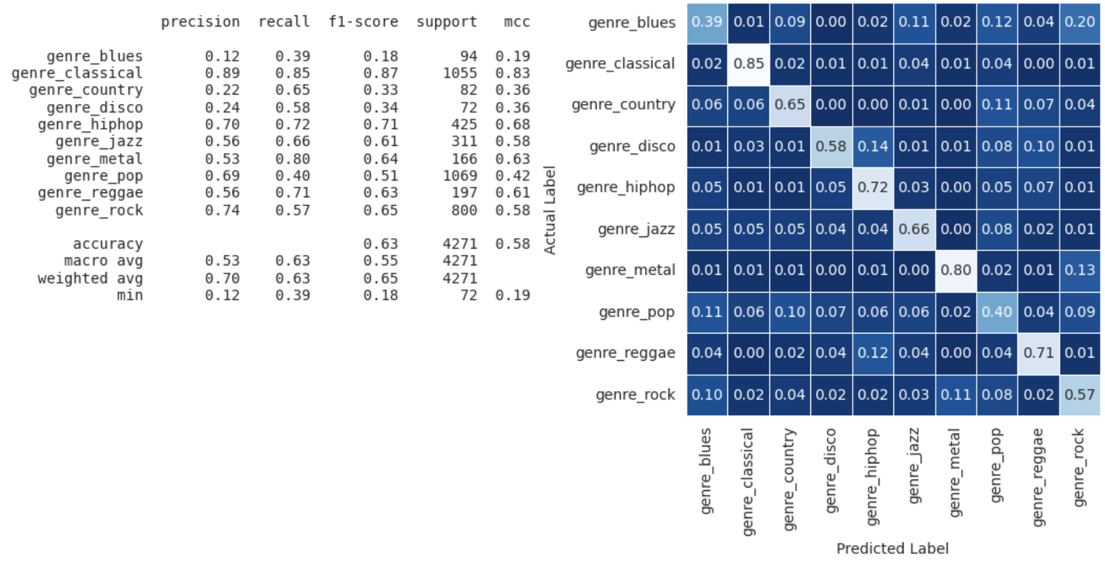
Logistic Regression with Feature Selection
Improvements of 1-10% in test MCCs using top 400 most important features as determined by random forest!
Notes:
LAWRENCE (60 sec)
Script:
We realize that we get the best improvement in the overall performance as measured by test MCC is to use features selected by random forest.
More specifically, we used 400 most important features as measured by random forest and used them in our logistic regression classifier with a regularization strength of 2.78.
The results are here with a couple of observations
Right off the bat - we saw an improvement in the overall test MCC by around 6% (highlighted in yellow) - not too bad there.
We were also able to achieve a 1-10% improvement in test MCCs across all the genres with the exception of one
Metal had the most improvement
Hiphop had the least improvement
Blues actually performed slightly worse than the baseline
Not too crazy about the improvement but we definitely learned a quite a bit from this improved baseline model.
Now I’m going to pass it off to Matt to walk us thru our SVM model.

Slide 8
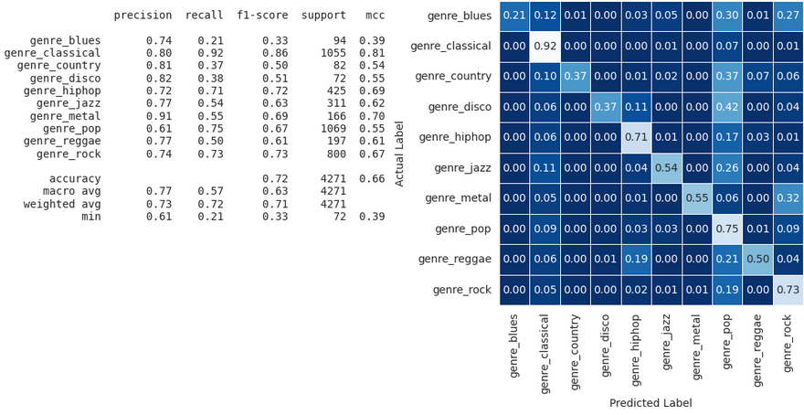
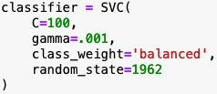
SVM w/PCA
Notes:
MATT
We also created a support vector machine model (SVM), given the strong results from existing literature. We address imbalance using the SVM class weight parameter.
Hypertuning SVM with GridSearch is very compute intensive. The dataset ran for almost 6 hours. When we used PCA to reduce dimensionality, processing time dropped meaningfully.
However, using PCA did not impact performance.
Unfortunately, we were not able to get training and validation curves easily from the sklearn SVM module so we are not in a position to comment on what those curves would reveal.
Our SVM models had MCC and average F1 Macro scores that are seven to eight percent better than our baseline and on par with the best scores for those metrics we found on any model. However, balanced accuracy trailed by a similar margin compared to the baseline and by about three percent compared to XGBoost (which Rich will cover next).

Slide 9
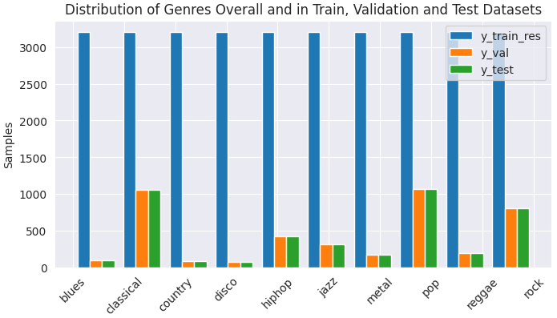
XGBoost: Data Imbalance and SMOTE
Notes:
RICHARD
Thanks Alvin.
We tried Extreme Gradient Boost. Extreme Gradient Boost is very popular these days, and it’s also complex, with a large number of hyperparameters, more than twenty, with six often identified as the most important.
Nevertheless, the version we used did not have a convenient way using weights to address data imbalance for multi-class problems.
Running XGBoost without addressing data imbalance did not work well.
We tried undersampling, but the results were also disappointing.
We did not want to oversample our data, instead we tried Synthetic Minority Oversampling Technique (SMOTE) to create synthetic data points close to samples of our minority classes. We were careful to apply SMOTE to only our training data, and not our validation or test data. We got our best results with XGBoost using this technique. We also tried variations of SMOTE that introduce undersampling together with synthetic data creation (SMOTETomek) as well as a variation that blends SMOTE with K-near neighbor techniques (SMOTE-ENN). We limit ourselves to SMOTE here.

Slide 10
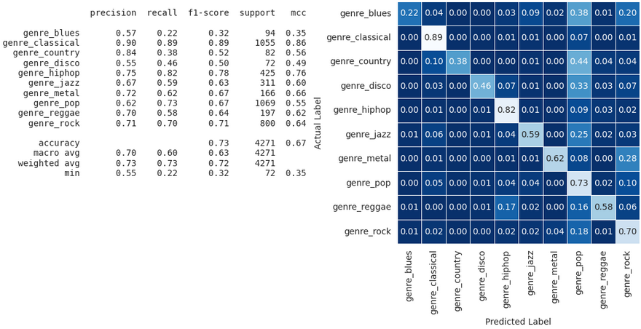
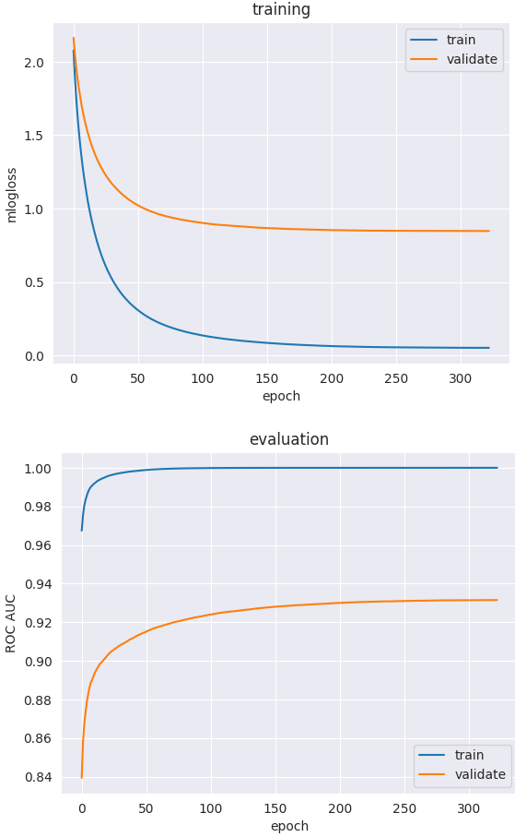
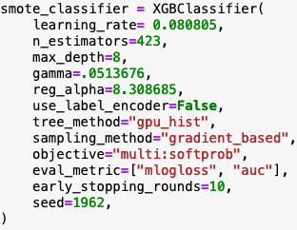
XGBoost: Bayesian Hyperparameter Tuning
Notes:
RICHARD
As I mentioned, tuning an XGBoost model is challenging. Because of the number of permutations to be considered, a brute force gridsearch approach is not practical. Instead we used a Bayesian optimization technique.
Bayesian optimization works by using a gaussian process to optimize parameters for a black box function, in our case, the function took the XGBoost model parameters as inputs, built the XGBoost model and then used our evaluation metric (mcc) as its output. We have more detail in our notebook.
In the end, our best XGBoost model relied on SMOTE to address the data imbalance and Bayesian hyperparameter optimization. We also relied on early stopping. But the curves above suggest there’s more work to be done to stop the model early.
As we saw throughout this exercise, performance across the genres is very uneven. Blues is particularly difficult and classical is especially strong. This model did better on pop than anticipated. Alvin, tell us about Mel spectrograms and your CNN work.

Slide 11
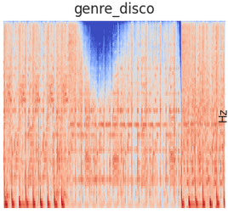
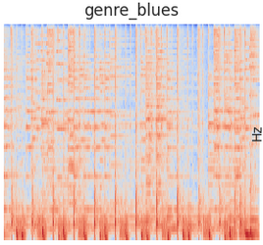
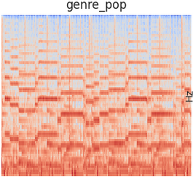
CNN - Mel Spectrogram
Notes:
ALVIN
Switching gear, we want to explain spectrograms. A spectrogram is a visual way of representing the signal strength, or “loudness”, of a signal over time at various frequencies present in a particular waveform. Not only can one see whether there is more or less energy at, for example, 2 Hz vs 10 Hz, but one can also see how energy levels vary over time
Studies have shown that humans do not perceive frequencies on a linear scale. We are better at detecting differences in lower frequencies than higher frequencies. Therefore, we use something called a mel spectrogram which is a spectrogram where the frequencies are converted to the mel scale that normalize how frequency is perceived by human.
So, it is most common today to start with the spectrogram representation of an audio signal and convert that to a spectrogram on the mel scale, a mel spectrogram. Some models, like our CNN model, work directly from the mel spectrogram. In other cases, people derive useful features from the mel spectrogram.

Slide 12
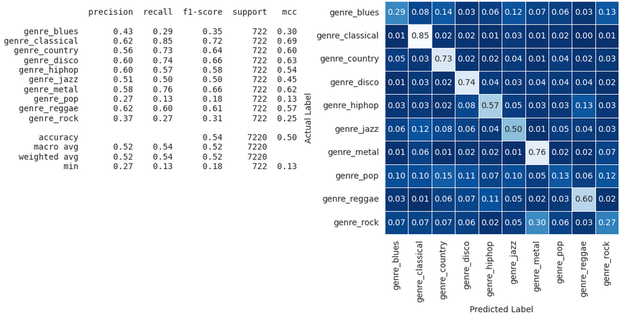
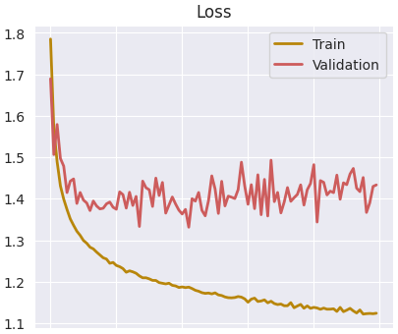
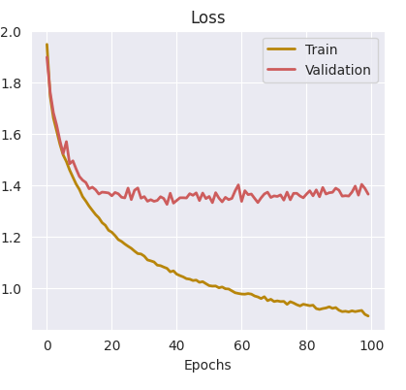
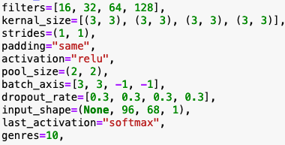
CNN - Mel Spectrogram
Imbalanced
Balanced
Notes:
ALVIN
First:
We started with a centered cropped 30 second data segment. The model did not perform well. A literature review suggested that we should split the the 30 second segment into ten 3 second segments. Humans are often able to identify genre after hearing just a few seconds of a song.
Splitting the data in this manner also created more samples. This simple split improved model performance significantly.
Second:
Overfitting was a persisting issue throughout the tuning process. The validation curves often plateaued while training curves continued to decrease. We tried to eliminate the issue with higher starting learning rates that decayed over time but the results were not satisfactory.
Third:
With the unbalanced dataset, the validation curve is very volatile, as shown in the slide. However, we were able to fix this issue by under sampling to create a balanced dataset. While the performance did decrease a bit, it was a worthwhile trade to ensure a consistent result. We believe this is a signal that we might actually be running into an issue where we do not have enough samples for CNN to create a better model.
Lastly,
There are many parameters, resulting many combinations of the model which makes it a difficult task to optimize.

Slide 13
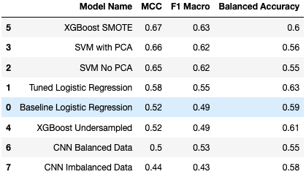
Models Summary
Notes:
ALVIN
In summary, we tried several different models. Some beat our baseline and others did not.
We chose MCC as our primary evaluation metric, followed by Average F1 Macro and then Balanced Accuracy.
Given those choices, XGBoost with SMOTE was our best model.
Its MCC and F1 Macro scores are essentially the same as our best SVM scores with better balanced accuracy than SVM by four to five percent.
We note though that our best logistic regression model had the best balanced accuracy score though, beating XGBoost by two to three percent on that statistic.
While we had hoped that our best model would perform better than we were able to achieve, we are pleased with what we learned throughout this project. We saw firsthand the difficulties of dealing with complicated, imbalanced data and explored various ways to address the imbalance. The impact of SMOTE surprised us.
We have a much better appreciation of the importance and difficulty of hyperparameter tuning, both due to complexity and compute intensity. Gridsearch is not a magic. Bayesian optimization is very helpful.
We learned a great deal about the relative strengths and weaknesses of different models.

Slide 14
Considerations for Future Iterations
Notes:
Since none of our models achieved spectacular results,there is a great amount of room for improvement. To that end, we've spent considerable time speculating what future iterations could lead to better success.

Slide 15
Fighting Class Imbalance
Underrepresented genres limit our options
Possible curation unfairness
Pop may be a dumping grounds
Notes:
Despite trying multiple methods like class weighting and SMOTE to balance our data, it is unlikely that these methods are a true substitution for the real thing.
We wonder if we were somewhat stuck between a rock and a hard place, where we could not increase the number of trainable parameters to fully capture the complexity of our larger genres without causing overfitting to our underrepresented genres.
Also, as with most crowdsourced efforts, it is possible the quality of labeling was inconsistent across genres.
Pop is also a particularly tricky genre. The definition of pop changes from decade to decade, and can be prone to be a dumping ground of songs that don't fit clearly into another category. A couple brief experiments on the effect of this genre on the model were inconclusive; while removing Pop from our CNN model improved overall performance by about 5 points, doing the same to our gradient boost model showed no change.

Slide 16
Ensemble++
Traditional voting ensemble likely ineffective
Potential success to be found in FFNN pseudo-ensemble model
Notes:
Many of our models excelled and stumbled at different genres. Being able to harness these strengths and weaknesses might yield better results.
It is unlikely that a simple voting ensemble would result in considerable success based on the confusion matrices we've observed.
However, we theorize it is possible that a more complex ensemble model, such as a feed-forward neural network, might find more nuanced relationships.
For example, if model 1 predicts reggae, and model 2 predicts jazz, then the true genre is often blues.
Due to time constraints, we weren't able to fully investigate this theory using our final models.

Slide 17

Machines in Need of guidance in Humaning
Humans define genre based on E.g.:
instruments used
time signatures and chord progressions
lyrics and speech dialect
Direct jump from abstract spectral measurements to genre is difficult
Create a chain of specialize genre feature models
Notes:
Humans define genre based on things like instruments used, time signatures, chord progressions, lyrics and speech dialect
It may be a tall ask for an algorithm to make the direct jump from intangible spectral measurements to genre
We wonder if better results could be achieved by an architecture that is a collection of smaller-scoped ML models, each designed to specifically detect one of these song features, fed into a final model that makes the jump from song features to song genre.
https://www.reddit.com/r/totallynotrobots/comments/a01itg/i_am_so_angry_this_robot_is_pretending_to_be/

Slide 18
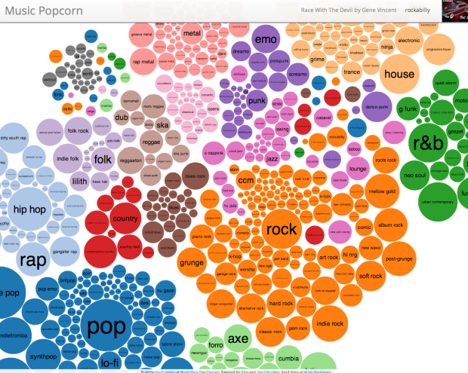
Genre is arguably fluid; not a class
Genres are related to each other
Not all misclassifications are equal
Define Genre as N-Dimensional Coordinate
Derive from multi-genre date using embedding
Notes:
And lastly, genres aren't discrete and mutually exclusive to each other. Genre is a convenient concise way to describe a song, however much of music lives on the borders between two or more genres.
Because of this, not all misclassifications are equal. A misclassification of blues as rock is not an equivalent failure to misclassifying a classical song as hip hop. We wonder if there are optimizers that could account for this.
Alternatively, we wonder if better results could be found by treating a genre as a set of coordinates in a multidimensional space rather than an independent class, that accurately encapsulates their relationship to each other.
As we briefly mentioned earlier, many songs were tagged with multiple genres. We speculate that these could be used to derive the common relations between different genres. Perhaps using something like embedding could create an N-Dimensional definition of each genre. These could then be used in place of classes as the labels for machine learning models. The nearest neighboring genre to the coordinates predicted by the model could be deemed the predicted genre.
Even this particular possible solution aside, or some other variant such as a multi-label model, in retrospect by limiting ourselves to songs with only one genre, we feel we left a lot on the table not doing more with the tagging information available to us.
https://musicmachinery.com/2013/09/22/5025/

Slide 19
Questions?

Slide 20
Contributions
Areas | Alvin | Danny | Lawrence | Matthew | Richard
Prior Research & Discovery | ⬤ | ⬤ | ⬤ | ⬤ | ⬤
Data Wrangling | ⬤ |  | ⬤ |  | ⬤
Exploratory Data Analysis | ⬤ |  | ⬤ | ⬤ | ⬤
Infrastructure Code | ⬤ | ⬤ | ⬤ |  | ⬤
Model & Data Selection Experiments |  |  |  |  | ⬤
Logistic Regression, FFNN, KNN, GMM Models |  | ⬤ | ⬤
PCA / Select K Best / Random Forest |  |  | ⬤ |  | ⬤
SVM Model | ⬤ |  | ⬤ | ⬤ | ⬤
XGBoost Model |  |  |  |  | ⬤
SMOTE & Bayesian Optimization |  |  |  |  | ⬤
Convolutional Neural Network Model | ⬤ | ⬤ | ⬤
Ensemble Model Research |  | ⬤
Project Management & General Strategy |  | ⬤ |  |  | ⬤
Primary Notebook Assembly |  | ⬤
Primary Baseline & Final Presentation Assembly |  | ⬤

