Slide 1
How to run the code through?
EFDM example

Slide 2
hack functions
(work in progress)
includes for example
makeathinP-function
= control file
= R file
= input file
P-file
P-file
P-file
efdminput
factors
one per act.
efdmestim (optional)
acitivities
outputrequests
efdmestiminput
initstate
actprobs
coefficients
pairdata
prior
one per
output
efdmui (optional)
rawoutput
efdmcore
resultstates
efdmoutput
output_by_byvar

Slide 3
R-file’s name | R-file’s description | Functions of R-file (and parameters) | Function’s description | Input files needed | Input file’s description | Files that input file refers to | Output files produced | Output file’s description
efdmcore.r | The main part of the program. Includes four functions and the actual simulation. | readtransprobs(filename) | Reads the transition probabilities from parameter file. | factors.txt | Describes factors. |  | rawoutput.txt | Number of columns is the number of activities per step.
 |  | mmf(M) | Multiplies matrix by a vector. Parameter M is the matrix which is wanted to be multiplied. | activities.txt | Describes activities. | estiminput.txt, ffellP.txt, thinP.RData
 |  |  |  |  |  |  | resultstates.txt
 |  | dividebyA(oldstate) | Partitions the current state using the activity probabilities | initstate.txt | Setting up the initial state.
 |  | newstate(oldstatediv) | Produces the next state from the current one by using the obtained transition probabilities on appropriate proportions of the current state.
 |  |  |  | actprobs.txt | Includes probabilities of activities.
efdmestim.r | File includes only one function and nothing else | estimatetransprobs(filename) | Estimates a transition matrix from data using the Bayes-like algorithm. | estiminput.txt | Includes data file’s name, prior and factors | nomgmtdata.Rdata, newprior.txt,
efdmoutput.r | File includes only one function and nothing else | outputcalc(outputrequests) | Calculates variables wanted by using factors given. | outputrequests.txt | Includes output requests wanted and filenames which include coefficients needed. |  | “outputvar_by_byvar”.txt | Includes output variable by variable(s) wanted, the final results.
efdmutils.r | User interface. Includes two functions and nothing else. | efdmui() | User interacts with the program. | efdminput.txt | Includes filenames of statespace, initstate, activities, probabilities of activities, output request’s file, and the number of steps | activities.txt, actprobs.txt, factors.txt, initstate.txt, outputrequests.txt
 |  | runefdm(inputfile) | Runs the efdmcore.r. Input file includes all information needed (efdminput.txt)
hackfunctions.r (WORK IN PROGRESS) | Includes small functions | setupstatespace(filename) | Initializes the state space | factors.txt | Describes factors |  | newprior.txt | Includes the coefficients of prior
 |  |  |  | estiminput.txt | Includes data file’s name, prior and factors | nomgmtdataP.Rdata, newprior.txt | thinP.Rdata | Includes thinning probabilities
 |  | pre.estimate(inputfilename, factorsfilename,changing, resultfilename) | Estimates transition matrix
 |  |  |  | nomgmdataP.Rdata | Includes the probabilities of no management |  | nomgmtdataP.Rdata | Includes the probabilities of no management
 |  | makeathinp(inputfilename, voldrops, resultfilename) | Makes a transition matrix out of a pre-made “no management” transition matrix (vol age –case)
 |  | neutralprior(nvol, nage, resultfilename) | Creates a simple prior for the estimation procedure
The number of columns
is the same than the
number of steps

Slide 4
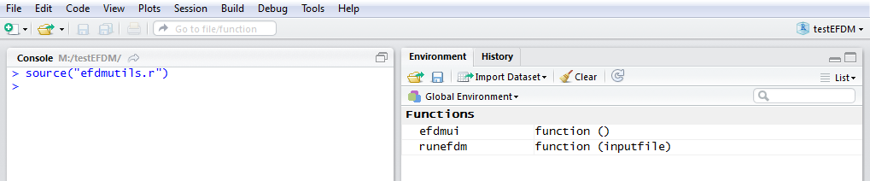
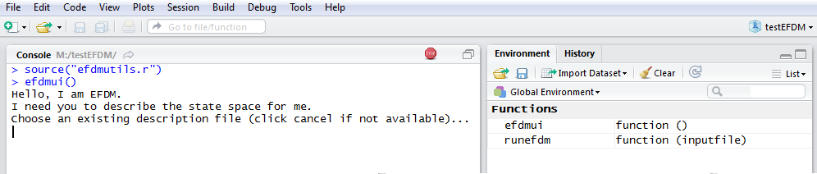
How to run the code through with user interface
1. Type source(”efdmutils.r”)
2. Type efdmui()

Slide 5
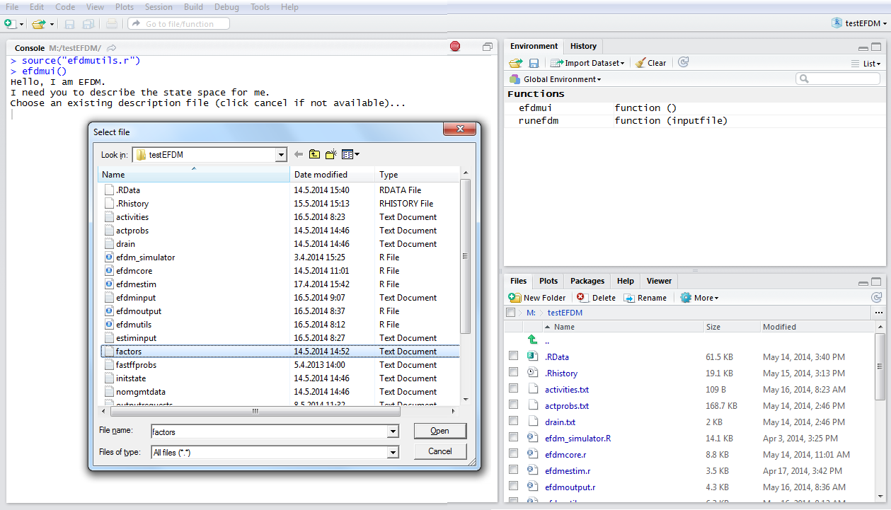
3. Choose factors.txt

Slide 6
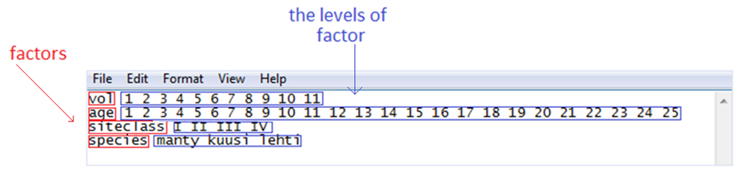
factors.txt
factors.txt includes factors and the levels of factors
Each row includes one factor and its levels

Slide 7
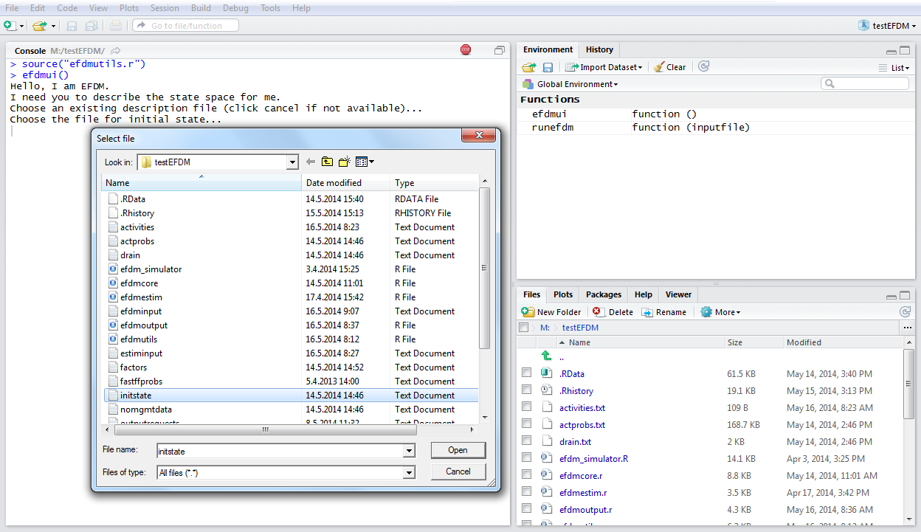
4. Choose initstate.txt

Slide 8
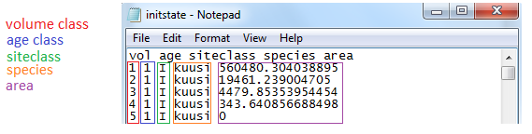
initstate.txt

Slide 9
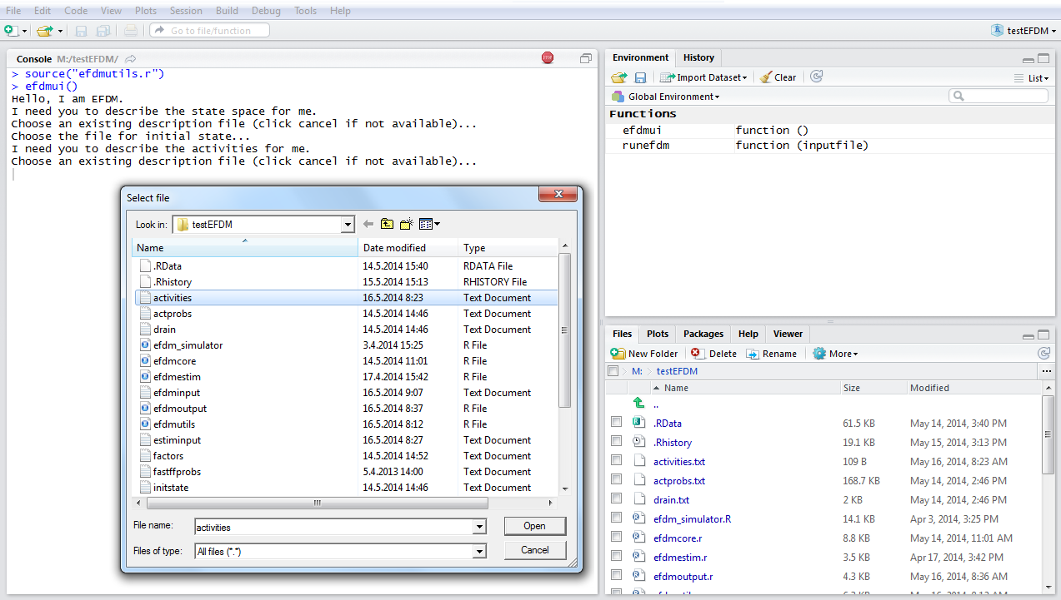
5. Choose activities.txt

Slide 10
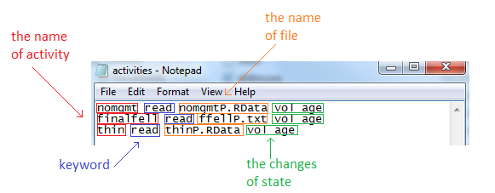
activities.txt
Keywords are going to be removed from the next version
The name of file for transition matrix either as text or R save file. Probabilities are created beforehand, there will be an example for that later
The changes of state are basically the axis of matrix

Slide 11
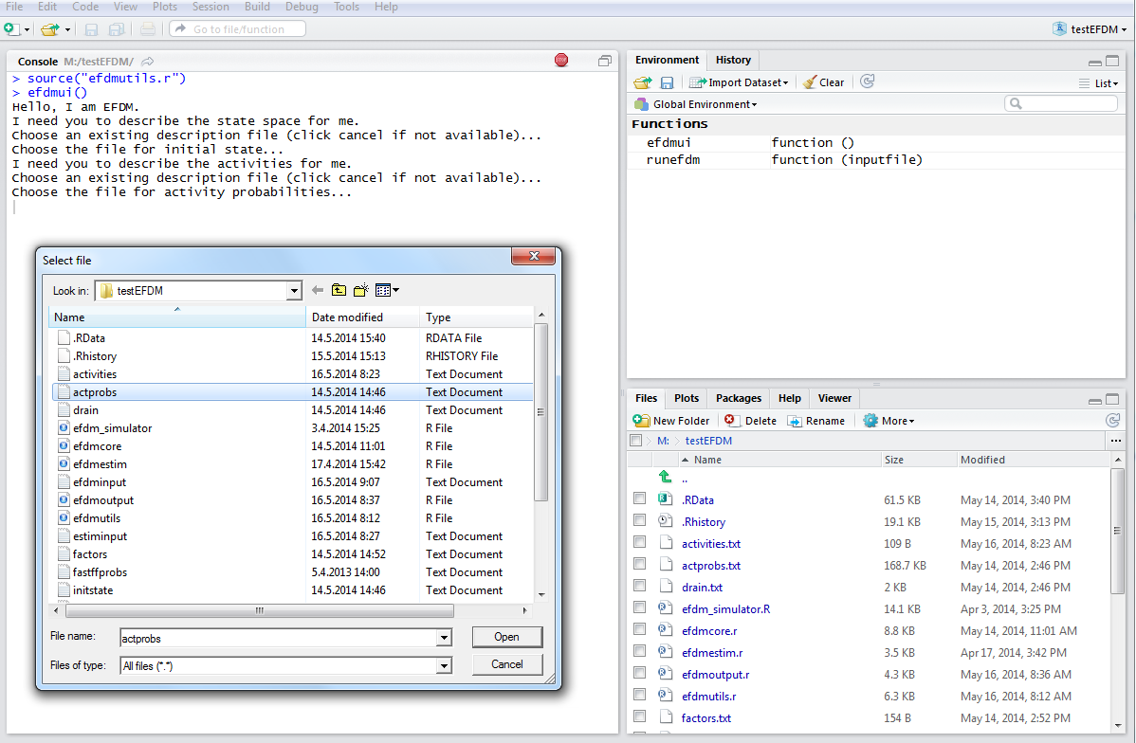
6. Choose actprobs.txt

Slide 12
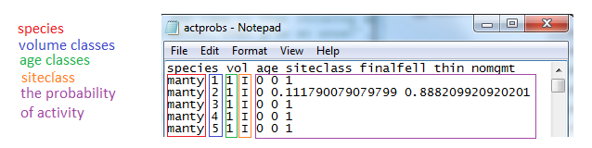
actprobs.txt
The sum of the probability of activity is 1

Slide 13
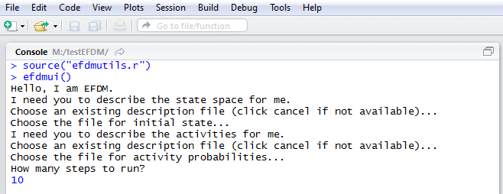
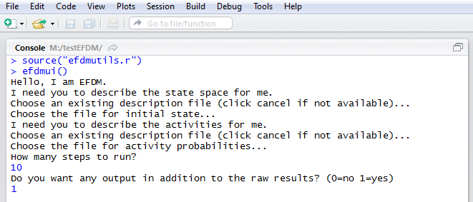
7. Tell the number
of steps
8. Choose whether
you want additional
results

Slide 14
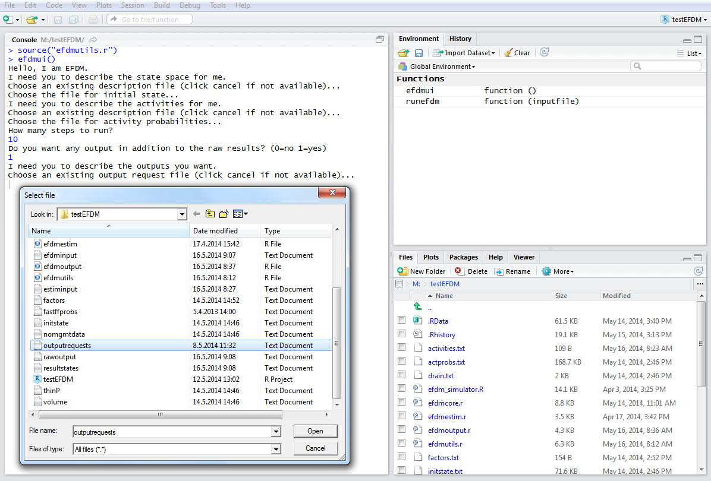
9. Choose outputrequests.txt for additional results

Slide 15
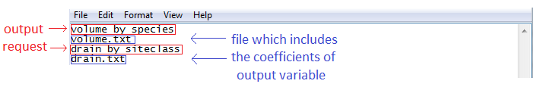
outputrequests.txt

Slide 16
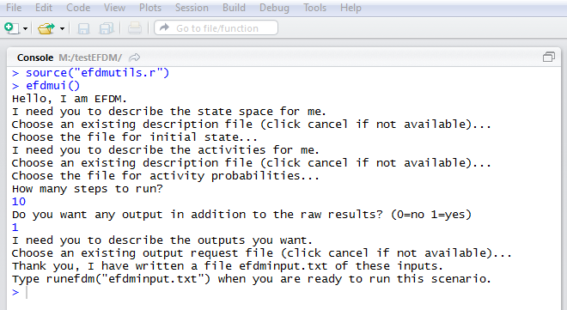
10. User interface closes

Slide 17
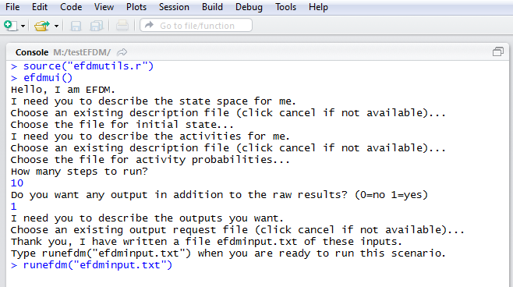
11. Type runefdm(”efdminput.txt”) for
running the code through

Slide 18
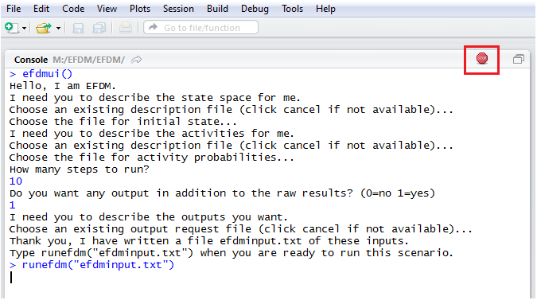
12. While R is running the code through,
there is a red sign in the upper right corner.
Wait until that disappears.

Slide 19
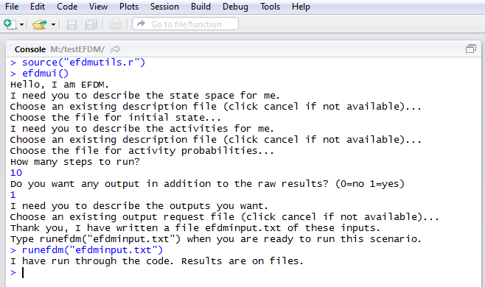
13. R has run the code through.
Results are on files.

Slide 20
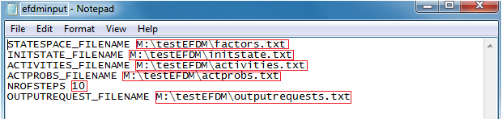
How to run the code through without user interface
You should have an input file (for example efdminput.txt) which
includes information about input files, number of steps and information
about additional input file

Slide 21
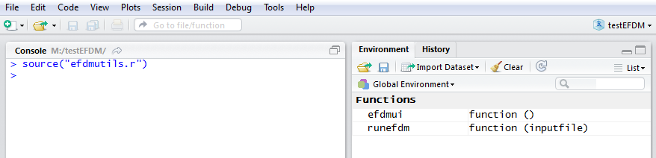
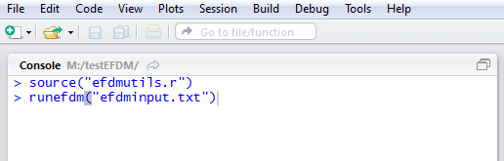
1. Type source(“efdmutils.r”)
2. Type runefdm(“INPUT FILE’S NAME”), for example
runefdm(“efdminput.txt”), if your input files name was efdminput.txt

Slide 22
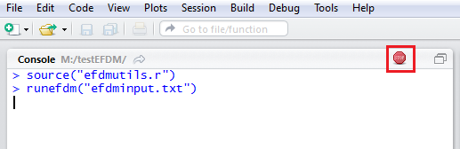
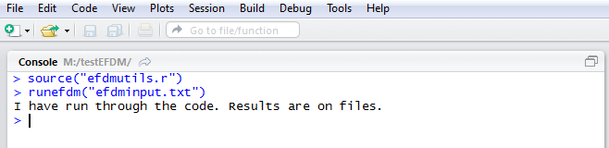
3. While the little “stop” sign is on the upper right corner, it means that
the program is doing something, wait until the sign disappears
4. When the sign has disappeared, you can close the R-studio. You can
save the workspace if you want, but it is not obligatory. The results have
been saved to their own files

Slide 23
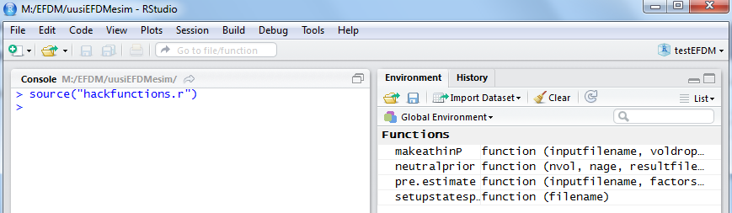
Creating P-matrices
1. Type source(“hackfunctions.r”)

Slide 24
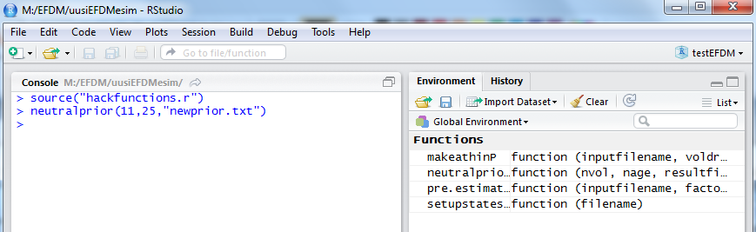
2. Type neutralprior(11,25,”newprior.txt”) for to get prior. This command means
that the number of volume classes is 11 and the number of age classes is 25.
The prior is saved to file “newprior.txt”.

Slide 25
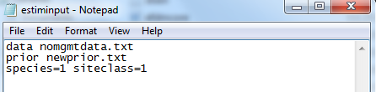
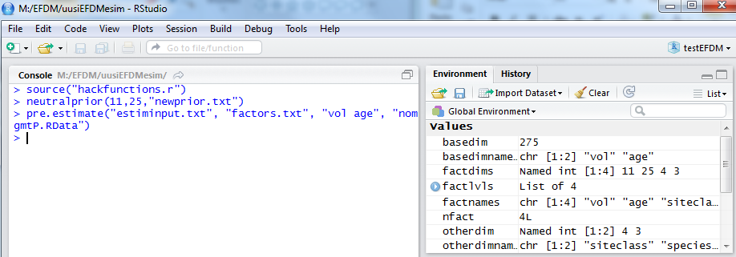
3. Open estiminput.txt. There should be pairdata (nomgmtdata.txt) on the 1st row,
the prior made earlier (newprior.txt) on the 2nd row and output variables on the
3rd row.
4. Use R-Studio again. Type pre.estimate(“estiminput.txt”, “factors.txt”,
“vol age”, “nomgmtP.Rdata”)

Slide 26
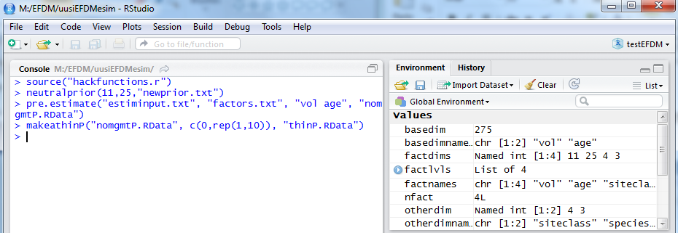
5. Type makeathinP(“nomgmtP.RData”, c(0,rep(1,10)), “thinP.RData”)
“c(0,rep(1,10))” describes the drops of volume classes when thinned
(how many classes the volume drops). The values of the volume classes have
to be at least 1. This means that if the value of the first volume class is 1, the
drop has to be 0. The length of the vector is same as the number of volume
classes. In this case, the drops are 0,1,1,1,1,1,1,1,1,1,1.

