Slide 1
Goal Setting

Slide 2
What is it for?

Slide 3
Zig Ziglar‘s Seven Steps of Goal Setting
Identify the goal
List the benefits – what‘s in it for me?
List the obstacles to overcome
List the skills and knowledge required
Identify the people and groups to work with
Develop a plan of action
Set a deadline for achievement

Slide 4
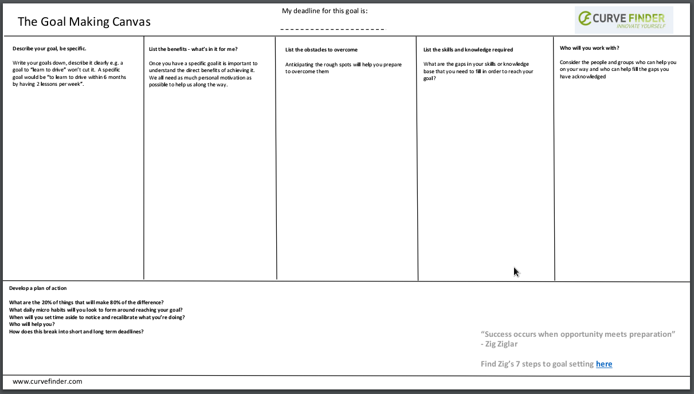

Slide 5
Plan of Action
What are the 20% of things which make 80% of the difference?
What daily micro habits will you form?
When will you set time aside to notice and recalibrate?
Who will help you?
How does this break down in short and long term deadlines?

Slide 6

Goal Setting
  What‘s the project? (page 2)
  When does it ship? (page 2)
  Who is responsible for shipping? (page 2)
  List every taks and event that needs to happen, by whom, and by when (page 11)

