Slide 1
Ship early, ship often
Sharing what I learnt during the altMBA
Cornelius Schumacher <cschum@suse.com>

Slide 2
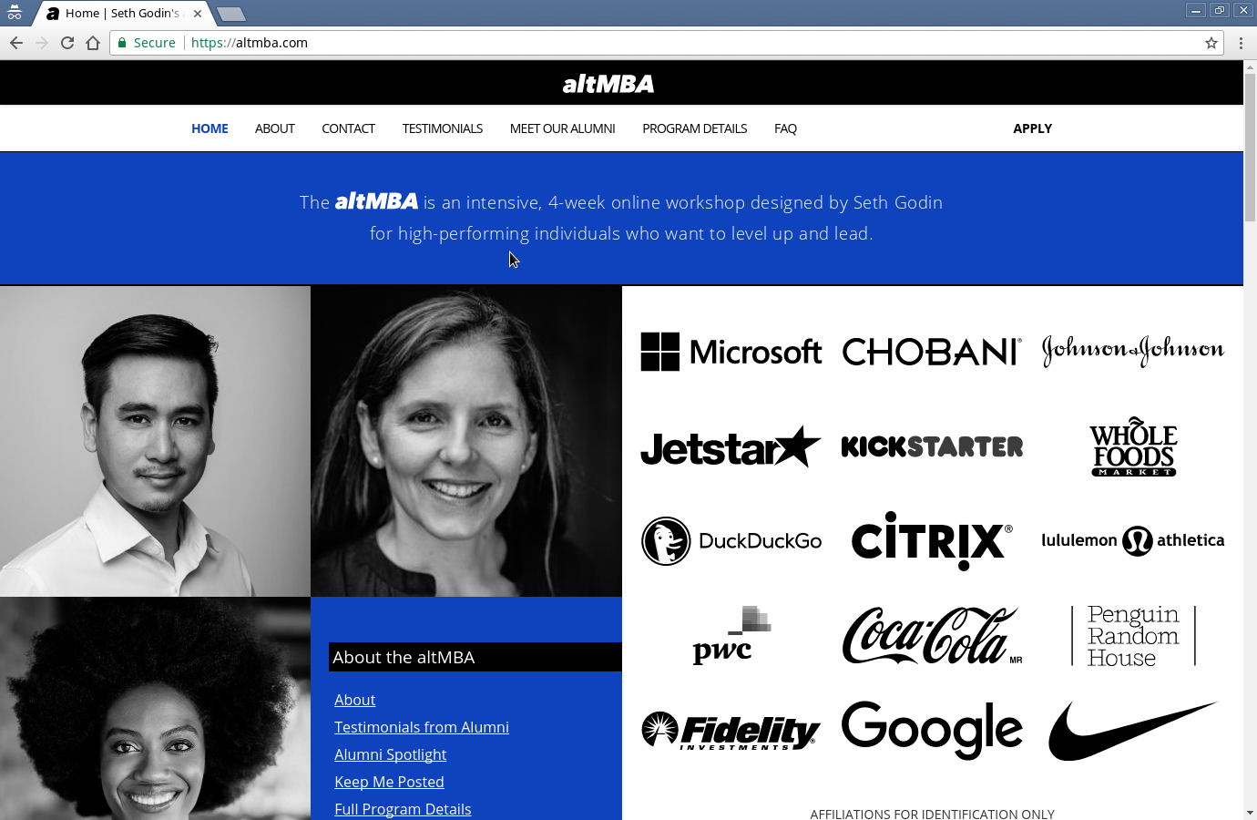

Slide 3
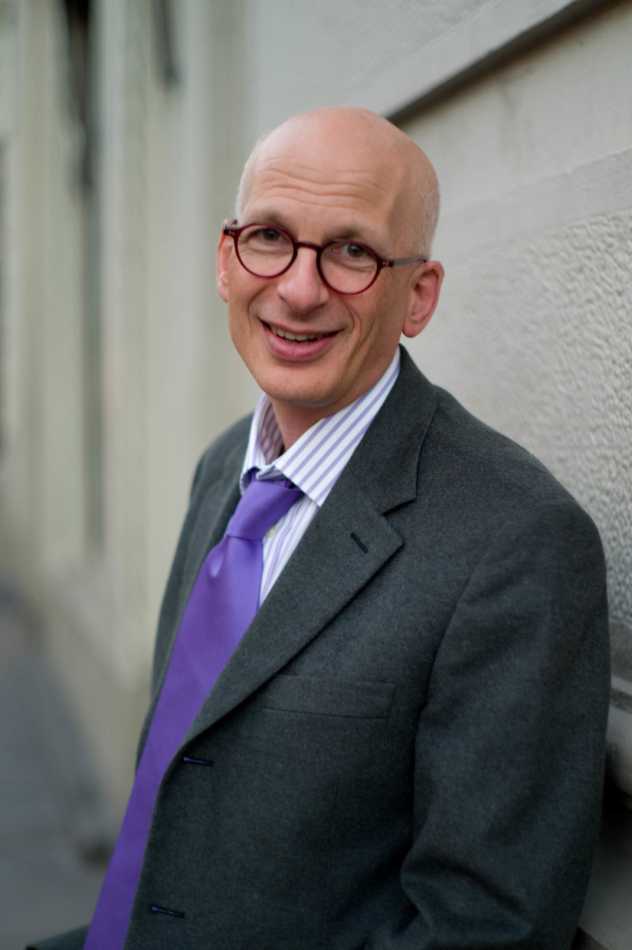
By Joi Ito - Seth Godin, CC BY 2.0, https://commons.wikimedia.org/w/index.php?curid=10763024

Slide 4
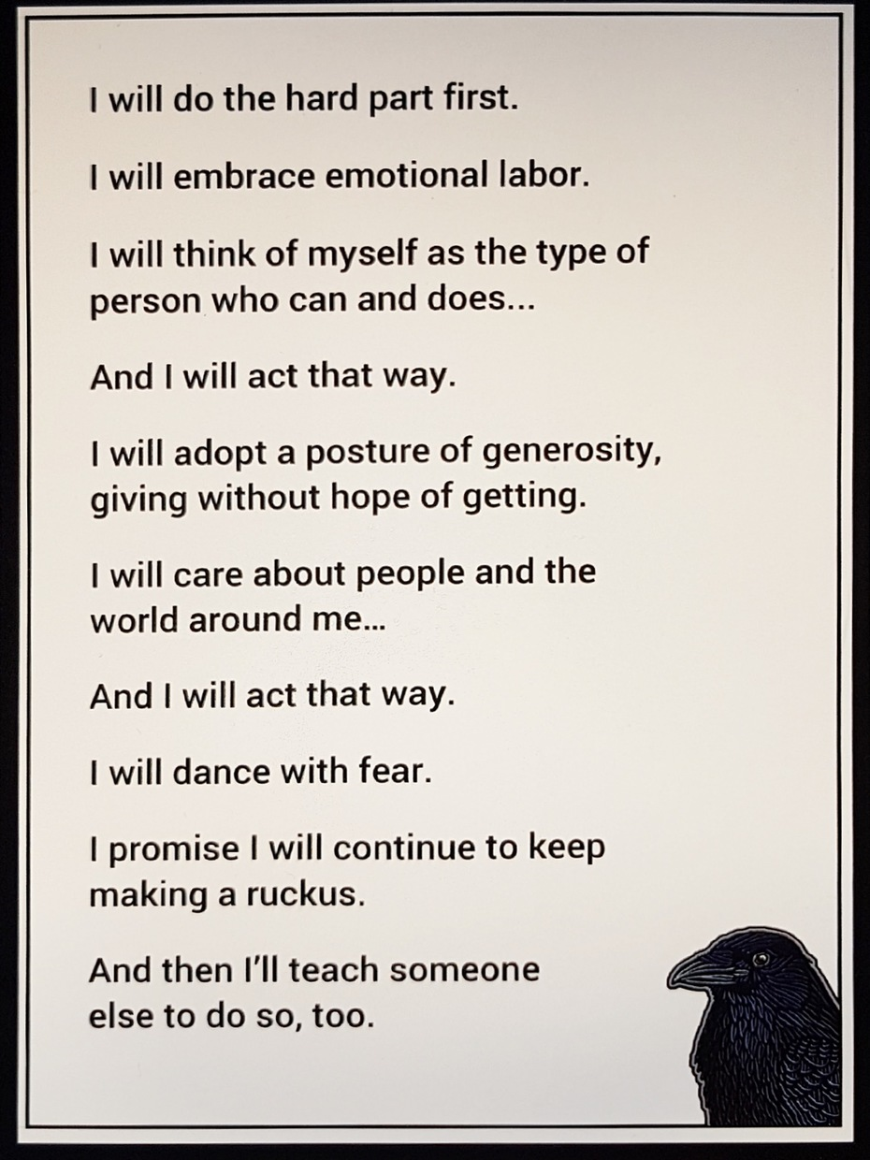

Slide 5
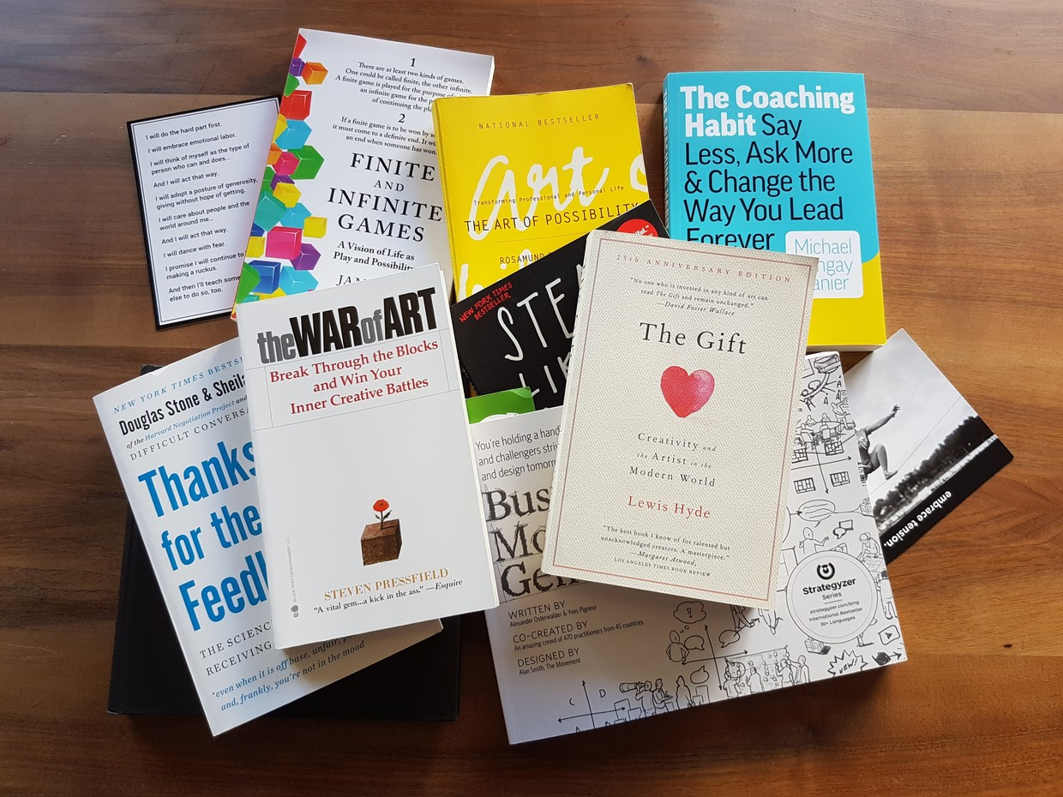

Slide 6
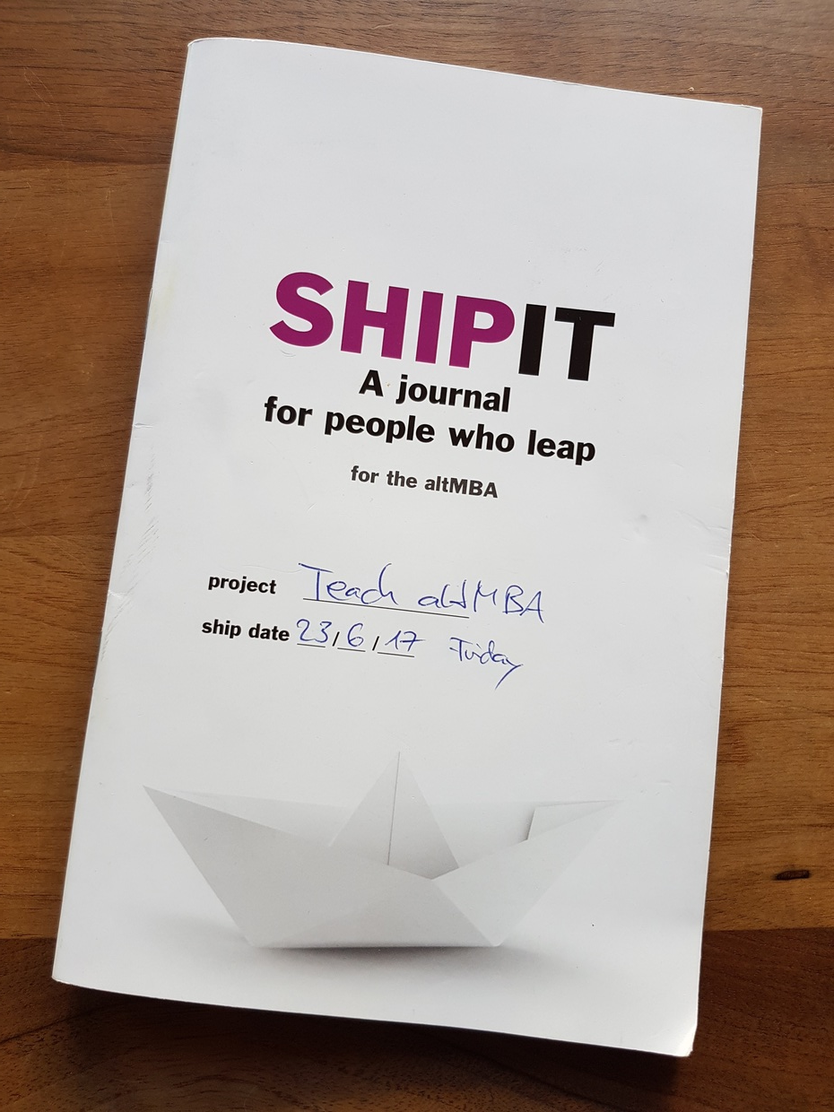

Slide 7
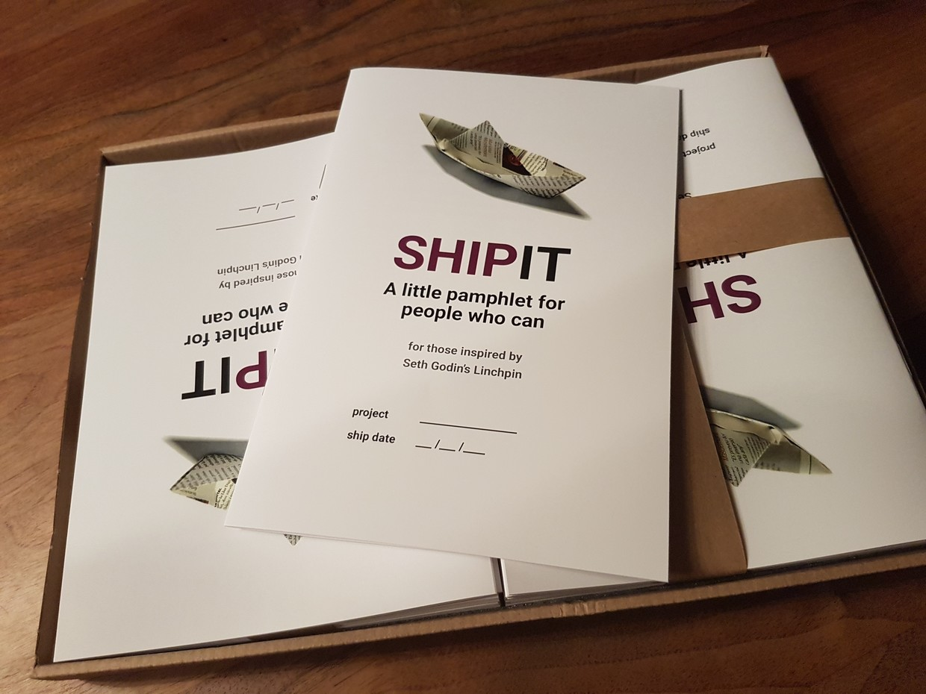

Slide 8
Techniques

Slide 9
Goal Setting
Decision Trees
Goodfinding
Public Speaking
Business Model Canvas
Brainwriting
Organizational Maps
Personas
Worldview
Feedback
Story Telling
Framing
Be a Pro
Pattern Matching

Slide 10
The method

Slide 11
Know the change you want to make
Be rational about your analysis and decisions
Change yourself into the kind of person who leads
Be aware of personas and worldviews
Create a story that will resonate with the people you seek to change
Deliver with humanity, charisma and trust

Slide 12
The Posture

Slide 13
Do the hard part first
Seek out emotional labor
Dance with fear
Embrace tension
Keep making a ruckus
... and ship

Slide 14


Slide 15
Use resistance as a compass for value
Be generous
Be vulnerable

Slide 16
The workshop

Slide 17
It‘s all about contributing

Slide 18
Ship
Reflection
Feedback

Slide 19
Seth‘s rules of feedback
No one cares about your opinion
Say the right thing at the right time
If you have something nice to say, say it
Give me feedback, no matter what

Slide 20
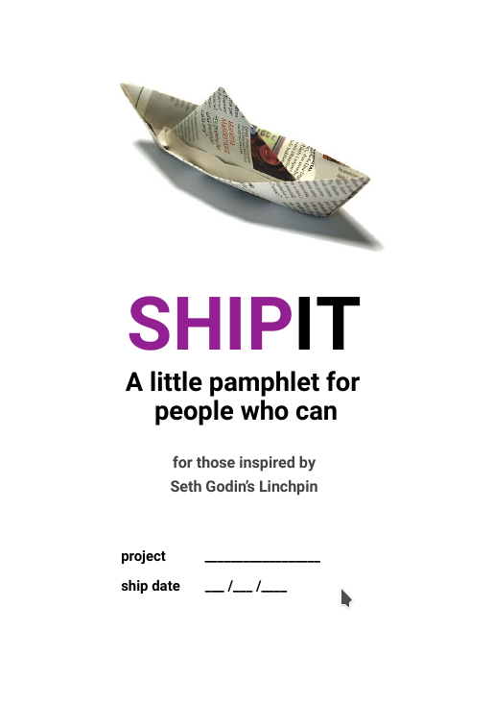
Goal Setting
  What‘s the project?
  When does it ship?
  Who is responsible for shipping?
  Action plan
Resistance
  What are you afraid of?
  Why are you afraid?
  What does failure look like?
Reframing
  What does perfect look like?
  What does good enough look like?
  Plus it
  Minus it

Slide 21
What are your questions?

