Slide 1
Reframing

Slide 2
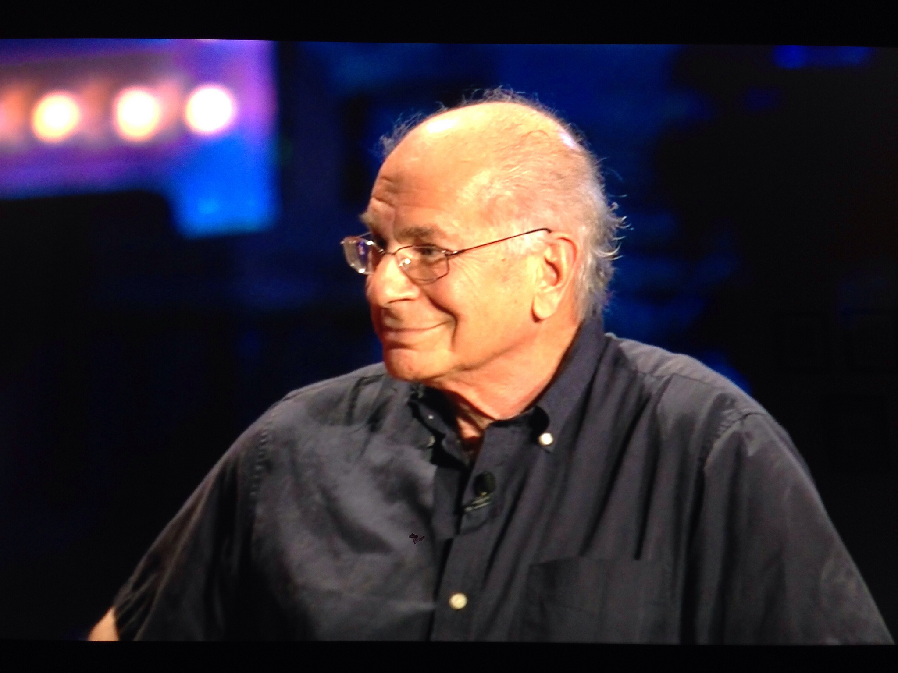
CC BY-SA, Buster Benson, https://www.flickr.com/photos/erikbenson/9585678357

Slide 3
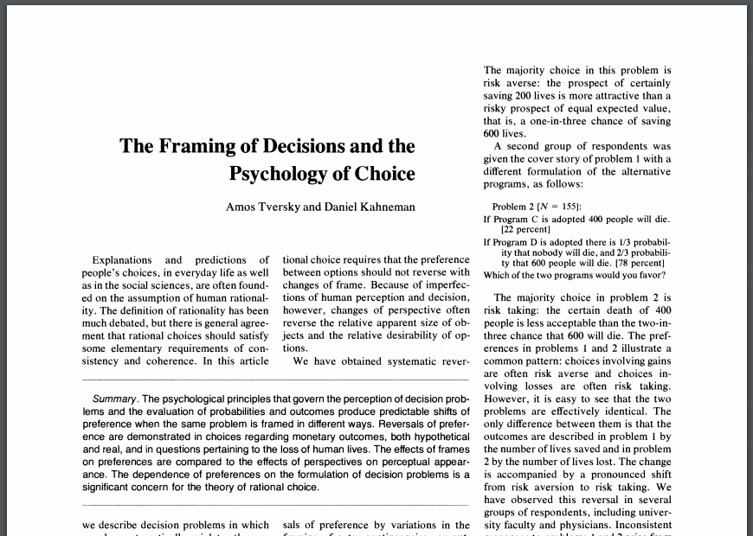

Slide 4
Imagine that you have decided to see a play where admission is $10 per ticket. As you enter the theater you discover that you have lost a $10 bill.
Would you still pay $10 for a ticket for the
Play?
Yes [88 percent] No [12 percent]

Slide 5
Imagine that you have decided to see a play and paid the admission price of $10 per ticket. As you enter the theater you discover that you have lost the ticket. The seat was not marked and the ticket
cannot be recovered.
Would you pay $10 for another ticket?

Slide 6
Imagine that you have decided to see a play and paid the admission price of $10 per ticket. As you enter the theater you discover that you have lost the ticket. The seat was not marked and the ticket
cannot be recovered.
Would you pay $10 for another ticket?
Yes [46 percent] No [54 percent]

Slide 7
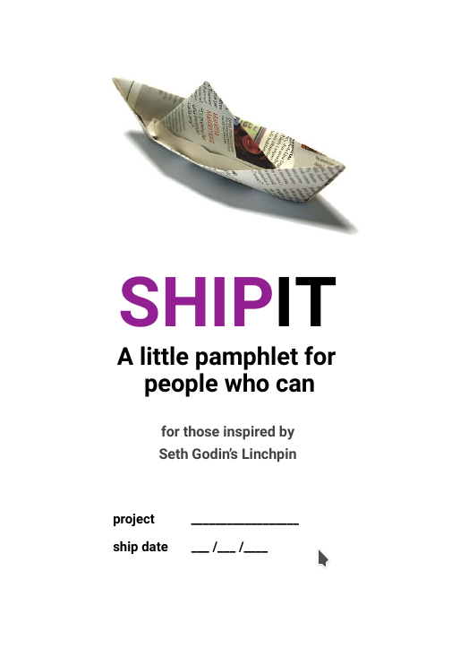
Reframing
  Plus it (page 16)
  Minus it (page 17)

