Slide 1
Resistance

Slide 2


Slide 3
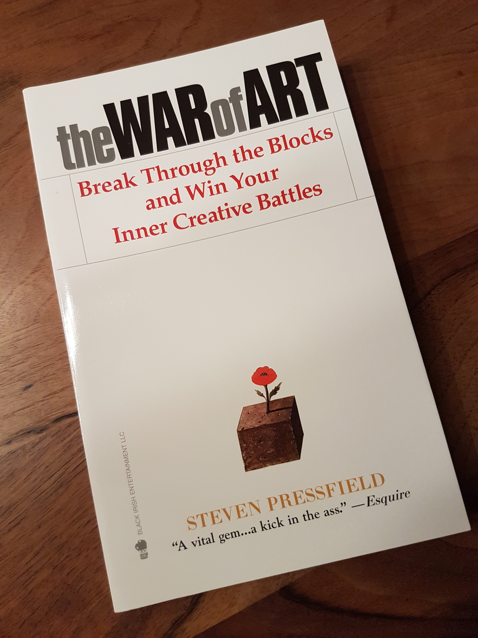

Slide 4
Turning pro
Do the hard part first
Dance with fear

Slide 5

Resistance
  What are you afraid of?
  (page 3)
  What else (the truth this time)? (page 3)
  Why are you afraid? (page 3)

