Slide 1
Advent of Code, 2024
Oregon Delphi User Group, Dec 2024

Slide 2
ODUG – Advent of Code 2024 [About]
What is Advent of code?
YouTube (2:07 – 5:48) https://www.youtube.com/watch?v=uZ8DcbhojOw
Discussion on Reddit
https://www.reddit.com/r/adventofcode/
Interesting (but unofficial) Survey
https://jeroenheijmans.github.io/advent-of-code-surveys/

Slide 3
ODUG – Advent of Code 2024 [Languages]
Python
Rust
Haskell
TypScript
APL
Clojure
Elixir
C#
OCaml
FSharp
Gleam
Ruby
Go
C++
Kotlin
Swift
Lisp
Smalltalk
Factor
Lua
Ada
Nim
Rebol
Java
R
Fortran
Brainfuck
Uiua
PowerShell
Crystal
Fennel
Raku
AWK
Excel
SQL
Groovy

Slide 4
ODUG – Advent of Code 2024 [Problems]
Story
The elves …
You can help …
Input
Unique per user
Large

Slide 5
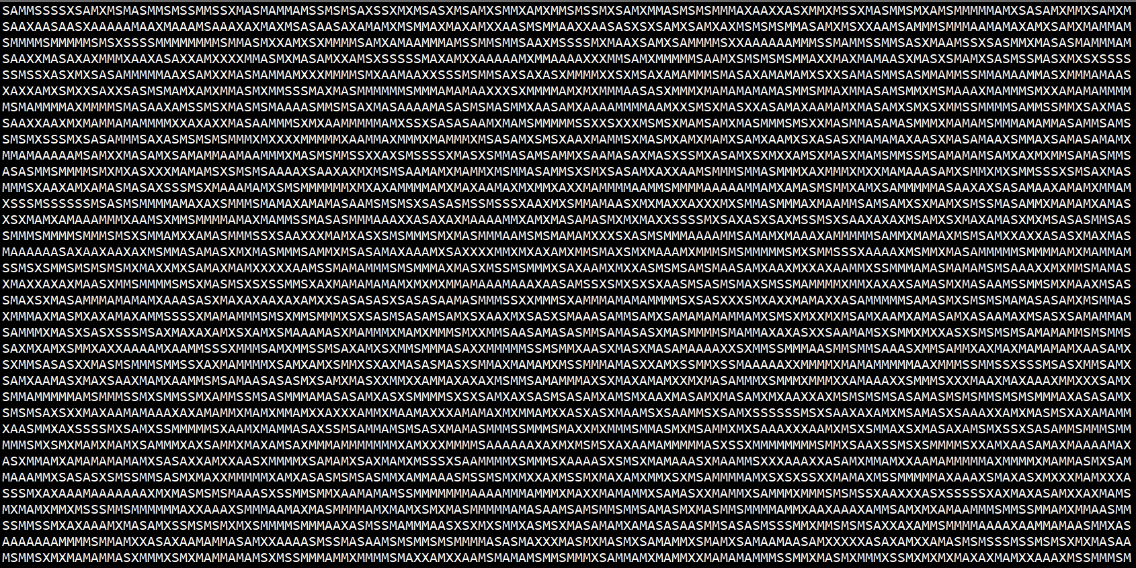

Slide 6
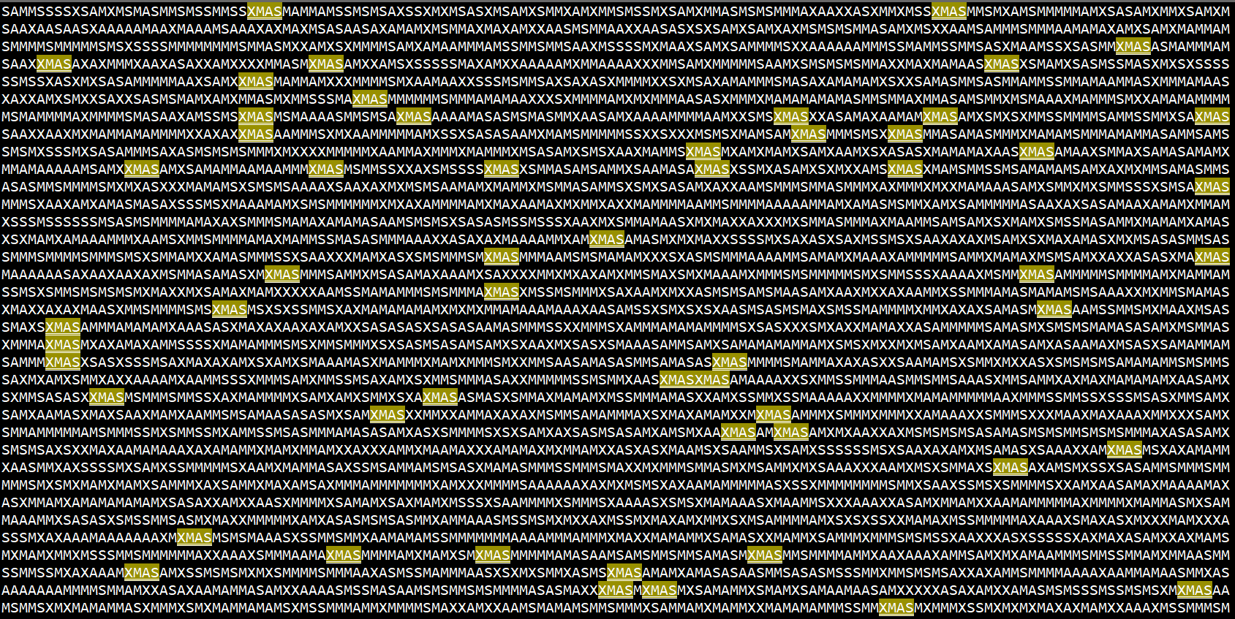

Slide 7
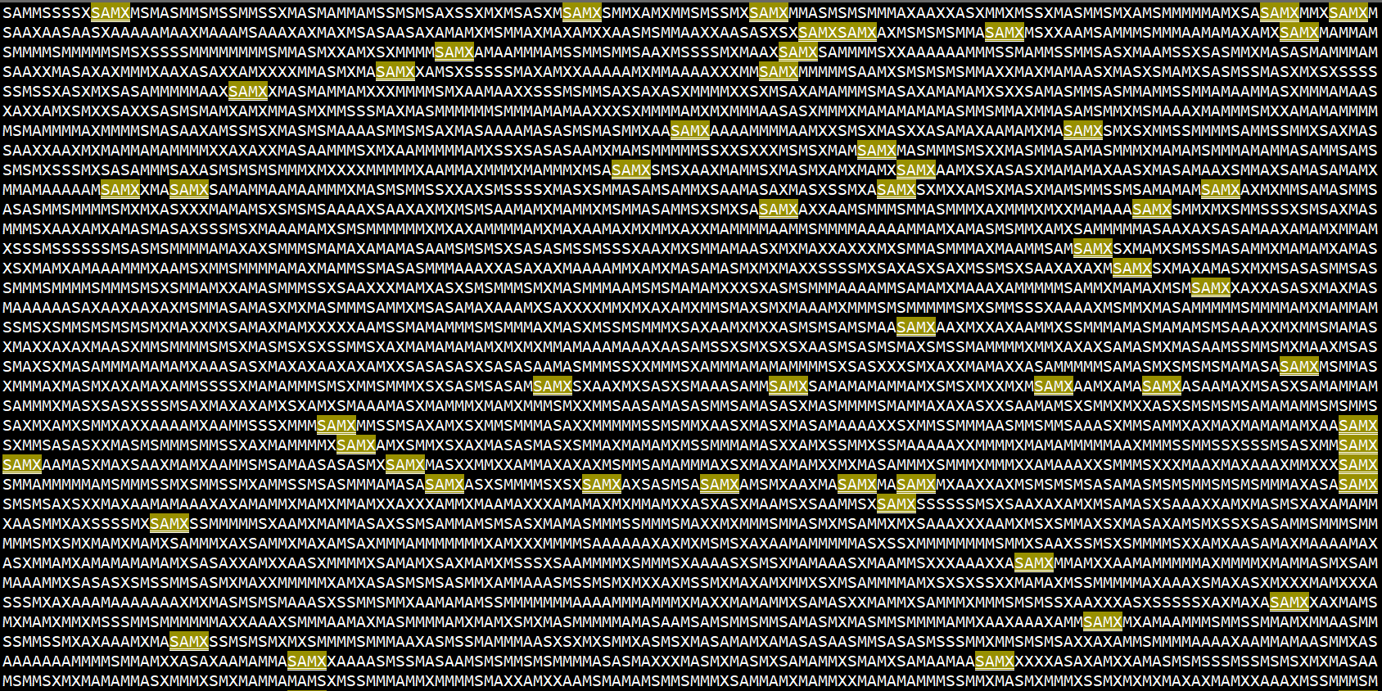

Slide 8
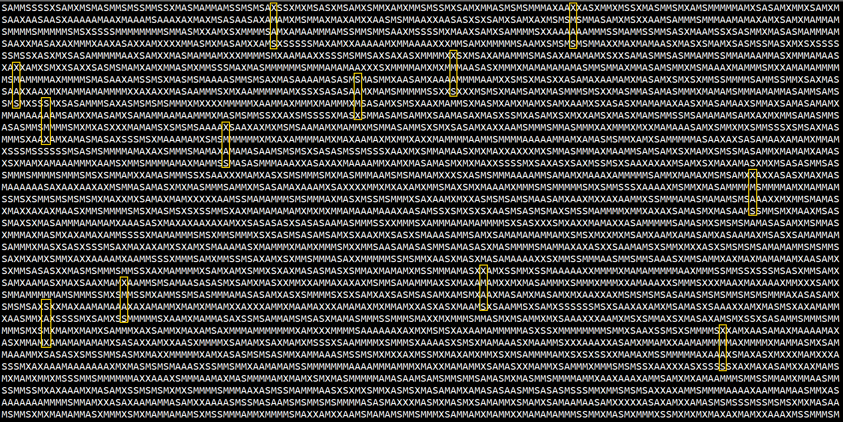

Slide 9
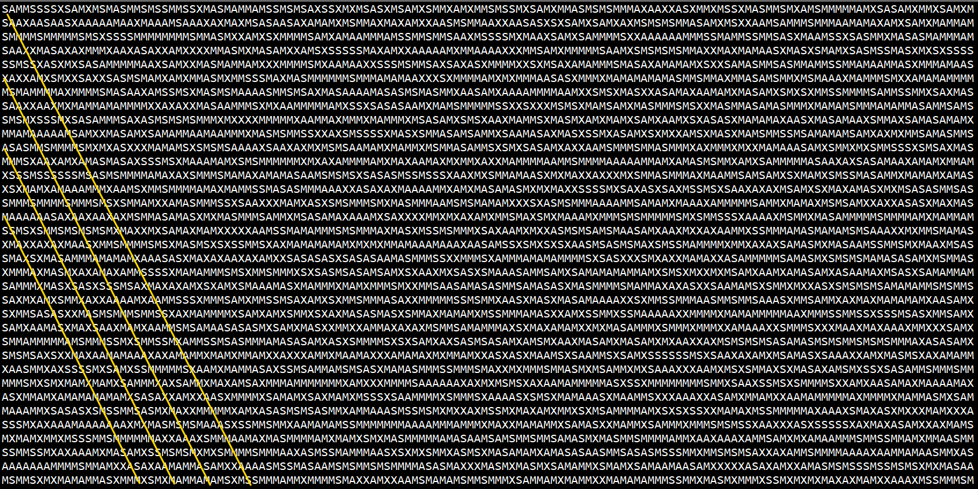

Slide 10
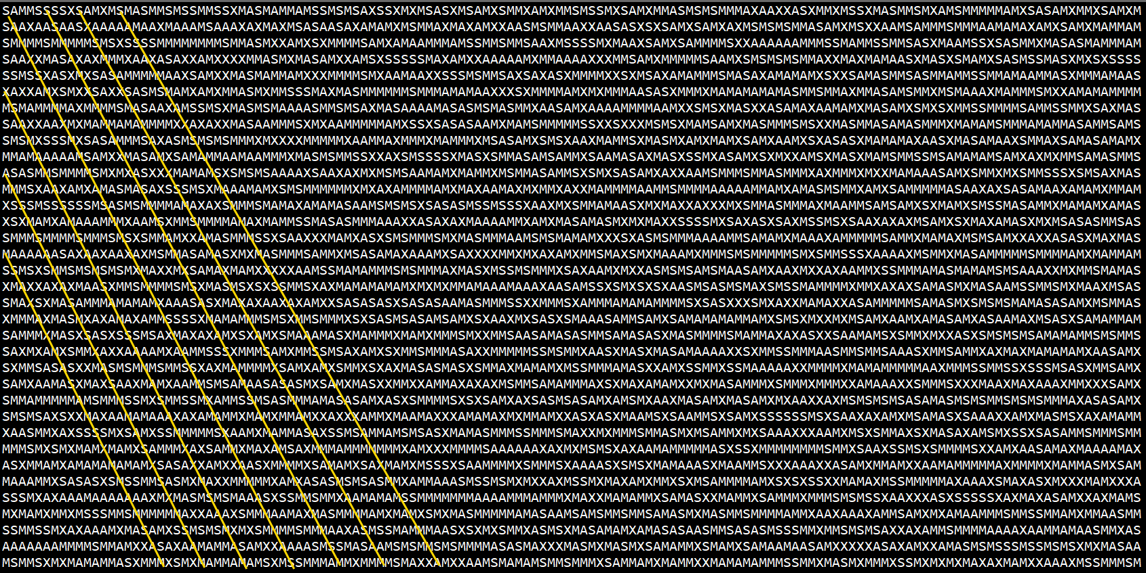

Slide 11
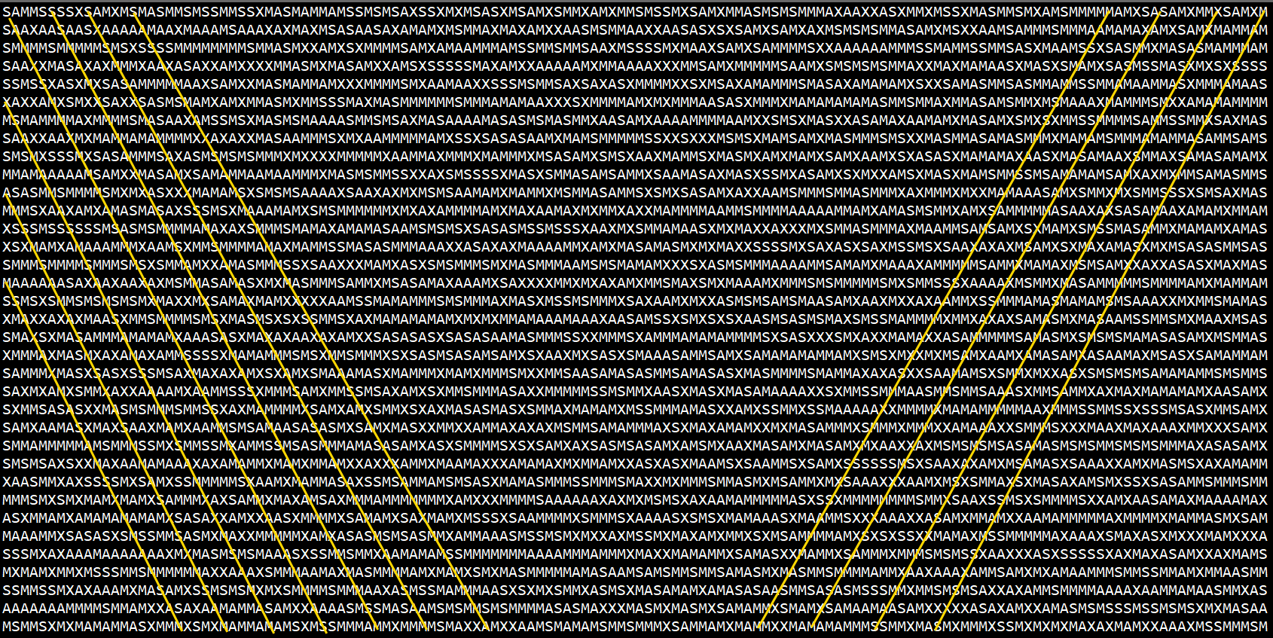

Slide 12
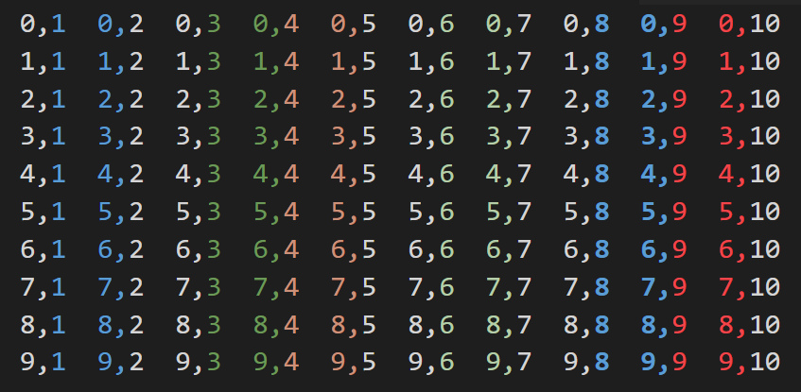

Slide 13
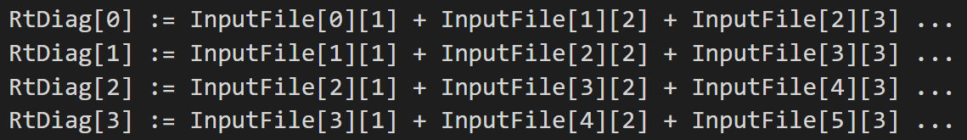

Slide 15
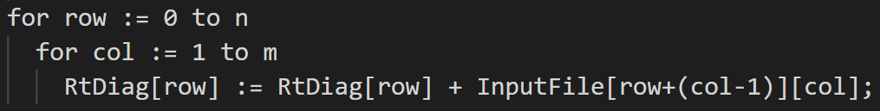

Slide 16
140 Wide
140 Wide
140 High
138 Wide
136 Wide

Slide 17
Finally found them all! YAY!
but wait…

Slide 18
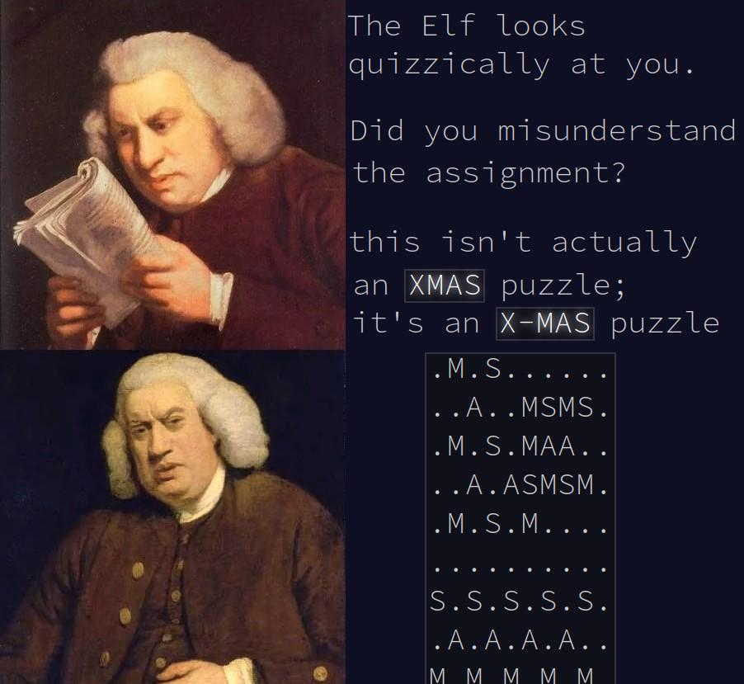

Slide 19
