Slide 1
Automate your software builds with FinalBuilder
http://www.finalbuilder.com
Presented by:
Notes:
Introduce yourself ☺

Slide 2
Agenda
The problems with no automated build process
What is an automated build process
Why use an automated build process
Introducing FinalBuilder
FinalBuilder overview and concepts
FinalBuilder capabilities
An example build process
Conclusion
Notes:
A quick overview of what will be covered by the presentation

Slide 3
No automated build process?
Typically rely on a single person to do the build
Inconsistent build
Takes a long time
Boring
High potential of human error
No record/log of the build process
Notes:
Explain the PAIN people have with a manual build process
Inconsistent build – eg. forgot to rebuild module 59
Takes a long time – some build processes can take days to do manually
Boring – very boring task for the person who has to do everything manually. Open up the Compiler IDE, open the project, check that all the settings are correct, compile, repeat.
No Record – most programs output a lot of messages during their operation. Maybe the compiler output is important to diagnose a problem down the track?

Slide 4
Semi-automated build process?
BAT files, PERL scripts, checklist, etc?
Generally still rely on one person
Little or no error handling
Hard to develop and maintain
Very time consuming to develop and maintain
Notes:
Semi-automated build processes also cause a lot of PAIN – but at least it’s a step in the right direction.
A lot of people have semi automatic build processes. FinalBuilder was developed because a DOS BATCH file was being used at a company which was extremely complicated and hard to maintain – and only one person knew how to fix it if it broke.

Slide 5
What is automated build software?
A tool to help manage and run a set of tasks
Provides integration with your Compilers, Version Control System and other 3rd Party tools you use
Handles build errors automatically
Records build history and logs
Easy to use and maintain
Allows anyone to start a build (or automatically)
Notify developers, testers, management of new build

Slide 6
Why Automate your build process?
Save time
Consistent, reliable and repeatable build process
Build more often
  Find integration issues sooner
  QA gets frequent builds to test with, so you get quick feedback
  Build and deployment issues are found and fixed sooner
Anyone can run the build
Reduce human errors
Scheduled build process
Notes:
Save time – automated builds are quicker than doing a build manually. It’s typical to save hours every time a build is done.
Consistent – the build is executed in the same way every time. If the build was done manually, then it’s harder to be consistent.
Reliable – once the build is set up, you can click Run and you know that when the build finishes it was done right.
Repeatable – If you have to build an old version of your code, then you can set your build process up to do just that… fully automatically. Or you can fix a bug and release a new perfect build very quickly
Build more often – if the build process is automatic, then it’s easier to build more often. Building more often means that you find integration issues sooner and quicker testing turnaround time.
Anyone can run the build – don’t need to rely on a single person who knows how to start the build process
Reduce human error – once the build process is set up and reliable, then there’s little that can go wrong because there is no human intervention required
Scheduled – Daily builds, overnight builds, weekly builds – it’s very good to have regular builds

Slide 7
Introducing FinalBuilder
Commercial tool, from $379 US
Website: http://www.finalbuilder.com
Developed by VSoft Technologies in Australia
Currently version 3.1 (released 15 April 2005)
Newsgroups at news://news.finalbuilder.com
Fully functional 30 day trial available for download on the website
Notes:
FinalBuilder is an established product, Version 1 was released in 2000

Slide 8
FinalBuilder Overview
Windows GUI and Command Line tool
Requires W2K, WinXP or WinServer2003
Visual development of the build process
Flow control and error handling
Hierarchical logging
Scheduled builds
Includes ActionStudio to develop plugins
Notes:
Just a brief overview of the product.
The next slides go into a lot more detail.

Slide 9
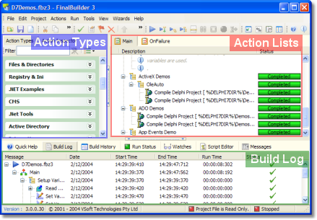
The FinalBuilder GUI
Notes:
Action Types – this is where the available actions are. You can use the filter to quickly find the action you are looking for
Action Lists – this is where your build process is defined.
Build Log – when the build is running, the build log shows the live status of the build process as well as the output from the actions as they execute.

Slide 10
FinalBuilder concepts - Actions
Action is a single task or step
Action Lists - collection of actions
Main Action list – where the build starts
OnFailure Action List – will execute if there is an unhandled error (global error handler)
Actions can be organised in a hierarchy (any action can have child actions)
Notes:
Action – represents a single task or step of the build process, eg. Compile something, Copy a file, Email a person, etc.
Action Lists – “Main” and “OnFailure” are always part of your build process. You can add other action lists and call out to them like a sub-procedure
Hierarchy – This is good to group similar actions under a parent. Disabling or skipping the parent means the children also won’t run. Hierarchy is also used to structure the flow control actions – as will be seen later.

Slide 11
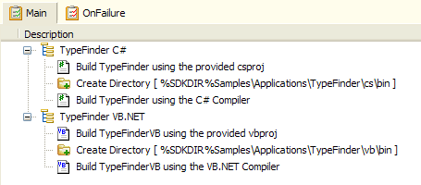
FinalBuilder concepts - Actions
Main Action List
OnFailure Action List
Actions
Notes:
Screen shot of the Main Action list with some actions
They have been arranged in a hierarchy so that they are grouped together (C# group and VB.Net group)

Slide 12
FinalBuilder concepts - Variables
Define user or project variables
Evaluated at start of build, or whenever the variable is referenced (Macro)
Can be set by an action or in script
Can be used in script or in any field of an action
Notes:
Variables are very powerful and can make the build process dynamic
Eg. you can use a “BuildNumber” variable, increment it at the start of your build process, and then apply it to all the different modules.

Slide 13
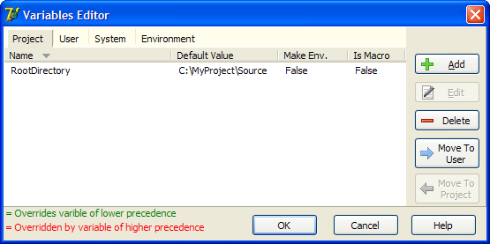
FinalBuilder concepts - Variables
Define a variable in the Variables Editor (Tools Menu)
Notes:
This shows how you would define a FinalBuilder variable.
Notice that there are 4 tabs:
Project – variables specific to the current build project
User – variables specific to the logged on user
System – special system variables created and maintained by FinalBuilder
Environment – Windows environment variables are available throughout the build process
The precedence of variables is Project (Highest) – User – System – Environment (lowest)
So, if you have a Project variable with the same name as an environment variable, then the value of the project variable will be used.

Slide 14
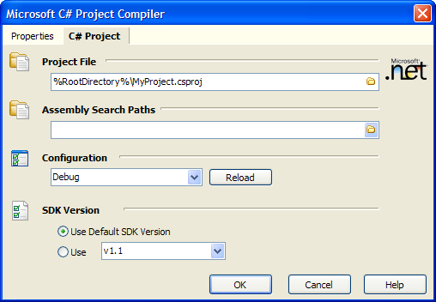
FinalBuilder concepts - Variables
Now you can use the variable in any action
Notes:
This shows how you can use variables in an action.
The variable has to be enclosed by “%”

Slide 15
Uses for FinalBuilder Variables
Use common paths
Synchronise version numbers
Decide to execute an action based on the value of a variable
Pass lists of files or action output to different actions
etc.
Notes:
Remember – fields containing variables are evaluated where ever they are used.
There are huge uses for variables – as you start to develop your build process you will find how useful they are.

Slide 16
FinalBuilder concepts – Script Events
Every action has the following events:
  BeforeAction (called before action runs)
  AfterAction (called after action runs)
  OnStatusMessage (called for every message output to the log during the action execution)
Some actions have other script events
You can write VBScript or JScript to do anything you want to in the script events
The editor includes automatic completion and parameter hints (like Microsoft’s “IntelliSense”)

Slide 17
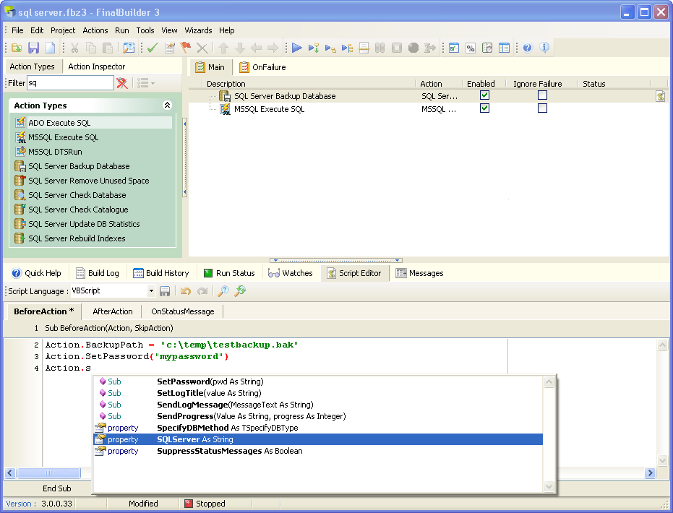
FinalBuilder Script Example

Slide 18
FinalBuilder concepts – Error handling and Flow control
Error handling
  Try, Catch, Finally actions
  Raise Exception action
  If Previous Action Failed action
Flow control
  If … Then, Else actions
  Switch, Case, Else actions
  While action
  Iterator actions (eg. File iterator, List iterator, INI Iterator)
Notes:
The main point of all these is that there is strong built-in flow control and error handling. Maybe at the end of the presentation you can open up some of the flow control demos in FinalBuilder\Examples\FlowControl to show these in action.

Slide 19
FinalBuilder concepts – creating a build process and running it
File menu, new project
Place actions in your Main action list from the “Action Types” list of available actions
Set the properties for the action
Run menu, Run!
Notes:
For this you can use the “BasicBuild.fbz3” as a very simple example. It doesn’t require you have any other tool installed, and should be easy to create during the presentation in about 3 minutes.
Obviously a real build process would compile code, copy files around, create installations, etc. This example is trying to show how easy it is to create a build process and run it.

Slide 20
FinalBuilder concepts – build log, and build history
All build steps are logged
All output from each action is logged (eg. compiler messages)
The action status and run times are logged
The log is hierarchical – in the same structure as the build, easy to find things
History of past builds are recorded

Slide 21
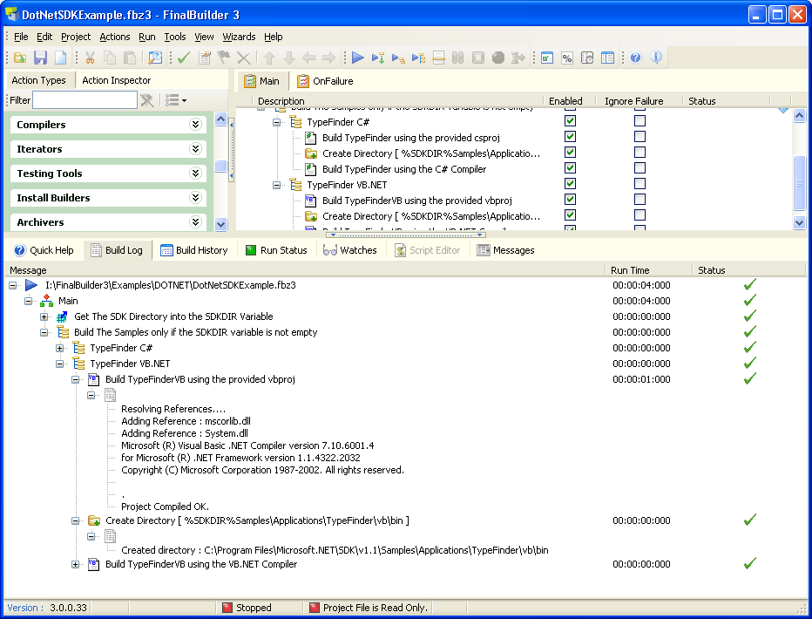
FinalBuilder concepts – build log
Notes:
Notice the structure and output of the compiler

Slide 22
Version control systems supported by FinalBuilder
SourceGear Vault
CVS
SubVersion
Perforce
Seapine Surround SCM
Microsoft Visual SourceSafe
QSC TeamCoherence
Quma Software QVCS
Borland StarTeam
ComponentSoftware RCS (by Martin Rothschink)
Notes:
ComponentSoftware RCS written by Martin Rothschink and donated to FinalBuilder community with source
FreeVCS/JediVCS currently in development by a FinalBuilder customer

Slide 23
Compilers supported by FinalBuilder
Microsoft C# Compiler
MS C# Project Compiler
MS VB.Net Compiler
MS VB.Net Project Compiler
MS J# Compiler
MS J# Project Compiler
VisualBasic Compiler
VisualStudio 6 Compiler
VS.Net Solution Compiler
Borland Delphi Win32
Borland Delphi .Net
Borland C++ Builder
Borland C# Compiler
Chrome (Pascal for .Net)
Java Compiler (Borland, Symantec, Sun, Jikes)
IncrediBuild
Resource Compiler
Notes:
Keep up to date with the latest compilers (eg. VisualStudio 2005 beta 2)

Slide 24
Install builders supported by FinalBuilder
InstallShield (Pro, Developer, Universal, etc)
WISE
Nullsoft NSIS
InstallAware
Install Anywhere (Enterprise and .Net)
InnoSetup
GP-Install

Slide 25
Other 3rd party tools supported by FinalBuilder
Doc-O-Matic
Help & Manual
NDoc
XCopy
RoboCopy
BeyondCompare
CityDesk
FxCop
Dotfuscator
Demeanor
TestComplete
AQTest
NUnit
SQL Server
MSBuild
Ant
NAnt
XenoCode
.Net Tools, eg. SN, GACUtil, Regasm, etc.
Notes:
SQL Server – execute sql (MSSQL or ADO), execute stored procedure, Run DTS package, Backup Database, Check Database, Update Indexes, etc.
And many more.

Slide 26
Other built in actions
CD/DVD Burning
Copy File(s)
Move File(s)
Delete File(s)
Create Directories
Delete Directory
Set File Attributes
Read from Ini File
Write To Ini File
Send SMTP Email
FTP Client
Create Zip Files
Execute Program
Run DOS command
Set Variable
Create File
Replace Text in file
etc, etc, etc

Slide 27
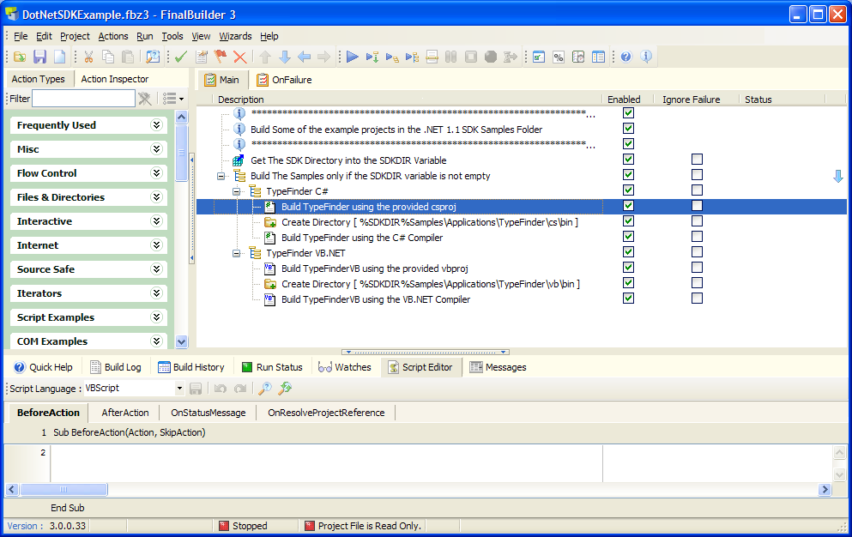
An example build process
Notes:
Best to open some of example projects in the FinalBuilder\Examples directory. There are examples for VisualStudio, Delphi, flow control, etc.

Slide 28
If FinalBuilder doesn’t support
<insert tool here> - use ActionStudio
ActionStudio is a stand-alone IDE for developing FinalBuilder actions
Included with your FinalBuilder license
Enables actions to be developed with any .Net language, VBScript, JScript and languages capable of creating COM dlls (eg. Delphi, C++)
Notes:
Be good idea to create an action with ActionStudio and run it in FinalBuilder if there is time. Should take around 5 mins.

Slide 29
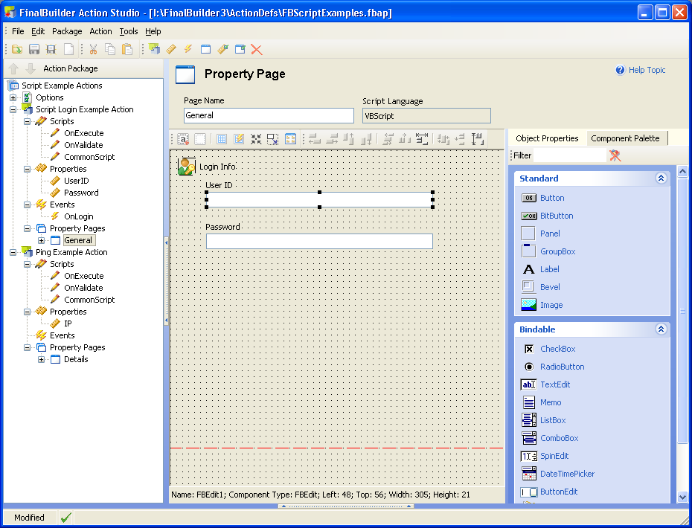
ActionStudio screen pic
Notes:
This shows two actions. Each action contains script, properties, events and property pages.
The current screen shows the Property Page editor

Slide 30
Conclusion
Automating your build process has a lot to offer:
  Repeatable, reliable, consistent builds
  Saves time and money
  Less human errors and no boredom
  Don’t rely on a single person to perform the builds
FinalBuilder is a mature tool with a huge amount of built in functionality
If the tool you’re trying to automate isn’t built into FinalBuilder, then use ActionStudio to create a plugin

Slide 31
References & Further Reading
http://www.finalbuilder.com
Daily builds are your friends - Joel Spolsky http://www.joelonsoftware.com/articles/fog0000000023.html
Improving Software Development - Mike Gunderloy http://mcpmag.com/backissues/columns/article.asp?EditorialsID=514

Slide 32
Questions?

Slide 33
The End.
Thankyou.

