Slide 1
What’s New in RAD Studio 2010
Anders Ohlsson – Developer Relations
Notes:
1

Slide 2
What’s New in Delphi 2010

Slide 3
Agenda
0830 – 0900 Registration
0900 – 0930 Embarcadero and Delphi Update
0930 – 1030 IDE, Debugger and Open Tools API
1030 – 1100 Compiler and Language
1100 – 1130 Coffee Break
1130 – 1215 VCL
1215 – 1230 Database
1230 – 1300 DataSnap
1300 – 1330 Summary and Q&A
Notes:
Install and Deployment
New InstantOn for zero-install deployment
IDE, Debugger and Open Tools API
IDE Insight
Search and Find improvements
Source Code Formatter
Use Unit dialog improvements
Object Inspector with verbs area
Background Compile
Audits & Metrics with no model support
Visualizers in Debugger
Thread Debugging
OpenTools API
Compiler and Language
Custom Attributes
New RTTI
VCL
Gesturing support for VCL controls on all supported platforms, not only Win7
Touch and virtual keyboard
Win7 APIs support
Direct2D (Win7 only)
Theming for TGrid-descendants
Database and Web Services
New DBX driver for Firebird
SOAP 1.2 web service client support
DBX improvements
MIDAS.DLL source code
DataSnap
New HTTP and In-Process Transports
Filters
Callbacks
REST interfaces and JSON support
IIS Hosting
Tunneling

Slide 4

Who is The DSW Group, Ltd?
In Business 20+ years
Embarcadero Technologies Partner
Services
Consulting
Education
Notes:
to increase productivity, openly collaborate and be free to innovate

Slide 5

What DSW Offers?
Training
Taught by experienced developers
Public & On-site (Client location)
Customization available
Discounts available
Consulting
Client location
Remotely
Development
Project Management
Migration
Project Assessments
Code Review
Public Training Classes
Delphi 2010 Application Development for Win32
Delphi 2009 Application Development for Win32
Delphi 2007 Application Development for Win32 & .NET
Delphi 2006 Application Development for Win32
Application Development with Delphi 7 Studio Enterprise
Other Tools
JBuilder
C++ Builder
Delphi for PHP
3rd Rail

Slide 6
Please Contact DSW
www.delphi-training.com
800.356.9644 x105
Jhungerford@thedswgroup.com

Slide 7
Embarcadero Update

Slide 8




















Who Is Embarcadero?
Embarcadero Technologies provides
database professionals and application developers with award-winning, multi-platform tools to design, build, and run their
software applications and database systems
Delphi
JBuilder
InterBase SMP
ER/Studio
DB Optimizer
C++Builder
J Optimizer
Blackfish SQL
EA/Studio
DBArtisan
Delphi Prism
3rdRail
Turbo Ruby
ER Enterprise
Portal
Performance
Center
RAD Studio
Delphi for PHP
Delphi for AS/400
Rapid SQL
Schema Examiner
Change Manager
Notes:
to increase productivity, openly collaborate and be free to innovate

Slide 9

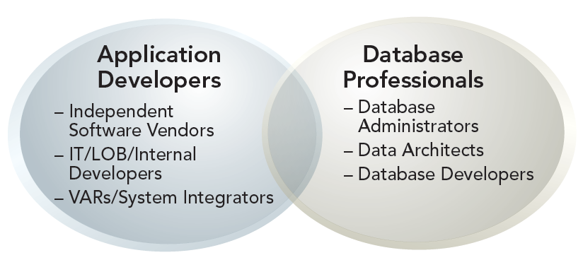
Our Customers
Embarcadero products serve:
IT development, independent software vendors (ISVs), VARs, database professionals, and large enterprise teams
Most demanding vertical industries including Financial Services and Banking, Manufacturing, Life Sciences, and Telecommunications across 29 countries
3.2 million customers worldwide
90 of the Fortune 100
97% of the Global 2000
Notes:
* Embarcadero serves the needs a broad range of software and database professional.
Hard to imagine a vertical industry segment that does not depend on software applications and secure/reliable data flows. Embarcadero products are found just about everywhere including some of the most computing and data intensive verticals such as Healthcare/Pharmaceuticals/BioTech, Energy/Utilities, and Government.
3.2 million people worldwide. Many of them active participants in the Embarcadero professional community.
We meet the needs of large and small enterprise alike – from F100 to small, vertically focused VARs and ISVs.

Slide 10
Industry Challenges
Economy is putting IT & R&D budgets under intense scrutiny
Organizations must get more value for every IT dollar spent and reduce costs where feasible
Consolidation, mergers, layoffs
Technical staff must now deal with more systems, platforms
Team members taking on additional tasks and roles, more blended and multi-roles
Teams must be able to understand and ramp up on others’ work – reverse engineering, visualization
Managing multiple tool licenses per user is time-consuming and complex
Managing numerous vendor relationships is time-consuming and complex
Individual tool purchases are not cost effective for “as needed” usage
Changes to role, project, and project phase often result in a need to re-tool
One can almost never afford the tools needed to assure the desired productivity, quality, traceability & compliance

Slide 11

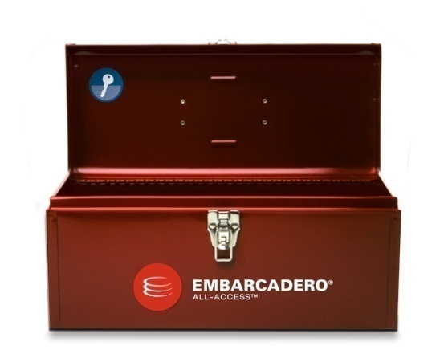
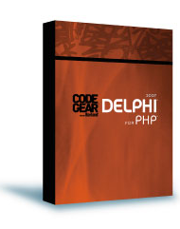
Embarcadero® All-Access™
The Industry’s First On-Demand, Multi-Platform Software Development and Data Tool Chest
All of Embarcadero’s tools in a cost-effective and powerful tool chest. The tools you need to quickly & effectively design, build, and run your software and database applications.
InstantOn deployment reduces costs by eliminating the install step!
All-Access greatly simplifies purchasing and license administration, eliminating the need to procure & budget for standalone products.
From the best tools
…to…
the most cost-effective tool chest.
The deepest, richest, most powerful, and most cost-effective software development and database tools suite in the industry!

Slide 12
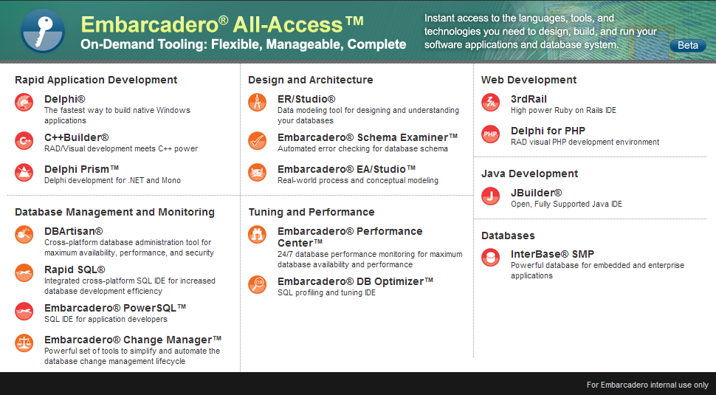


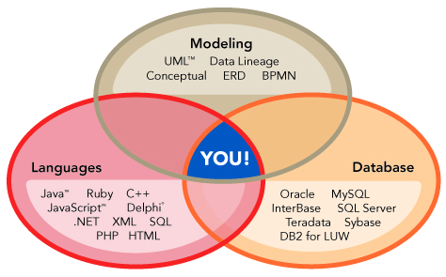
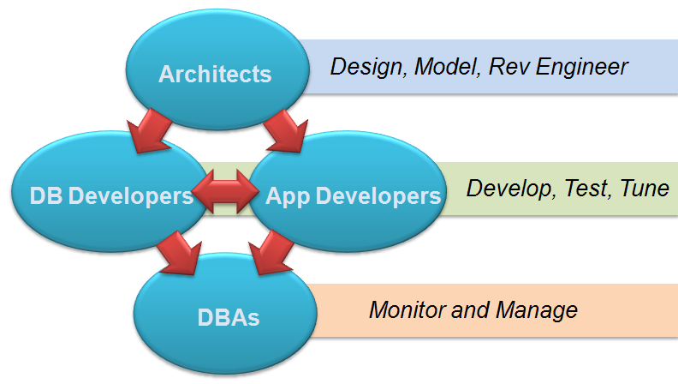
Embarcadero® All-Access™
All Products
One Pass
Unlocks
All Languages
All Roles

Slide 13
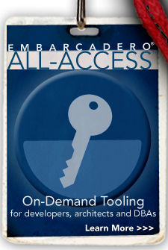
Embarcadero® All-Access™ Pass
All-Access™ Pass is a license key that unlocks all tools in the respective Embarcadero All-Access tier
Four levels: Bronze, Silver, Gold, Platinum
Unlocked products are licensed perpetually – do not expire even if pass is not renewed
All-Access Client and All-Access Server (available with network licensing) provide a single point for accessing & managing your tools
Annually renewable All-Access membership benefits include
Support, maintenance including all product updates and upgrades to any unlocked product
Access to any new products that may be released and added to All-Access tiers
Replay Versioning – Rewind and Fast Forward to any unlocked version
InstantOn™ deployment option: click and run products instantly, on-demand (without install)
Ultra-flexible licensing options
Workstation, Network Named (New!), Network Concurrent
Provides easy-to-manage and administer licensing scenarios

Slide 14
Tooling On-Demand with InstantOn™
Embarcadero ® InstantOn™ allows click-n-run access to Embarcadero® All-Access™ products
Launch and run instantly with zero install
Choice to run locally or from an All-Access™ Server
InstantOn available for some products today*. Other products now in beta.
*Includes DBArtisan, Rapid SQL, ER/Studio, Change Manager, DB Optimizer, and more…
On-Demand tooling smashes many productivity barriers:
Awareness - Find the right tool quickly and easily, it’s “in the toolbox!”
Acquisition - Avoid tool research and acquisition hassles every time another tool is needed
Installation - No lengthy installs & upgrades required
Locked-Down-Desktop. Zero impact to registry, system files, etc.

Slide 15


Delphi

Slide 16
Delphi Update

Slide 17
Delphi is important to Embarcadero
Large, loyal customer base >1.5m developers worldwide
Our keys to success – Native, RAD, GUI, Database
Our Mission: Delphi Everywhere
RAD Studio 2010 shipping now!
We’re investing in Delphi’s future – your future!
Project X, Project Chromium, Project Commodore
Key Initiatives: Natural Input, Cross-Platform, 64bit, User Experience, Delphi Language Advancement, Documentation
The next version of the All-Access client is built with Delphi
Notes:
Explain the two big investments we are making in Delphi (Touch and Delphi X) and why they are of critical importance. The elephant in the room is Visual Studio and we must take it head on and let them know these investments will ensure Delphi has a reason to coexist side by side with Visual Studio in companies of all sizes

Slide 18
Migrating projects: 6 things you should know
Moving projects from previous versions
Project files converted – MS Build
Code reuse
Win32 – good to go (mostly)
ASP.NET – some assembly required
Updating UI(s)
VCL enhancements and new components
Ribbon Controls
Database
dbExpress 4
BDE to dbExpress
Midas RDM to DataSnap 2009
Components
http://edn.embarcadero.com/article/38459
Unicode
String = UnicodeString
AnsiString and AnsiString(codepage)
string[<1-255>] = AnsiChar elements
Char = WideChar = UTF16 character
PChar = PWideChar
<Char> in <set of AnsiChar>
Notes:
RemObjects – Channel, Message type

Slide 19
Native Delphi Everywhere
More native platforms
Makes you and your software more competitive
Increasing your value and the value of your software
RAD/Visual/Native Code/Components for multiple platforms
Windows – 32bit, 64bit, .NET, XP, Vista, and Win7
Mac OSX
Linux
Other platforms in the future:
Mobile, Rich Internet Applications, Cloud Computing, …
Notes:
Touch is not just Windows 7 – it’s appearing everywhere.
We are a multi-platform company!!!
Elephants in the Room – Eclipse and Visual Studio

Slide 20
Focus for the Future
High performance, Rich GUI Windows applications
Client/Server application development
Database application development
RESTful and SOAP web services
Simple multi-tier development
Exposure of data anywhere and any type
Web application development
Exploitation of hardware advances

Slide 21

Project Delphi “X”
Cross-platform Windows, MacOS, and Linux.
emphasis on creating GUI applications with dbExpress and DataSnapX connectivity.
Other features under consideration for Delphi “X” include:
Cross-platform component library
Limited backward compatibility
DataSnapX the ability to create both Server and Clients on Windows, Mac, Linux, and Web

Slide 22

Project “Commodore”
Commodore project is bringing 64-bit native development to Delphi, C++Builder, and the VCL.
Features under consideration for Commodore:
Full compiler, RTL, and VCL support for 64-bit native compilation
An option in the IDE to compile an application either as a 32-bit or a 64-bit application
Multi-core/Multi-threaded applications
Support for parallelization in the RTL

Slide 23
Delphi 2010 What’s New in the IDE

Slide 24
Usability improvements
IDEInsight™ – keyboard access to everything (F6)
Code Formatter for Delphi and C++ source files
Background compilation for Delphi and C++ projects
Enhanced searching in the code editor („Find”, „Find in Files”)
New „File>Reopen>Properties” dialog for managing „Reopen” list
Improved „Use Unit” dialog
Filtering to search for gallery items in „File>New>Other”
Better XML Data Binding wizard handling of schema "include" elements
Refactoring support for generic code syntax:
Rename refactoring on a generic type symbol
Change Parameters refactoring on a generic procedure
Extract Method refactoring within the body of method of a generic class
Notes:
C++ Class Explorer: The "View|C++ Class Explorer" menu item now displays the types of the active C++ project and allows you to add a field/method/property to classes declared in managed modules
In C++Builder, pressing Esc will abort a code completion
• In C++ files, Code Completion is auto-invoked after typing the scope operator (::). • For C++, the syntax highlighter supports preprocessed (.i) files.
• Live Templates include new “Raise” and “Throw” templates. • Code Completion has support for Delphi keywords. • There is an option to display the Tool Palette in the main form as a toolbar
• A 'Sort' menu has been added to the projects' local menu in the Project Manager which you can choose to sort Alphabetically, by File Modification Date, or by Type (extension). These sorting orders will be maintained automatically by the IDE based on the project's "Auto Sort" state which is another menu item available in the project's local menu. If you turn off Auto Sort, the project entries will only be sorted 'on demand' when the user selects one of the sort types; Auto Sort will also be turned off if you use drag & drop to reorder the files in the project manager, as it is assumed if you rearrange files this way you do not want any sorting done. The sort settings order will be maintained in the project's .local file, and applied whenever the project is reloaded. • The Environment Options dialog is resizable. • The project manager now has an Uninstall context menu item when a package is loaded. • Compile All and Build All context menu items are available when you select the Project Group node in the Project Manager.

Slide 25
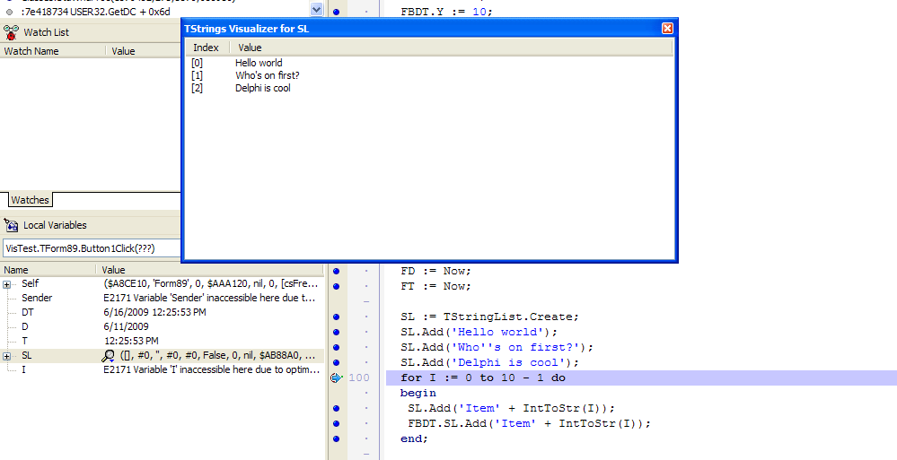
Debugger
New data visualizers in the debugger
Open Tools API support for custom visualizer for data types
Stepping and debugging within selected threads
Selectively „Freeze" and „Thaw" threads
You can set a breakpoint for a selected thread
Notes:
• Custom data viewers/data visualizers in the debugger now provide a way to view data other than using the standard output from the evaluators to make debugging programs much easier. The Open Tools API supports the development of custom visualizers for data types. Sample visualizers for several data types are in Weaver, including the TDateTimes, TDates, and TTimes types and the std::string and std::wstring instances for C++. Please see the posting in the .debugger newsgroup for more information on Debugger Visualizers. • The debugger now allows for stepping and debugging within selected threads. You can selectively "freeze" and "thaw" threads so that debugging activity can be isolated to a particular thread or threads. When a thread is frozen, it will not actually run and no debug events will occur in the context of that thread. You can access this functionality in the Thread Status view by using one of the four new context menu items: "Freeze", "Freeze All Other Threads", "Thaw" and "Thaw All Threads". • You can set a breakpoint for a selected thread. The following breakpoint dialogs have a new field "Thread" that can be set: -- Add Source Breakpoint -- Source Breakpoint Properties -- Add Address Breakpoint -- Address Breakpoint Properties -- Add Data Breakpoint -- Data Breakpoint Properties The Breakpoint List view has a new column "Thread" that will show the Thread condition for each breakpoint. The hints that show up when you hover over a glyph in the Editor gutter will also now show the Breakpoint condition. When setting a thread condition, you can use a thread ID or the thread's name (if it is a named thread).

Slide 26
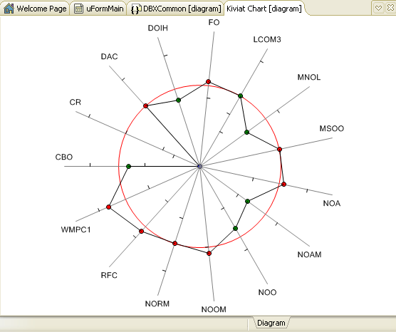
Modeling
New look and feel for modeling diagrams, including gradient filling and ability to create links between elements
Audits and Metrics can be used without turning on modeling
Performance improvements for C++ modeling
Diagram Editor improvements:
use the '+' control at the end of compartment name area to add corresponding member for classifiers
collapse/expand all compartments of selected element
show elements without compartments
Notes:
Limited set of Audits and Metrics now available in Professional version

Slide 27
Demo: Usability
New (or Old) Component Palette
IDE Insight
Search | Find Improvements
Reopen Menu Properties
Use Unit Dialog
Object Inspector Improvements (checkboxes and verbs area)
Component Editors on context menu (TClientDataSet)
TDateTimePicker
Code Formatter
Generic Types Refactoring
QA Metrics and QA Auditis without Model support
Visualizers in Debugger
Thread Debugging

Slide 28
Tools API
Code Folding
Version Control additions to IOTAProject
New editor tabs and dockable views
IOTAThread EnnhancementsSupport has been added to IOTAThread for
Support has been added to IOTADebuggerServices for
Accessing Module Load breakpoint,
Removing a breakpoint
Registering/unregistering visualizers
Support in IOTAServices for getting the IDE's preferred UI language
IDE Insight. See INTAIDEInsightItem, IOTAIDEInsightCategory, IOTAIDEInsightNotifier, and IOTAIDEInsightServices
Compiler Services: See IOTACompileNotifier and IOTACompileServices
Project Manager Local Menu Support
Notes:
1) Code folding API is enhanced. See IOTAElideActions. The number of "code folding" actions you can perform using the ToolsAPI has been increased to more closely match the actions accessible via the code editor's local menu items "Fold" and "Unfold"
2) Version Control additions to IOTAProject. See also new interfaces IOTAVersionControlNotifier and IOTAVersionControlServices
3) Support has been added to IOTABreakpoint for Thread conditions
4) Support has been added to IOTAThread for a) Thread Freeze/Thaw b) accessing a thread's name, and c) using the debugger evaluator to determine if a particular class descends from another class
5) Debugger visualizer support in IOTADebuggerVisualizer, IOTADebuggerVisualizerValueReplacer, IOTADebuggerVisualizerExternalViewer
6) Support has been added to IOTADebuggerServices for a) accessing Module Load breakpoint, b) removing a breakpoint, and registering/unregistering visualizers
7) Support has been added for creating/showing a dockable view in the IDE. See INTACustomDockableForm, and enhancements to INTAServices.
8) Support has been added to IOTAServices for getting the IDE's preferred UI language.
9) Support for creating/showing new editor tabs. This includes support for creating top-level editor tabs as well as adding additional bottom-level editor tabs. See INTAEditorServices, INTACustomEditorView, INTACustomEditorViewState, INTACustomEditorViewStatusPanel, INTACustomEditorSubView and IOTAEditorViewServices
10) IDE Insight. See INTAIDEInsightItem, IOTAIDEInsightCategory, IOTAIDEInsightNotifier, and IOTAIDEInsightServices
11) Compiler Services: See IOTACompileNotifier and IOTACompileServices
12) Project Manager Local Menu Support. See IOTAProjectMenuItemCreatorNotifier, IOTAProjectManager, IOTAMenuContext, IOTALocalMenu,

Slide 29
Demo: Open Tools API
Embedding top level tabs in the IDE
Adding new editor tabs

Slide 30
Compiler and Language

Slide 31
Delphi Compiler
New RTTI
Custom Attributes
Casting Interface References to Objects
Class Destructors
Notes:
Custom Attributes with syntax from Delphi for .NET
The „as” operator can be used to cast an interface reference back to the object from which it was obtained. This casting only works for interfaces obtained from Delphi objects. The as operator returns a nil object if the interface was not extracted from the given class. To avoid potential nil references, use the is operator to verify whether the interface reference was extracted from a given class.
Class destructors used here: http://blogs.embarcadero.com/abauer/2009/05/29/38888

Slide 32
RTL
The TThread class in the Delphi RTL has a new static (class) method to facilitate naming threads
RTL now uses the operating system’s UILocale property to determine which localized resources to use
RTL now uses language names (e.g. fr-FR) for the extension of localized resource DLLs

Slide 33
RTTI
Roughly isomorphic with .NET / Java reflection
New unit: RTTI.pas
Object-oriented API
for aType in package.GetTypes
for aMethod in aType.GetMethods
if aMethod.HasAttribute then (...)
Notes:
“Roughly isomorphic with .NET / Java reflection” - Barry Kelly on DelphiLive! Conference, May 2009

Slide 34
Object pooling: TRttiContext
Object Pooling: TRttiContext
Most objects are not needed for long
Manual lifetime management would be tedious
Lots of cycles – interfaces not great
Interfaces also lack version flexibility
Object pool strategy
Queries are rooted from a TRttiContext object
The context:
Maps underlying RTTI handles to instances
Frees instances when destroyed

Slide 35
RTTI Descriptors
RTTI objects live in a graph
TRttiMethod has declaring type and parameters
TRttiParameter has parameter type and owner
Cycles
Descriptor <=> RTTI object instance
Descriptor not bound to a context
Migration of instance from one context to another
Caching only interesting RTTI instances for later

Slide 36
Attributes
Same syntax as Delphi for .NET
All attributes descend from TCustomAttribute
Only simple types allowed in constructors
Ordinal types – integers, characters, enums
Strings
Type references
RTTI objects have GetAttributes method
Attributes are owned by the RTTI object, and therefore implicitly part of the context

Slide 37
Method Invocation
TRttiMethod.Invoke
Invoke instance, class and class static methods
TRttiConstructor.Invoke
Dynamically construct instances without needing virtual constructors and metaclasses
Required for general custom attribute support
How to handle argument values?
ObjAuto uses Variant – has limitations

Slide 38
TValue – a simple top type
Is a tuple of raw value data and type info
Does not support operators, methods, etc.
Not a replacement for Variant
Conversions in:
Has implicit conversions where possible
Has explicit generic conversion for other types
Conversions out:
Runtime typed with explicit type (generic)
Untyped access to underlying bytes

Slide 39
C++ Compiler
FastMM is now standard heap manager for C++ runtime libraries
Support for #pragma once
-Zx option for generating XML representation of source code
Added support for _FUNCTION_
Support for [[deprecated]] attribute
__declspec(dllimport) and __declspec(dllexport) for template classes
Notes:
Support for [[deprecated]] attribute. The C++ compiler emits a diagnostic when this attribute is set. The Delphi compiler emits this attribute in .hpp files when compiling .pas files with deprecated methods. • __declspec(dllimport) and __declspec(dllexport) have been implemented for template classes. The dllimport modifier prevents inline template functions from being instantiated (either inline or out-of-line). The dllexport modifier causes the entire class, including inline functions, to be instantiated and exported. • The C++ runtime libraries now contain a version of FastMM as the standard heap manager.
• -Zx option will generate XML representation of source code. • Support for #pragma once. This support improves compatibility with MSVC. #pragma once acts as a header guard, preventing the compiler from looking at the same header file more than once. • Support for _FUNCTION_ has been added. This will provide additional information for debugging runtime failures.

Slide 40
Demo: Compiler and RTTI
Custom attributes syntax
Using TRttiContext to retrieve type information
RTTI Class Browser
Dynamic Method Invocation with new RTTI
Casting Interface references to objects

Slide 41
Coffee Break

Slide 42
VCL

Slide 43

Delphi Natural Input
Notes:
Tricorder from StarTrek – the iPhone ancestor

Slide 44

Delphi Natural Input

Slide 45

Delphi Natural Input

Slide 46

Delphi Natural Input
Notes:
„Minority Report” video snippet

Slide 47
Delphi Natural Input
From fiction to reality:
Star Trek
Minority Report
007 Quantum of Solace
Natural Input hardware will become PC standard
Touch Screens, Accelerometers, Gyros, GPS’s, Cameras, Microphones
Natural Input will rapidly increase in use and capability
Touch
Vision
Motion
Speech
Location

Slide 48

Delphi Natural Input
Notes:
„James Bond: Quantum of Solace” video snippet

Slide 49
Why Touch
It's cool!
The hardware is here and more is being built
Touch is perceived as the next evolution of computing
New form factors are being created
New paradigm for easy to use computers
The evolution of the computer is becoming multi-user
Touch is more fun and intuitive to use
Only limited by your imagination

Slide 50
Designing for Touch
New platforms bring new challenges
Some challenges can be solved with existing paradigms
Know the problem you are solving
Cutting edge Interactive Design
Human Computer Interaction
Multi-user
Try to make complicated things simpler
Leverage how people interact with objects in the real world
Use Natural User Interfaces
Aesthetically pleasing are assumed to be more usable

Slide 51
Kinds of Touch
Basic Touch
Finger replaces the left mouse button
Big buttons, wizard style applications
Examples: Kiosk, Post Office, ATM, Self Checkout
Multi-Touch
Extremely interactive touch with application elements
Examples: Minority Report, iPhone
Only supported on Windows 7 and the latest hardware
Gestures
Perform a finger or mouse movement and an event is fired
Can be intuitive, allows for customizability, more input, supported on nearly all touch systems

Slide 52
Basic Touch
Available on all versions of Windows
Use the touch screen as a mouse
Use the mouse as a raw data collector
Big buttons
Whitespace between buttons
Make it intuitive where to press
Give it a nice look

Slide 53
Multi-Touch
Only Windows 7 supports interactive Touch
Multi-touch with WM_GESTURE message providing panning, zooming, rotating
Raw touch data using the WM_TOUCH, then use manipulators and Inertia Processors (Translate, Scale, Rotate) or your own processing

Slide 54
Gestures
Available on Windows XP Tablet, Vista and Windows 7
Real-time stylus
Inking
Supports gestures
Real-time stylus can be used as a raw data collector

Slide 55
Building a Custom Gesture Engine
There are two kinds of gesture engines
Line Matching
Spline Interpolation or Piecewise Linear Regression
Slow but accurate
Requires the gesture to be defined as an equation
Point Matching
Fast and potentially less accurate
Multiple point matching strategies for increased accuracy
Allows the gesture to be defined by a stream of points which can be drawn on the screen by a user

Slide 56
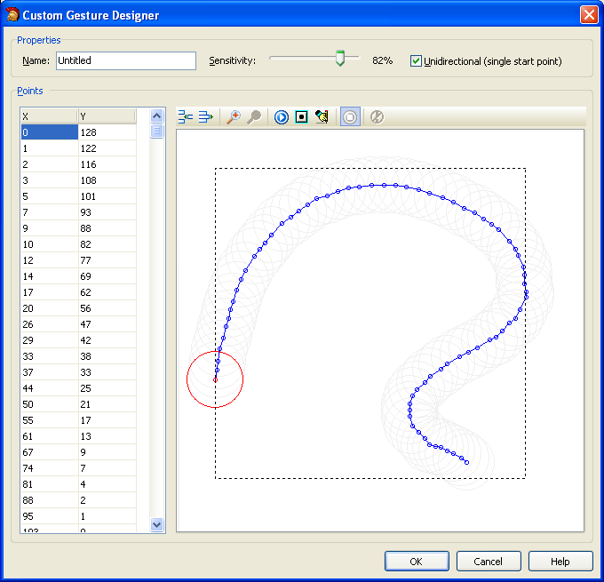
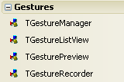
Touch and Gesturing
Pluggable gesture engine architecture
Works on all supported versions of Windows, not only Windows 7
Use touch-enabled hardware or work with what you have (eg, mouse)
30+ standard gestures („TStandardGesture” enumerated type)
Custom Gesture Editor
TTouchKeyboard component and framework for creating virtual keyboards
Notes:
New „Gestures” unit and new types in „Controls” („TStandardGesture” enumerated type)

Slide 57
Demo: Touch and Gesturing
FishFact
Standard Gestures
Custom Gesture Editor
Touch Keyboard (prebuilt)

Slide 58
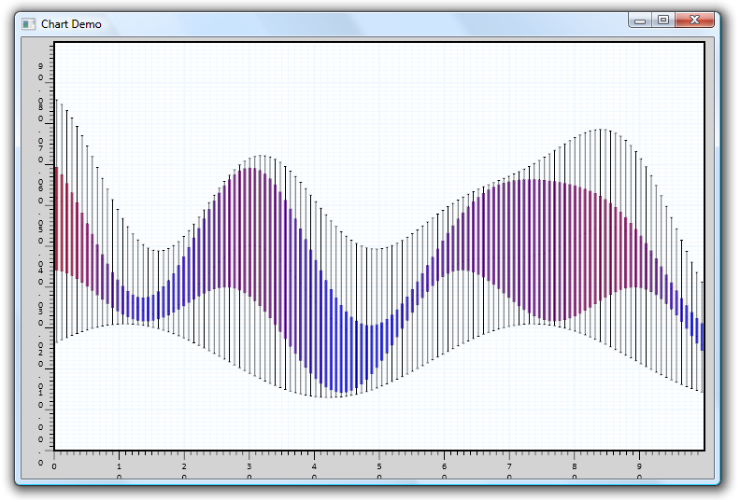
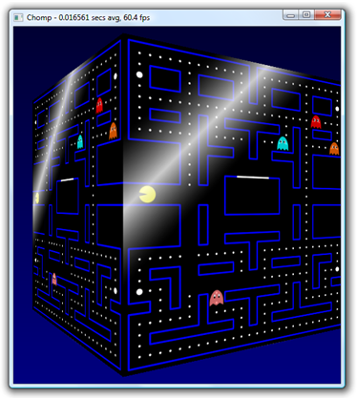
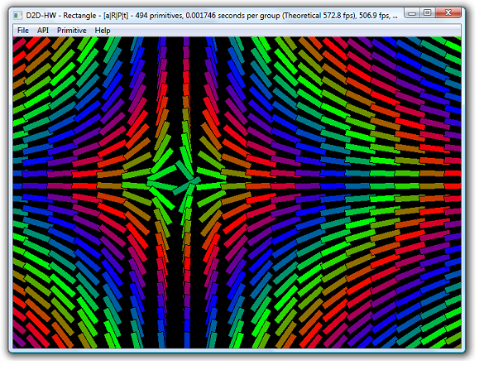
Direct2D and Windows 7 API
TDirect2DCanvas supports Direct2D and DirectWrite (Windows 7 only)
TGraphic wrapper for WIC (TWICGraphic)
TIFF support in TImage
Notes:
Direct2D is new native (!) graphics system in Win7
WIC – Windows Imaging Component
http://blogs.technet.com/thomasolsen/archive/2008/10/29/introducing-the-microsoft-direct2d-api.aspx
You can display TIF/TIFF with TImage.
More information on the Windows Imaging Component can be found here: http://msdn.microsoft.com/en-us/library/ms737408%28VS.85%29.aspx TWICImage is declared in the GRAPHICS.PAS unit, and is compatible down to XP SP3. Wikipedia also has a good summary: http://en.wikipedia.org/wiki/Windows_Imaging_Component

Slide 59
Demo: Direct2D
Image Viewer demo from DelphiLive!
Multitouch Direct2D demo from DelphiLive!

Slide 60
New in VCL
Theming added for the grid components
New I/O utility classes in IOUtils.pas
New custom message CM_INPUTLANGCHANGE added to notify controls when the language is changed
Icons can be assigned to Bitmaps using TIcon.AssignTo
New custom drop down Month Calendar box to choose a Date property from the Object Inspector
New inplace rename functionality in the TCategoryButtons control
TCheckListBox has a new method: CheckAll(cbUnchecked, True, True)
PtInCircle function added to „Types” unit (similar to „PtInRect”)
The TRichEdit control has an ActiveLineNo property which returns the correct location of the cursor
A default Property Editor has been added to the Object Inspector that allows users to use a checkbox to set Boolean properties.
Notes:
... Plus:
A new method, ReadSubSections, has been added to TCustomIniFile to address inconsistencies with the behavior of the existing ReadSections method between TIniFile and TRegistryIniFile
Hint and CustomHint are now published properties of TEditButton (Left and Right Button of TButtonedEdit). Left/Right Buttons must be visible with glyph in place for hints to appear. ShowHint on TButtonedEdit must be True.
TStringBuilder.Clear method added to the Delphi Runtime Library.
GetComputerNameEX is now available in Windows.pas.
Min, Max and Position properties support 32-bit values.
The custom message CM_INPUTLANGCHANGE has been added to VCL. The reason for this is that the Windows message WM_INPUTLANGCHANGE is sent to the active control when the language is changed. All controls must know about this message so here is what will happens: The user changes the language. All TWinControl decedents listen to WM_INPUTLANGCHANGE. WM_INPUTLANGCHANGE is sent to the active TWinControl. If Application is nil then the TWinControl walks the Parent property until the root TWinControl is found and sends the custom message, CM_INPUTLANGCHANGE, with the same WParam and LParam that were passed in. If Application is not nil then the TWinControl sends the custom message, CM_INPUTLANGCHANGE with the same WParam and LParam to TApplication. TApplication or the root TWinControl listen for CM_INPUTLANGCHANGE and then broadcast the message to all children TWinControls. Users can then add: procedure CMInputLangChange(var Message: TMessage); message CM_INPUTLANGCHANGE; to their TWinControl decedents to get the language change message.
New inplace rename functionality in the TCategoryButtons control. New Methods: function TBaseItem.EditText: Boolean; procedure TBaseItem.EndEdit(Cancel: Boolean); function TCategoryButtons.IsEditing: Boolean; New Event handler types: TCatButtonEditingEvent = procedure(Sender: TObject; Item: TBaseItem; var AllowEdit: Boolean) of object; TCatButtonEditedEvent = procedure(Sender: TObject; Item: TBaseItem; var S: string) of object; TCatButtonCancelEditEvent = procedure(Sender: TObject; const Button: TBaseItem) of object; New Events: property OnCancelEdit; property OnEditing; property OnEdited;

Slide 61
Demo: VCL
New IOUtils.pas

Slide 62
Database

Slide 63
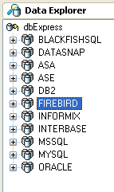

Database
New dbExpress Firebird driver for 2.1.1 and 1.5
dbExpress drivers support:
InterBase 2009
MSSQL Server 2008
Oracle 11g
MySQL 5.1
Additional DBX driver for SQL Native Client 2005 that works with Windows 2000 and supports Multiple Active Results Sets (MARS)
dbExpress date/time functions now support:
Locale dependant string formatting
Timestamp offset based on locale
MIDAS.DLL source code
Web Service SOAP 1.2 client support

Slide 64
Demo: Database
Firebird support
MIDAS.DLL source code

Slide 65
Datasnap

Slide 66
DataSnap Highlights
„New DataSnap Server” and „New DataSnap WebBroker App” wizards
New support for HTTP communication and in-process connectivity
New HTTP tunneling support for clients outside firewall
REST support for DataSnap HTTP requests
Filters for processing communication stream
New DataSnap API for filtering
Compression filter provided
Callbacks and JSON
Server methods accept TJSONValue and descendants
Hosting DataSnap servers in Web Server Applications
.NET Proxy generation
Notes:
New HTTP and In-Process Transports
Filters
Callbacks
REST interfaces and JSON support
IIS Hosting
Tunneling

Slide 67
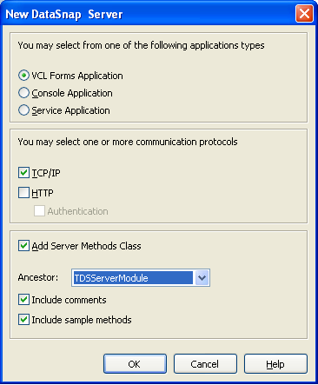
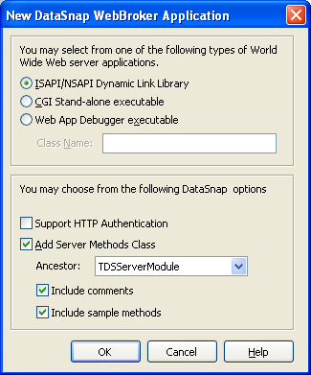
New Wizards
New DataSnap Project Wizards in „New Items”
„New DataSnap Server”
„New DataSnap WebBroker Application”

Slide 68
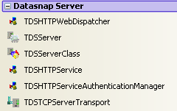
Transports and Web Server Hosting
New DataSnap Transports
HTTP
In-Process
Hosting DataSnap Servers in WebBroker Applications
New HTTP tunneling support for clients outside firewall

Slide 69
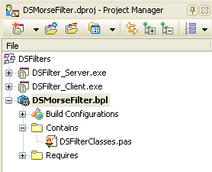
DataSnap Filters
Filters for processing communication stream
New DataSnap API for filtering
Compression filter provided
Intercept the communication byte stream
Chain of filter
Ease of use
Notes:
Intercept the communication byte stream
Chain of filters
Ease of use
Filter lives in a package and is used from client and server projects.
Just override
function ProcessInput(const Data: TBytes): TBytes; override;
function ProcessOutput(const Data: TBytes): TBytes; override;
in the „TTransportFilter” descendant class and you have a simple filter

Slide 70
DataSnap Callbacks
Server calling back to client
Feedback from long running server operations
New DBXJSON unit
Just pass TDBXCallback descendant as a parameter to a server method that will call its Execute(const Arg: TJSONValue): TJSONValue; method during this method call
Notes:
Override abstract
function Execute(const Arg: TJSONValue): TJSONValue; virtual; abstract;
in a „TDBXCallback” descendant.

Slide 71
Tunnelling
Tunnel emits events with the actual byte stream being handled
They cover the tunnel session life-cycle
OnOpenSession, OnErrorOpenSession,
OnCloseSession
OnWriteSession, OnErrorWriteSession
OnReadSession, OnErrorReadSession
Intercepting those events can help with
Failover
Replication
Load-balancing

Slide 72
REST interfaces
REST support for DataSnap HTTP requests
Server methods accept TJSONValue and descendants
New DSService unit with TDSService and TDSRESTService base classes
Invocation through REST
http://www.xyz.com/datasnap/rest/<class>/<method>/<paramers(s)>
calls
<class>.[prefix]<method>(<parameters(s)>)
where prefix is an action based on PUT, POST, GET, DELETE http methods.
Notes:
http://en.wikipedia.org/wiki/Representational_State_Transfer
http://json.org
http://www.json.org/fatfree.html

Slide 73

JSON Support
Pass an object (or a tree of objects) through its JSON notation
{
"firstName": "John",
"lastName": "Smith",
"address": {
"streetAddress": "21 2nd Street",
"city": "New York"
}
}

Slide 74
Demo: DataSnap
New DataSnap Server Wizard
HTTP Transport
Filters
Callbacks
JSON
New DataSnap Server Web Broker Application Wizard
REST interfaces
Tunneling

Slide 75
Summary

Slide 76
InterBase Roadmap October, 2009

Slide 77
Statement of Use
77
This document contains forward-looking statements based on current expectations, forecasts and assumptions of Embarcadero that involve risks and uncertainties. Forward looking statements are subject to risks and uncertainties associated with the Embarcadero's business that could cause actual results to vary materially from those stated or implied by such forward-looking statements.

Slide 78
InterBase SMP
InterBase SMP combines a multi-generational architecture with simple installation, low administration and deployment costs, automatic crash recovery, and a self-tuning engine that makes it well-suited for small enterprise, desktop, and embedded applications.
High-performance and scalability, with built-in support for Symmetric Multi-Processing (SMP) for multi-core CPUs
Simple installation
Near zero maintenance and low deployment costs
Automatic crash recovery
Strong encryption(AES), journaling, and other data protection and security features
A small memory footprint
A self-tuning engine that helps maximize database performance and availability for server, desktop, and embedded applications
Notes:
78
InterBase® SMP 2009 delivers high performance for applications with complex business logic and high concurrent user levels through its symmetric multiple processing support and multi-threaded architecture. New security and encryption features provide enhanced data protection. Fast, easy installation, a small footprint, automatic crash recovery, self-tuning, and near zero maintenance make InterBase is the ideal solution for embedded, turn-key applications. SQL 92 compliance, advanced data reliability and recovery, Unicode, numerous connectivity options, and support for Windows®, Linux, Solaris™, and Mac OS®/X makes InterBase perfect for high-powered, cost-effective business-critical server applications in small-to-medium enterprises.

Slide 79
Roadmap
Security & Encryption
Native 64 Bit Support
Productivity
Column and Database Level Encryption
Over-the-Wire (OTW) Network Encryption
Encryption of Backup Files
InterBase SMP 2009 To-Go Edition
64-bit InterBase on Windows
Cloud deployment
Extended Password encryption
Stored procedure debugging
Universal triggers
SQL hints
Larger index keys
C/S protocol optimization
CY 2009
CY 2010
CY 2011
79

Slide 80
New InterBase SMP 2009
80
Column and Database Level Encryption InterBase now supports the use of weak (DES) or strong (AES) encryption to encrypt a database and/or individual columns in a database table.
Over-the-Wire (OTW) Network Encryption OTW encryption allows you to encrypt data as it is communicated over a network from a client to a server. If you use OTW encryption, you must encrypt network transmissions with the same strength as was used to encrypt the database or columns. You can use weak or strong encryption, though to use strong (AES) encryption, you must obtain a optional strong encryption license, available at no additional charge.
Encryption of Backup Files If you encrypt a database and/or any of its columns, you must also encrypt the backup files for that database. You decrypt the backup files during the restore process. This adds an additional layer of protection to your data.
InterBase SMP 2009 To-Go Edition The new InterBase To-Go Edition is a small, portable version of the Desktop Edition. Target applications for the To-Go Edition include small devices and public kiosks, as well as Value Added Reseller (VAR) applications that were built using InterBase. Used in the To-Go edition form, InterBase does not have to be installed on any server or end-user workstation.

Slide 81
InterBase SMP 2011
81
Core Themes: Planned for September 2010 Release
64-bit InterBase on Windows Greater memory and performance benefits can be gained with 64-bit scalability of InterBase semantics (transactions, DB page etc.)
Cloud Deployment Creating an instance of InterBase and making it available on the cloud that will allow customers to use InterBase in a flexible and scalable cloud environment
Extended Password encryption Extended password encryption allows for stronger security

Slide 82
InterBase SMP – Future Requirements
82
Stored procedure debugging: APIs to strengthen for debugging stored procedures into InterBase that can be plugged into DB development tools for debugging.
Universal triggers: Consolidate trigger logic across multiple operations.
SQL hints: More customized tuning of your SQL queries for better performance.
Larger index keys: Index to accommodate larger index keys.
C/S protocol optimization: Improving performance of client/server applications.

Slide 83

RAD Studio 2010
Delphi 2010
C++Builder 2010
Delphi Prism 2010

Slide 84
RAD Studio 2010
Delphi 2010
C++Builder 2010
Delphi Prism 2010
ER/Studio 8.0.3 Developer Edition (in Architect)
InterBase 2009 Developer Edition
Blackfish SQL for .NET with Deployment Licenses
Notes:
Available for registered users:
TMS Smooth Control Pack
InstallAware Express
Doc-O-Matic Express

Slide 85
Delphi 2010 Highlights
All-Access InstantOn for zero-install deployment
Touch and Gesturing
Direct2X and Windows 7 API
IDE Insight
Data Visualizers in Debuger
Delphi and C++ Code Formatter
Firebird support
SOAP 1.2
DataSnap with HTTP, tunneling, filters, REST and Web Broker hosting
New Generation RTTI
Delphi Prism AOP
Notes:
.NET 3.5 SP1 has been added to the Install prerequisites

Slide 86
C++Builder
New C++ Class Explorer
FastMM is now standard heap manager for C++ runtime libraries
Support for #pragma once
-Zx option for generating XML representation of source code
Added support for _FUNCTION_
Support for [[deprecated]] attribute
__declspec(dllimport) and __declspec(dllexport) for template classes
Notes:
Support for [[deprecated]] attribute. The C++ compiler emits a diagnostic when this attribute is set. The Delphi compiler emits this attribute in .hpp files when compiling .pas files with deprecated methods. • __declspec(dllimport) and __declspec(dllexport) have been implemented for template classes. The dllimport modifier prevents inline template functions from being instantiated (either inline or out-of-line). The dllexport modifier causes the entire class, including inline functions, to be instantiated and exported. • The C++ runtime libraries now contain a version of FastMM as the standard heap manager.
• -Zx option will generate XML representation of source code. • Support for #pragma once. This support improves compatibility with MSVC. #pragma once acts as a header guard, preventing the compiler from looking at the same header file more than once. • Support for _FUNCTION_ has been added. This will provide additional information for debugging runtime failures.

Slide 87

Delphi Prism 2010
AOP (Aspect Oriented Programming)
DataSnap Client Proxy Generator
ASP.NET MVC Support

Slide 88
3rd Party
IntraWeb CrossTalk for native .NET communication
Updated versions of:
TChart
Indy
IBX
Notes:
** Potential for demo of IntraWeb cross-talk stuff.

Slide 89
Editions and Availability
Deployment Options
Regular Install
Instant-On for zero-install deployment
Versions
Professional
Enterprise
Architect
Languages
English
German
French
Japanese

Slide 90
References
http://www.embarcadero.com/products/delphi
http://www.perceptivepixel.com/
http://www.json.org/fatfree.html
http://en.wikipedia.org/wiki/Representational_State_Transfer

Slide 91
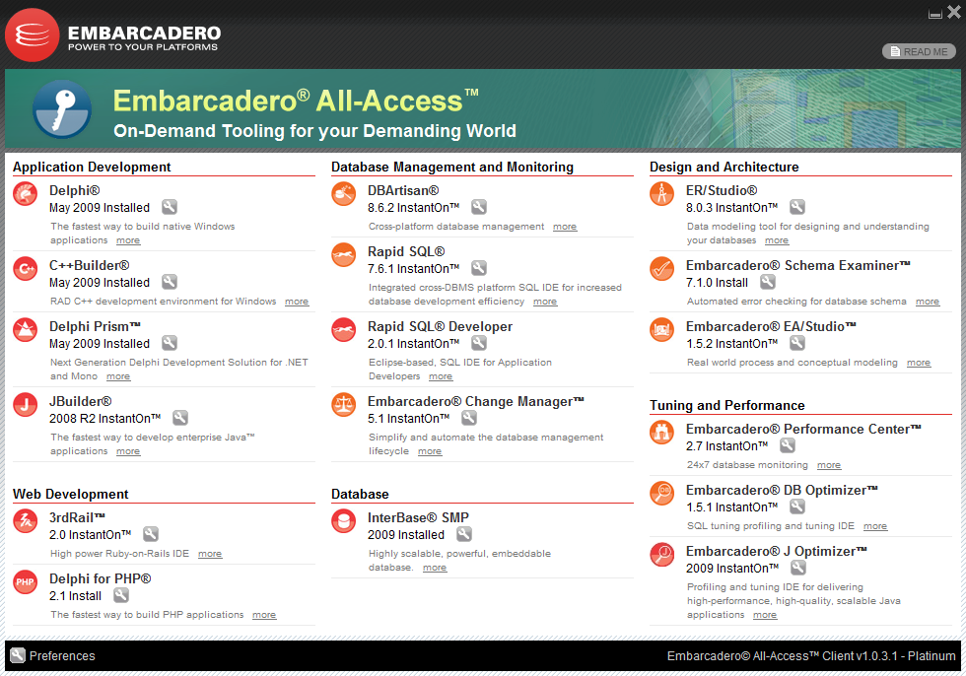
Embarcadero All-Access

Slide 92
Re-Seller Offer / Promo Details

Slide 93
US Tour special offers
All event attendees will receive:
20% discount on Delphi, C++Builder, Delphi Prism and RAD Studio
Entry in a drawing for a free copy of RAD Studio 2010 and other prizes
Discount on Delphi training from The DSW Group
Coupon Code: DUG10ORE1
Timeframe: 1/18/2010 - 1/31/2010

Slide 94
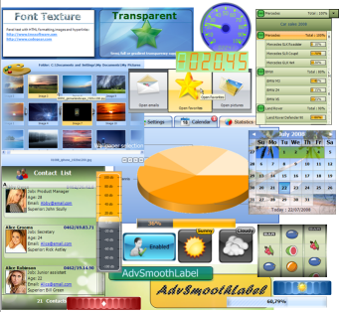
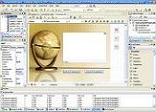
Additional Special Offer
Free TMS Smooth Controls with purchase of any edition of Delphi, C++Builder or RAD Studio 2010
Free Delphi for PHP with purchase of any Enterprise or Architect edition of Delphi, C++Builder or RAD Studio 2010
Offer expires Dec 31, 2009
Can be used with tour discount
+

Slide 95
Reminders
If you’re still using Delphi or C++Builder 2005 earlier
December 31st is your last chance to get upgrade pricing on version 2010
http://edn.embarcadero.com/article/40021
Delphi and C++Builder surveys are open
http://edn.embarcadero.com/article/40071
Tell us about apps you've built with Embarcadero tools
http://edn.embarcadero.com/article/39930
Submit Unicode migration stories for Delphi and C++Builder
http://edn.embarcadero.com/article/40018

Slide 96
Thank you

Slide 97
aohlsson@embarcadero.com
http://blogs.embarcadero.com/ao

