Slide 1

Firebird
Ing.
Alfonso Presa Marti
alfonsopresa@yahoo.com

Slide 2
What is Firebird
Compact Client/Server RDBMS
Run on a variety of OS
Industrial Strength DB Server
High Level of compliance with SQL Standards

Slide 3
Origin
Descendant of Interbase 6.0 released under IPL in 2000
Maintained and developed by an international foundry
www.firebirdsql.org

Slide 4
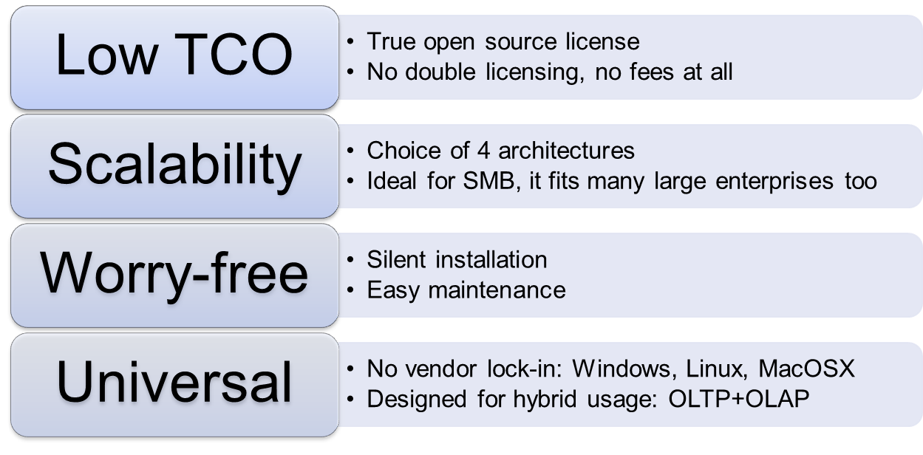
Why Firebird
An experiment is better than 1000 words
http://www.ib-aid.com/articles/item104

Slide 5
Architectures
Up to 1000 users, 1Tb size
Up to 500 users, 300 Gb size
Up to 100 users, 50Gb size
Single-user, DBMS in DLL
SuperClassic
New (in 2.5) architecture! Combination of best features of SuperServer and Classic. Ideal for virtualized environments.
SuperServer
Small footprint, performance, easy embedding and silent installation. Ideal for ISVs.
Embedded
Lightweight single user full-blown DBMS in DLL. Transparent upgrade to high architectures.
Classic
Heavy duty architecture for multi-CPU servers with large amount of RAM and fast HDD.
*# of database users and sizes are not limits of Firebird.
They are given for information purposes only.

Slide 6


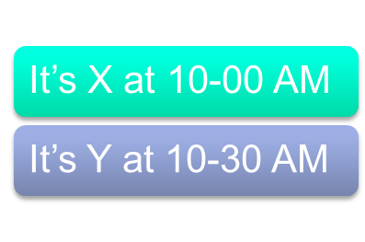


Multigenerational Architecture
Readers do not lock writers
OLTP
OLAP (reports, BI)
Hybrid (OLTP+OLAP)
MGA makes a Firebird database capable of serving simultaneously as both an analytical and an operational data store (OLTP/OLAP).
Automatic sweep
Firebird can manage versioning automatically and perform sweep (known as vacuum in other DBMS) as needed.
Competitors with this feature
MSSQL 2005+ (Standard and Ent, not Express)
Oracle
PostgreSQL
InterBase

Slide 7
Multigenerational Architecture
Store more than one version of the record concurrently
Each user holds it owns contextual view of the DB state
Most recent committed version is the only one visible outside user transaction
No need for 2 phase locking or page locking
No dirty reads as DB2, not “Snapshot too old” as Oracle 9i and not “record has changed outside this transaction” as SQL Server

Slide 8
Transactions
All tasks are enclosed within transactions, including operations in more than 1 DB
All locks are at Row Level and it is said to be optimistic
3 levels of isolation Table stability, Snapshot and Read Committed
Access Mode : Read/Write or Read/Only
Lock Resolution : Wait or No Wait
Save Points and Implicit transactions

Slide 9
Cont…
A “Post” will succeed if no other R/W Trans has a newer record
If a “Post” succeeds, the Trans has a lock on the row. Other Trans can read the Last committed record but no Update or Delete

Slide 10
Strong typed Database
Create Domain Name as DataType [Default value]
[not null]
[Check Constraint]
[Collate]

Slide 11
Cont…
Create domain DBoolean as smallint check (value is null or value in (1,0));
create domain rather_silly as char(3) check (value in (select substring (registration from 1 for 3) from aircraft));
Domains can be used in tables
Defining IN/OUT params in stored proc
Domain changes runs in cascade

Slide 12
Generators/Sequences
CREATE { SEQUENCE | GENERATOR } <name>
DROP { SEQUENCE | GENERATOR } <name>
SET GENERATOR <name> TO <start_value>
ALTER SEQUENCE <name> RESTART WITH <start_value>
GEN_ID (<name>, <increment_value>)
NEXT VALUE FOR <name>

Slide 13
Generators/Sequences
No need for a different type of field. Any numeric type fit. Specially INT64
Easy to get the value even if a trigger has modified it. No need for global variables or SP like @@identity and scope_identity
Insert into Items(Description) value (‘TEXT’) returning ID into :ID
Key value could be modified

Slide 14
Queries
Operators (distinct, union, in, exist, rows [that really works], virtual tables)
Insert or Update, returning, matching
update or insert into PRODUCTOS_MODELOS (ID, DESCRIPCION)
values(:ID, DESCRIPCION) matching(DESCRIPCION)
returning ID into :ID
CTE and recursive CTE

Slide 15
Referential integrity
Options (no action, cascade, set null, set default)
Index for the constraint is created automatically and consistency is checked before commit the DDL

Slide 16
Stored procedures
Cursors
For select into
Full selectable

Slide 17
Triggers
Any unhandled exception rolls back the transaction
Database triggers (connect, disconnect, Trans [start, commit, rollback])
Table Triggers fires on row insert, modification or deletion
Universal Triggers

Slide 18
Exceptions
Any unhandled exception rolls back the entire operation
Raising exceptions : exception MyExec
Handling exception :
When <sqlcode, gdscode, exception, any>
Do begin … end

Slide 19
Temporary tables (GTTs)
Can use any domain defined in the DB
By Connection
By Transaction

Slide 20
Global variables
Get_CONTEXT
Set_CONTEXT
Ex : Notify which application user is connected

Slide 21

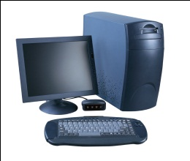
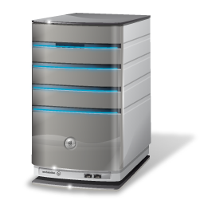

Events
AS
BEGIN
…
POST_EVENT ‘MY_VIP_EVENT1’;
…
END
Events received by all subscribers
Events
Notifications can be sent from database triggers, stored procedures and Execute Blocks
Flexible subscription mechanism
  ON TRANSACTION START
  ON TRANSACTON COMMIT
Logging and synchronizing
Instant notifications can be raised (and written to some table) right from database-level triggers
  ON CONNECT
  ON DISCONNECT

Slide 22
What Firebird Lacks
Good replicator
Namespaces
Referential constraints among Databases

