Slide 1
Touch and Gestures
Oregon Delphi User Group
November 14, 2011

Slide 2
Why Touch and Gestures?
Intuitive
Natural instinct to touch viewable objects
You’re already used to a physical desktop
Responsive
Remember DOS?
People are increasingly impatient
Or have our expectations risen?
Notes:
Babies and cats
Background processes: anti-virus, spooling print job, defragging, updates, denial-of-service attacks

Slide 3
Design Goals
Intuitive
Don’t Make Me Think!
Don’t change from what I’m used to
Responsive
Let me know that something is happening
If it’s slow, show an hourglass or progress bar
Notes:
Web pages – blue underlined links
Linux works on slow computers, but doesn’t let you know an app started
Without a progressbar, I’ve had customers kill apps working on a long process

Slide 4
How do we do this?
Get out of your chair!
Simplify, simplify, simplify!
Focus. Deliver. Iterate.
Be consistent, adhere to standards.
Think FUNCTION, not Feature
Notes:
You have no idea how a customer will use your program until you WATCH a customer use your program!
Don’t add needless options—it just takes more time and confuses the customer.
Focus: Don't try to be everything. Don’t over deliver. Have a goal in mind and stick to it. Get it done and do it really well. Add features later.
Customers know what result they need, they don’t want to have to learn nifty features in order to get it.
FUNCTION: [Need to get a sales report sorted by salesperson for the last quarter. Need to update a customer’s email address. Need to send a PO to a vendor before EOD to lock in a price.]
FEATURE: [Can move the columns in this grid to any order you want. Can filter by store, quantity-on-hand, salesperson, date range, style, number of returns in the last month… Can change the color of any data grid.]

Slide 5
“Surface” Designer Blog
“When not done properly, touch and gesture can appear as a step backwards”
“Make sure the interaction fits the needs”
Notes:
http://johnnyholland.org/2009/02/17/touch-and-gesture-systems-what-you-haven%E2%80%99t-heard/
[Two circles and a right swoosh to extend the due date by two weeks]
[Flick down-left to delete, flick down to scroll to next record] --how many accidental deletes?

Slide 6
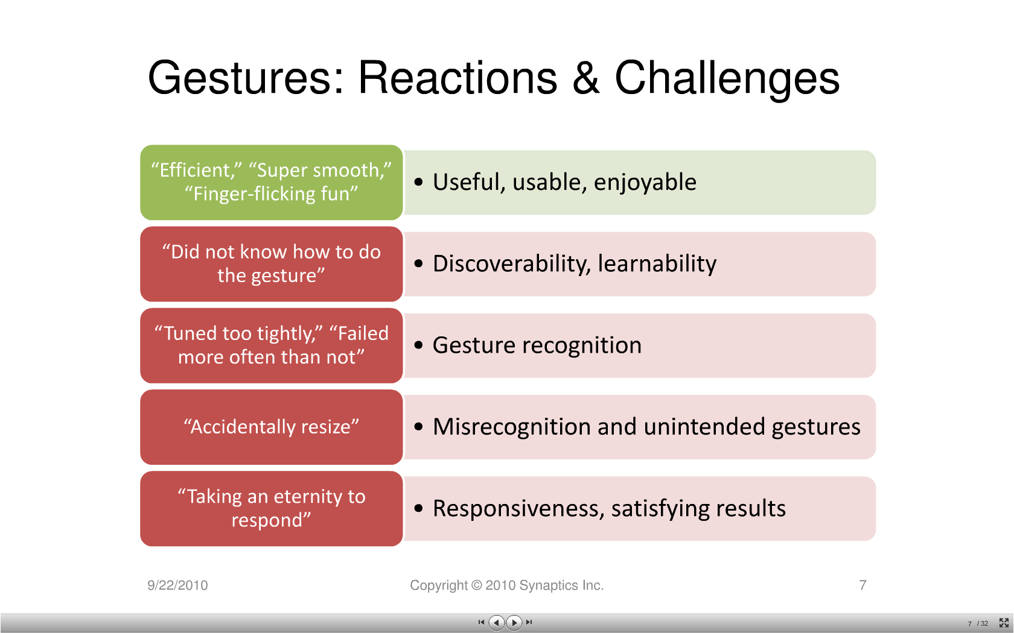
Usability Study – Synaptics
Notes:
http://www.slideshare.net/kevinarthur/d4-m-karthur-share

Slide 7
Some Links
Gesture Reference Guide http://www.lukew.com/ff/entry.asp?1071
RAD Studio 2010 Review #5 http://windwings.wordpress.com/2009/08/10/rad-studio-2010-review-5-vcl-natural-input-overview/
Dr. Bob Examines Touch and Gestures http://www.drbob42.com/examine/examinB6.htm
Seppy Bloom – Touch & Gestures Part 1 http://blogs.embarcadero.com/seppybloom/2009/08/11/37624
Anders Ohlsson with FishFact http://www.metacafe.com/watch/3369835/delphi_2010_using_touch_features_and_gestures/
Notes:
http://www.lukew.com/ff/entry.asp?1071

