Slide 1
JSON and the JSON Objects framework in Delphi

Slide 2
JSON? How do you even say it?
Pronounced /ˈdʒeɪ·sən/, as in “Jason and The Argonauts” - per ECMA-404 The JSON data interchange syntax 2nd edition, Dec 2017
JSON is a lightweight, text-based, language-independent syntax for defining data interchange formats

Slide 3
JSON References
Some JSON examples: https://jsoning.com/examples/
JSON and the JSON syntax: ECMA-404 The JSON data interchange syntax 2nd edition, Dec 2017
A shorter representation of the JSON syntax: https://www.json.org/json-en.html
Some JSON tools: https://jsoning.com/

Slide 4
JSON in Delphi
JSON Frameworks in Delphi: https://docwiki.embarcadero.com/RADStudio/Sydney/en/JSON
This presentation covers the JSON Objects Framework, not the Readers and Writers JSON Framework

Slide 5
JSON Objects framework – Functionality
Consumes JSON text into objects
Produces JSON text from objects
Provides ways to navigate objects and get data out of them
Provides ways to create objects and set data in them

Slide 6
JSON Objects framework - Classes
The framework is in System.JSON
For each JSON syntax, the framework provides a class (see right)
The framework also provides a convenience class called TJSONPair
JSON syntax | Delphi Class
Object | TJSONObject
Array | TJSONArray
Value | TJSONValue
Number | TJSONNumber
String | TJSONString
True | TJSONTrue
False | TJSONFalse
Null | TJSONNull

Slide 7
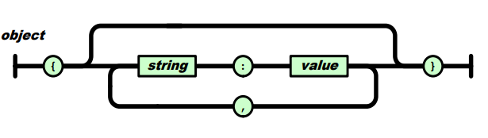

JSON Objects framework - TJSONPair
In JSON, the Object syntax contains name/value pairs.
However, a separate syntax for the name/value pair does not exist in the JSON spec. That is, no syntax exists for this piece of the Object syntax:
In the framework, TJSONPair is a convenience class that represents the name/value pair

Slide 8
JSON Objects framework – Class hierarchy
TJSONValue
Containers
Data
Convenience
TJSONObject
TJSONArray
TJSONString
TJSONNull
TJSONBool
TJSONPair
TJSONNumber
TJSONTrue
TJSONFalse
In the framework, everything representing one of the JSON syntaxes descends from TJSONValue

Slide 9
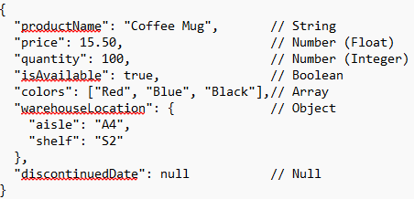
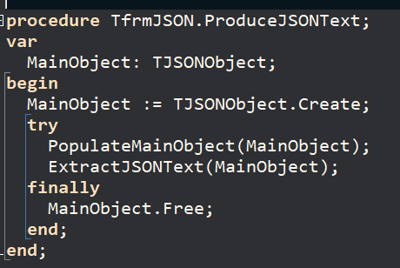
Producing JSON Text
Let’s say we want to produce this JSON example
The example contains the data within a JSON Object.
So, we’ll populate a TJSONObject object
And extract the JSON text from it

Slide 10
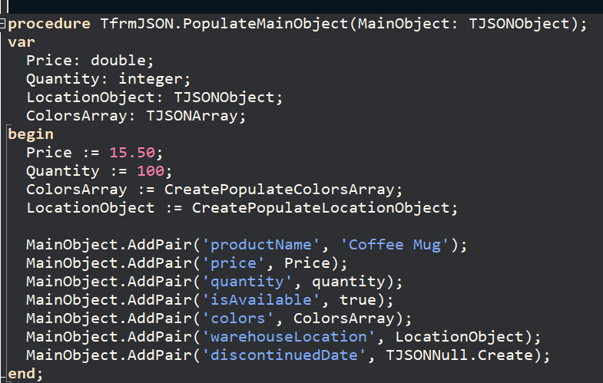
Producing JSON Text - Populating
To populate, use the various AddPair convenience methods.
AddPair creates the appropriate data class based on the data type being passed.
All versions of AddPair create a TJSONPair instance

Slide 11
Producing JSON Text – Populating (AddPair/strings)
In this version of AddPair, the first parameter is the name of the value and the second is the value, which in this case, is a string (i.e. ‘Coffee Mug’)
Because a string was passed, AddPair will create an instance of a TJSONString and give it the value ‘Coffee Mug’
When the JSON text is extracted from the TJSONString instance, it will conform to the JSON string syntax. In this case, “Coffee Mug”
In this case, the JSON text for the TJSONPair will be: “productName”:”Coffee Mug”

Slide 12
Producing JSON Text – Populating (AddPair/strings, numbers, boolean)
 | Type for the value being passed | Type of JSON class created | JSON text created for the pair
AddPair(‘productName’,’Coffee Mug’) | String | TJSONString | “productName”:”Coffee Mug”
AddPair(‘price’,Price); // Price = 15.5 | Double | TJSONNumber | “price”:15.5
AddPair(‘quantity’,Quantity); Quantity = 100 | Integer | TJSONNumber | “quantity”:100
AddPair(‘isAvailable’,true) | Boolean | TJSONTrue | “isAvailable”:true
TJSONObject has AddPair methods these types of numbers:
UInt64
Integer
Cardinal
Double
Extended
Currency

Slide 13
Producing JSON Text – Populating (AddPair/TJSONValue)
 | JSON text created for the pair
AddPair(‘colors’, ColorsArray) | “colors”:[“Red”,”Blue”,”Black”]
AddPair(‘warehouseLocation’, LocationObject) | “warehouseLocation”:{“aisle”:”A4”,”shelf”:”S2”}
AddPair(‘discontinuedDate’, TJSONNull.Create) | “discontinuedDate”:null
In this signature of AddPair, the value is of type TJSONValue.
TJSONValue, like in the JSON syntax, can represent any one of the other JSON syntaxes.
Therefore, you can pass TJSONString, TJSONNumber, etc. instances into AddPair
MainObject will store a link to those instances
When MainObject is destroyed, it will destroy the instances (as long as you haven’t changed the instances’ Owned property to false).

Slide 14

Producing JSON Text – Populating (formatting numbers)
For numbers, the number being passed will be converted to a string.
In our example, the price of 15.5 will appear in the JSON text as 15.5.
However, the JSON text that we’re trying to make shows 15.50.
If you need to, you can do everything yourself instead of using the AddPair convenience method.

Slide 15
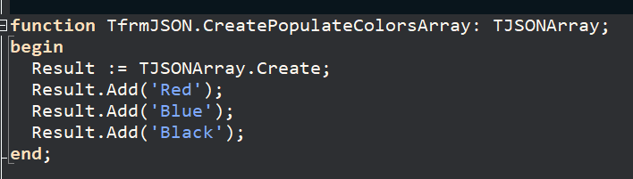
Producing JSON Text – Populating (arrays)
For objects, use AddPair
For our other container structure, arrays, use Add
Like AddPair, Add has several versions and will create the appropriate TJSONValue descendant based on the type of variable being passed.
In this example, TJSONString instances are created

Slide 16
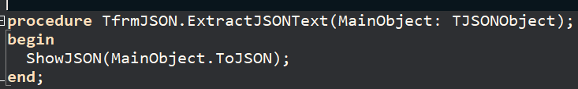
Producing JSON Text – Extracting (for transfer)
To extract JSON text for data transfer, use ToJSON
For reference, here’s our original

Slide 17
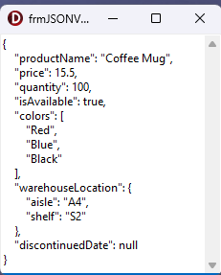
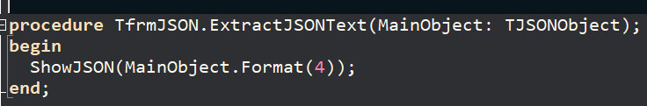
Producing JSON Text – Extracting (for viewing)
To extract for viewing, you might like Format

Slide 18
Producing JSON Text – Extracting (details)
ToJSON only returns ASCII characters making it the preferred way to transfer data
ToString is another way to extract JSON text
it does not encode non-ASCII and low-ASCII characters
it is not viewer friendly
 | ToJSON | Format | ToString
Non-ASCII characters (above 127) and Low-ASCII characters (below 32) are encoded using “\uNNNN” format | Yes | No | No
Special characters (like quote, backslash, tab, new-line, line-feed, etc.) are encoded using “\C” format | Yes | Yes | Yes
Viewer friendly | No | Yes | No
Accessible for all TJSONValue descendants, not just TJSONObject | Yes | Yes | Yes

Slide 19
Consuming JSON text
Let’s say we want to consume this JSON text
We’ll give the JSON text to the framework and it will create and populate JSON class instances that match the structure and content of the JSON text.
Then, we’ll find the JSON Values that have the data that we want to extract
And once found, extract the data

Slide 20
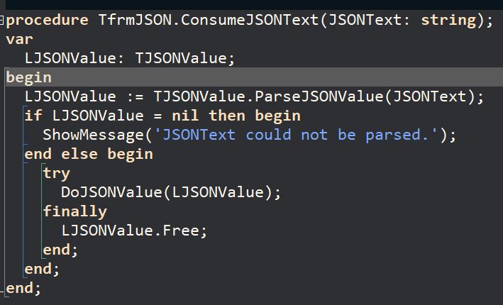
Consuming JSON text - ParseJSONValue
To consume JSON text, call the class function ParseJSONValue in TJSONValue
ParseJSONValue will create and populate JSON class instances that match the structure and content of the JSON text
ParseJSONValue will return the TJSONValue for the outermost JSON structure, which we’ll use to find and extract data that are within it.
When you receive JSON text from a provider, you’ll get one of the containing structures (i.e. JSON Object or JSON Array). You won’t get, say, a JSON True.
On the off chance that you do receive one of the simple data structures, such as TJSONString, ParseJSONValue will return nil.

Slide 21
Consuming JSON text – ParseJSONValue (example)
For our example, ParseJSONValue will return a TJSONObject instance
Within that instance, will be 7 TJSONPair instances, one for each of the JSON structures in the example.
Each TJSONPair instance will have an appropriate JSON class instance. For example, the pair for productName will contain a TJSONString.

Slide 22
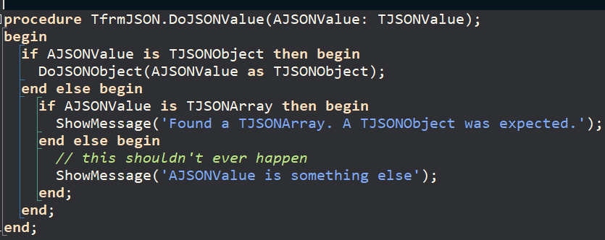
Consuming JSON text – ParseJSONValue (container check)
You will know what your provider will be sending you. That is, an object or an array.
After calling ParseJSONValue, you might want to make sure that what you received is what your application expects.

Slide 23
Consuming JSON text – Finding JSON Values
Use FindValue, P, and A to find JSON Values
function FindValue(const APath: string): TJSONValue;
property P[const APath: string]: TJSONValue
property A[const AIndex: Integer]: TJSONValue
When the JSON value cannot be found
FindValue returns nil
P and A throw an EJSONException
You can find nested and indexed JSON values
FindValue, P, and A are all related

Slide 24
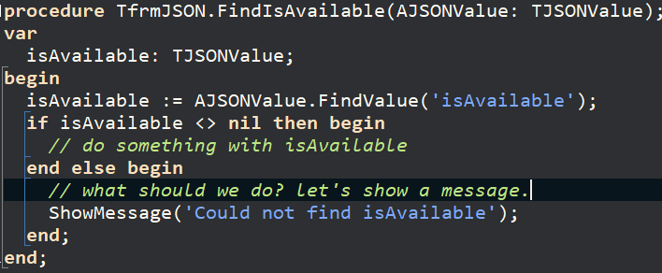
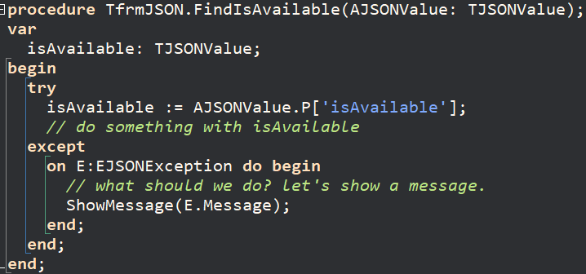
Consuming JSON text – Find JSON Values (not found)
Here’s sample code using FindValue and P that find isAvailable
An example of A isn’t shown. You would check for an exception – just like with P

Slide 25
Consuming JSON text – Find JSON Values (nested values)
You can find JSON values that are nested. Both examples return the same JSON Value:

Slide 26


Consuming JSON text – Find JSON Values (indexed values)
You can find JSON values that are indexed.
All examples return the same JSON value
The implementation of A calls P. That is, it converts the integer to a string, puts [] around it, and calls P.

Slide 27
Consuming JSON text – Find JSON Values (FindValue, P, A relationship)
The A property is a convenience property so that you can use an integer index when iterating arrays.
The A property calls the P property.
The P property calls FindValue.
If FindValue returns nil, P raises an exception.
The Path parameter in P and FindValue supports dot notation and array indexing to navigate deep into JSON structures

Slide 28
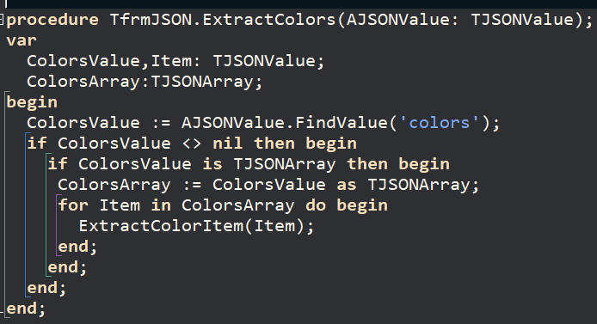
Consuming JSON text – Find JSON Values (Iterating Arrays)
TJSONValue does not provide a count of items in an array.
To iterate an array, you need to downcast the TJSONValue instance.

Slide 29
Consuming JSON text – Extracting Data
Three ways to extract/convert
Use the Value property to extract the data as a string and convert the data yourself
Downcast the TJSONValue to its descendant type and use the descendants’ convenience methods to extract/convert the data
Use AsType<T> to extract/convert the data without having to downcast the TJSONValue

Slide 30
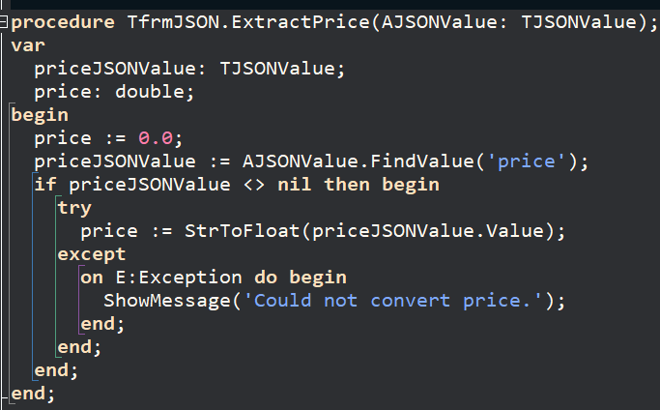
Consuming JSON text – Extracting Data (Value)
Use the Value property for data types (not the container types)
The Value property returns the text that appeared in the JSON text
If needed, convert the string value.

Slide 31
Consuming JSON text – Extracting Data (Descendants)
TJSONValue
Null
We can use descendants to convert data
In practice, we use the Null property with a TJSONValue instance
Actually, it’s a property of TJSONValue’s parent, TJSONAncestor
Data
TJSONString
TJSONNull
TJSONBool
AsBoolean
TJSONNumber
AsDouble
AsCurrency
AsInt
AsUInt
AsInt64
AsUInt64
TJSONTrue
TJSONFalse

Slide 32
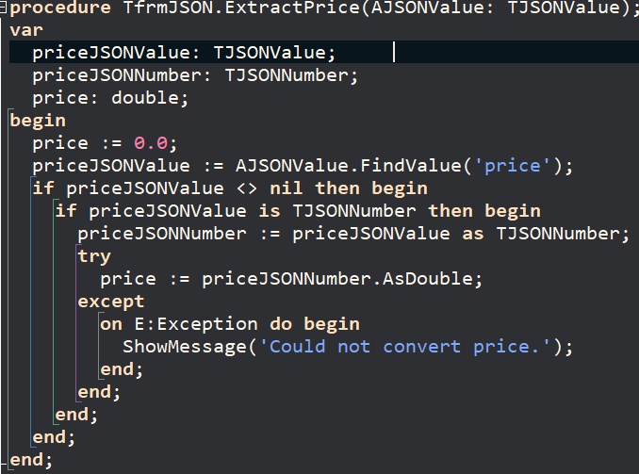
Consuming JSON text – Extracting Data (Descendants - TJSONNumber)
Find the price JSON value
Downcast it to a TJSONNumber
Use AsDouble to convert the data
Even though we know the data is a number, check for conversion errors.
Here, if we had called AsInt instead of AsDouble, a conversion would occur.

Slide 33
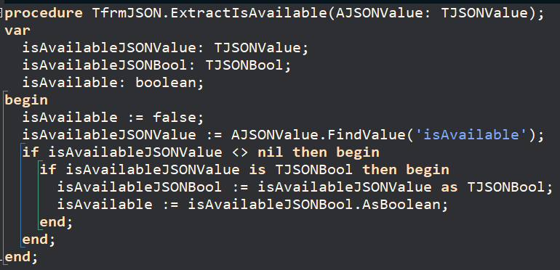
Consuming JSON text – Extracting Data (Descendants - TJSONBool)
Find the isAvailable JSON value
Downcast it to a TJSONBool
Use AsBoolean to extract the data
No conversion occurs. The data is stored internally as a boolean in TJSONBool instances

Slide 34
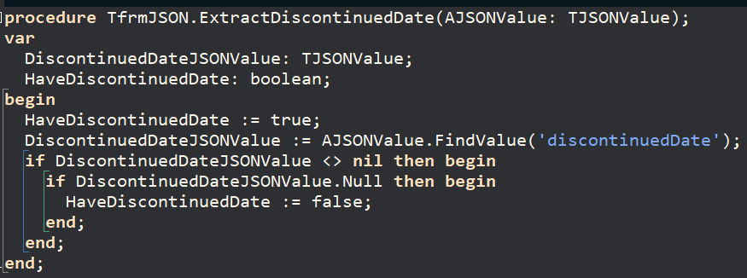
Consuming JSON text – Extracting Data (Descendants - Null)
Find the discontinuedDate JSON value
If its Null property is true, we don’t have a discontinued date
This is equivalent to checking if the JSON value is a TJSONNull

Slide 35
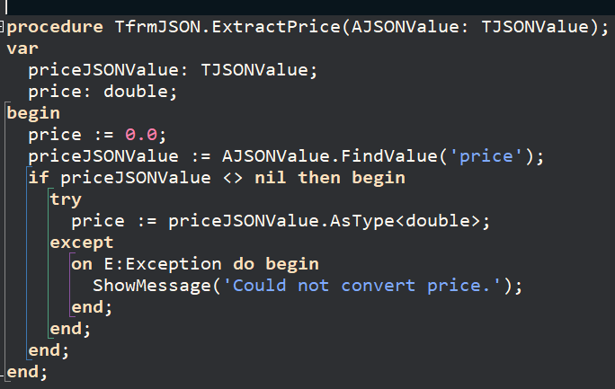
Consuming JSON text – Extracting Data (AsType<T> - Specific example)
Find the price JSON value
Use AsType<double> to extract and convert the data
Check for conversion errors.

Slide 36
Consuming JSON text – Extracting Data (AsType<T> - General)
With AsType<T>, you can think of it as extracting/converting data end-to-end.
You don’t need to know the JSON structure or the TJSONValue descendant type.
You need to know, semantically, what the data really is.
And that the framework/RTTI can convert it to your chosen variable type.
You can convert to variable types that are not part of the JSON syntax

Slide 37
Consuming JSON text – Extracting Data (AsType<T> - Semantic Boolean)
For example, a Boolean value could be sent in one of these ways
AsType<Boolean> will return a Boolean value regardless of which way the value was sent
AsType<String> will return a string value regardless of which way the value was sent.
JSON text | JSON syntax | TJSONValue Descendant Type
“True” | String | TJSONString
1 | Number | TJSONNumber
True | Boolean | TJSONBool

Slide 38
Consuming JSON text – Extracting Data – (date/times)
JSON does not support date/time types
You must know your provider’s date/time formats
Most likely, your provider will send date/times as a string
You can use TJSONValue.Value to get the string and then convert it yourself to, say, a TDateTime
Or you can use AsType<TDateTime> if the framework/RTTI supports converting the provider’s date/time format.

Slide 39
Consuming JSON text – Extracting Data (Convenience – GetValue<T>)
Four convenience methods find a JSON value and extract/convert its data in one step.
Empty APath or no APath
When you call these method with an empty APath, they return the value of Self.
Use an empty APath when you’re iterating an array and have an instance of one of its items.
Similarly, use the version of TryGetValue<T> that doesn’t have an APath parameter for arrays.
Function | Couldn’t Find | Couldn’t Convert
GetValue<T>(const APath: string = ''): T | Raises exception | Raises exception
GetValue<T>(const APath: string; ADefaultValue: T): T | Returns default value | Raises exception
TryGetValue<T>(const APath: string; out AValue: T): Boolean | Returns false | Returns false
TryGetValue<T>(out AValue: T): Boolean; | n/a | Returns false

Slide 40
Consuming JSON text – Extracting Data (Convenience – GetValue<T>/no default)
GetValue<T>(const APath: string = ''): T
This version of GetValue<T> raises an exception when the path cannot be found and when the data value cannot be converted.
It’s useful when finding/extracting data that your app requires.
For required data, call GetValue<T> in a try/except block. An exception will be raised when
when JSON value is missing
when the JSON value is null (the conversion will fail)
when it cannot be converted

Slide 41
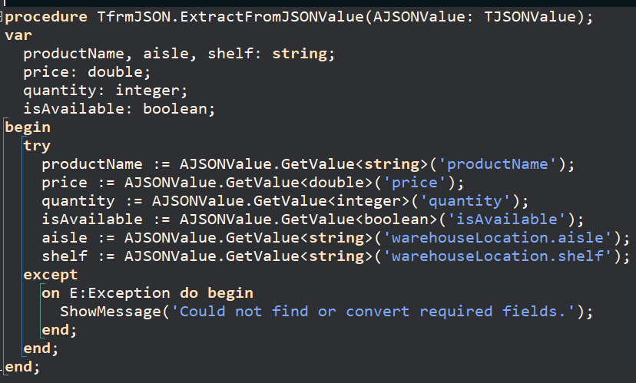
Consuming JSON text – Extracting Data (Convenience – GetValue<T>/no default)
if this method succeeds; we know that all our required data
was in the JSON text
wasn’t null
was converted

Slide 42
Consuming JSON text – Extracting Data (Convenience – GetValue<T>/default)
GetValue<T>(const APath: string; ADefaultValue: T): T
This version of GetValue<T>
returns the default value when
the JSON value is missing
the JSON value is null
raises an exception when the data value cannot be converted.
It’s useful for finding/extracting data that your app uses; but does not require.

Slide 43
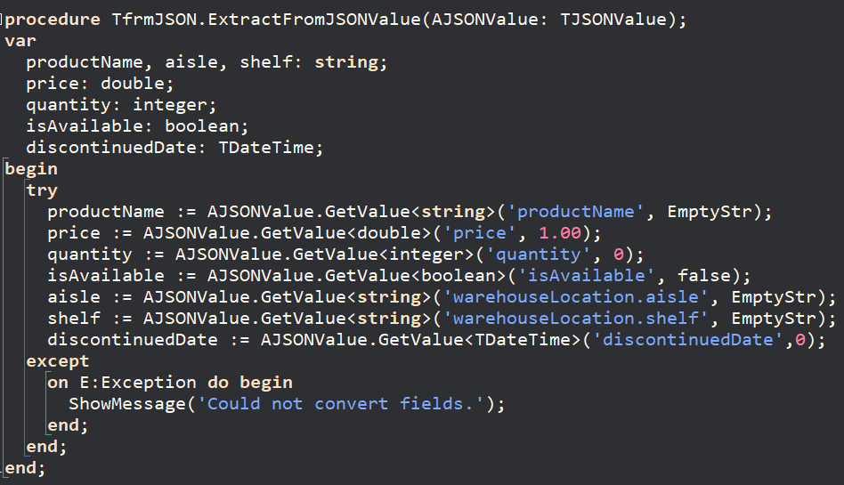
Consuming JSON text – Extracting Data (Convenience – GetValue<T>/default)
If this block succeeds, the data has reasonable value

Slide 44
Consuming JSON text – Extracting Data (Convenience – TryGetValue<T>)
TryGetValue<T> (both signatures) returns false if the value is missing or cannot be converted
Because it returns a status, it’s useful when you need to do something conditionally.

Slide 45
The End

