Slide 1
Sample presentation
Cornelius Hennch

Slide 2
R Markdown
This is an R Markdown presentation. Markdown is a simple formatting syntax for authoring HTML, PDF, and MS Word documents. For more details on using R Markdown see http://rmarkdown.rstudio.com.
When you click the Knit button a document will be generated that includes both content as well as the output of any embedded R code chunks within the document.

Slide 3
Slide with Bullets
Bullet 1
Bullet 2
Bullet 3

Slide 4
Slide with R Output
head(tar_read(data), 3)
## # A tibble: 3 × 5 ## Sepal.Length Sepal.Width Petal.Length Petal.Width Species ## <dbl> <dbl> <dbl> <dbl> <chr> ## 1 5.1 3.5 1.4 0.2 setosa ## 2 4.9 3 1.4 0.2 setosa ## 3 4.7 3.2 1.3 0.2 setosa

Slide 5
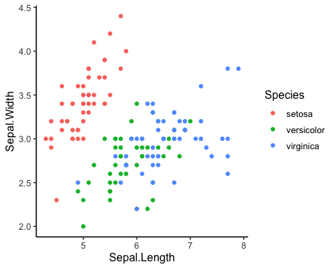
Slide with Plot

