Slide 1
Presentation title (Update 18.06.2021)
Cornelius Hennch

Slide 2
Slide with multiple points
Filter lesions > 10% prevalence
Create crosstables for binary outcome variables (add p-/q-values)
Logistic Regression

Slide 3
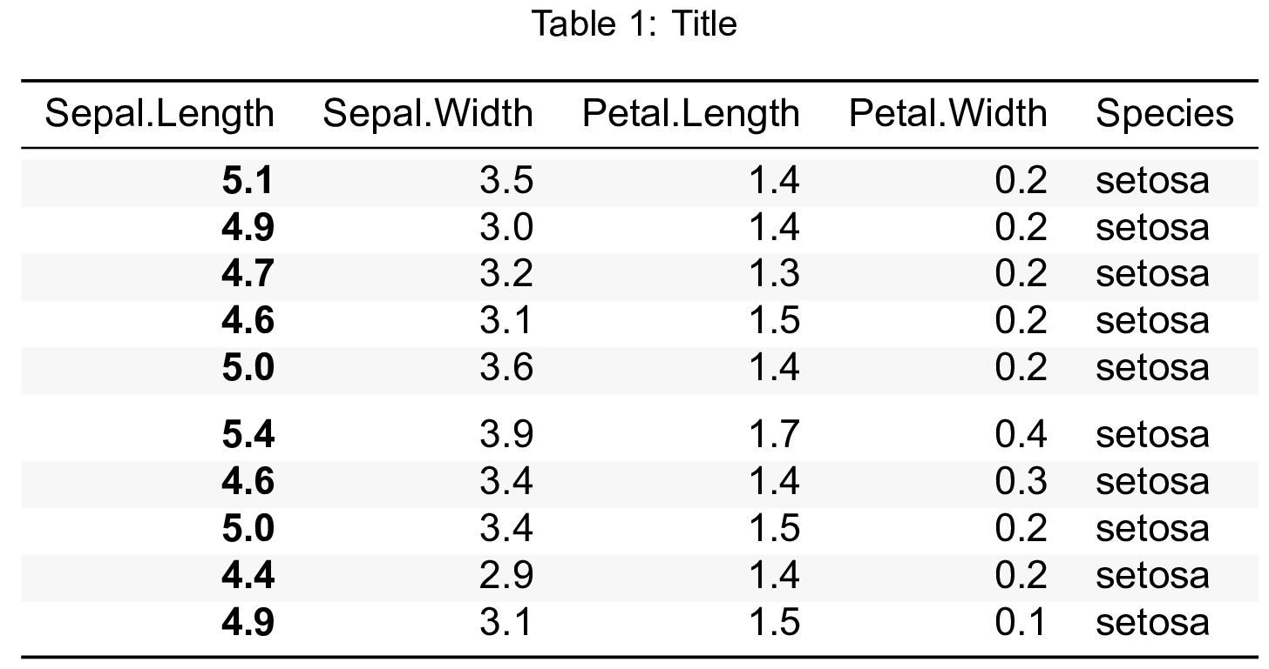
Two column example
Wow, this is a nice table.

