Slide 1
presentation
Cornelius Hennch

Slide 2
R Markdown
This is an R Markdown presentation. Markdown is a simple formatting syntax for authoring HTML, PDF, and MS Word documents. For more details on using R Markdown see http://rmarkdown.rstudio.com.
When you click the Knit button a document will be generated that includes both content as well as the output of any embedded R code chunks within the document.

Slide 3
Slide with Bullets
Bullet 1
Bullet 2
Bullet 3

Slide 4
Slide with R Output
summary(tar_read(data))
## Sepal.Length Sepal.Width Petal.Length Petal.Width ## Min. :4.300 Min. :2.000 Min. :1.000 Min. :0.100 ## 1st Qu.:5.100 1st Qu.:2.800 1st Qu.:1.600 1st Qu.:0.300 ## Median :5.800 Median :3.000 Median :4.350 Median :1.300 ## Mean :5.843 Mean :3.057 Mean :3.758 Mean :1.199 ## 3rd Qu.:6.400 3rd Qu.:3.300 3rd Qu.:5.100 3rd Qu.:1.800 ## Max. :7.900 Max. :4.400 Max. :6.900 Max. :2.500 ## Species ## Length:150 ## Class :character ## Mode :character ## ## ##

Slide 5
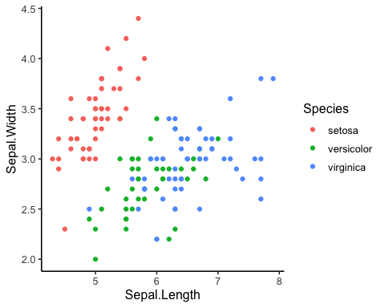
Slide with Plot

