Slide 1



Slide 2

Introductory Comments
Brings you back to the main selection
Advances to the next slide
Returns to the previous slide

Slide 3
Virtual Reality
Select one of the following options bellow to obtain information on that topic:
View Project Information
Revisions Log
Quick Facts
About Virtual Reality
Run 3D Immersion
3D Object Convertor

Slide 4
Purpose
The purpose of 3D Immersion is to develop a powerful three-dimensional polygon graphics engine that is so versatile that it can be used to simulate the real, physical world. The program has no single purpose other than to provide an expandable base that can be used to learn, teach, or simulate physics, chemistry, and real world situations. The only limiting factor being, one’s imagination!

Slide 5
Materials
Borland 5.01 C/C++ Compiler
Microsoft Windows 95
North-CAD 3D Modeller
Paint Shop Pro
Flight’s of Fantasy Source Code

Slide 6
Applications of Virtual Reality
Court room scene recreations
Psychological treatments (ex. overcoming fear of heights, claustrophobia, etc)
Entertainment
Medical technologies (ex. Magnetic Resonance Imaging (MRI), Computerized Tomography (CT), etc)
Training
Education

Slide 7
Procedure
    I did a considerable amount of reading in a short time to learn what is involved in simulating the third dimension on a computer.
    Next, I began writing the documentation on my intentions and goals for the project. For example, I decided to record a revisions log throughout the development process, decided that I would need some form of a scripting language so that each object could have it’s own characteristics and respond to message’s so the programs scope would be boundless. I decided upon the use of Dynamic

Slide 8
Link Libraries that can be associated with objects and respond to messages.
My first concern was to develop my very own file format to describe the worlds and objects that were going to be necessary for the engine. These files are responsible for recording the vertex coordinates, polygon composition information (texture, color, etc), and other important information that is necessary to have a truly versatile world.
Next, I began the actual implementation of the project in C++ for Windows.
I started off with a flat shading polygonal engine, before later discovered a method that could be used to create realistic shading by having a directional light source an

Slide 9
infinite distance away. Using this method, the lighting intensity could be approximated by obtaining the dot product between the light vector and the polygon normal.
I later implemented what is commonly referred to as bilinear texture mapping. Texture mapping can be thought of as simply wall papering the polygons with some “texture”. The bilinear method that I implemented simply uses two slope values to stretch the bitmap to the polygon. The problem being that it doesn’t take the polygons three-dimensional properties into account and therefore can produce “warps.”
Next step was to implement cameras… cameras used to simulate our view of the virtual world by having the perspective change in response to input. In my implementation, the camera never moves, but rather to

Slide 10
world moves (inversely) to simulate the experience. This saves some unnecessary calculations and has no drawbacks.
The next step was to create some dynalib’s (Dynamic Link Libraries) to provide some different interfaces, and different object libraries to allow the objects to dynamically change on their own and in any way, without modifying one line of code in the main executable program!! This is quite a innovation and feat, and is what makes the ability so special is that it allows users to “play god” by programming their own objects from a large database of already created models and image. Whether their intention is to have the object shot laser blasts or attributing a mass and elasticity to an object and having it ricochet and rotate according to real world physics… it’s all possibly with a minimal amount of work.

Slide 11
Finally, I had to use these libraries in some virtual worlds. What would I create… alien planets, earth simulation, a game… the options were endless. However, in order to please you judges I realized that I would have to create a physics simulator… and there went my dreams of creating Quake III :-)
Unfortunately, most of my time went into the programming of the 3d engine than in creating exciting new worlds that fully exploit the programs capabilities, but with engine coming to be nearly finalized, I have begun “playing god.
In “Playing God” I have found it necessary to obtain university text books to independently research topics such as Kepler’s law of planetary motion, and text books on linear algebra, as virtual reality makes extensive use of

Slide 12
matrices which is not covered a high school level. Many of the topics referred only two cases in two dimensions and therefore had to be extrapolated into three dimensions.
Throughout the development of the project I have spent a considerable amount of time in not only researching, and programming, but also in documentation of my progress.

Slide 13
Observations
The three dimensional engine is very fast and would be even faster if the computer had a 3D accelerator.
The interface can be fully customized and would be even more intuitive if proper interface devices were available, such as data gloves and HMD which would enrich the virtual reality experience.

Slide 14
Conclusion(s)
The program is very powerful having many potential applications that can be exploited with a right amount of ingenuity. Unfortunately, however, simulating the third dimension on a two dimensional screen is less then immersive and would greatly benefit from technologies such as data gloves, head mounted displays (HMD), and other immersive technologies that enable the user to fully interact in a pseudo-reality with convincing auditory, visual, and sensory feedback. Such technologies are unfortunately out of my reach, but may becoming feasible in future with increasing demand.

Slide 15

Career's in Virtual Reality

Slide 16
Just what is virtual reality??
Virtual Reality can be thought of as the simulating of the real world on a computer system. To enhance the immersion of the virtual reality experience for the user, he/she often wears a body suit, gloves, and a head mounted display (HMD). These devices constantly take record of the persons position and movements and feed them to the computer which interprets the expressions and attempts to respond to them in a manor that could be expected if it happened in the real world. This field is expected significant growth in 1998, and offers many benefits in entertainment, engineering, education, medicine, as well as many other fields where virtual reality technology is indispensable.

Slide 17
Some Jobs in Virtual Reality
Entertainment
Medicine
Engineering
Training

Slide 18
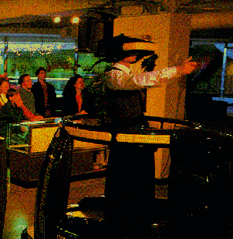
Virtual Reality as Entertainment
Undoubtedly the most widely used and popular form of virtual reality is that used in the latest video games for the computer. Like a good novel, the objective of any game is to immerse the player into a story in which he/she must obtain some, difficult, but obtainable goal. In attempting to obtain this goal it is hoped that the participant learns something about them self.

Slide 19
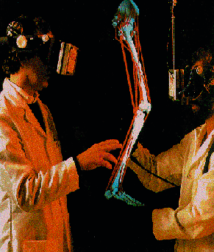
Virtual Reality in Medicine
Virtual Reality is becoming increasingly used in emerging medical technologies. Currently, there are notably two widely used medical technologies that employ the technologies of VR, these are Magnetic Resonance Imaging (MRI), and Computerized Tomography (CT).

Slide 20
Virtual Reality in Medicine
These technologies use medical technology to gather data and generate a three-dimensional model which can be projected onto a computer panel. VR is also used in attempts to cure people of mental aliments such as fear of heights. In this case the person can be immersed in a virtual world in which they are inside a glass elevator, the person can control their upward speed, and if need be they can simply remove the HMD. Projects are already in development to allow the doctor to scan the patient, creating a virtual representation so that they might practice a risky procedure before ever making an incision... this technology would also benefit medical students who would have unlimited practice in learning the procedures.

Slide 21
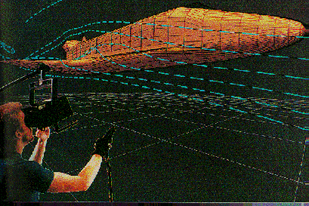
Virtual Reality in Engineering
Virtual reality is vital to internationally renowned agencies such as the National Aeronautics and Space Administration (NASA). They actively use virtual reality technology in testing new shuttle models, and other complex engineering tasks that would otherwise be to expensive

Slide 22
Virtual Reality in Engineering
and time consuming to be of practical use. Whereas, virtual reality allows models to be tested before constructing prototypes -- saving time, money, and materials.
Construction companies are now using virtual reality today to allow their customers to navigate through their building before a nail is ever hammered… allowing both the contractor and the individuals to spot errors before any serious errors develop.

Slide 23
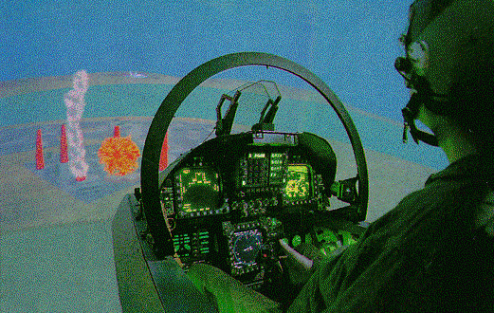
Virtual Reality in Training
There are many fields today which can and do benefit from virtual reality technologies. Most notably are the complex plane simulators used by military and other aeronautic agencies which depend upon these simulations for training new pilots in which air time is too expensive, risky, and time consuming.

Slide 24
Schools Offering Programs
Waterloo University of Ontario, Canada.
Massachusetts Institute of Technology of Massachusetts, United States.
Harvard University, Massachusetts, United States.
Memorial University, St. Johns, Canada.

Slide 25
Companies Hiring
Microsoft Corporation
Interplay, Inc.
Lucas Arts
NASA
Electronic Arts
Nova Logic
Apple Computer
Strategic Simulations, Inc.
Leprechaun Software… very promising prospects :-)

Slide 26
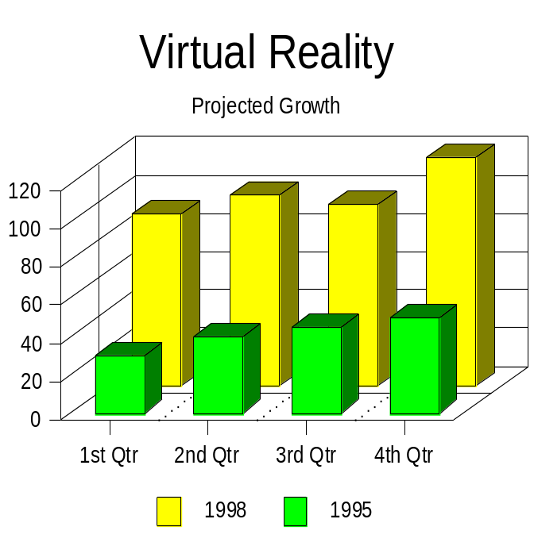
Concluding comments
The first market study on the virtual reality industry has been completed by CyberEdge Information Systems, Inc. Their report shows significant growth and business opportunities into the billions of dollars for the 1998 year.

Slide 27
Bibliography
Roehl, B. (1994). Playing God: Creating Virtual Worlds with Rend386. Corte Madera: Waite Group Press.
Lavroff, N. (1992). Virtual Reality Playhouse. Corte Madera: Waite Group Press.
Ferrell, K. (1995). Welcome to the Virtual World. World Book Science Year. Washington, DC: World Book Press.
Homebrew VR. (1998). Http://www.vr-publishing.com/
Dictionary of Acronyms. (1998). CyberEdge Journal. Http://www.cyberedge.com/acronyms.html
History of VR. (1998). Journals and Magazines. Http://ww.vrs.org.uk/

Slide 28
Bibliography
MIT SIPB Home Page. (1998). Http://www.mit.edu/
Harvard University. (1998). Http://www.harvard.edu/

Slide 29

The End

Slide 30
Revisions Log
(January 11-12th) Began developing the 3D Immersion program after having received the application form for the 1998 International Science Fair in Texas. I decided that I would prepare a sample demonstration of what I hope to accomplish by coding a small example of how feasible my project was done and to ensure the committee that, despite my later start on this aspect of my project, I have all the tools and knowledge available to see this projects success. Unfortunately, I am severely limited in time, as I have to put this demo together in just 2 days... as I must get this distraction out of the way to prepare for my exams at the end

Slide 31
of the month. However, it is my hope that this demonstration will spark interest and show my dedication to becoming a proud member of Team Canada in Texas.
(January 15th) Ok, so I wasn't able to throw the demonstration together in two day's but I've benefited from an annoying bug which I've now taken care of.
(January 16th) I've made the code very intuitive and object orientated and am very impressed with the result thus far. Embarking upon this project has opened many possibilities for both my upcoming operating system, and for a project which I had submitted into the science fair to aid in the memorization of varied material. In any event, I am now working to allow for the interaction and animation of a single simple object projected onto the screen.

Slide 32
(January 18th) I have finally implemented dynamic object manipulation support which allows every object to manipulated dynamically through the use of dynamic link libraries. With these breakthrough the user will be able to interact with any object he/she chooses and not be limited in any way. For example, I could have a physics dynamic link
library that would calculate the result of the object colliding
with another, taking into account the gravitational force, speed, etc. I could even make a game of Pacman, or Quake without modifying any of the thousands of lines of code for the actual program... Simply loading the world description file into the program and playing. The possibilities are overwhelming, and so easily implemented with my knowledge of 3D.

Slide 33
(January 19th) I finally implemented the texture mapping function for the polygon drawing.
(February 1st) Exams are finally over and after fixing a BIOS bug that prevented me from from booting any operating system and displaying the following message, "Divide Overflow."
(February 23rd) Opps, I've forgotten to update this journal. Well in the time elapsed I've had serious doubts as to what my whole project is about. I'm now considering instead of creating an alternative three dimensional interface, I'll focus on the mathematics behind the simulating of the real world on a computer. After my experience last year at the national science fair I fell that the judges (being mostly of mathematics background who would be greatly interested in the innovative uses of mathematics) would greatly appreciate the complex mathematics and physics involved.

Slide 34
(February 28th) Modularized common controls into a library module along with significant code rewrite. However, I main intentions for today are to: implement camera routines, and figure out 3D Studio MAX.
(March 7th) Fixed camera support, and fixed other miscellaneous bugs.
(March 8th) Significant rewrites... to the extend that I haven't been able to get it to recompile. I hate how every weekend I waste my time by doing nothing (as I'm to tired) and then on Sunday I'm fully awake, however, haven't enough time to maximize this spurt as I have to study.
(March 9th) I guess the realization of the science fair approaching upon me has worked in making me more productive with my time. I've compiled the 3d engine so that

Slide 35
it works, however, the texture mapping clipping has to be added as well as the two dimensional clipping must be corrected as it appears not to be dividing a clipped point into two points in some cases. Other than that, the engine is a lot better and efficiently. Lines to date: approx.. 5000 lines (Yikes!)
(March 10th) I'm a roll now... I've fixed a number of bugs which had been introduced with my earlier rewrites. Texture mapped polygons are now clipped to the cameras hither plane, however, the two dimensional clipping will have to be worked out.
(March 11th) Further modifications made. The current version is now very stable.

Slide 36
(March 14th) Fixed 2D texture mapped clipping.
(March 15th) Added the dynamic interface capabilities.
(March 16th) Very annoyed that my attempts to have memory shared between the application and the dynalib is failing to work even after 12 hours.
(March 17th) I just know that I must have some Literature homework that I'm not going to get around to because of the major rewriting required to get this project on the move. The teachers a real great guy to, which makes it all the worse! ... what I do for the benefit of science :-)
(March 18th) Well after the many times I've considered forgetting about the science fair to simply focus on my study I've made it to the school science fair. I had considered forgetting about the science fair to focus on school and

Slide 37
pursuing other projects and ideas, however, I've developed a high quality program, learnt a great deal, and can only hope that I will meet or exceed my last's years triumph.
I focused on the creation of worlds today so that my fellow students and judges will have something to look at and hopefully recognize the difficulty in development and get the recognition of this marvelous feat.
(March 19th) After staying up till 4am the previous night to prepare for the school science fair I decided to have a nap... only to wake up at 12 :-) The science fair went well... I hadn't enough done and didn't even bother to slap together a backboard as I had to focus my efforts on a presentation and getting some sample world together... as up to that point I had been focusing on the engine's development. In any case, my

Slide 38
priorities are now straightened out and will be going on the provincial fair (as if I didn't know beforehand), and have a impressive presentation and ideas that will ensure my success at the provincial fair.
(March 20th) I focused on the further development of the engine and improvements such as more efficient error reporting and the ability to switch between worlds. I also devised my personal method for quickly calculating when the mouse clicks on an object on the screen.
(March 21st) I am making great progress. I have devoted some of my time to modifying existing code that I feel will make the program more user friendly and easy to use... ie. the program now accurately detects syntax errors and
@^#%&$^%^^^^*&^*&&^&#^^%$1@#$* I just discovered

Slide 39
the bug in the program that caused the camera not to function correctly. It was deeply nested in the matrix functions and could have easily overlooked as the Y rotations
must be done on the matrix before the X!!!!!
(March 22nd) Finally fixed XY clipping which was not working perfectly. Focuses on the optimizing of the 3D engine... which is now blazingly fast. Implemented the ability to click on the objects. As well, I worked on
more efficient error reporting which I believe is now completed as it detects on any potentially hazardous commands. Finally, I added the opening animation.
(March 28th) Implemented Z Buffering

Slide 40
(March 29th) Added floating point token support, and added additional lighting features.
(March 31st) Fixed lighting so that the light can have different red, green, and blue intensities.
(April 1st-2nd) I'm staying up all night to ensure the project is
prepared to be presented at the regional science fair. It is during this time that I have focused on the refinement of the interfacing between the main application and the dynalibs. Unfortunately, this hasn't been implemented perfectly, and as a result the program has to be reset to load a different
world because of some code resident after the world has been terminated. I might possibly have to resort to destroying and then recreating the world class!
Discovered an error in the polygon drawing in which only one object exists

Slide 41
Quick Facts
Directional light sourced polygons
Bilinear texture mapping
Z-Buffering
Dynamic procedure handling for interface
Dynamic procedure handling for objects
XY and Z Plane clipping
Dynamic and intelligent error reporting and handling
Long filename support
Camera support

Slide 42
Backface culled polygon optimizations
DDE (Dynamic Data Exchange) support
Collision detection
Mouse intractability
Multimedia support (AVI, MIDI, and Waveform)
Stunning 640x480x8 graphics resolution

