Slide 1
Data Analysis for the Humanities
Laure Thompson
laurejt@cs.cornell.edu

Slide 2

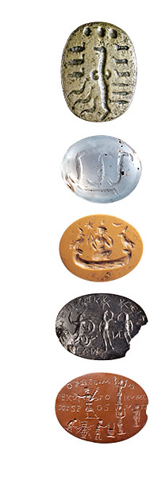


Computational Pipeline
Notes:
To do this…

Slide 3
Vectorizing Collections

Slide 4
What are Vectors?
Lists of Numbers
5 | 10 | 0 | 1 | 0 | 0 | 0 | 4 | 2 | 1
0.1 | 5.2 | 0.2 | 1.7 | 2.3 | 0.1 | 02 | 4.1 | 2.5 | 1
0.1 | 1.0 | 0.0 | 0.2 | 0.1 | 0.7 | 0.0 | 0.4 | 0.3 | 1.0
-2 | 0 | 4 | -1 | 10 | 3 | -5 | 0 | 0 | 1

Slide 5
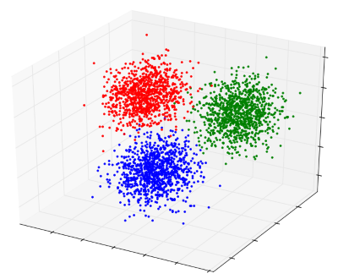
What are Vectors?
Points in a k-dimensional space

Slide 6
Bag of Words (BoW)
When action grows unprofitable, gather information; when information grows unprofitable, sleep.
action | gather | grows | information | sleep | unprofitable | when
1 | 1 | 2 | 2 | 1 | 2 | 2

Slide 7
What about images?
Convolutional Neural Network

Slide 8


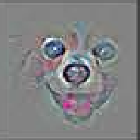
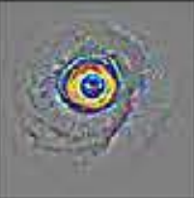
What about images?

Slide 9
Studying Vector Spaces

Slide 10
Measuring Document Similarity
Measure distance between points
e.g. Euclidean distance

Slide 11
Measuring Document Similarity
Measure angle between vectors
e.g. cosine similarity

Slide 12
SameDiff
https://databasic.io/en/samediff/

Slide 13
Neural Neighbors
https://yaledhlab.github.io/neural-neighbors/

Slide 14
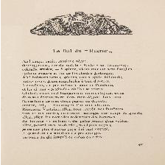
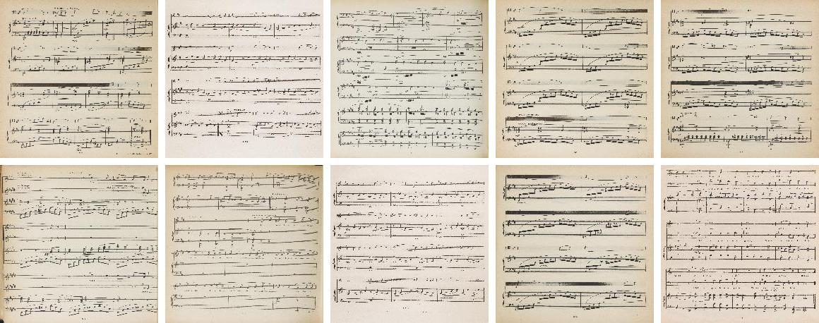
Analyzing Label Groups
Naïve Bayes
Music Classifier
✗
✓

Slide 15
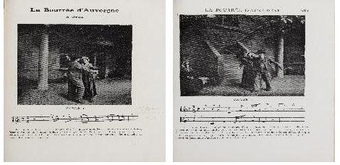
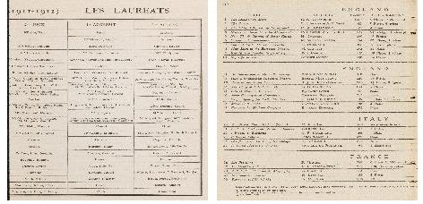
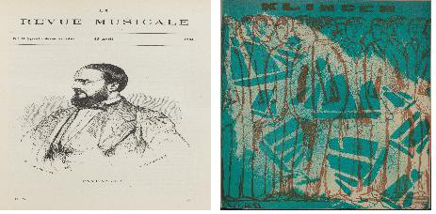
Analyzing Label Groups
Naïve Bayes
TP
FN
FP
TN

Slide 16



Analyze Data Clustering

Slide 17
K-Means Clustering
https://www.naftaliharris.com/blog/visualizing-k-means-clustering/

Slide 18
Visualizing Vectors Spaces
http://projector.tensorflow.org/

Slide 19
Beyond Word Counts
“Initial”
“Latent”
User-generated
Model-generated

Slide 20
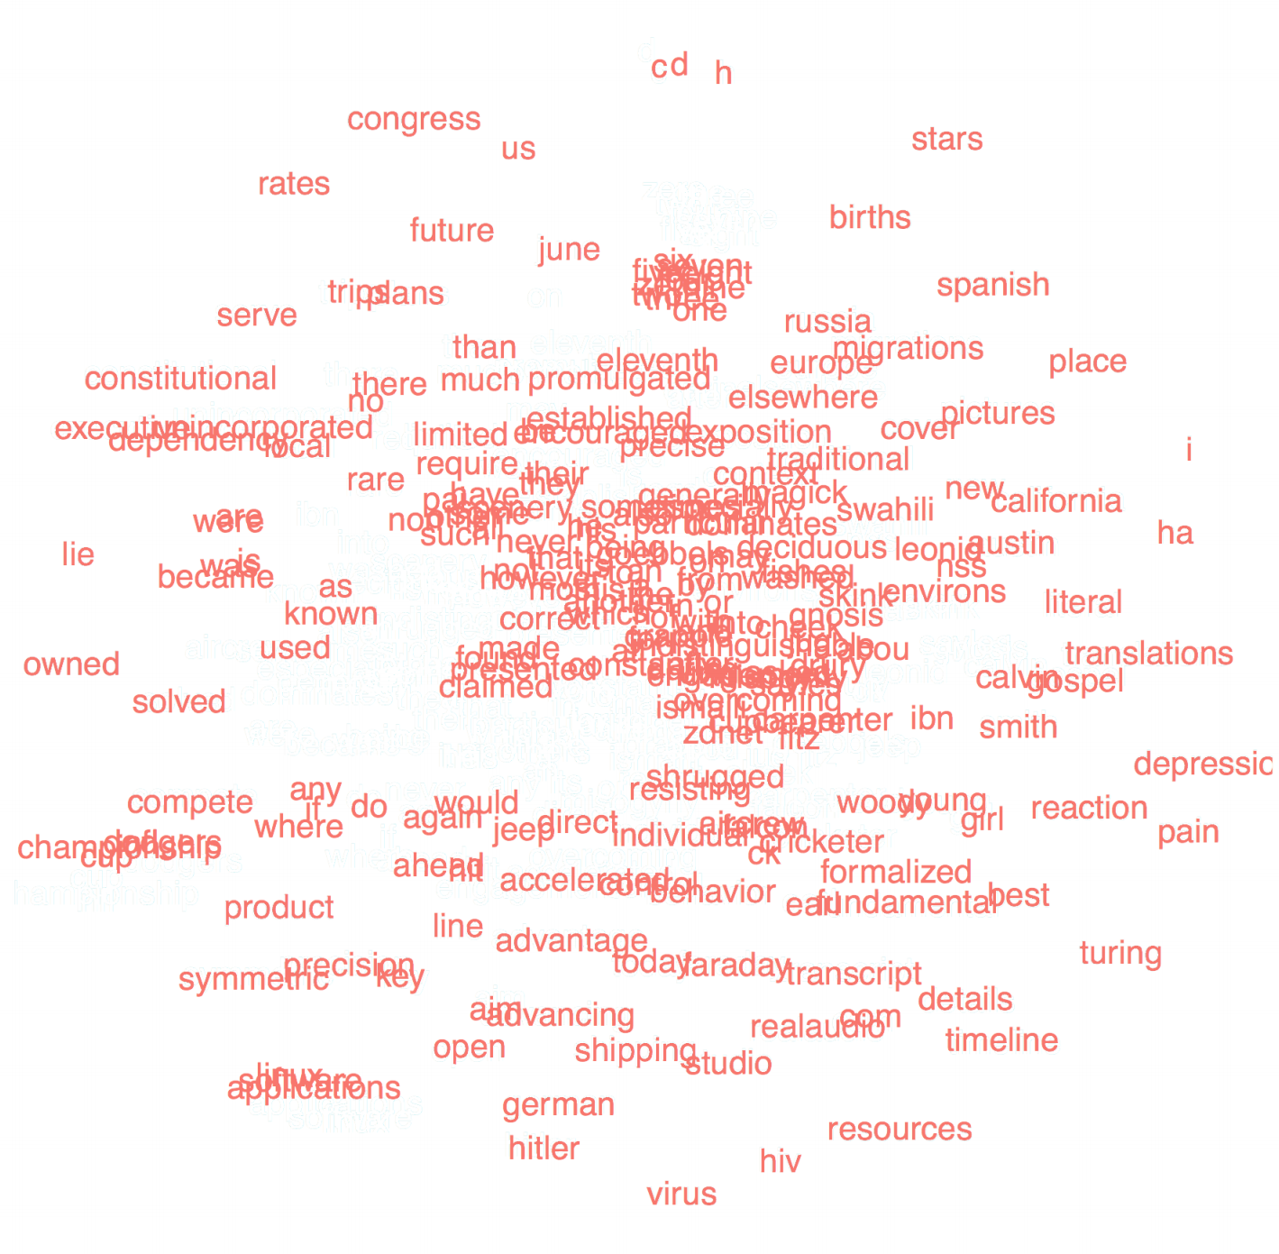
Latent Vector Space
Distance reflects object similarity
Objects span
the entire space

Slide 21
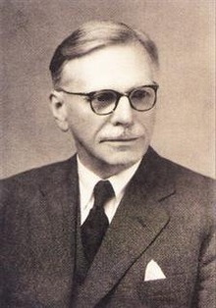
Distributional Semantic Models
You shall know a word by the company it keeps

Slide 22
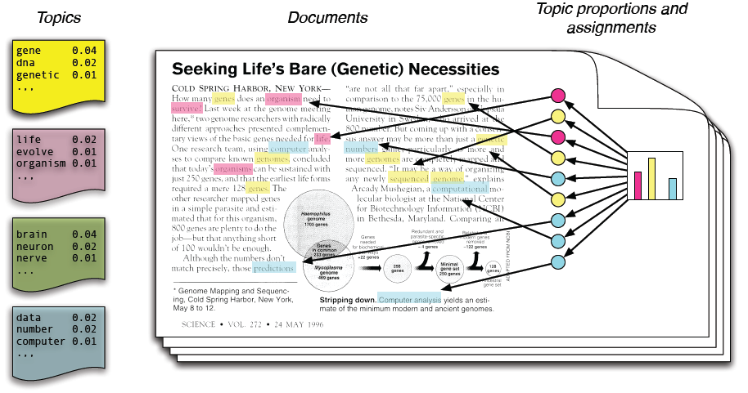
Topic Modelling (LDA)

Slide 23
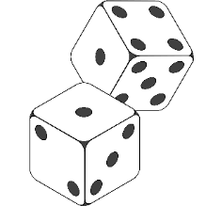
Topic Modeling: Latent Dirichlet Allocation (LDA)
Document d
Topics
Words
Topic t
Documents
Word w
Topics

Slide 24

Topic Modeling: Latent Dirichlet Allocation (LDA)
2 | 1 | 5 | 3 | 1 | 4 | 1 | 5
The brown fox jumps over the lazy dog

Slide 25

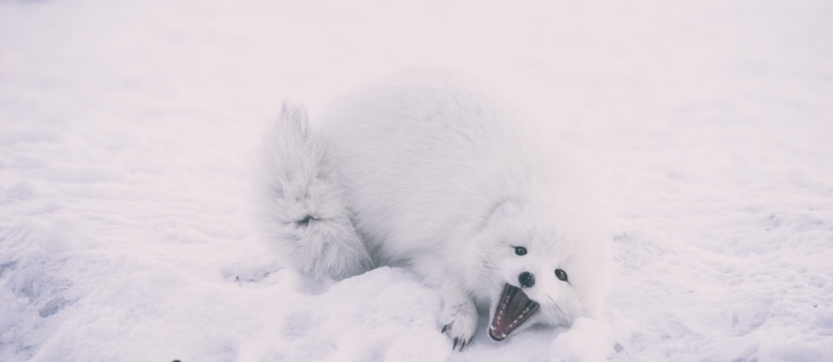

Topics = Interpretable Dimensions
music song sing singing sang play played songs playing heard tune…
snow cold rain wind ice storm weather winter warm night air…
computer machine data system work program new information machines human computers…

Slide 26
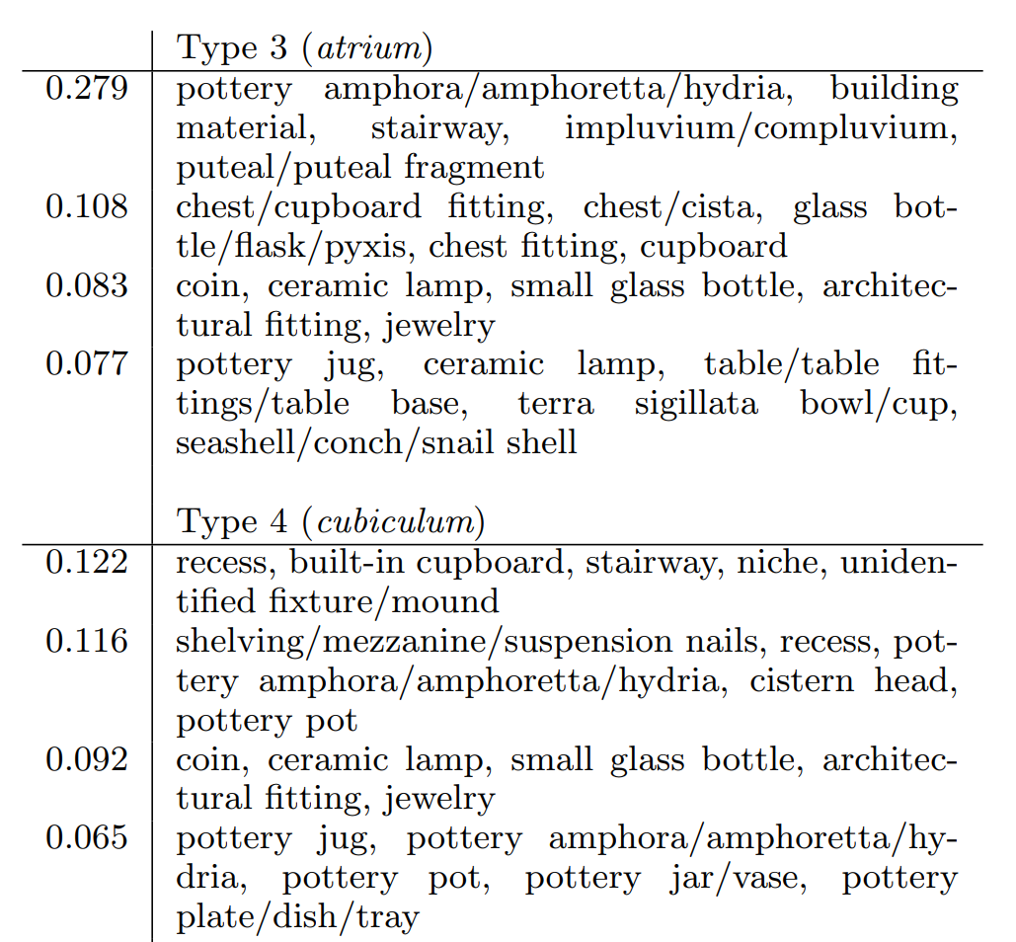
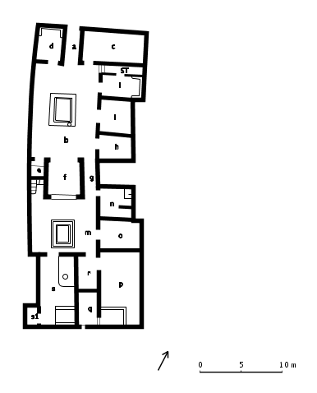
More than Words
Notes:
http://www.stoa.org/projects/ph/home

Slide 27

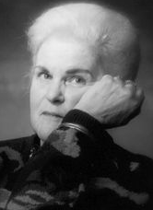

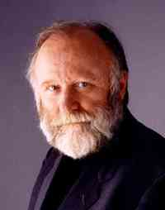
…but topics can correlate with known structure
jaxom ruth pellar dragon menolly harper lytol hold cristov fire-lizards…
leto paul jessica baron fremen duke emperor atreides idaho duncan…

Slide 28
Tips
There is no “right” number of topics
“Optimal” document size ≈ a paragraph
Remove the highest frequency “stop” words to improve topic quality
Remove the lowest frequency words to reduce training time
Look beyond top words

Slide 29
jsLDA
https://mimno.infosci.cornell.edu/jsLDA/

Slide 30
Supsampling techniques can help
school professor work university years research science students
professor university college student students research school science
f'lar lessa weyr robinton hold dragon f'nor lord dragons benden rider
lord hold between master queen star enough turns high good
jack emma malenfant trip janet michael ing wireman leonard
✗
sand pirx mars desert roger dust rock bass dunes crater martian
sand desert rock mountains mountain dust land surface plain

Slide 31
For more details…
https://github.com/laurejt/authorless-tms

