Slide 1
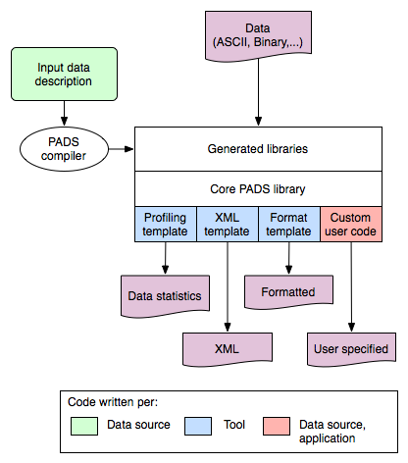
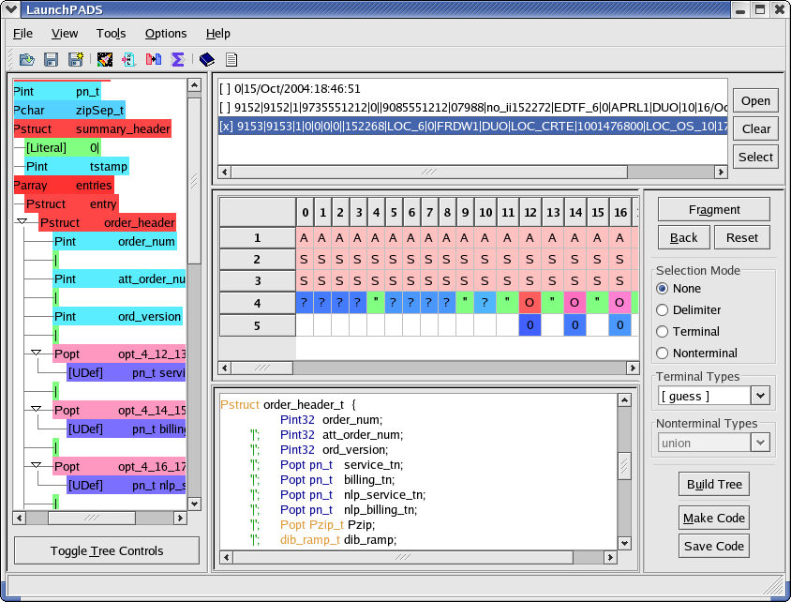


Schema Inference for Real-Time Network Forensic Analysis
Objective: automated inference of semi-structured data schemas
STUDY DESCRIPTION
Background: Real-time network forensics involves human-guided analysis of multiple data sources that cannot be anticipated in advance.
Status quo: Real-time forensic analysis cannot be conducted because reverse engineering the schema and building parsers for the newly encountered data sources require too much time. Only after these preliminaries are accomplished is it possible to perform forensic analysis.
Objective: Determine if it is possible to automatically infer semi-structured data schemas. Develop the architecture of a larger “network forensics analysis workbench”
Approach: …
Network Forensic Data
Analysis Workbench Architecture
Network forensics requires automated schema inference because one cannot anticipate all necessary data sources and handcrafting data parsers takes too much time.
PAYOFF
Real-time forensic analysis will support more flexible and reactive computer network defenses
A “data analyst’s workbench” with automatic schema inference has applications beyond network forensics, in domains as diverse as telecommunications, financial analysis, and scientific endeavors from computational biology to physics.
KEY SCIENTIFIC QUESTIONS
Question 1: Can semi-structured data schemas be inferred automatically?
Question 2: By what metrics can the quality of schema inference be expressed?
Question 3: What interactive process would allow an analyst to refine the automatically inferred schema?
Question 4: What is the architecture of a larger forensic analysis workbench?

