Slide 1
PADS Kick-off Meeting
Kathleen Fisher
David Walker
David Burke
Andy Adams-Moran
Dec 8th, 2006

Slide 2

localhost - - [25/Nov/2006:12:37:43 -0800] "POST / HTTP/1.1" 200 224
localhost - - [25/Nov/2006:12:37:43 -0800] "POST / HTTP/1.1" 200 236
localhost - - [25/Nov/2006:12:37:48 -0800] "POST / HTTP/1.1" 200 224
localhost - - [25/Nov/2006:12:37:48 -0800] "POST / HTTP/1.1" 200 224
?
Dec 10 04:07:50 Updated: pam.x86_64 0.77-66.13
Dec 10 04:07:51 Updated: openssl.x86_64 0.9.7a-43.4
Dec 10 04:07:51 Updated: openldap.x86_64 2.2.13-4
Dec 10 04:07:52 Updated: wget.x86_64 1.10.2-0.40E
Dec 10 04:07:52 Updated: util-linux.x86_64 2.12a-16.EL4.12
----Configure File Security...
Configure c:\autoexec.bat.
Configure c:\boot.ini.
Configure c:\config.sys.
Configure c:\ntbootdd.sys.
Warning 2: The system cannot find the file specified.
Error setting security on c:\ntbootdd.sys.
Background: Network forensics involves human-guided analysis of “ad hoc” data
  key difficulty: neither required data sources nor questions to ask known in advance
  consequence: prior to data analysis, it is necessary to understand the formats of relevant data sources & to build tools for analysis (parser, format translator, query engine) ==> analysis can’t currently be done in real time.
Long-term (post seedling) goal: Build “Network Forensic Workbench” --- a platform for real-time network forensic analysis
Critical seedling questions:
  What kinds of data formats are used in network forensics?
  Can these data formats be learned automatically or partly automatically?
  How should one evaluate the success of format inference (from both theoretical and empirical perspectives)?
  What is the overall architecture of a network forensic workbench?

Slide 3
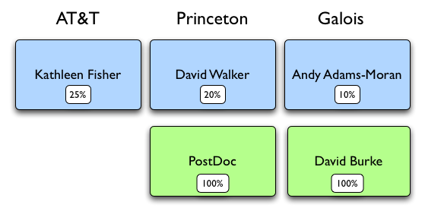
Organizational Chart
New

Slide 4
Tasks
4.1.1 collect data sources (CDRL A003)
4.1.2 design and implement inference algorithm (CDRL A004)
4.1.2.1 identify needed base types
4.1.2.2 develop algorithms to identify base types and punctuation
4.1.2.3 develop algorithms to infer higher-level structure
4.1.2.4 develop algorithms to infer dependencies
4.1.2.5 prototype algorithms
4.1.3 propose Forensic Data Workbench Architecture (CDRL A005)
4.1.4 evaluate inference algorithm (CDRL A006)
4.1.4.1 develop metric for description quality
4.1.4.1 compare with Excel
4.1.4.2 measure effectiveness using PADS tools
4.1.4.3 measure speed of inference
4.1.4.4 document difficult formats
4.1.5 develop and conduct software demonstrations (CDRL A007)
4.1.5.1 develop software demonstrations
4.1.5.2 conduct software demonstrations
4.1.6 deliver software (CDRL A008 A009)
4.1.7 Document and report
4.1.7.1 continually report progress (CDRL A001)
4.1.7.2 oral presentations (CDRL A002)
4.1.7.3 write final report (CDRL A010)

Slide 5
Overall Schedule
TASK
SUBTASK
begin
dec 1
jan 1
feb 1
mar 1
apr 1
end
1.
4.1.1 collect data sources (CDRL A003)
4.1.2 design and implement inference algorithm (CDRL A004)
2.
4.1.2.1 identify needed base types
3.
4.1.2.2 develop/prototype algorithms to identify base types
4.
4.1.2.3 develop/prototype algorithms to infer rough structure
5.
4.1.2.3 develop/prototype algorithms to infer refine structure
4.1.2.4 develop/prototype algorithms to infer dependencies
6.
7.
4.1.3 propose Forensic Data Workbench Architecture (CDRL A005)
8.
4.1.4 evaluate inference algorithm (CDRL A006)
4.1.4.1 develop metric for description quality
4.1.4.1 compare with Excel
4.1.4.2 measure effectiveness using PADS tools
4.1.4.3 measure speed of inference
4.1.4.4 document difficult formats
4.1.5 develop and conduct software demonstrations (CDRL A007)
4.1.5.1 develop software demonstrations
4.1.5.2 conduct software demonstrations
& 4.1.7.2 oral presentations (CDRL A002)
4.1.6 deliver software (CDRL A008 A009)
4.1.7.3 write final report (CDRL A010)
9.

Slide 6
Schedule notes
Schedule is “extraordinarily” preliminary.
  Need to know formal end date of proposal!
preliminary data sets (log files from Mac, Linux, Windows collected. Must schedule meet with forensics experts.
implement base type library jan-march
expressed using regular expressions (support implemented already); second development phase for new base types identified
infer single-record type formats (progress begun; end dec); infer multi-record type formats (Kathleen)
dependency analysis (Zach, Walker, postdoc)
structure rewriting (Kathleen, Walker, postdoc)
who? Burke?
who?
all – last month is empirical performance evaluation of prototype & report writing

Slide 7
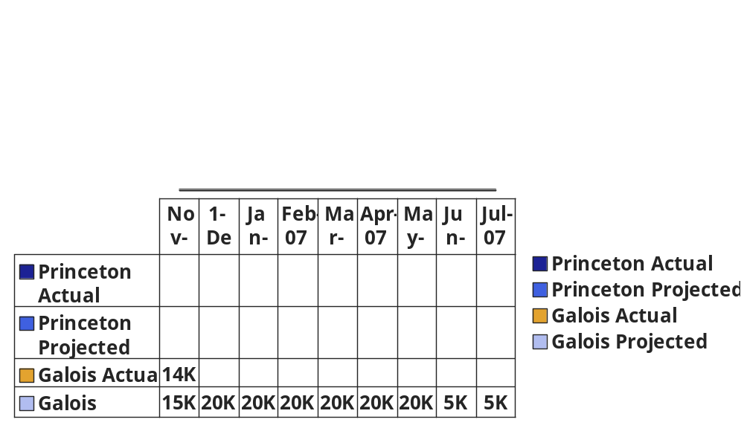
Financial Expenditures Chart

Slide 8
Recent Accomplishments
Administrative
  Signed contract
  Hired postdoc (Kenny Zhu)
Domain Experts & Data Acquisition [cdrl 3]
  Created interview template & begun conducting interviews
  Collected sample log files from various sources
Technical [cdrl 4]
  Defined 3-stage algorithm structure
    (a) tokenize (b) rough structure (c) refine
    see technical section of slides
    initial prototypes for (a) and (b)
      success on relevant, simple formats already
  Conducted literature search for theoretical background
    identified key related work on grammatical inference & info theory
  Defined information-theoretic scoring function to measure success

Slide 9
Current Plan
Administrative
  Kenny Zhu begins research
Domain Experts & Data Acquisition [cdrl 3]
  Complete expert interviews and data acquisition (end Jan)
Technical [cdrl 4, 5]
  Design preliminary Network Forensic Workbench Architecture
    document ideas with slides and text
  Improve tokenization techniques & library (end Feb)
  Refine implementation of core structure inference (end Feb)
  Implement structure refinement (end Feb)
  Implement complexity measure (end Jan)
    Implement evaluation infrastructure (begin Feb)

Slide 10
Risks and Risk Mitigation
technical risks:
  inference may not work for certain formats needed by forensic analysts
    mitigation: convenient visual interface allows user to interactively control inference
    analysis: relatively high possibility inference will not be perfect in all cases, relatively low consequences
  may take Kenny longer to come up to speed on technical components than is allowed for
    mitigation: inference architecture is modular and can produce useful results even if Kenny’s module is less sophisticated than what may ultimately be possible
    analysis: medium possibility, relatively low consequences
management risk: none (small team)
market risk: none (seedling provides no marketable products)

Slide 11
Intellectual property developments
Seedling proposal does not rely on pre-existing PADS intellectual property.
PADS currently available with non-commercial use license, going through process for open-source license (CPL).
AT&T intends to join follow-on proposal and include PADS license for government as would be required.

Slide 12
Administrative wrap up

Slide 13
Technical Discussion
PADS Overview
Prototype Network Forensic Analysis Workbench
  Identify domain experts
Format Inference Algorithm
Underlying Theory
Metrics
Experimental Evaluation

Slide 14
Technical Challenges of Ad Hoc Data
Data arrives “as is.”
Documentation is often out-of-date or nonexistent.
  Hijacked fields.
  Undocumented “missing value” representations.
Data is buggy.
  Missing data, human error, malfunctioning machines, race conditions on log entries, “extra” data, …
  Processing must detect relevant errors and respond in application-specific ways.
  Errors are sometimes the most interesting portion of the data.
Data sources often have high volume.
  Data may not fit into main memory.
Notes:
As is: just say thank you.
Documentation may or may not exist. If it does exist, out of date. Hijacked fields.. Evolving spec.
Seems to be a fact of life: buggy data. Machines that start outputing wrong data, human data entry, missing data
How to respond to errors is very application specific. Halt, discard, repair.
Errors can be the most interesting part of the data. They can signal that a machine is experiencing problems, which is very crucial for monitoring applications. Or where two machines are failing to communicate.
All these problems exaserbated by the scale of the data. How do you ‘look’ at gigabytes of data and develop a feel for it?
Of course, before you can do anything with such data sets, you have to write a parser.
Being computer scientists, we think of standard tools,… lex, yacc,,, How many people use such tools?

Slide 15
PADS Language
Provides rich and extensible set of base types.
  Pint8, Puint8, … // -123, 44
  Pstring(:’|’:) // hello | Pstring_FW(:3:) // catdog Pstring_ME(:”/a*/”:) // aaaaaab
  Pdate, Ptime, Pip, …
Provides type constructors to describe data source structure:
Pstruct, Parray, Punion, Ptypedef, Penum
Allows arbitrary predicates to describe expected properties.
Types indicate how to process associated data.
Notes:
So, what does the language look like? It provides a type based model. A pads spec is a sequence of type declarations, each of which describes a portion of the associated ad hoc data sources. PADS provides a rich and extensible collection of base types, each of which describes some form of atomic data. There are collecitons of integer gypes, including signed and unsigned varieties at a number of different sizes. For example, Pint8 denotes a signed integer that will fit in one byte of memory. There are a collection of base types for describing strings, each of which is parameterized by a value parameter indicating the extent of the string. The first form takes as an argument a termination character. So, applied to the character squence at left, would match the string hello, leaving the vertical bar in the input for later processing. The second string type on the slide takes an integer expression denoting the length of the sequence, in this case, three. The third form takes a regular expression, which describes the string to be matched. In addition, there are base types for describing dates, times, ip addresses, and others as we find atomic types in demand. Pads also provides a collection of type constructors to allow programmers to build descriptions of complex structures out of simpler pieces. We named the constructors in analogy with C types. Pstructs describe sequences of data with unrelated types. Parrays describe sequences with the same type. Punions describe alternatatives. We support two varieties: in place and switched. In place unions try each branch in seuqnce and take the first branch that parses without error. Switched unions branch to a particular choice depending upon an earlier determined value. Typedefs all us to add constraints to existing types, while enums describe a fixed collection of character sequences on disk.

Slide 16
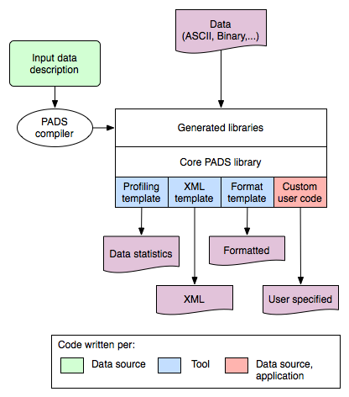
PADS Architecture
Notes:
The programmer writes a pads description, which the pads compiler converts into a data-source specific library. This code gets linked with the core PADS library.

Slide 17
Network Forensic Analysis Workbench
User interface wrapped around PADS engine.
Data description sources:
  Format inference
  Library of common formats
  Hand written/customized
Data understanding tools:
  Statistical analysis
  Visualization
  Query support
Data transformation support:
  XML, relational databases, S, ...

Slide 18
Domain experts
Need to meet with NFA experts
  Improve understanding of domain
  Refine prototype architecture
  Identify relevant data sources
Candidate experts:
  Gary Klein (gklein@mitre.org)
  COL Hunt (Carl.Hunt@tic.doc.mil)
  PSU
  AT&T
  BAH
  Raytheon
  Jurinnov
  Others?

Slide 19
Sample Data Formats
Log files
  Apache, asl, access_log, crashreporter, interface.loop, windowserver_last.log, page_log, install.log, daily.out
Government web sites
  MER_T01_01.csv
  Railroad.txt
  Quartery Personal Income
Need to identify many others

Slide 20
Format inference
Chunked data
Tokenization
Structure
Discovery
Format
Refinement
Data Description

Slide 21
Tokenization
Expressed as regular expressions
Basic tokens
  Integers, white space, punctuation
  Strings: alpha, alpha[alpha,numeric]*, dashes, etc?
“Distinctive” tokens
  IP addresses, times, dates, MAC addresses,…
  How important are such tokenizations?
  What others should we consider?
Matching tokenization of underlying data source can make a big difference in structure discovery.

Slide 22
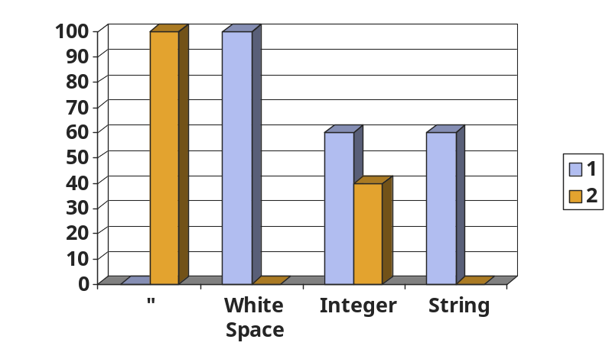
Structure Discovery: Finding Clusters
Compute frequency distribution for each token.
Cluster tokens with similar frequency distributions.
  Quote and white space end up in same cluster.
“123, 24”
“345, begin”
“574, end”
“9378, 56”
“12, middle”
“-12, problem”
…

Slide 23
Structure Discovery: Finding Structs
Identify any “struct-like” cluster:
  Single-spike in frequency distribution
  Above threshold for coverage (number of chunks with all tokens in cluster).
Partition chunks:
  One group for each ordering of cluster tokens that appears in data: (G₁, …, G_{n})
  One group for chunks that don’t have tokens: G_{other}.
  In example, all chunks end up in G₁
“123, 24”
“345, begin”
“574, end”
“9378, 56”
“12, middle”
“-12, problem”
…

Slide 24
Structure Discovery: Finding Structs, con’t
For each G₁, …, G_{n}, use cluster tokens to divide input into new chunked data.
If n>1 and G_{other} exists, introduce union.
For each G_{i}, introduce struct into description.
123
345
574
9378
12
-12
…
“123, 24”
“345, begin”
“574, end”
“9378, 56”
“12, middle”
“-12, problem”
…
24
begin
end
56
middle
problem
…
Struct{
“\””;
TBD_0;
“, “;
TBD_1;
“\””;
}
Recurse...

Slide 25
Structure Discovery: Finding Arrays
If no struct-like cluster exists, we look for an array cluster:
  High coverage
  Frequency distribution has width above threshold
Use tokens in array cluster to create two nested contexts:
  All array cells not including last.
  All array cells in last position.
Recursively process each nested context.
If array has separator, it will appear in first context but not the second.

Slide 26
Format refinement
Reanalyze example data with aid of rough description
Rewrite format description to:
  optimize information-theoretic complexity
    simplify presentation
    improve precision
      reorganize description structure
      add constraints (sortedness, uniqueness, linear relations, functional dependencies)
  fill in missing details
    find completions where structure discovery bottoms out
    refine base types (termination conditions for strings, integer sizes)

Slide 27
Format Refinement
Three main sub-phases
  Phase 1: Tagging/Table generation
    Convert rough description into tagged description + relational table
  Phase 2: Constraint inference
    Analyze table and infer constraints
    Use TANE algorithm [Huhtala et al. 99]
  Phase 3: Format rewriting
    Use inferred constraints & type isomorphisms to rewrite rough description

Slide 28
Format inference and refinement: Simple Example

Slide 29
“0, 24”
“foo, beg”
“bar, end”
“0, 56”
“baz, middle”
“0, 12”
“0, 33”
…

Slide 30
struct
“0, 24”
“foo, beg”
“bar, end”
“0, 56”
“baz, middle”
“0, 12”
“0, 33”
…
“
union
,
union
”
structure
discovery
int
alpha
int
alpha

Slide 31
struct
struct
“0, 24”
“foo, beg”
“bar, end”
“0, 56”
“baz, middle”
“0, 12”
“0, 33”
…
“
union
,
union
”
“
union
(id1)
,
union
(id2)
”
structure
discovery
tagging/
table gen
int
alpha
int
alpha
int (id3)
alpha (id4)
int (id5)
alpha
(id6)
id1
id2
id3
id4
id5
id6
1
1
0
--
24
--
2
2
--
foo
--
beg
...
...
...
...
...
...

Slide 32
struct
struct
“0, 24”
“foo, beg”
“bar, end”
“0, 56”
“baz, middle”
“0, 12”
“0, 33”
…
“
union
,
union
”
“
union
(id1)
,
union
(id2)
”
structure
discovery
tagging/
table gen
int
alpha
int
alpha
int (id3)
alpha (id4)
int (id5)
alpha
(id6)
id1
id2
id3
id4
id5
id6
1
1
0
--
24
--
2
2
--
foo
--
beg
...
...
...
...
...
...
constraint
inference
id3 = 0
id1 = id2
(first union is “int” whenever
second union is “int”)

Slide 33
struct
struct
“0, 24”
“foo, beg”
“bar, end”
“0, 56”
“baz, middle”
“0, 12”
“0, 33”
…
“
union
,
union
”
“
union
(id1)
,
union
(id2)
”
structure
discovery
tagging/
table gen
int
alpha
int
alpha
int (id3)
alpha (id4)
int (id5)
alpha
(id6)
id1
id2
id3
id4
id5
id6
1
1
0
--
24
--
2
2
--
foo
--
beg
...
...
...
...
...
...
struct
constraint
inference
“
union
”
struct
struct
id3 = 0
id1 = id2
(first union is “int” whenever
second union is “int”)
rule-based
structure
rewriting
0
,
int
alpha-string
,
alpha-string
more accurate:
-- first int = 0
-- rules out “int , alpha-string” records

Slide 34
Format refinement:
Tagging/Table Generation
Phase input: rough format structure
Phase output: tagged structure & relational table

Slide 35
Format refinement:
Tagging/Table Generation
Phase input: rough format structure
Phase output: tagged structure & relational table
24
56
13
...
int
int values, one per row

Slide 36
Format refinement:
Tagging/Table Generation
Phase input: rough format structure
Phase output: tagged structure & relational table
24
56
13
...
int
int values, one per row
struct
tables for each
sub-type Ti
glued together
T1
T2
T3
T1
T2
T3

Slide 37
Format refinement:
Tagging/Table Generation
Phase input: rough format structure
Phase output: tagged structure & relational table
24
56
13
...
int
int values, one per row
struct
tables for each
sub-type Ti
glued together
T1
T2
T3
T1
T2
T3
BR = union branch
number for that row
a row of Table Ti is
occupied when BR = i
a row of Ti unoccupied
when BR not= i
union
BR
T1
T2
T3
T1
T2
T3

Slide 38
Format refinement:
Tagging/Table Generation
Phase input: rough format structure
Phase output: tagged structure & relational table
24
56
13
...
int
int values, one per row
struct
tables for each
sub-type Ti
glued together
T1
T2
T3
T1
T2
T3
BR = union branch
number for that row
a row of Table Ti is
occupied when BR = i
a row of Ti unoccupied
when BR not= i
union
BR
T1
T2
T3
T1
T2
T3
array
the table for the array
type has a column
for the length (like an
int or base type)
a completely separate
table is created for the
array elements
L
T2
T1
T1
T1
T2
primary table for
arrays returned in recursive alg.

Slide 39
Format refinement:
Constraint Inference
Phase input: relational tables
Phase output: list of constraints
  several kinds of constraints
    uninterpreted functional dependencies – a relation {colA, colB, ...} --> colk such that a row indexed by colA, colB, ... determines the item in colk
      a key is a trivial functional dependency
    equality constraints – colA = colB
    set constraints – colA ∈ {val1, val2, ... }
    linear functional dependencies – a functional dependency that satisfies a linear equation a*colA + b*colB + c*colC + k = 0
  set of constraints guaranteed to be minimal
  use the TANE algorithm [Huhtala et al. 99]
  example:
A
B
C
D
1
3
2
7
9
4
5
100
100
300
100
300
200
100
foo
foo
foo
foo
foo
bof
foo
50
50
150
50
150
100
50
A is a key
{B} --> C is an uninterpreted functional dependency
{C} --> B is NOT a functional dependency
{D} --> B with B – 2*D = 0 is a linear functional dependency

Slide 40
Format refinement:
Format rewriting
Phase input: tagged structure, list of constraints
Phase output: complete, refined structure
Algorithm:
  Bottom-up algorithm rewrites tagged structure whenever rewriting rules match
  Rule form: {constraint} & structure pattern ==> new structure
  Example rules:
constraint-independent rules:
constraint-dependent rules:
T * T array ==> T array
T array * T ==> T array
T + empty ==> T option
empty + T ==> T option
T * ... * T ==> T array[k]
a*id1 - id2 + k = 0 & id2:T array ==> T array[a*id1 + k]
id1 = id2 & (id1:T1+T3) * .... * (id2:T2+T4)
==>
(T1 * ... * T2) + (T3 * ... * T4)
{id1} ==> id2 & id2: (T1 + T2)
id1 ∈ {c1, c2} ==>
switch id1 of
c1 ==> T1
| c2 ==> T2
k, k > 3

Slide 41
Underlying Theory
Shannon’s information theory
Connections to compression?
Leads from Michelle Effros
Hector Garcia-Molena’s work on extracting information from web pages.

Slide 42
Experimentation & Evaluation: Goals
Develop qualitative assessment of formats
  categorize formats by syntactic features:
    kinds of structured elements, English text, xml/html
  identify difficult features/formats
  identify notions of “failure” and their consequences (talk to Klein)
Develop “gold standard” for comparison
  descriptions written by people
Develop quantitative assessment of inferred formats
  measure information-theoretic complexity
  measure stability of descriptions inferred from different training samples
  measure underfitting relative to gold standard
  measure overfitting relative to gold standard and errors detected by PADS accumulator on new data of that form
  measure performance
Evaluate existing tools
  Hector (if code is available and executes)
  Excel (qualitatively)

Slide 43
Experimentation & Evaluation: Tasks
Write ‘gold standard’ format descriptions
  Postdoc’s first job
  Will time manual description writing process
Define evaluation metrics
  single-description complexity metric
  distance metric between two descriptions
    based on complexity
    based on format rewriting/merging
Develop evaluation infrastructure & run experiments
  implement evaluation metrics
  implement test harness
  compare with gold standard via evaluation metrics
  cross-validate inference techniques on multiple data sets of the same kind (assess inference stability)
  measure error rate using PADS accumulator
  qualitative evaluation of excel
  document results

