Slide 1
From Dirt to Shovels:
Automatic Tool Generation from Ad Hoc Data
Kenny Zhu
Princeton University
with Kathleen Fisher, David Walker and Peter White

Slide 2

A System Admin’s Life

Slide 3

Web Server Logs…

Slide 4

System Logs…

Slide 5

Application Configs…

Slide 6

User Emails

Slide 7

Script Outputs and more…
Notes:
Usually not well documented and poorly understood
No ready-made tools
They change from time to time!
We call them ad-hoc data

Slide 8
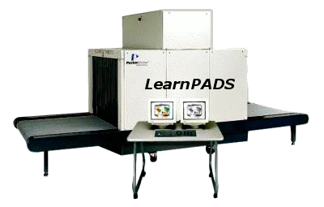


Automatically Generate Tools from Data!
XML converter
Data profiler
Grapher, etc.
Notes:
Managing ad hoc data is tedius, error-prone and costly task
We have built LearnPADS! That’s what this talk is about!

Slide 9
Architecture
Raw Data
XML
converter
XML
Profiler
Analysis
Report
Format
Inference
Tokenization
Tokenization
LearnPADS
Structure
Discovery
Structure
Discovery
Format
Refinement
Format
Refinement
Scoring
Function
Data
Description
PADS
Compiler

Slide 10
Simple End-to-End
Data Sources:
Description:
XML output:
Punion payload {
Pint32 i;
PstringFW(3) s2;
};
Pstruct source {
‘\”’; payload p1;
“,”; payload p2;
‘\”’;
}
<source>
<payload>
<int><val>0</val></int>
</payload>
<payload>
<int><val>24</val></int>
</payload>
</source>
<source>
<payload>
<string><val>bar</val></string>
</payload>
<payload>
<string><val>end</val></string>
</payload>
</source>
“0, 24”
“bar, end”
“foo, 16”
Notes:
PADS descriptions based on “types”
Broad collection of “base types” (ints, strings, dates, ip addresses...)
Structured types includes “structs,” “unions” and “arrays”
has many other features: dependency, constraints, recursion, ...

Slide 11
Tokenization
Parse strings; convert to symbolic tokens
  Basic token set skewed towards systems data
    Int, string, date, time, URLs, hostnames …
  A config file allows users to define their own new token types via regular expressions
“0, 24”
“ INT , INT ”
tokenize
“bar, end”
“ STR , STR ”
“foo, 16”
“ STR , INT ”

Slide 12
Structure Discovery: Overview
Top-down, divide-and-conquer algorithm:
  Compute various statistics from tokenized data
  Guess a top-level description
  Partition tokenized data into smaller chunks
  Recursively analyze and compute descriptions from smaller chunks

Slide 13
Structure Discovery: Overview
Top-down, divide-and-conquer algorithm:
  Compute various statistics from tokenized data
  Guess a top-level description
  Partition tokenized data into smaller chunks
  Recursively analyze and compute descriptions from smaller chunks
candidate
structure
so far
struct
?
discover
“
,
”
?
?
“ INT , INT ”
INT
INT
“ STR , STR ”
sources
STR
STR
“ STR , INT ”
STR
INT

Slide 14
Structure Discovery: Overview
Top-down, divide-and-conquer algorithm:
  Compute various statistics from tokenized data
  Guess a top-level description
  Partition tokenized data into smaller chunks
  Recursively analyze and compute descriptions from smaller chunks
struct
struct
discover
“
,
”
“
,
”
?
?
?
union
INT
INT
INT
STR
INT
STR
STR
?
?
STR
INT
INT
STR
STR

Slide 15
Structure Discovery: Details
Compute frequency distribution histogram for each token.
(And recompute at every level of recursion).
“ INT , INT ”
“ STR , STR ”
“ STR , INT ”
percentage
of sources
Number
of occurrences
per source
Notes:
For the data source on the left, the diagram on the right shows 4 histograms, one for each token
For each token x, purple column represents the percentage of sources that has exactly 1 occurrence of x
green column represents the percentage of sources that has exactly 2 ocurrences of x

Slide 16
Structure Discovery: Details
Cluster tokens with similar histograms into groups
  Similar histograms
    tokens with strong regularity coexist in same description component
    use symmetric relative entropy to measure similarity
  Only the “shape” of the histogram matters
    normalize histograms by sorting columns in descending size
    result: comma & quote in one group, int & string in another

Slide 17
Structure Discovery: Details
Classify the groups into:
  Structs == Groups with high coverage & low “residual mass”
  Arrays == Groups with high coverage, sufficient width & high “residual mass”
  Unions == Other token groups
Pick group with strongest signal to divide and conquer
More mathematical details in the paper
Struct involving comma, quote identified in histogram above
Overall procedure gives good starting point for refinement

Slide 18
Format Refinement
Reanalyze source data with aid of rough description and obtain functional dependencies and constaints
Rewrite format description to:
  simplify presentation
    merge & rewrite structures
  improve precision
    add constraints (uniqueness, ranges, functional dependencies)
  fill in missing details
    find completions where structure discovery bottoms out
    refine base types (integer sizes, array sizes, seperators and terminators)
Rewriting is guided by local search that optimizes an information-theoretic score (more details in the paper)

Slide 19
Refinement: Simple Example

Slide 20
struct
struct
“0, 24”
“foo, beg”
“bar, end”
“0, 56”
“baz, middle”
“0, 12”
“0, 33”
…
“
union
,
union
”
“
union
(id1)
,
union
(id2)
”
structure
discovery
tagging/
table gen
int
str
int
str
int (id3)
str (id4)
int (id5)
str (id6)
id1 | id2 | id3 | id4 | id5 | id6
1 | 1 | 0 | --- | 24 | ---
2 | 2 | --- | foo | --- | beg
. . . | . . . | . . . | . . . | . . . | . . .
struct
“
union
”
constraint
inference
struct
struct
Constraints:
id3 = 0
id1 = id2
0
,
int
str
,
str
rule-based
structure
rewriting
Greater Accuracy
First int is 0
No “int, str”
Notes:
Start with orig data sources and obtain an initial candidate structure
populate the data into the tree and attach relevant data to all the base types
tag all the base types and union types with unique ids and generate a table
using the data attached to the base types.
Each column in the table contains data associated with a particular base type
For a union column, branch numbers are included as data
Each row contains data from the one chunk of source

Slide 21
Evaluation

Slide 22
Benchmark Formats
Data source | Chunks | Bytes | Description
1967Transactions.short | 999 | 70929 | Transaction records
MER_T01_01.cvs | 491 | 21731 | Comma-separated records
Ai.3000 | 3000 | 293460 | Web server log
Asl.log | 1500 | 279600 | Log file of MAC ASL
Boot.log | 262 | 16241 | Mac OS boot log
Crashreporter.log | 441 | 50152 | Original crashreporter daemon log
Crashreporter.log.mod | 441 | 49255 | Modified crashreporter daemon log
Sirius.1000 | 999 | 142607 | AT&T phone provision data
Ls-l.txt | 35 | 1979 | Command ls -l output
Netstat-an | 202 | 14355 | Output from netstat -an
Page_log | 354 | 28170 | Printer log from CUPS
quarterlypersonalincome | 62 | 10177 | Spread sheet
Railroad.txt | 67 | 6218 | US Rail road info
Scrollkeeper.log | 671 | 66288 | Log from cataloging system
Windowserver_last.log | 680 | 52394 | Log from Mac LoginWindow server
Yum.txt | 328 | 18221 | Log from package installer Yum
Available at http://www.padsproj.org/

Slide 23
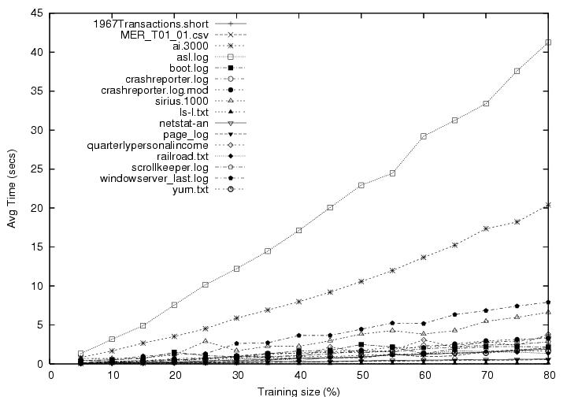
Training Time vs. Training Size
Notes:
Training time increase almost linearly with the size of training data

Slide 24
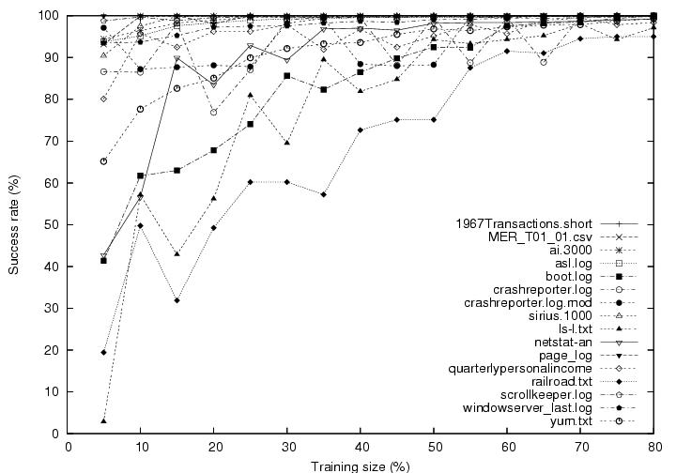
Training Accuracy vs Training Size
Notes:
We measure the training accuracy by parsing original data source using the description trained from smaller chunks
More heterogeneous and complex formats takes more data to train
Simpler data sources takes very little amount of data to train

Slide 25
Conclusions
We are able produce XML and statistical reports fully automatically from ad hoc data sources.
We’ve tested on approximately 15 real, mostly systemsy data sources (web logs, crash reports, AT&T phone call data, etc.) with what we believe is a good success
For papers, online demos & pads software, see our website at:
http://www.padsproj.org/

Slide 26
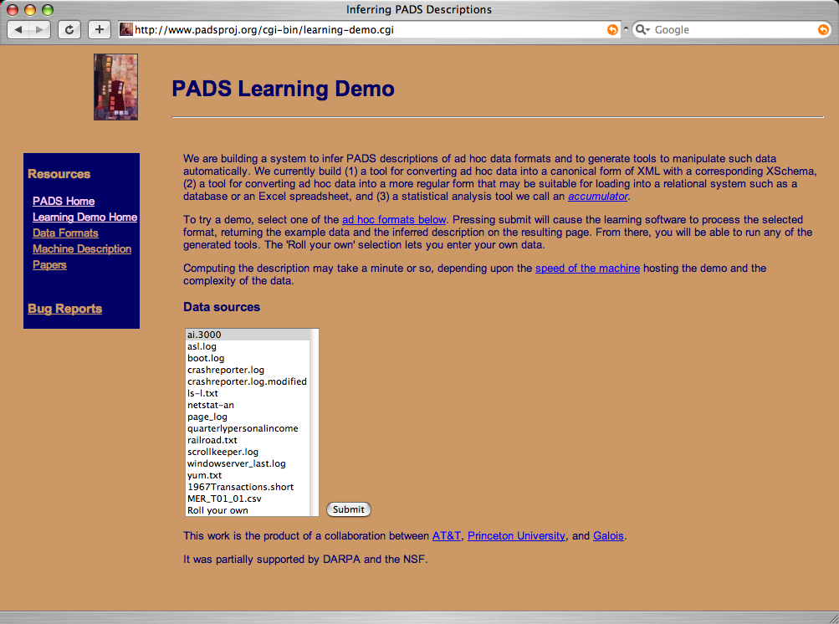
LearnPADS On the Web

Slide 27
End

Slide 28
Related Work
Most common domains for grammar inference:
  xml/html
  natural language
Systems that focus on ad hoc data are rare and those that do don’t support PADS tool suite:
  Rufus system ’93, TSIMMIS ’94, Potter’s Wheel ’01
Top-down structure discovery
  Arasu & Garcia-Molina ’03 (extracting data from web pages)
Grammar induction using MDL & grammar rewriting search
  Stolcke and Omohundro ’94 “Inducing probabilistic grammars...”
  T. W. Hong ’02, Ph.D. thesis on information extraction from web pages
  Higuera ’01 “Current trends in grammar induction”
  Garofalakis et al. ’00 “XTRACT for infering DTDs”
Notes:
We are solving an end-to-end problem
Generating tools
An under-studied domain: ad-hoc data
New top-down structure discovery algorithm
Other grammer inference techniques (for regex e.g.) are not immediately applicable
Information extration is often supervised learning using labeling, and they extract features, not the entire grammar…

Slide 29
Scoring Function
Finding a function to evaluate the “goodness” of a description involves balancing two ideas:
  a description must be concise
    people cannot read and understand enormous descriptions
  a description must be precise
    imprecise descriptions do not give us much useful information
Note the trade-off:
  increasing precision (good) usually increases description size (bad)
  decreasing description size (good) usually decreases precision (bad)
Minimum Description Length (MDL) Principle:
  Normalized Information-theoretic Scores
Transmission Bits = BitsForDescription(T) + BitsForData(D given T)

