Slide 1
The PADS-Galax Project
Enabling XQuery over Ad-hoc Data Sources
Yitzhak Mandelbaum

Slide 2
What is PADS?
Declarative data description language
Syntax & semantics of semi-structured, legacy data sources
From description, compiler generates:
  Data-parsing library
  In-memory representation
You write C program

Slide 3
What are XQuery and Galax?
XQuery
  Functional, strongly typed XML query language
  Well-suited to querying semi-structured sources
Galax
  Complete, extensible implementation of XQuery 1.0

Slide 4
HTTP Common Log Format
HTTP CLF Data
207.136.97.49 - - [15/Oct/1997:18:46:51 -0700]
"GET /tk/p.txt HTTP/1.0" 200 30
PADS Description
Pstruct http_request_t {
'\"'; http_method_t meth;
' '; Pa_string(:' ':) req_uri;
' '; http_v_t version: checkVersion
(version, meth);
'\"';
};

Slide 5
CLF as XML
207.136.97.49 … "GET /tk/p.txt HTTP/1.0" …
<http_clf>
<host>207.136.97.49</host>
...
<request>
<meth>GET</meth>
<req_uri>/tk/p.txt</req_uri>
<version>HTTP/1.0</version>
</request>
...
</http_clf>

Slide 6
Querying HTTP CLF
Selection & projection using XQuery
  Return list of URI’s requested by host $x.
  $log/http_clf[host=$x][request/meth= GET]/req_uri
Vet errors in data using XQuery
  Return locations of records with error in host field
  $log/http_clf[host/@errCode]/@loc

Slide 7
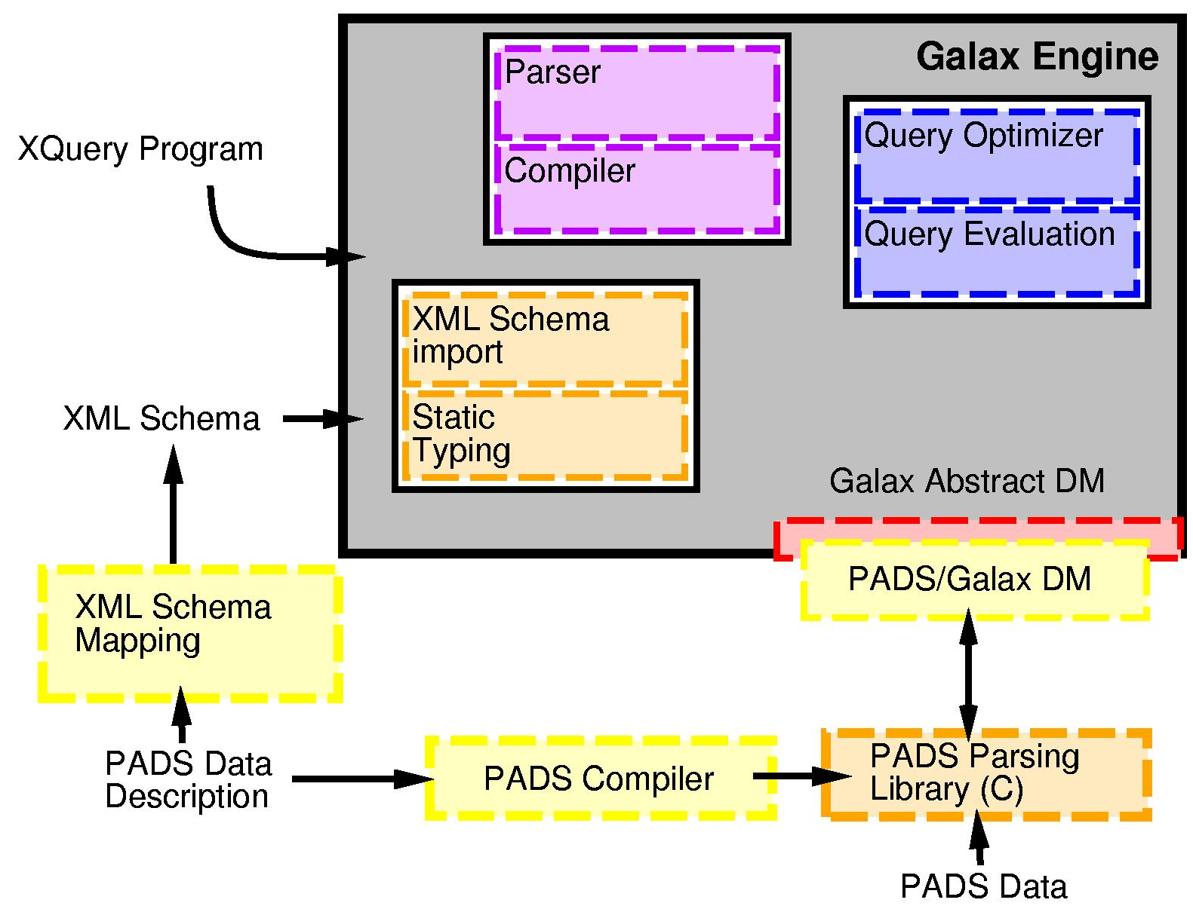
PADS-Galax Architecture

Slide 8
Technical Challenges
Define mapping from PADS description to XML Schema
Materialize PADS data as virtual XML
  Galax has abstract data model
  Implement Galax’s abstract data model on top of PADS

Slide 9
Technical Challenges
Memory management of PADS records
  Data exceeding memory limits requires clever memory management
  PADS program typically reads records sequentially
  Galax may not access records sequentially
User-friendly interface
  Describe PADS data, compile library, write & execute queries

Slide 10
Challenges & Solutions (1)
Define mapping from PADS description to XML Schema
  Canonical mapping defined Summer 2003
Materialize PADS data as virtual XML
  Started Summer 2003 but incomplete
  Align with current Galax Data Model

Slide 11
Abstract Node Interface
Fragment of Galax’s abstract XML node interface
  Full navigation of XML tree
  Access to atomic values
method virtual node_name : unit -> atomicQName option
method virtual typed_value : unit -> atomicValue cursor
method virtual parent : unit -> node option
method virtual children : unit -> node cursor
method virtual docorder : unit -> Nodeid.docorder
Cursor : lazy iterator access to node sequence
Node identity & document order : canonical order

Slide 12
Challenges & Solutions (2)
Memory management of PADS records
  Choose record as read granularity
  Read records on demand
  Maintain meta-data for fast re-retrieval
User-friendly interface
  Integrated docorder, cursors, and MM into compiler
  Room for improvement

Slide 13
A Smart Array
0
6 GB
…
log
meth
Meta-Data
GET

Slide 14
Project Status
Integration effort successful
More thorough regression testing
Demonstrate to potential users
Research problems
  Extending Galax’s data model to leverage streams access
  More efficient meta-data structures in PADS

Slide 15
Thanks to …
Kathleen Fisher
Robert Gruber
Mary Fernandez

Slide 16
Viewing & Querying HTTP CLF
Virtual XML Data
<http-clf>
<host>207.136.97.49</host>
<remoteID>-</remoteID>
<auth>-</auth>
<mydate>15/Oct/1997:18:46:51 -0700</mydate>
<request>
<meth>GET</meth>
<req_uri>/tk/p.txt</req_uri>
<version>HTTP/1.0 </version>
</request>
<response>200</response> <contentLength>30</contentLength>
</http-clf>

Slide 17
Describing HTTP Common Log Format
HTTP CLF Data
207.136.97.49 - - [15/Oct/1997:18:46:51 -0700]
"GET /tk/p.txt HTTP/1.0" 200 30
PADS Description
Pstruct http_request_t {
'\"'; http_method_t meth;
' '; Pa_string(:' ':) req_uri;
' '; http_v_t version:
chkVn(version, meth);
'\"';
\};
Pstruct http_clf_t {
Pint8 ip_t[4] : Psep('.') && Pterm(' ');
… http_request_t request;
};

Slide 18
Accessing Record Sequences
Access to record (node) sequence
  Read all items in sequence
  Produce items on demand
Each record field materialized strictly as needed
Solution:
  Choose record as read granularity
  Read records on demand
  Maintain meta-data for fast re-retrieval

