Slide 1



Virtual
Meet & Greet
March 30, 2023

Slide 2
Organizational Structure & Plans
Chat & Networking

Slide 3

CMADS Demo Site (https://cornellmads.github.io)
MADS intends to represent our diversity through Events and Board
2023 Board Members
President Danial Asmat `10
Programming & Outreach Dan Yelle `02
Marketing & Comm Namratha Satish `22
Operations & Mentorship Nathan Nastili `17
President
Outreach
Communications
Operations

Slide 4

Programming & Outreach
Establish connections with alumni and others to:
Introduce MADS
Build up the MADS network and yours
Find out from you what we can do to help
Programming
Events
Mentoring
Tell you about opportunities for getting involved
…contact us: cornellMADS@gmail.com CC: dmy6@cornell.edu

Slide 5
Operations & Mentoring
Mentorship
Volunteer basis
Participant Driven
Currently looking for mentors and mentees
Sign up for either or both!
Official Launch Pending Interest
Have suggestion or thoughts on the program, please get in touch!

Slide 6
Chat & Networking

Slide 7
What was your experience in the Masters Applied Stats program?
How connected are you to the program alumni (classmates)? What about Cornell at large?
What are you looking for in the next step of your career as a Data Scientist (or related)?
Are you looking to develop managerial or leadership skills?
What would you like to gain from a community of alumni?

Slide 8

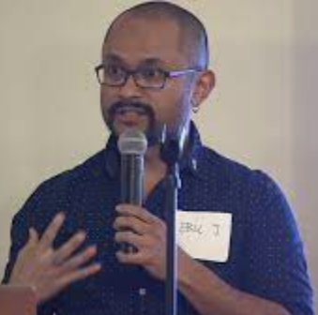
Fireside Chat
Eric Daza ′02
Our Next Session…
(Date TBD)

