Slide 1
CS5112: Algorithms and Data Structures for Applications
Lecture 4.1: Applications of hashing
Ramin Zabih
Some figures from Wikipedia/Google image search

Slide 2
Administrivia
Web site is: https://github.com/cornelltech/CS5112-F18
As usual, this is pretty much all you need to know
HW 1 at Thursday 11:59PM
Also very high tech!

Slide 3
Quiz 1 comments
Overall people did pretty well
6/6: 73 people
5/6: 58 people
4/5: 22 people
There was a Dijkstra question that required some thought
Might be on prelim/final in some form?
High tech solution seemed to work well
Reminder: we will drop your lowest quiz

Slide 4
Homework comments
Getting the course staff is slower than we hoped
Slack should be your primary contact
Each student has 1 slip day over the semester
For a pair, you can use a single day (not 2 days)
You need to tell us which student to charge it to
If you don’t, we will ask you, and eventually charge it to both of you

Slide 5
Today
Fun applications of hashing!
Lots of billion-dollar ideas
Greg on cryptocurrency

Slide 6
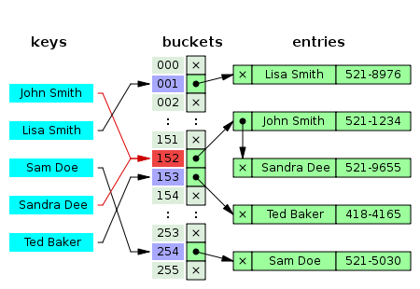
Collisions are an issue
See HW 1

Slide 7
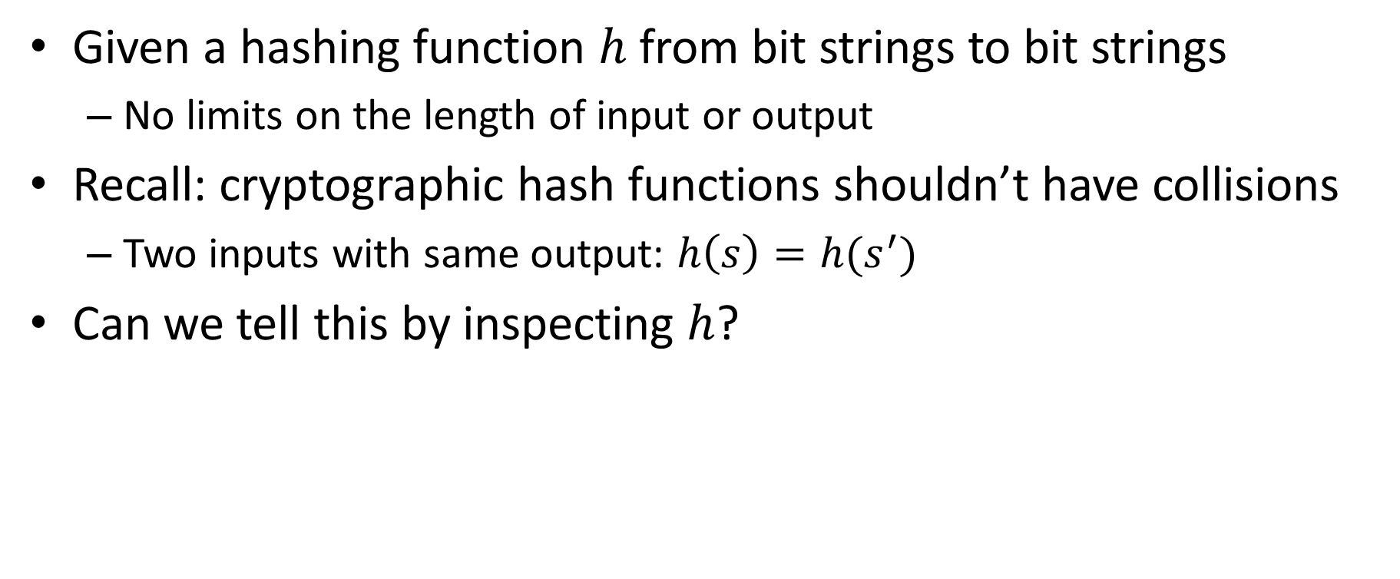
Can you determine if there are collisions?
Given a hashing function $h$ from bit strings to bit strings
No limits on the length of input or output
Recall: cryptographic hash functions shouldn’t have collisions
Two inputs with same output: $h\left(s\right)=h(s^{′})$
Can we tell this by inspecting $h$?

Slide 8
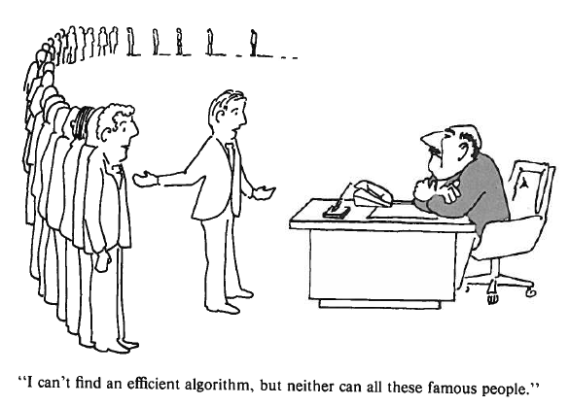
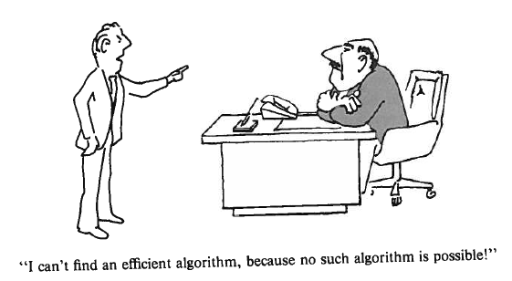
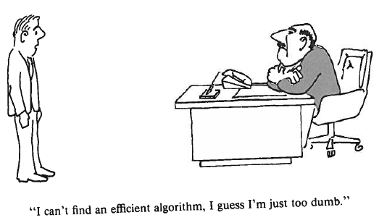
Different excuses for failure
Garey & Johnson, Computers and Intractability

Slide 9
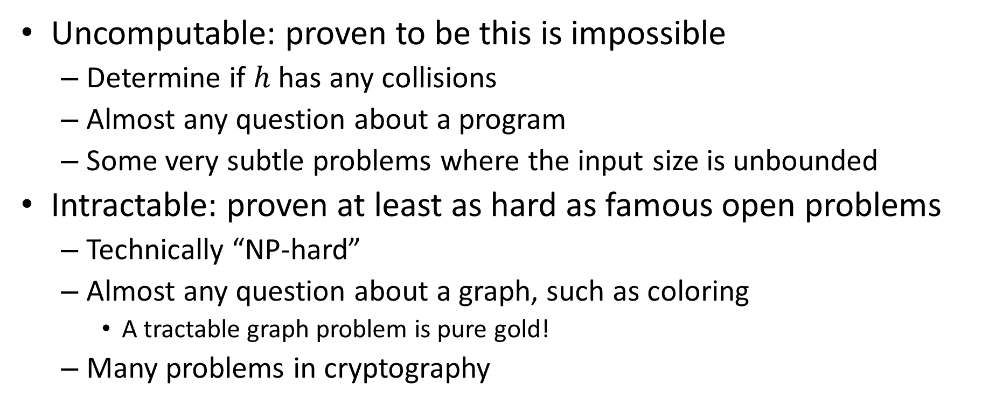
Uncomputable vs intractable
Uncomputable: proven to be this is impossible
Determine if $h$ has any collisions
Almost any question about a program
Some very subtle problems where the input size is unbounded
Intractable: proven at least as hard as famous open problems
Technically “NP-hard”
Almost any question about a graph, such as coloring
A tractable graph problem is pure gold!
Many problems in cryptography

Slide 10
Uses in CS of hardness results
Very important in many applications
Use case 1: hard problems can help you
Want to show that if you could break a code you could also solve a famous open problem (e.g. factoring efficiently)
Mostly shows up in adversarial situations
Use case 2: hard problems avoid wasting time
Showing that a problem is hard will keep people from working on it
Amusingly enough, sometimes it shows publications are wrong

Slide 11
Back to the fun part…
What cool stuff can we do with hashing?

Slide 12
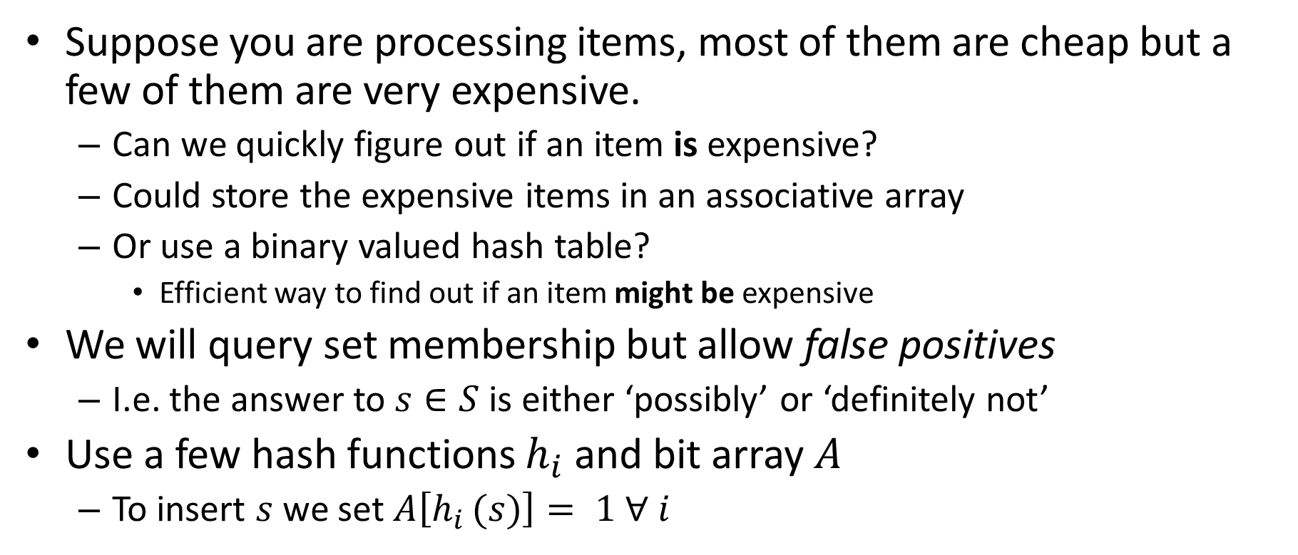
Bloom filters
Suppose you are processing items, most of them are cheap but a few of them are very expensive.
Can we quickly figure out if an item is expensive?
Could store the expensive items in an associative array
Or use a binary valued hash table?
Efficient way to find out if an item might be expensive
We will query set membership but allow false positives
I.e. the answer to $s∈S$ is either ‘possibly’ or ‘definitely not’
Use a few hash functions $h_{i}$ and bit array $A$
To insert $s$ we set $A\left[h_{i }(s)\right]= 1 ∀ i$

Slide 13
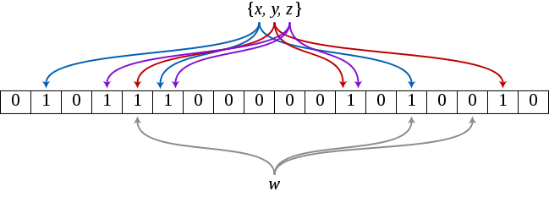

Bloom filter example
Example has 3 hash functions and 18 bit array
$\{x,y,z\}$ are in the set, $w$ is not
Bits are (sort of) signature
Figure by David Eppstein, https://commons.wikimedia.org/w/index.php?curid=2609777

Slide 14
Application: web caching
CDN’s, like Akamai, make the web work (~70% of traffic)
About 75% of URL’s are ‘one hit wonders’
Never looked at again by anyone
Let’s not do the work to put these in the disk cache!
Cache on second hit
Use a Bloom filter to record URL’s that have been accessed
A one hit wonder will not be in the Bloom filter
See: Maggs, Bruce M.; Sitaraman, Ramesh K. (July 2015), "Algorithmic nuggets in content delivery" (PDF), SIGCOMM Computer Communication Review, New York, NY, USA,45 (3): 52–66

Slide 15
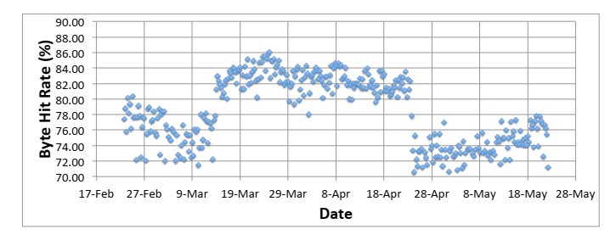
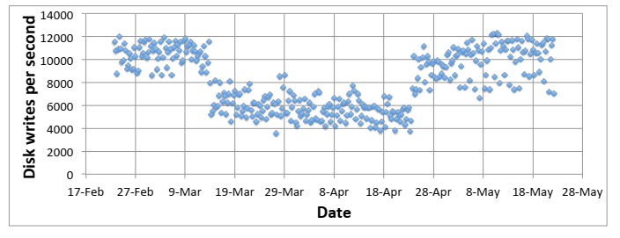
Bloom filters really work!
Figures from: Maggs, Bruce M.; Sitaraman, Ramesh K. (July 2015), "Algorithmic nuggets in content delivery" (PDF), SIGCOMM Computer Communication Review, New York, NY, USA,45 (3): 52–66

Slide 16
Cool facts about Bloom filters
You don’t need to build different hash functions, you can use a single one and divide its output into fields (usually)
Can calculate probability of false positives and keep it low
Time to add an element to the filter, or check if an element is in the filter, is independent of the size of the element (!)
You can estimate the size of the union of two sets from the bitwise OR of their Bloom filters

Slide 17
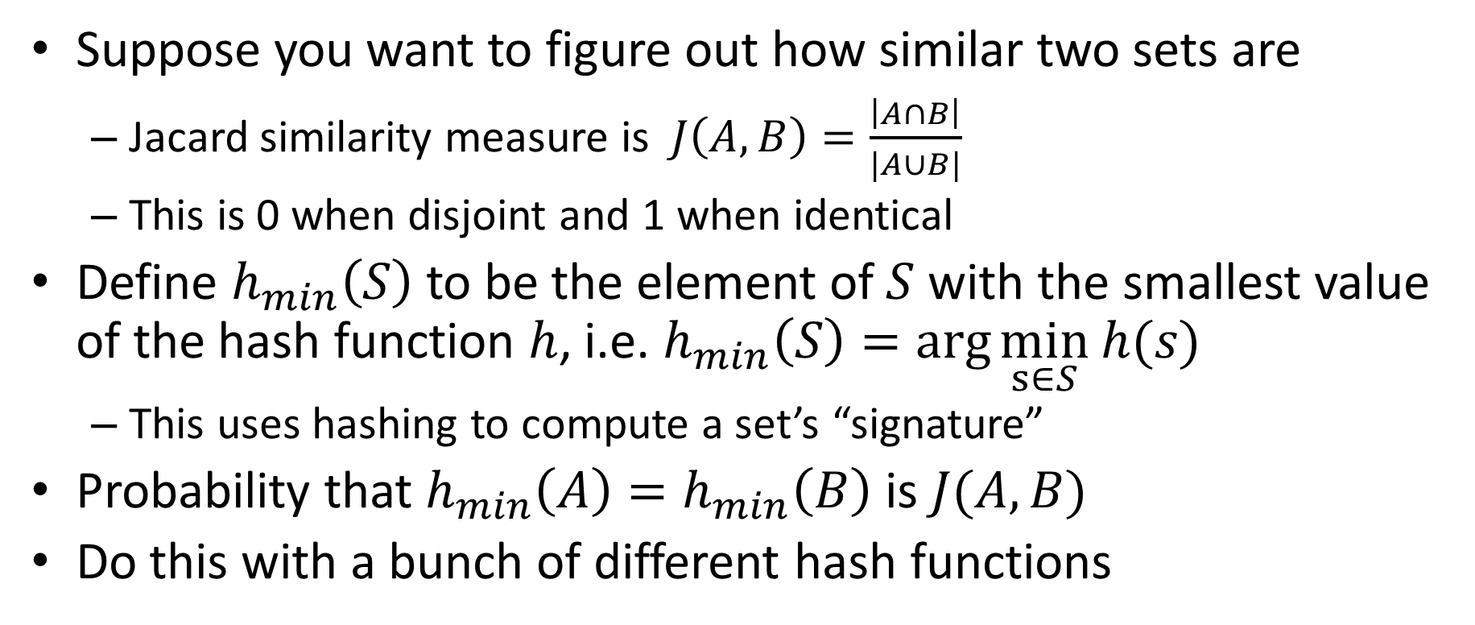
MinHash
Suppose you want to figure out how similar two sets are
Jacard similarity measure is $J\left(A,B\right)=\frac{\left|A∩B\right|}{|A∪B|}$
This is 0 when disjoint and 1 when identical
Define $h_{min}\left(S\right)$ to be the element of $S$ with the smallest value of the hash function $h$, i.e. $h_{min}\left(S\right)=\arg{\min_{s∈S}}$ $h(s)$
This uses hashing to compute a set’s “signature”
Probability that $h_{min}\left(A\right)=h_{min}\left(B\right)$ is $J(A,B)$
Do this with a bunch of different hash functions

Slide 18
MinHash applications
Plagiarism detection in articles
Collaborative filtering!
Amazon, NetFlix, etc.

Slide 19
Distributed hash tables (DHT)
BitTorrent, etc.
Given a file name and its data, store/retrieve it in a network
Compute the hash of the file name
This maps to a particular processor, which holds the file

