Slide 1
CS5112: Algorithms and Data Structures for Applications
Lecture 19: Association rules
Ramin Zabih
Some content from: Wikipedia/Google image search; Harrington;
J. Leskovec, A. Rajaraman, J. Ullman: Mining of Massive Datasets, http://www.mmds.org

Slide 2
Lecture Outline
From last time: course grades, SimHash
From supervised to unsupervised learning
Some useful logical identities
Frequent item set data mining
The Apriori algorithm

Slide 3
Course grades
The below is NOT a promise, just an educated guess
Typically in a graduate course like CS5112, most students get some kind of an A or B

Slide 4
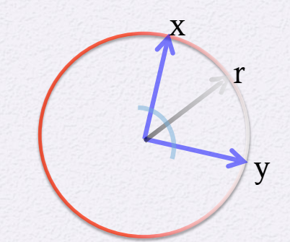
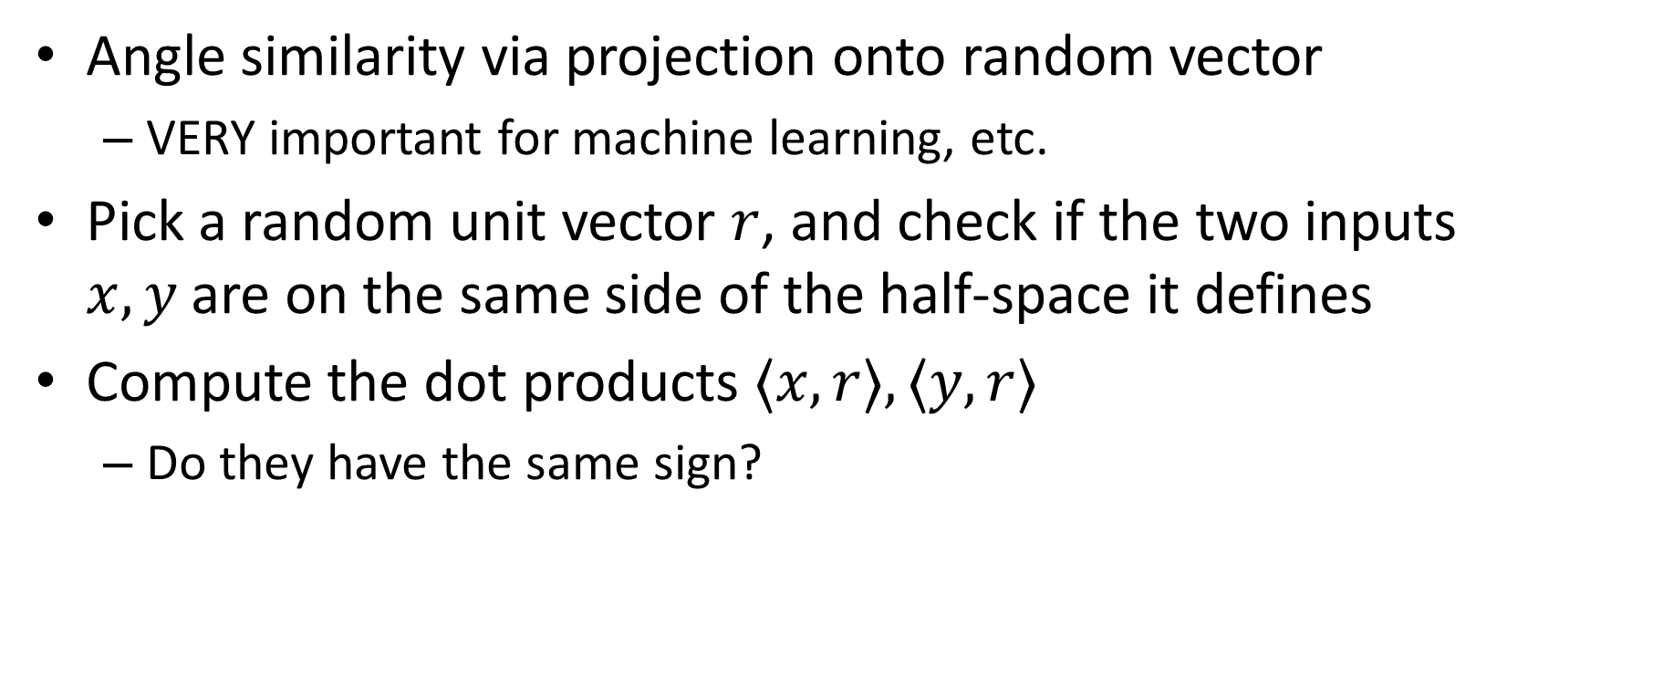
Angle similarity via SimHash
Angle similarity via projection onto random vector
VERY important for machine learning, etc.
Pick a random unit vector $r$, and check if the two inputs $x,y$are on the same side of the half-space it defines
Compute the dot products $〈x,r〉, 〈y,r〉$
Do they have the same sign?

Slide 5
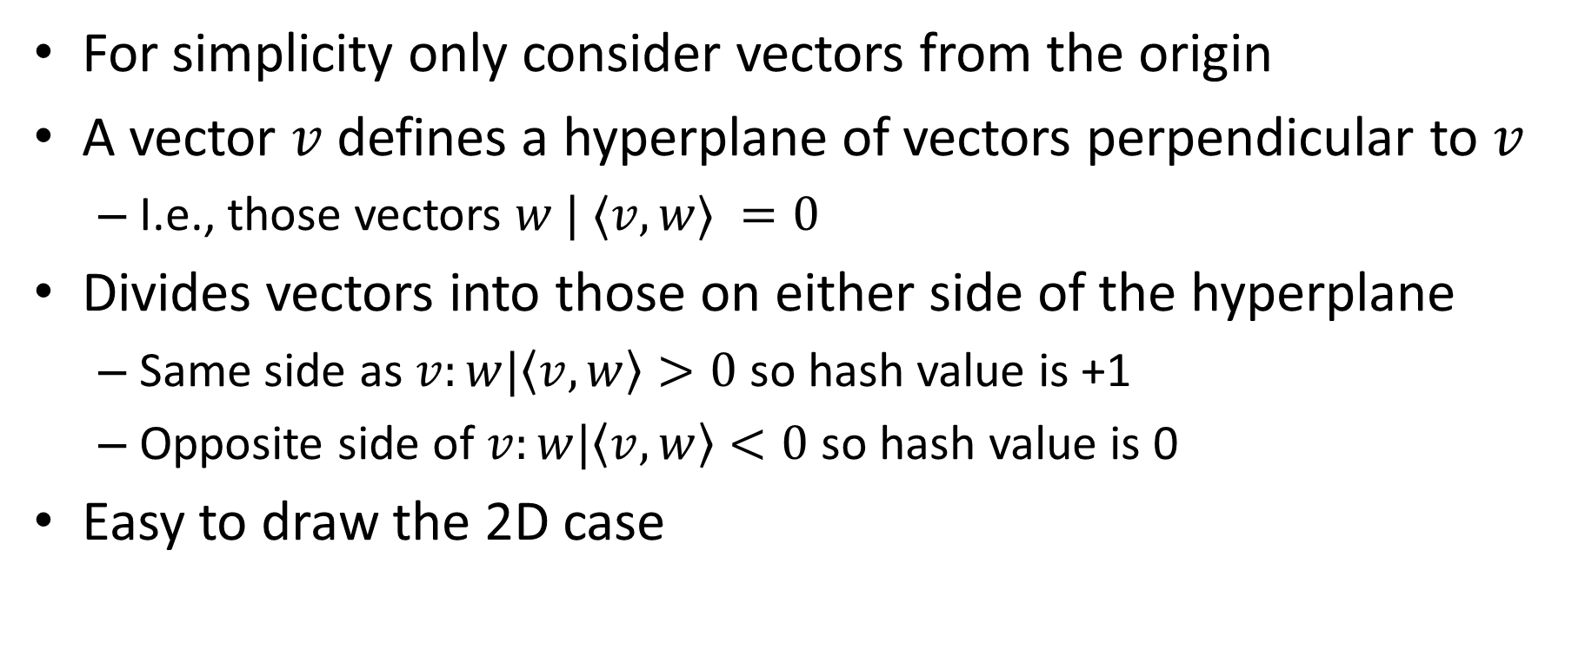
Dot product and hyperplanes
For simplicity only consider vectors from the origin
A vector $v$ defines a hyperplane of vectors perpendicular to $v$
I.e., those vectors $w | 〈v,w〉 =0$
Divides vectors into those on either side of the hyperplane
Same side as $v:w|〈v,w〉>0$ so hash value is +1
Opposite side of $v:w|〈v,w〉<0$ so hash value is 0
Easy to draw the 2D case

Slide 6
A bad LSH function and how to fix it
This gives us a single bit per vector
Which generates a really lousy LSH hash function
It only has 2 buckets!
What goes wrong and how do we fix it?
Same slice of the pizza!

Slide 7


2D case of SimHash
$$\begin{matrix}v= 1 & 0 & 1\end{matrix}$$
$$v$$

Slide 8
Unsupervised learning
What interesting things can we learn in the absence of a labeled data set?
Labeled data is expensive
Semi-supervised learning
Main unsupervised areas are:
Clusters (see: k-means algorithm)
Low dimensional structure (not covered in CS5112)
Associations (today’s lecture)

Slide 9
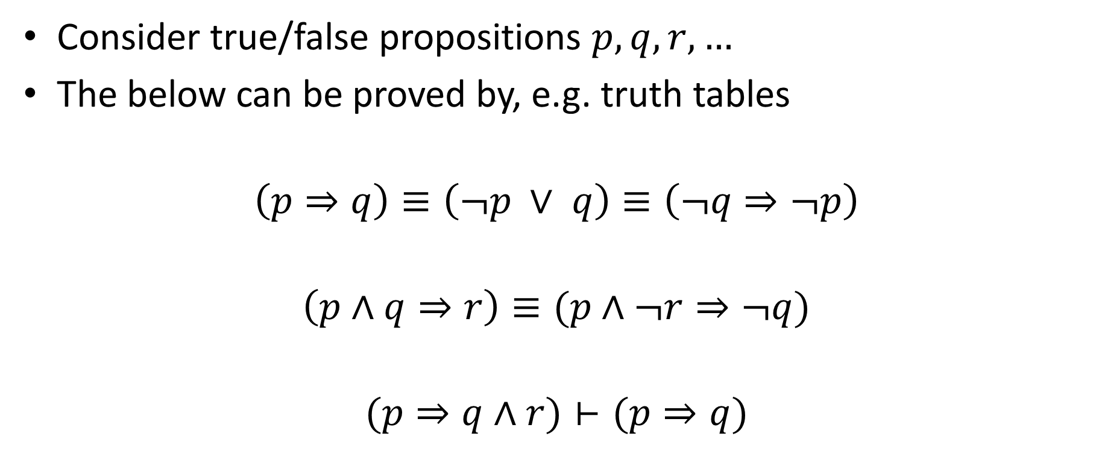
Useful logical identities
Consider true/false propositions $p,q,r,…$
The below can be proved by, e.g. truth tables
$$\left(p⇒q\right)≡\left(¬p ∨ q\right)≡\left(¬q⇒¬p\right)$$
$$\left(p∧q⇒r\right)≡(p∧¬r⇒¬q)$$
$$(p⇒q∧r)⊢(p⇒q)$$

Slide 10
Example transactions
Rule discovered: Coke→Diaper

Slide 11
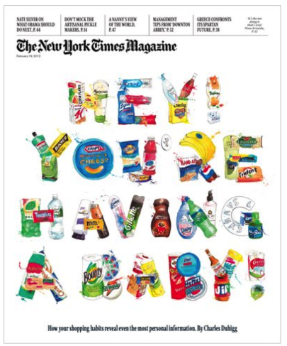
Things can go badly wrong…

Slide 12
Association rules
Learn rules that are supported by your data
Rules are co-occurrence, not causality!
Very clear in the propositional formulation
Beer and diapers legend
What do you do with an association rule?
In practice you don’t want too many of them
Need to act on them

Slide 13
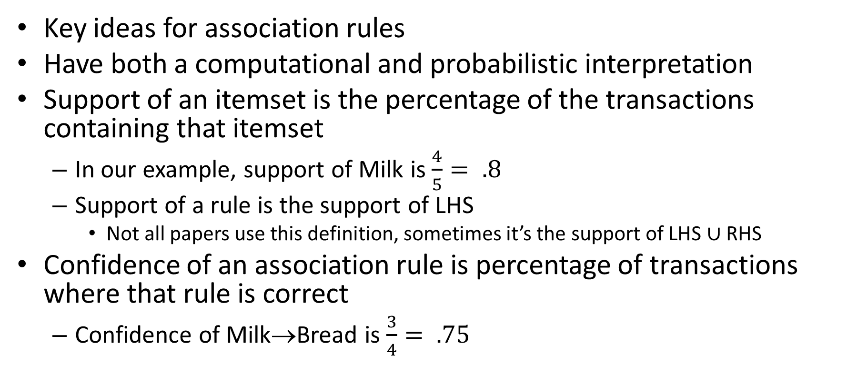
Support and confidence
Key ideas for association rules
Have both a computational and probabilistic interpretation
Support of an itemset is the percentage of the transactions containing that itemset
In our example, support of Milk is $\frac{4}{5}= .8$
Support of a rule is the support of LHS
Not all papers use this definition, sometimes it’s the support of LHS $∪$ RHS
Confidence of an association rule is percentage of transactions where that rule is correct
Confidence of Milk→Bread is $\frac{3}{4}= .75$

Slide 14
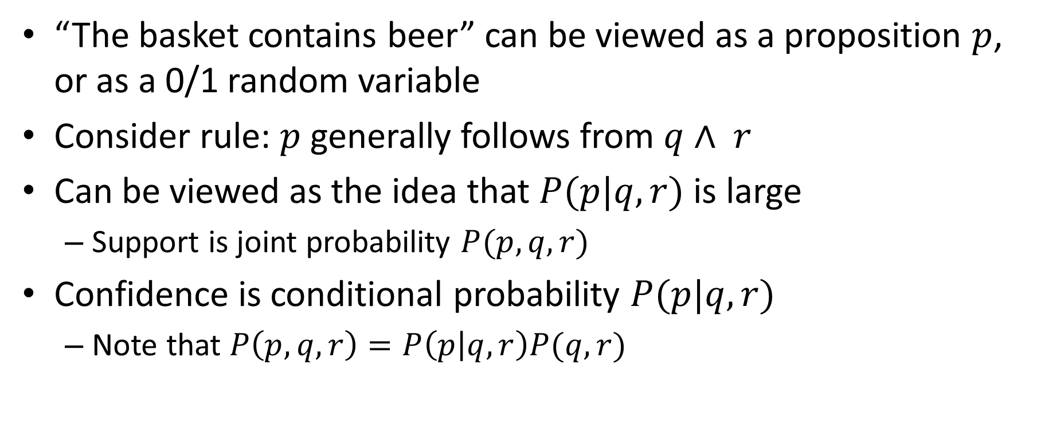
Probabilistic view
“The basket contains beer” can be viewed as a proposition $p$, or as a 0/1 random variable
Consider rule: $p$generally follows from $q∧ r$
Can be viewed as the idea that $P(p|q,r)$ is large
Support is joint probability $P(p,q,r)$
Confidence is conditional probability $P(p|q,r)$
Note that $P\left(p,q,r\right)=P\left(p | q,r\right)P(q,r)$

Slide 15
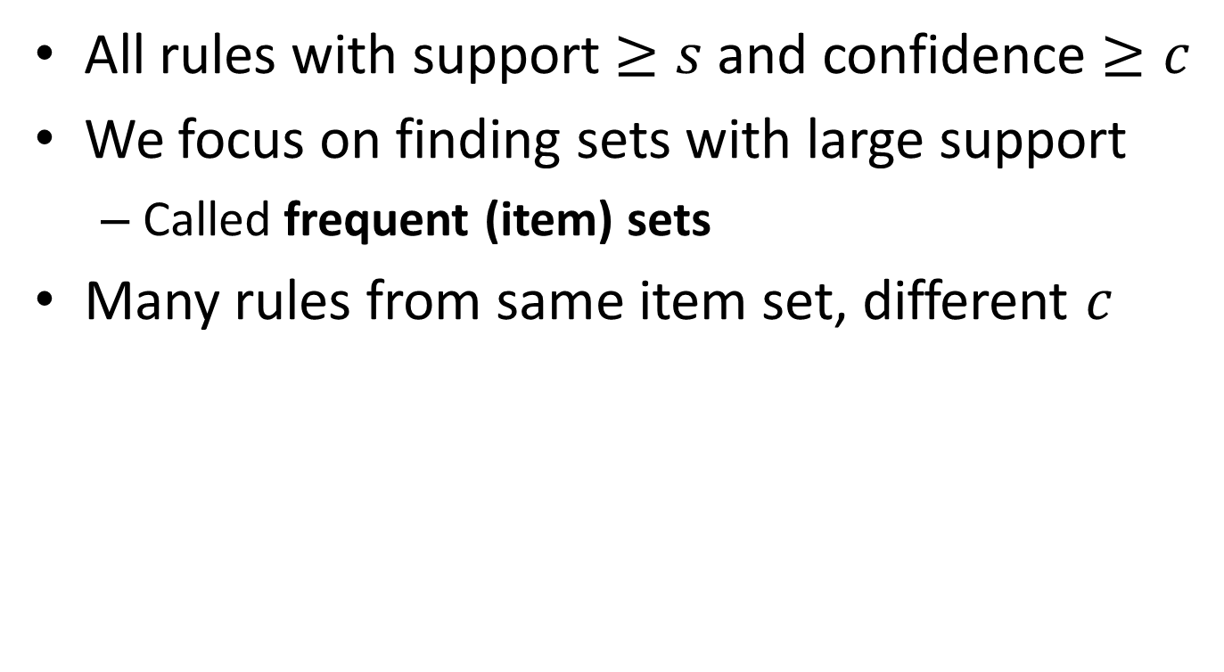
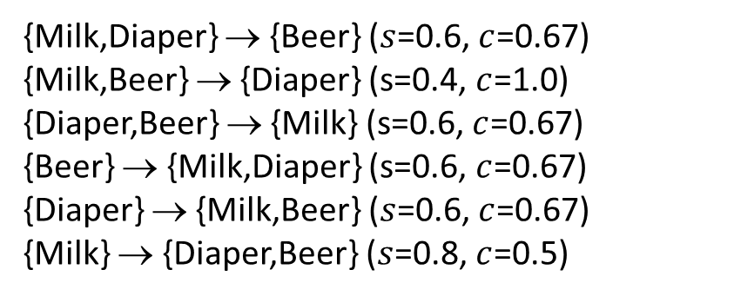
Association rule learning
All rules with support $≥s$and confidence $≥c$
We focus on finding sets with large support
Called frequent (item) sets
Many rules from same item set, different $c$
{Milk,Diaper} → {Beer} ($s$=0.6, $c$=0.67) {Milk,Beer} → {Diaper} (s=0.4, $c$=1.0)
{Diaper,Beer} → {Milk} (s=0.6, $c$=0.67)
{Beer} → {Milk,Diaper} (s=0.6, $c$=0.67) {Diaper} → {Milk,Beer} ($s$=0.6, $c$=0.67)
{Milk} → {Diaper,Beer} ($s$=0.8, $c$=0.5)
Notes:
Rule: A → B
Added value is P(B|A) – P(B)
Lift is P(B|A)/P(B)
These are not used consistently

Slide 16
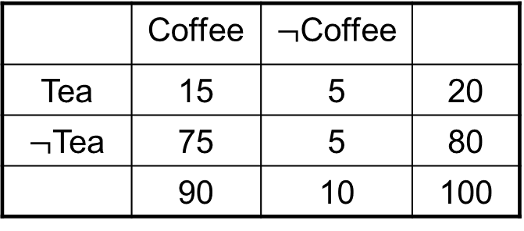
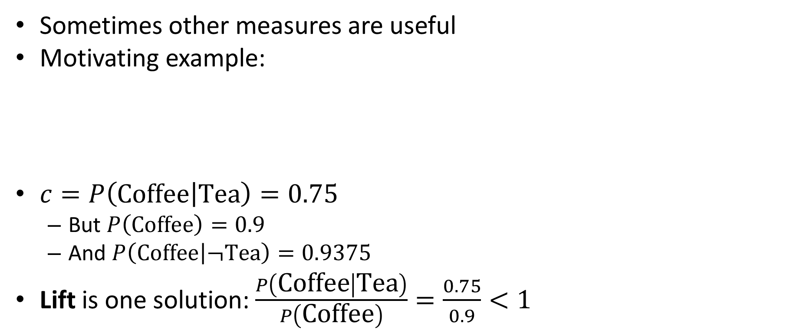
Beyond confidence
Sometimes other measures are useful
Motivating example:
$c=P\left(\text{Coffee} | \text{Tea}\right)=0.75$
But $P\left(\text{Coffee}\right)=0.9$
And $P\left(\text{Coffee} | ¬\text{Tea}\right)=0.9375$
Lift is one solution: $\frac{P\left(\text{Coffee} | \text{Tea}\right)}{P\left(\text{Coffee}\right)}=\frac{0.75}{0.9}<1$
 | Coffee | $¬$Coffee
Tea | 15 | 5 | 20
$¬$Tea | 75 | 5 | 80
 | 90 | 10 | 100

Slide 17
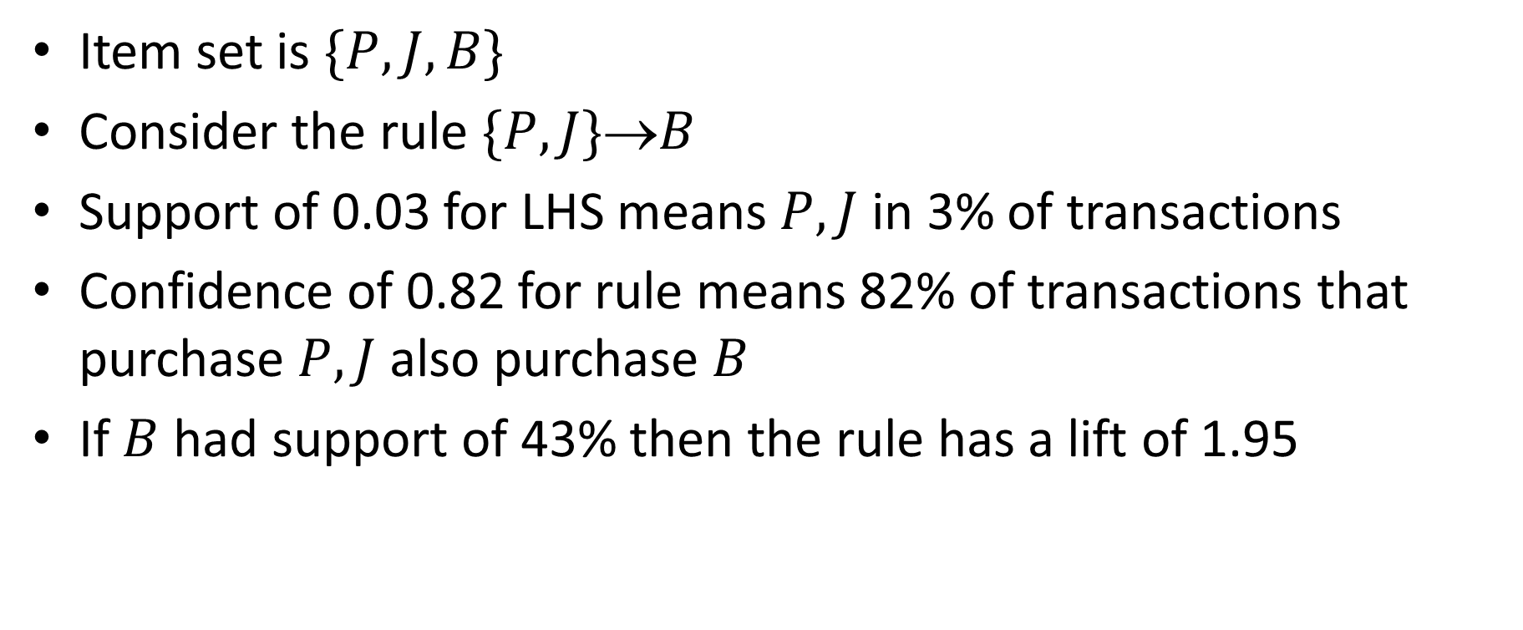
PB&J example
Item set is $\{P,J,B\}$
Consider the rule $\{P,J\}$→$B$
Support of 0.03 for LHS means $P,J$ in 3% of transactions
Confidence of 0.82 for rule means 82% of transactions that purchase $P,J$ also purchase $B$
If $B$ had support of 43% then the rule has a lift of 1.95

Slide 18

Fields of sets
Consider a set with $n$elements
We can arrange all of its $2^{n}$ subsets into a lattice
Via union and intersection
This structure is called a field of sets

Slide 19
Example
Harrington, Machine Learning in Action

Slide 20
The A Priori Principle
Problem: exponentially many item sets
As we grow an item set, its support goes down
If an item set is frequent, all of its subsets are frequent
If an item set is infrequent, all of its supersets are infrequent

Slide 21
Example
Harrington, Machine Learning in Action

Slide 22
Illustrating Apriori Principle
Items (1-itemsets)
Pairs (2-itemsets)
(No need to generate candidates involving Coke or Eggs)
Minimum Support = 3
If every subset is considered,
⁶C₁ + ⁶C₂ + ⁶C₃ = 41
With support-based pruning,
6 + 6 + 1 = 13

Slide 23
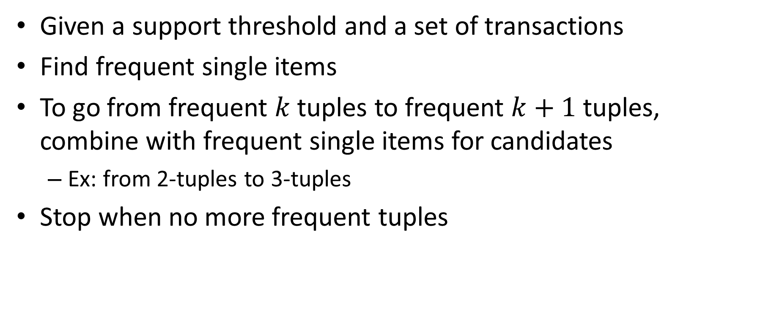
Apriori algorithm
Given a support threshold and a set of transactions
Find frequent single items
To go from frequent $k$tuples to frequent $k+1$tuples, combine with frequent single items for candidates
Ex: from 2-tuples to 3-tuples
Stop when no more frequent tuples

Slide 24
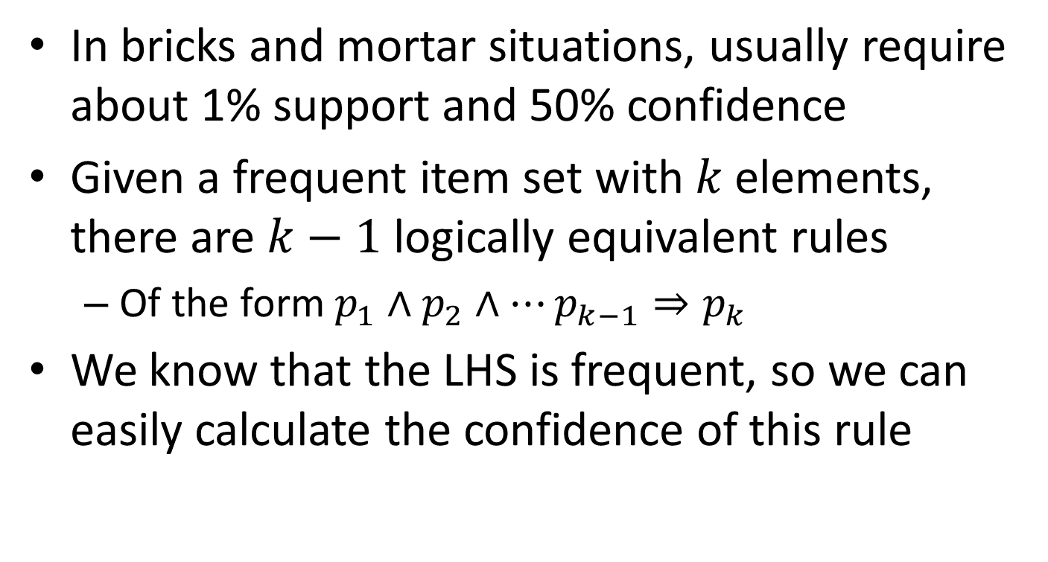
From frequent item sets to rules
In bricks and mortar situations, usually require about 1% support and 50% confidence
Given a frequent item set with $k$elements, there are $k−1$logically equivalent rules
Of the form $p_{1}∧p_{2}∧…p_{k−1}⇒p_{k}$
We know that the LHS is frequent, so we can easily calculate the confidence of this rule

Slide 25
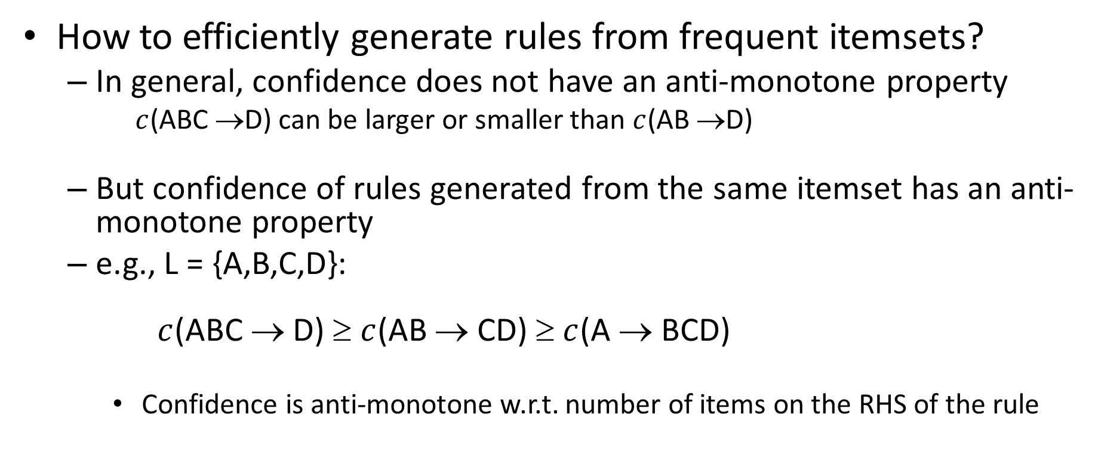
Rule Generation
How to efficiently generate rules from frequent itemsets?
In general, confidence does not have an anti-monotone property
$c$(ABC →D) can be larger or smaller than $c$(AB →D)
But confidence of rules generated from the same itemset has an anti-monotone property
e.g., L = {A,B,C,D}: $c$(ABC → D) ≥ $c$(AB → CD) ≥ $c$(A → BCD)
Confidence is anti-monotone w.r.t. number of items on the RHS of the rule

Slide 26
Apriori plus and minus
Plus: Fast, runs on huge data sets, easy to interpret
Rules with high confidence but low support are missed
Classic example: vodka → caviar

Slide 27
Extension: PCY algorithm
Park-Chen-Yu speedup of apriori
Use a hash table to store counts of pairs
Hash on the pair
Collisions: may think something is frequent even if it is not
But you can use hashing to eliminate a ton of computation
What does this remind you of?

