Slide 1
CS5112: Algorithms and Data Structures for Applications
Lecture 20: Image segmentation
Ramin Zabih
Some content from: Wikipedia/Google image search

Slide 2
Lecture Outline
Segmentation, in grayscale and color images
Image representations
Edge detection
Segmentation with shortest paths
Clustering based segmentation
Mean shift segmentation
Non-parametric density estimation (Parzen)
Multi-modal distributions

Slide 3
Images and segmentation
Images are 2D arrays, typically 512-by-512 or bigger
Video is images at 30 hz
Entries are 8 bit (grayscale) or 24 bit (R/G/B color)
Black is 0 or 0/0/0, white is 255 or 255/255/255
Segmentation: produce a meaningful partition of the image
Allegedly task independent
Warning: color does not work the way you think it does
“Color constancy”

Slide 4
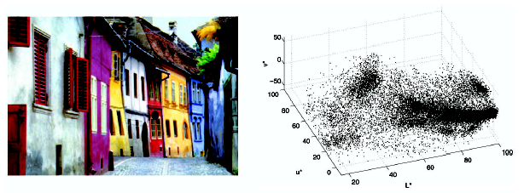
Image and feature space

Slide 5
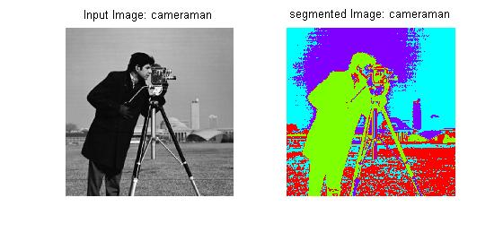
Image segmentation example
Notes:
http://pixelsciences.blogspot.com/2017/07/image-segmentation-k-means-clustering.html

Slide 6
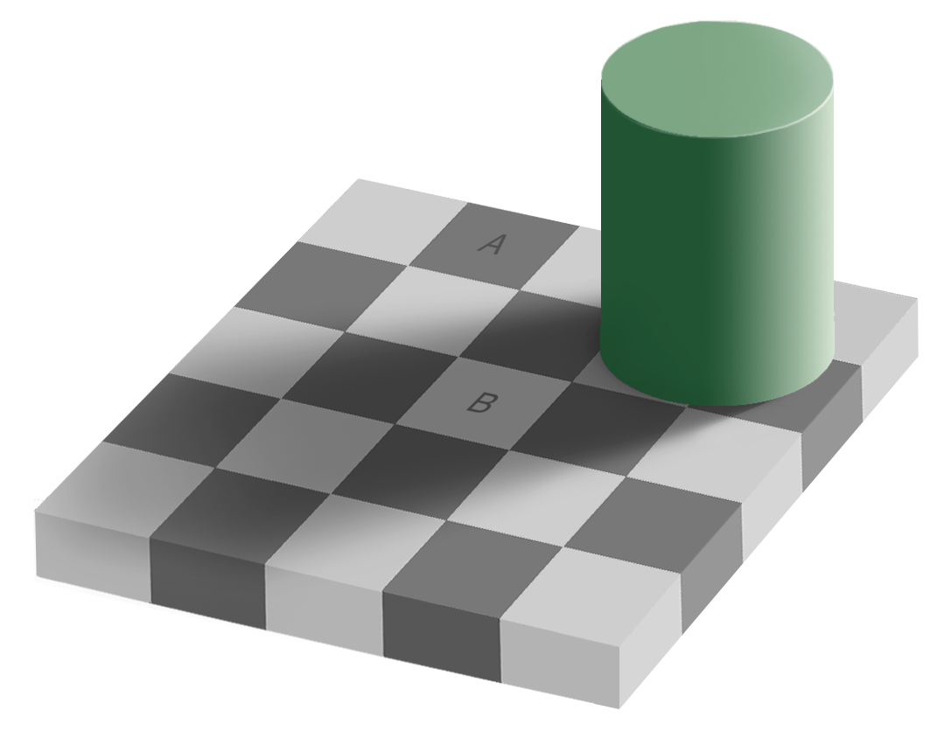
Color constancy famous example

Slide 7
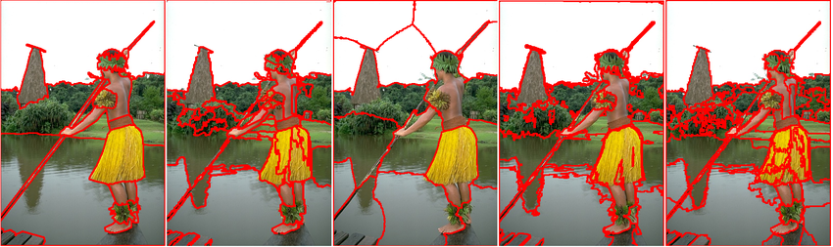
Comparison of segmentation algorithms
Notes:
https://www.researchgate.net/figure/Comparative-segmentation-results-A-Human-Segmentation-Graph-based-Salient-Object_fig5_220531443

Slide 8
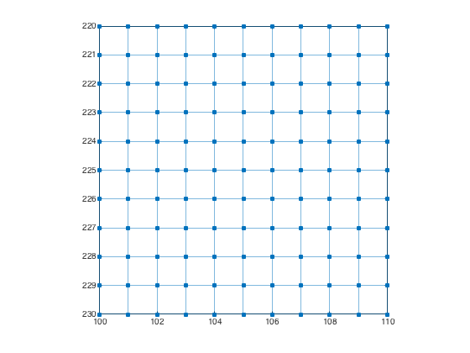
Image representation
Three common image representations used for most algorithms and image processing
1. Array representation. This is what a camera produces.
2. Feature representation, where each pixel is mapped into a feature space. Simplest example: feature = intensity or color.
3. Graph representation. Pixels are nodes, edges connect adjacent pixels, usually 4-connected (grid)
Notes:
https://blogs.mathworks.com/steve/2015/12/14/image-based-graphs/

Slide 9
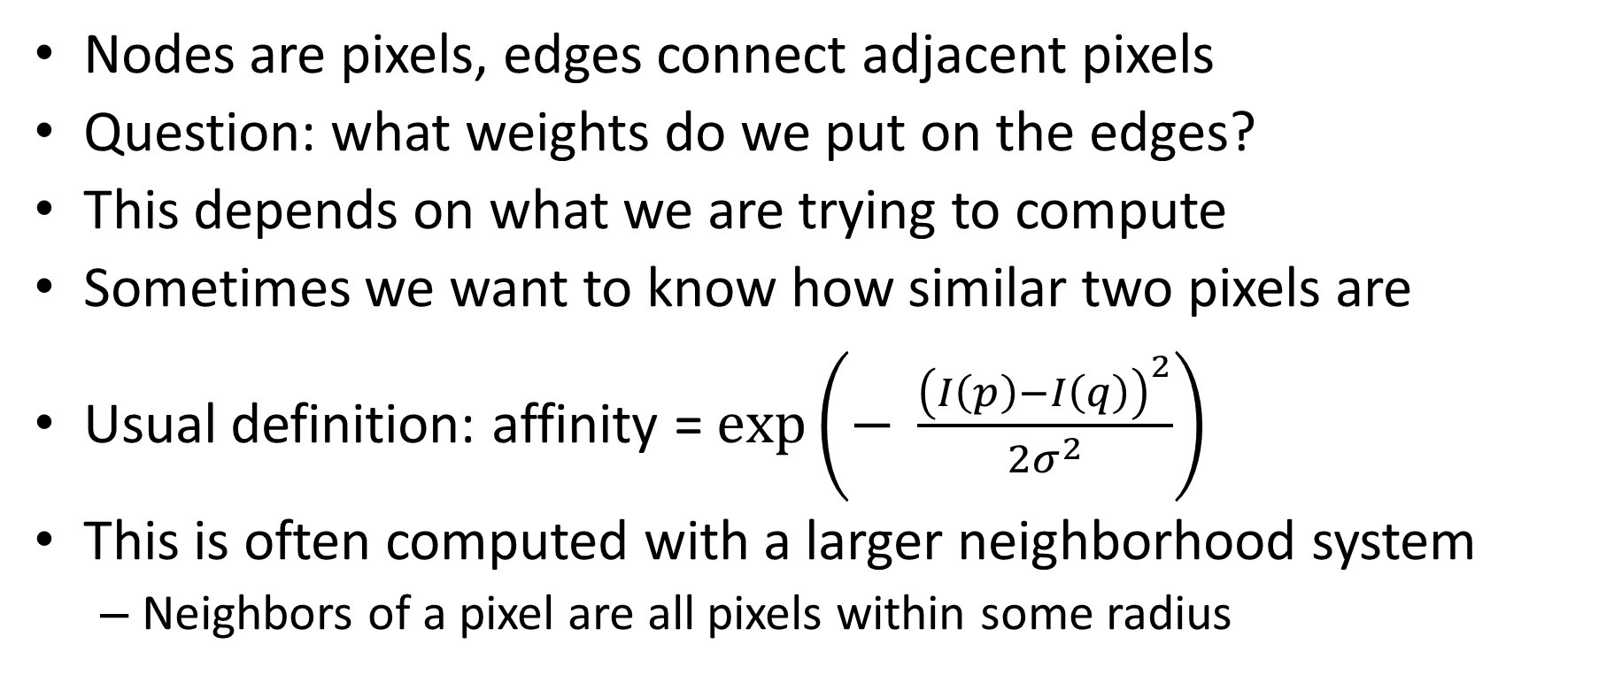
Image as a graph
Nodes are pixels, edges connect adjacent pixels
Question: what weights do we put on the edges?
This depends on what we are trying to compute
Sometimes we want to know how similar two pixels are
Usual definition: affinity = $exp\left(− \frac{{\left(I\left(p\right)−I\left(q\right)\right)}^{2}}{{2σ}^{2}}\right)$
This is often computed with a larger neighborhood system
Neighbors of a pixel are all pixels within some radius

Slide 10
Normalized cuts
Famous computer vision paper (Shi and Malik, 2000)
Used spectral methods, i.e. eigenvectors of the affinity matrix
Well beyond the scope of this course
Notes:
https://www.researchgate.net/figure/Comparative-segmentation-results-A-Human-Segmentation-Graph-based-Salient-Object_fig5_220531443

Slide 11
Edge detection and gradients
For some applications you need a small value for similar pixels
An edge that you want to follow around an object
You can invert affinity, but in practice it works much better to use something based on edge detection

Slide 12
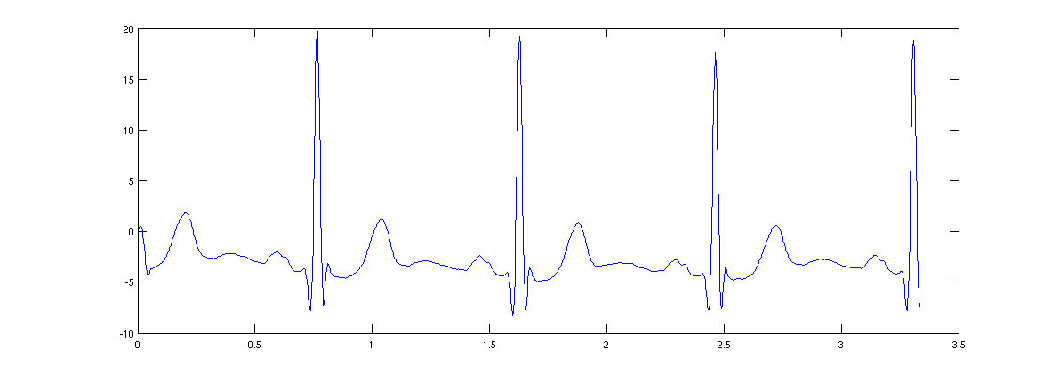
Edge detection ideas
Two basic notions, easily seen in 1D
Large first derivative (gradient, Canny-style)
Zero second derivative (Laplacian)

Slide 13
Intelligent scissors
Idea: shortest paths
E.N. Mortensen and W.A. Barrett, Interactive Segmentation with Intelligent Scissors, SIGGRAPH 1995
Adobe calls this the “Magnetic Lasso”
Video here
Basic idea: image is a graph, connectivity is how much perpendicular contrast there is between adjacent pixels
Computed based on edge detection

Slide 14

Video demonstration

Slide 15
Mean shift algorithm
Hill climbing algorithm based on local density of data
Density increases as we get near “center”

Slide 16
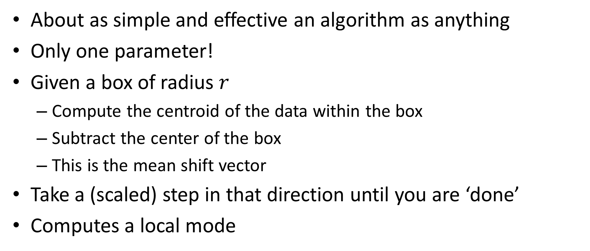
Computing mean shift
About as simple and effective an algorithm as anything
Only one parameter!
Given a box of radius $r$
Compute the centroid of the data within the box
Subtract the center of the box
This is the mean shift vector
Take a (scaled) step in that direction until you are ‘done’
Computes a local mode

Slide 17
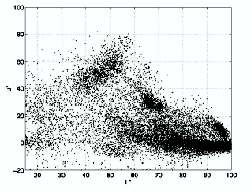
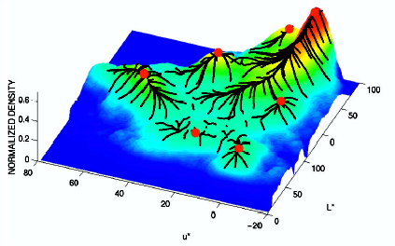
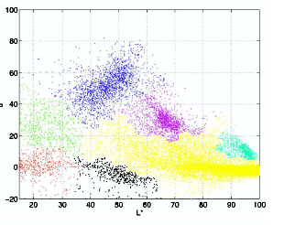
Local modes

Slide 18
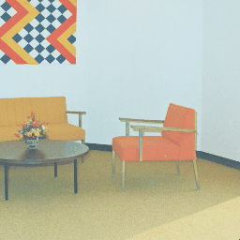
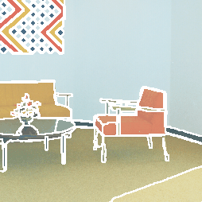
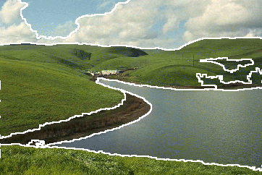
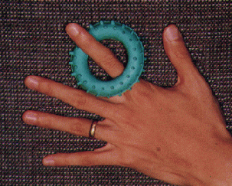
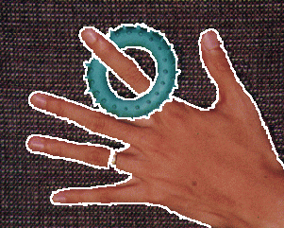
Mean shift segmentations
Notes:
Originally taken from http://www.caip.rutgers.edu/~comanici/MSPAMI/msPamiResults.html

Slide 19
Multi-modal distributions
Statistics has historically focused on unimodal distributions
Normal distribution, justified by the Central Limit Theorem (Gauss)
Multi-modal distributions are:
Problematic
All over the place in computer vision
Even compared to machine learning
Why are they hard? How do we handle them?

Slide 20
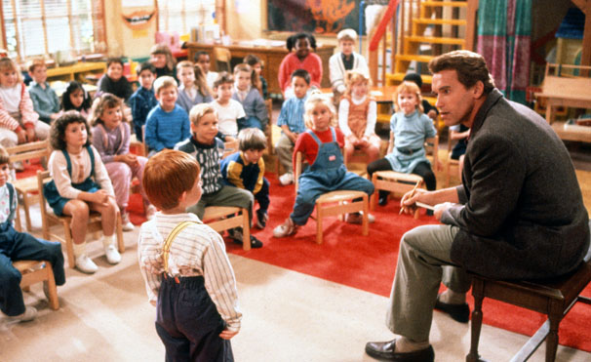
Multi-modal distributions are hard
Standard statistical measures are not meaningful
They often implicitly assume normal distribution
Or something very close to it
This is sometimes described in terms of outliers
What is the average weight of the humans in this picture?

Slide 21
How to handle?
Easiest cases:
Very small number of outliers
Statistics textbook historically suggest you plot your data and filter it (!)
But you can sometimes pre-filter the data
Two gaussians (mixture of gaussians, aka MOG)
Example: mischievous lab partner in chemistry

Slide 22
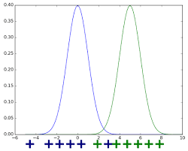
Two gaussians

Slide 23
Standard algorithm: expectation maximization
We have a chicken and egg problem
If we knew which data is water and which is beer, we could compute the mean and variance separately
If we know the mean and variance were for beer and water, we could figure out which data is water and which is beer
But we don’t know anything!
So, just like in k-means, we guess and iterate

Slide 24
From P. Smyth
ICML 2001

Slide 25
From P. Smyth
ICML 2001

Slide 26
From P. Smyth
ICML 2001

Slide 27
From P. Smyth
ICML 2001

Slide 28
From P. Smyth
ICML 2001

Slide 29
From P. Smyth
ICML 2001

Slide 30
From P. Smyth
ICML 2001

