Slide 1
CS5112: Algorithms and Data Structures for Applications
Lecture 18: Locality-sensitive hashing
Ramin Zabih
Some content from: Piotr Indyk; Wikipedia/Google image search;
J. Leskovec, A. Rajaraman, J. Ullman: Mining of Massive Datasets, http://www.mmds.org

Slide 2
Today
Prelim discussion
Locality sensitive hashing

Slide 3
Prelim discussion
Final will be a lot like the prelim
But including material starting today
Review session in class before exam
Regrades are done on the entire exam
Your score can go up or down
Clearly you should request one if we made an obvious mistake
Regrades on gradescope, open at 2PM, close a week later
Staff available after lecture, informally

Slide 4
Prelim stats
Overall people did quite well
14 students got a perfect score
Hardest questions:
1.4 (collision handling data structures): 54% got this right
4.5 (last 4 had c): 45%
Dynamic programming question: 72%

Slide 5
Curse of dimensionality
High dimensions are not intuitive, and data becomes sparse
Volume goes up so fast that an exponential amount of data needed
“Most of the volume is in the corners” theorem
Think of a 3D sphere inscribed in a box
Particularly problematic for NN search
Quad trees require exponential space and time
k-d trees requires exponential time

Slide 6
Locality sensitive hashing
We can use hashing to solve ‘near neighbors’
And thus nearest neighbors, if we really need this
Ensuring collisions is the key idea!
Make nearby points hash to the same bucket
In a probabilistic manner
By giving up on exactness we can overcome the curse of dimensionality
This is an extremely important technique in practice

Slide 7
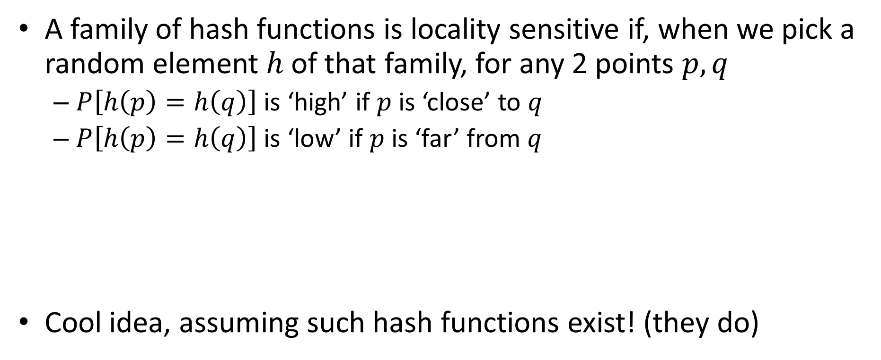
Basic idea of LSH
A family of hash functions is locality sensitive if, when we pick a random element $h$of that family, for any 2 points $p,q$
$P\left[h\left(p\right)=h\left(q\right)\right]$ is ‘high’ if $p$ is ‘close’ to $q$
$P\left[h\left(p\right)=h\left(q\right)\right]$ is ‘low’ if $p$ is ‘far’ from $q$
Cool idea, assuming such hash functions exist! (they do)

Slide 8
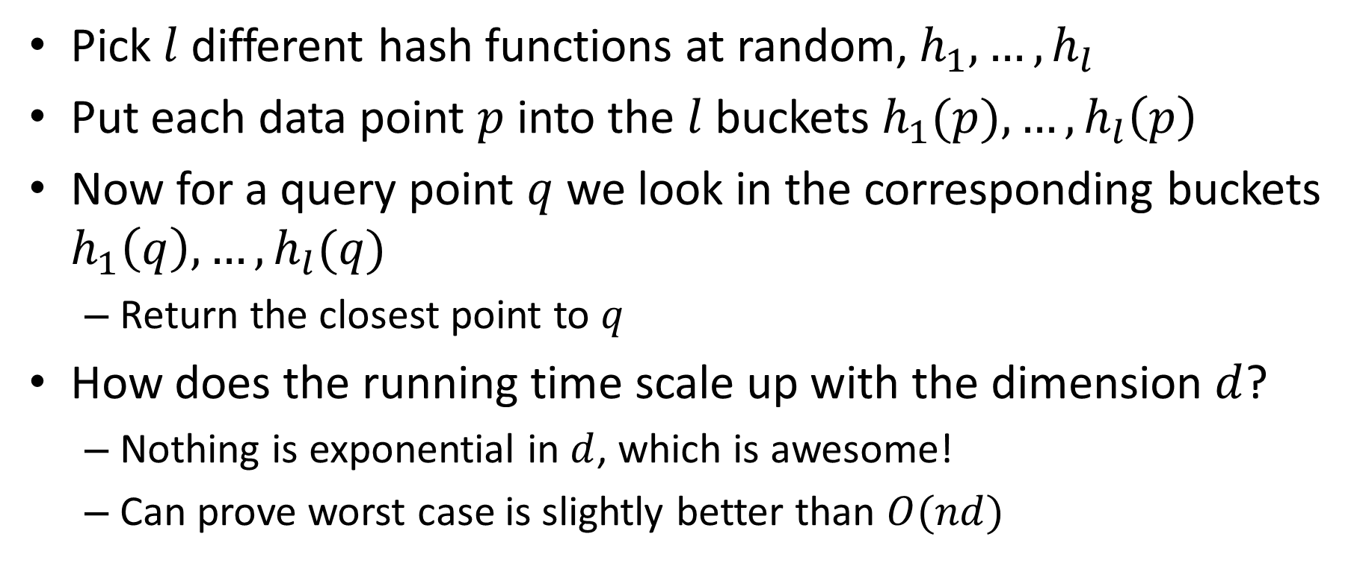
How to use LSH for NN
Pick $l$ different hash functions at random, $h_{1},…, h_{l}$
Put each data point $p$into the $l$buckets $h_{1}(p), …, h_{l}\left(p\right)$
Now for a query point $q$ we look in the corresponding buckets $h_{1}\left(q\right), …, h_{l}(q)$
Return the closest point to $q$
How does the running time scale up with the dimension $d$?
Nothing is exponential in $d$, which is awesome!
Can prove worst case is slightly better than $O(nd)$

Slide 9
Visualizing LSH
q
p

Slide 10
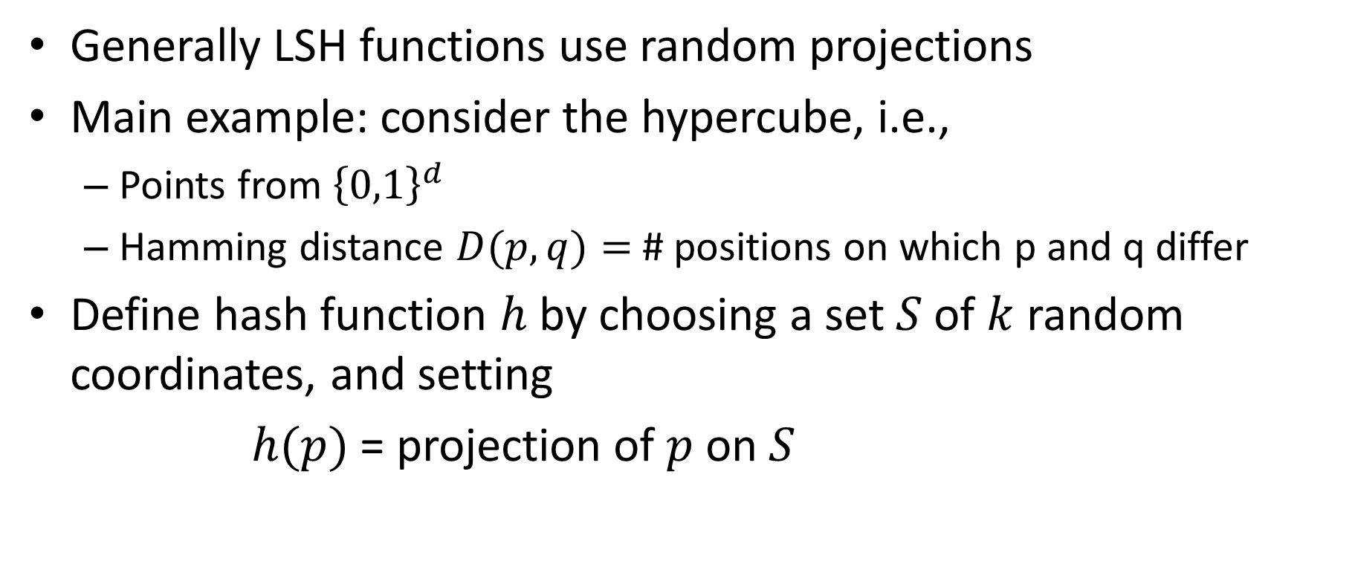
Do such functions exist ?
Generally LSH functions use random projections
Main example: consider the hypercube, i.e.,
Points from ${\left\{0,1\right\}}^{d}$
Hamming distance $D(p,q)=$# positions on which p and q differ
Define hash function $h$ by choosing a set $S$of $k$ random coordinates, and setting
$h(p)$ = projection of $p$on $S$

Slide 11

Example
Take
$$d=10,$$
$$p=0101110010,$$
$$k=2,$$
$$S=\{2,5\}$$
Then $h(p)=11$

Slide 12

These hash functions are locality-sensitive
$$P⁡[h(p)=h(q)]=(1−\frac{D\left(p,q\right)}{d})k$$
We can vary the probability by changing $k$
P
k=1
P
k=2
distance
distance

Slide 13
Random Projections + Binning
Nearby points will often fall in same bin
Faraway points will rarely fall in same bin

Slide 14
Other important LSH families
We looked at Hamming distance via random subset projection
There is a large literature on what distance functions support LSH, including lots of important cases and impossibility proofs
Two particularly nice examples:
Jacard similarity via MinHash
Angle similarity via SimHash

Slide 15
Jacard similarity via min hash
Given a universe of items we want to compare two subsets
Need a hash function which maps to same bucket if they have a lot of overlap
Hash functions are random re-ordering of the universe
Hash is the minimum value of a subset under a permutation
When there is a lot of overlap, the minimum value tends to be the same, and so the two subsets map to the same bucket

Slide 16
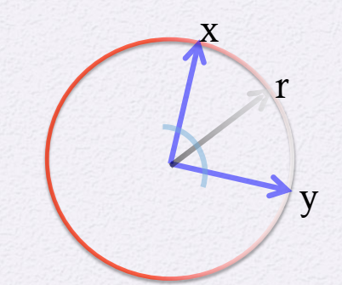
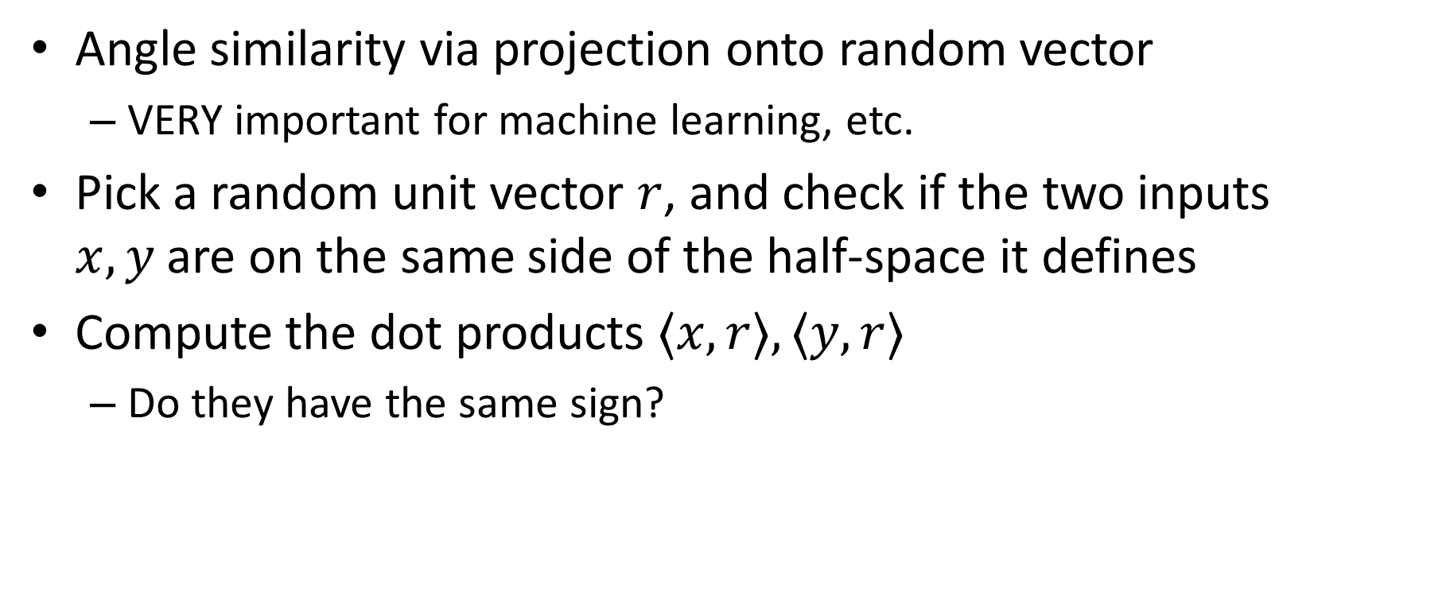
Angle similarity via SimHash
Angle similarity via projection onto random vector
VERY important for machine learning, etc.
Pick a random unit vector $r$, and check if the two inputs $x,y$are on the same side of the half-space it defines
Compute the dot products $〈x,r〉, 〈y,r〉$
Do they have the same sign?

