Slide 1
CS5112: Algorithms and Data Structures for Applications
Lecture 14: Exponential decay; convolution
Ramin Zabih
Some content from: Piotr Indyk; Wikipedia/Google image search;
J. Leskovec, A. Rajaraman, J. Ullman: Mining of Massive Datasets, http://www.mmds.org

Slide 2
Administrivia
Q7 delayed due to Columbus day holiday
HW3 out but short, can do HW in groups of 3 from now on
Class 10/23 will be prelim review for 10/25
Greg lectures on dynamic programming next week
Anonymous survey out, please respond!
Automatic grading apology

Slide 3
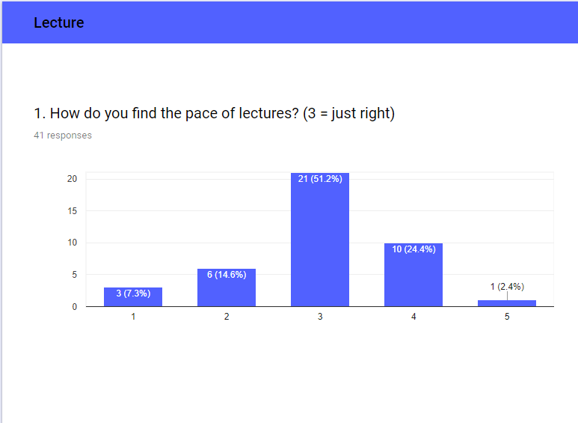
Survey feedback

Slide 4
Automatic grading apology
In general students should not have a grade revised downward
Main exception is regrade requests
Automatic grading means that this sometimes happened
At the end, we decided that the priority was to assign HW grades based on how correct the code was
Going forward, please treat HW grades as tentative grades
We will announce when those grades are finalized
After, they will only be changed under exceptional circumstances

Slide 5
Today
Two streaming algorithms
Convolution

Slide 6
Some natural histogram queries
Top-k most frequent elements
1 2 3 4 5 6 7 8 9 10 11 12 13 14 15 16 17 18 19 20
Find all elements
with frequency > 0.1%
What is the frequency
of element 3?
What is the total frequency
of elements between 8 and 14?
How many elements have non-zero frequency?
Notes:
Slide taken from Motwani and

Slide 7
Streaming algorithms (recap)
Boyer-Moore majority algorithm
Misra-Gries frequent items
Find popular recent items (box filter)
Find popular recent items (exponential window)
Flajolet-Martin number of items

Slide 8
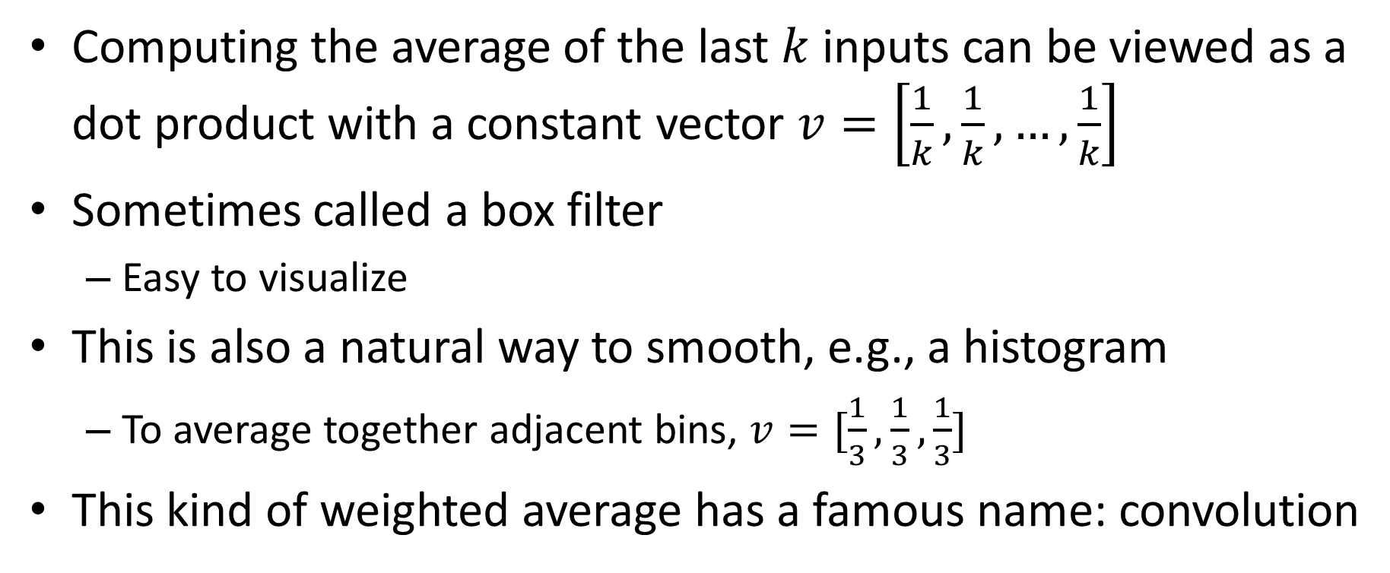
Weighted average in a sliding window
Computing the average of the last $k$ inputs can be viewed as a dot product with a constant vector $v=\left[\frac{1}{k},\frac{1}{k}, …,\frac{1}{k}\right]$
Sometimes called a box filter
Easy to visualize
This is also a natural way to smooth, e.g., a histogram
To average together adjacent bins, $v=[\frac{1}{3},\frac{1}{3},\frac{1}{3}]$
This kind of weighted average has a famous name: convolution

Slide 9
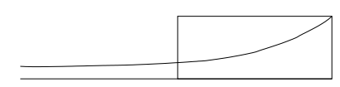
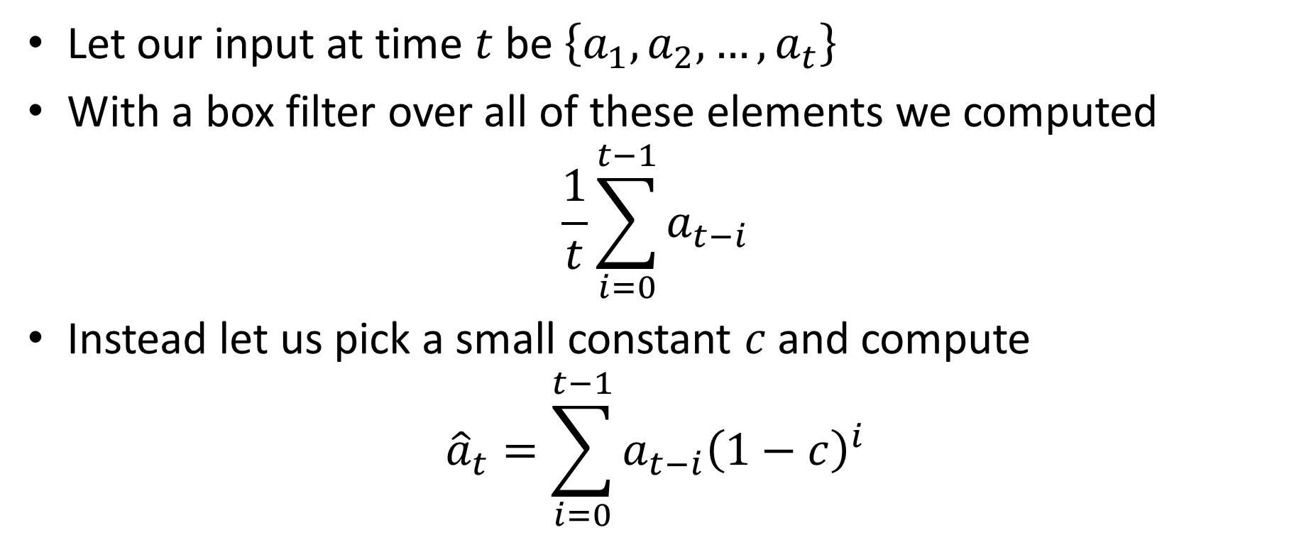
Decaying windows
Let our input at time $t$ be $\left\{a_{1},a_{2},…, a_{t}\right\}$
With a box filter over all of these elements we computed
$$\frac{1}{t}\sum_{i=0}^{t−1}{a_{t−i}}$$
Instead let us pick a small constant $c$and compute
$${\hat{a}}_{t}=\sum_{i=0}^{t−1}{a_{t−i}{\left(1−c\right)}^{i}}$$

Slide 10
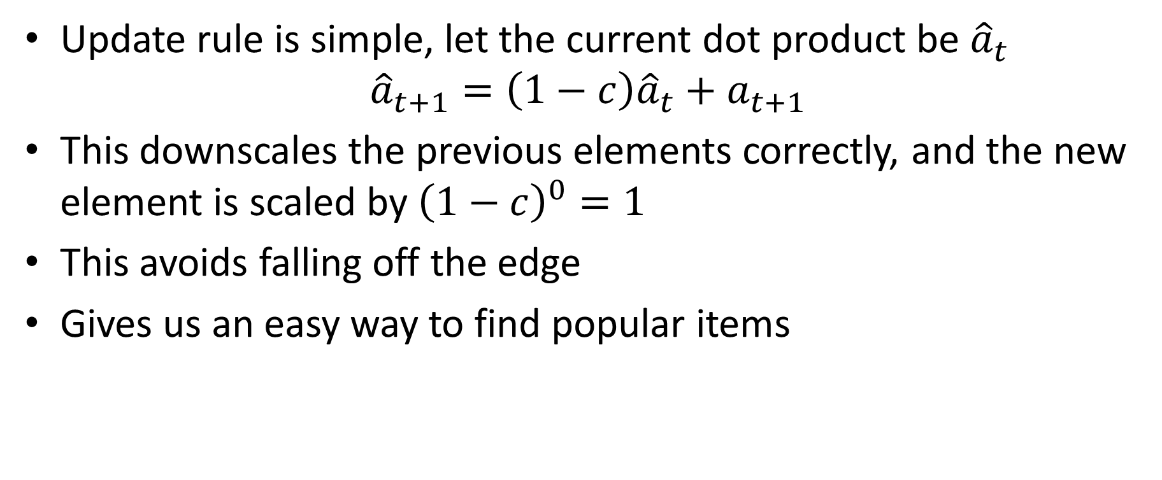
Easy to update this
Update rule is simple, let the current dot product be ${\hat{a}}_{t}$
$${\hat{a}}_{t+1}=\left(1−c\right){\hat{a}}_{t}+a_{t+1}$$
This downscales the previous elements correctly, and the new element is scaled by ${\left(1−c\right)}^{0}=1$
This avoids falling off the edge
Gives us an easy way to find popular items

Slide 11
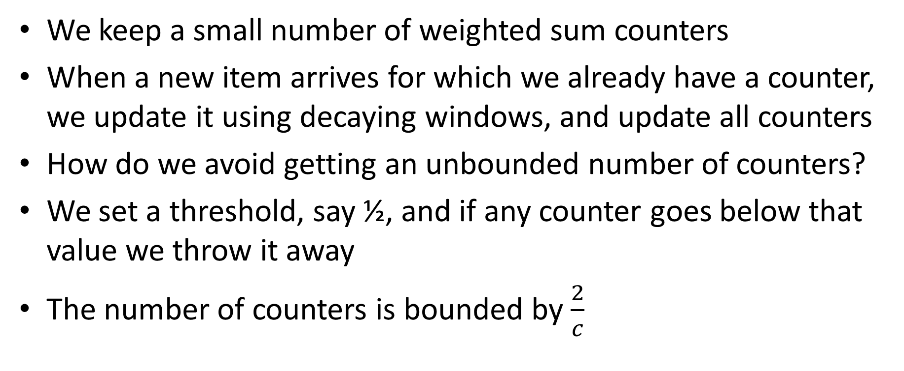
4. Popular items with decaying windows
We keep a small number of weighted sum counters
When a new item arrives for which we already have a counter, we update it using decaying windows, and update all counters
How do we avoid getting an unbounded number of counters?
We set a threshold, say ½, and if any counter goes below that value we throw it away
The number of counters is bounded by $\frac{2}{c}$

Slide 12
How many distinct items are there?
This tells you the size of the histogram, among other things
To solve this problem exactly requires space that is linear in the size of the input stream
Impractical for many applications
Instead we will compute an efficient estimate via hashing

Slide 13
5. Flajolet-Martin algorithm
Basic idea: the more different elements we see, the more different hash values we will see
We will pick a hash function that spreads out the input elements
Typically uses universal hashing

Slide 14
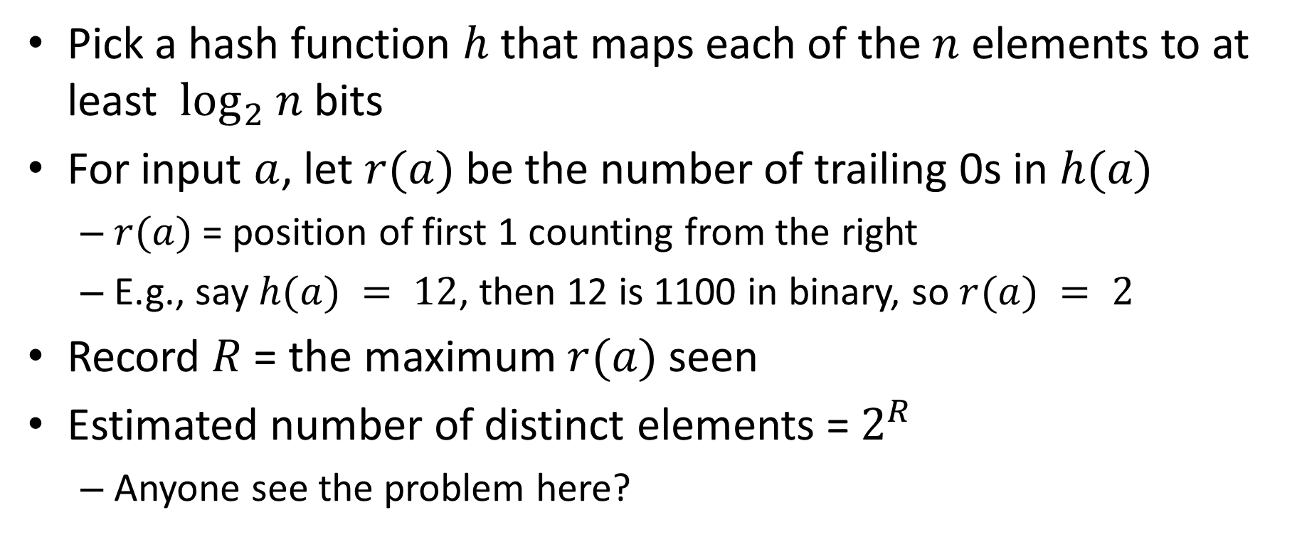
Flajolet-Martin algorithm
Pick a hash function $h$ that maps each of the $n$ elements to at least $\log_{2} n$bits
For input $a$, let $r(a)$be the number of trailing 0s in $h(a)$
$r(a)$= position of first 1 counting from the right
E.g., say $h(a) = 12$, then 12 is 1100 in binary, so $r(a) = 2$
Record $R$ = the maximum $r(a)$seen
Estimated number of distinct elements = $2^{R}$
Anyone see the problem here?

Slide 15
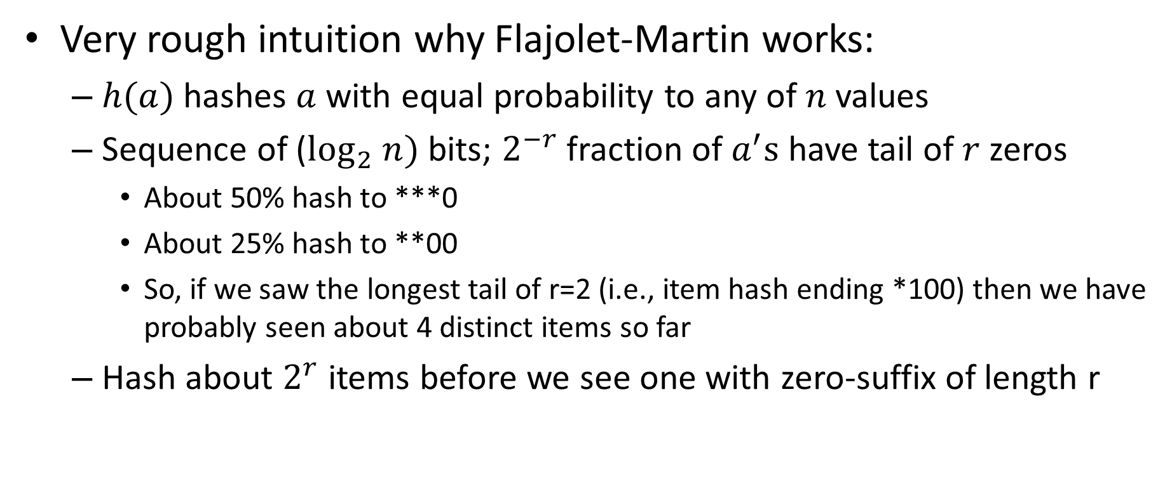
Why It Works: Intuition
Very rough intuition why Flajolet-Martin works:
$h(a)$hashes $a$with equal probability to any of $n$values
Sequence of ($\log_{2} n)$ bits; $2^{−r}$fraction of $a^{′}s$ have tail of $r$ zeros
About 50% hash to ***0
About 25% hash to **00
So, if we saw the longest tail of r=2 (i.e., item hash ending *100) then we have probably seen about 4 distinct items so far
Hash about $2^{r}$ items before we see one with zero-suffix of length r

Slide 16
Convolution
Weighted average with a mask/stencil/template
Dot product of vectors
Many important properties and applications
Symmetric in the inputs
Equivalent to linear shift-invariant systems
“Well behaved”, in a certain precise sense
Primary uses are smoothing and matching
This is the “C” in “CNN”

Slide 17
Local averaging in action

Slide 18
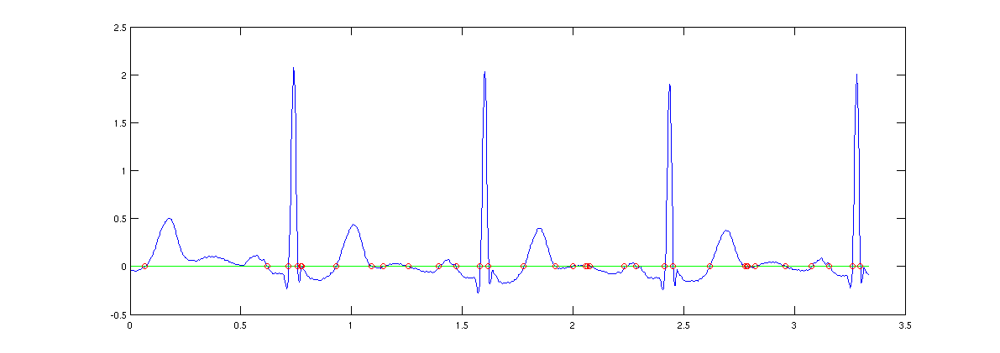
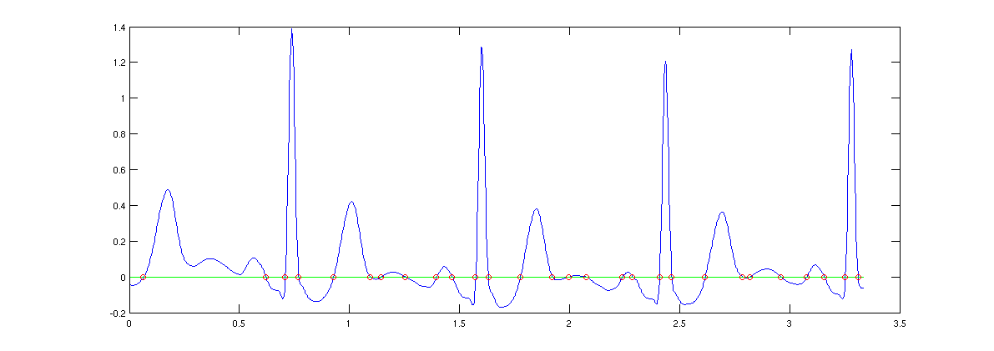
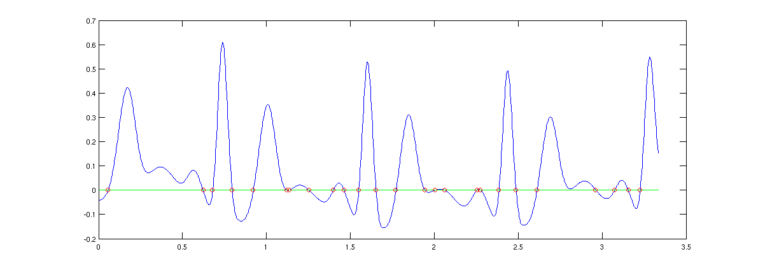
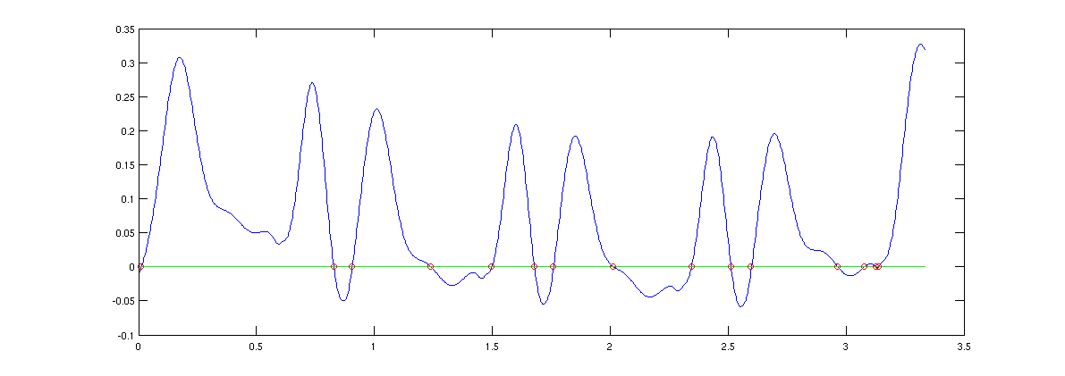
Smoothing parameter effects

Slide 19
Matched filters
Convolution can be used to find pulses
This is actually closely related to smoothing
How do we find a known pulse in a signal? Convolve the signal with our template!
E.g. to find something in the signal that looks like [1 6 -10] we convolve with [1 6 -10]
Question: what sense does this make?
Anecdotally it worked for finding boxes

Slide 20
Box finding example

Slide 21
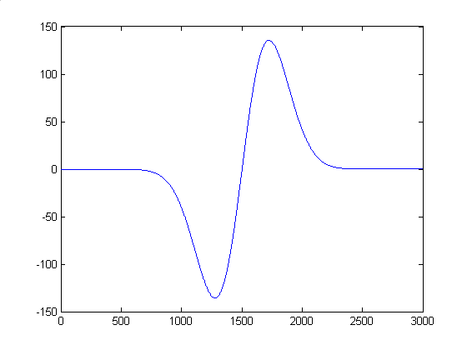
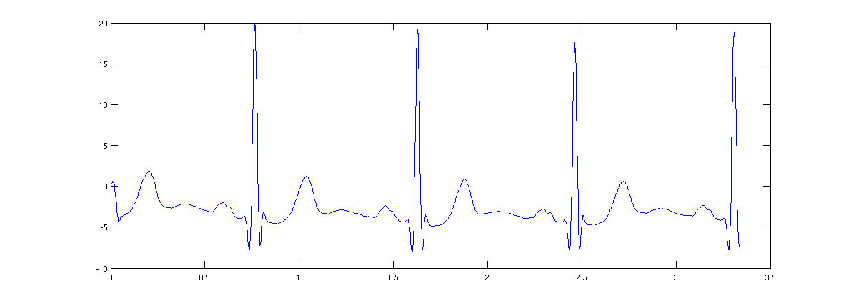
Pulse finding example

Slide 22
Why does this work?
Some nice optimality properties, but the way I described it, the algorithm fails
Idea: the [1 6 -10] template gives biggest response when signal is [… 1 6 -10 …]
Value is 137 at this point
But is this actually correct?
You actually need both the template and the input to have a zero mean and unit energy (sum of squares)
Easily accomplished: subtract -1, then divide by 137, get 1/137 * [2 7 -9]

Slide 23
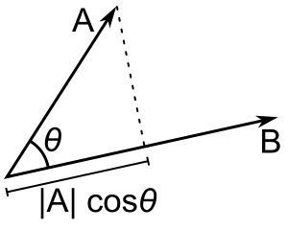
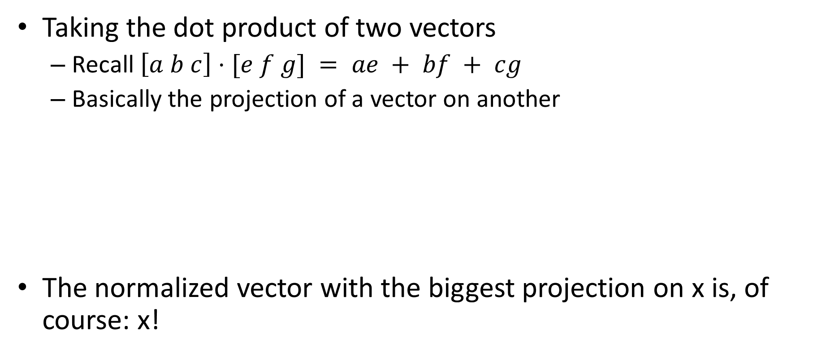
Geometric intuition
Taking the dot product of two vectors
Recall $\left[a b c\right]⋅[e f g] = ae + bf + cg$
Basically the projection of a vector on another
The normalized vector with the biggest projection on x is, of course: x!

