Slide 1
CS5112: Algorithms and Data Structures for Applications
Lecture 13: Streaming algorithms
Ramin Zabih
Some figures from: Wikipedia/Google image search;
J. Leskovec, A. Rajaraman, J. Ullman: Mining of Massive Datasets, http://www.mmds.org

Slide 2
Administrivia
Reminder: HW comments and minor corrections on Slack
Important announcements via email (best efforts)
Q6 out tonight
HW3 (and HW2!) delayed due to grading software issues
Anonymous survey coming re: speed of course, etc.

Slide 3
Today
Comments about the prelim!
Six approximate algorithms for histograms and NN

Slide 4
Prelim comments
NOTHING TODAY IS AUTHORITATIVE (YET)
Closed book, multiple choice and short answer
I will give example questions throughout today’s lecture

Slide 5
Online histogram approximations
Many AI/ML applications hinge on understanding the distribution of your input data
Classification is just one example
Classically we assume that all the input data is available
You can run an offline algorithm over it
Then do NN classification, density estimation, etc.
This assumption is often wrong: data comes streaming in
And you cannot afford to store the entire data set

Slide 6
Some natural histogram queries
Top-k most frequent elements
1 2 3 4 5 6 7 8 9 10 11 12 13 14 15 16 17 18 19 20
Find all elements
with frequency > 0.1%
What is the frequency
of element 3?
What is the total frequency
of elements between 8 and 14?
How many elements have non-zero frequency?
Notes:
Slide taken from Motwani and

Slide 7
Why approximation?
Suppose you want an (exact) histogram of your data
This requires space linear in the number of data points
Which is intractable for many internet applications!
Examples: IP addresses for DDOS detection; most popular page/item to buy
So instead we will use a small amount of space but solve the problem approximately
But, not precisely the same problem
Instead of computing the histogram we will look at several key properties of a histogram we can efficiently approximate
Typically with constant or logarithmic space and time

Slide 8
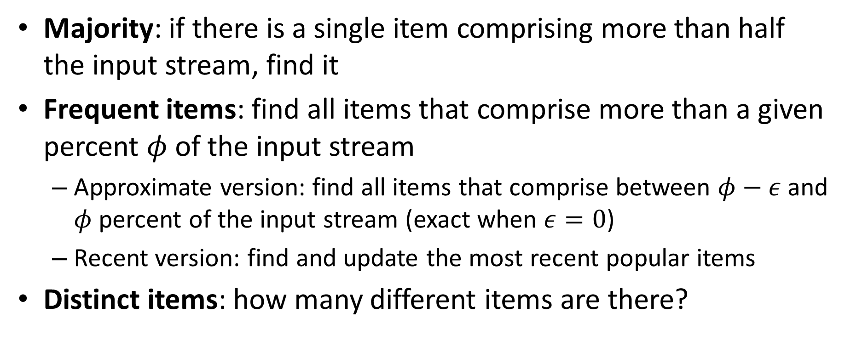
Relevant quantities to compute
Majority: if there is a single item comprising more than half the input stream, find it
Frequent items: find all items that comprise more than a given percent $φ$ of the input stream
Approximate version: find all items that comprise between $φ−ε$ and $φ$ percent of the input stream (exact when $ε=0$)
Recent version: find and update the most recent popular items
Distinct items: how many different items are there?

Slide 9
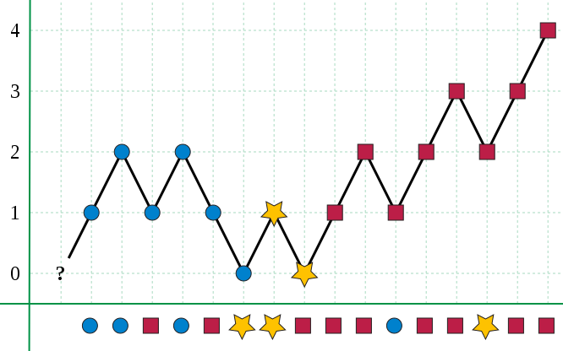
1. Boyer-Moore majority algorithm
Notes:
Figure from Wikipedia: https://en.wikipedia.org/wiki/File:Boyer-Moore_MJRTY.svg

Slide 10
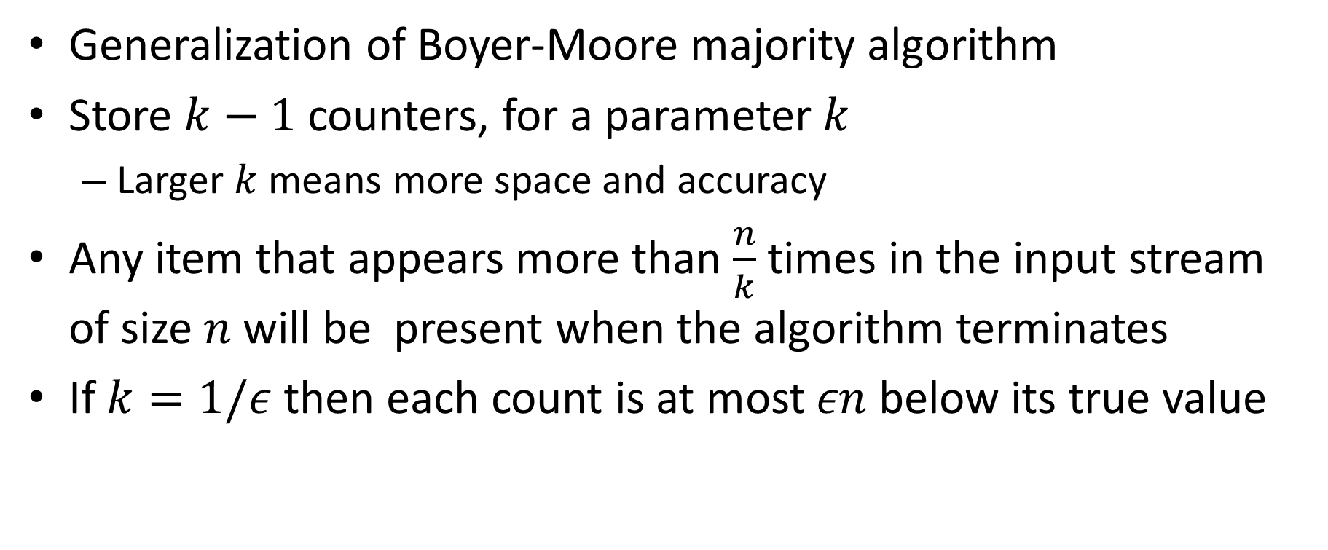
2. Misra-Gries
Generalization of Boyer-Moore majority algorithm
Store $k−1$ counters, for a parameter $k$
Larger $k$means more space and accuracy
Any item that appears more than $\frac{n}{k}$ times in the input stream of size $n$will be present when the algorithm terminates
If $k=1/ε$ then each count is at most $εn$ below its true value

Slide 11
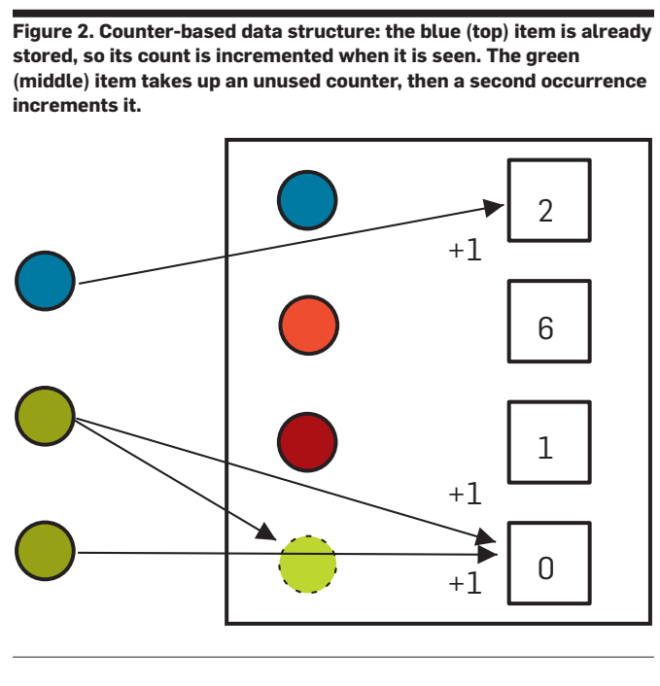
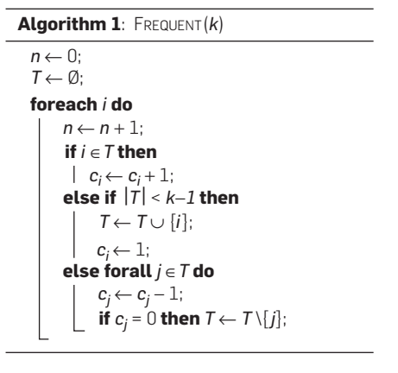
Misra-Gries algorithm in action
Finding the Frequent Items in Streams of Data, Cormode and Hadjieleftheriou, CACM 52(10), October 2009

Slide 12
3. Find popular recent items
Want to be able to naturally update this over time
Think of popular: movies, shopping items, web pages, etc.
We could run, e.g., Misra-Gries on a sliding window
This is both impractical and wrong
Wrong because the importance of an item should not “fall off a cliff” when it moves outside of our window

Slide 13
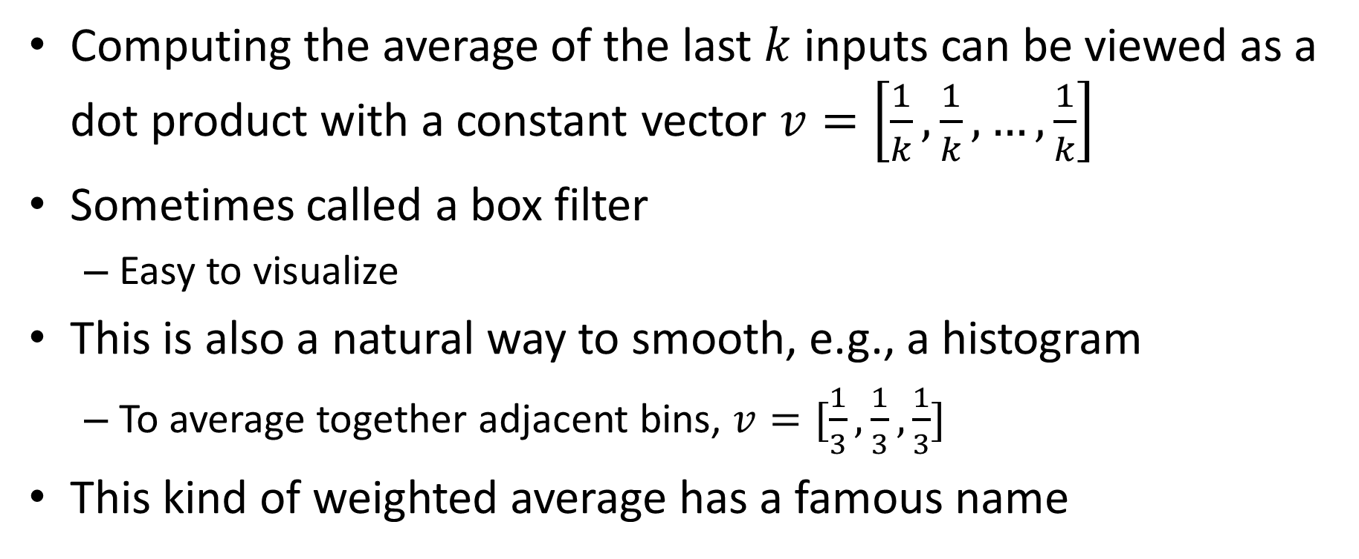
Weighted average in a sliding window
Computing the average of the last $k$ inputs can be viewed as a dot product with a constant vector $v=\left[\frac{1}{k},\frac{1}{k}, …,\frac{1}{k}\right]$
Sometimes called a box filter
Easy to visualize
This is also a natural way to smooth, e.g., a histogram
To average together adjacent bins, $v=[\frac{1}{3},\frac{1}{3},\frac{1}{3}]$
This kind of weighted average has a famous name

Slide 14
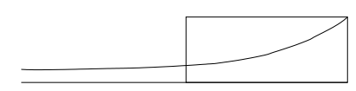
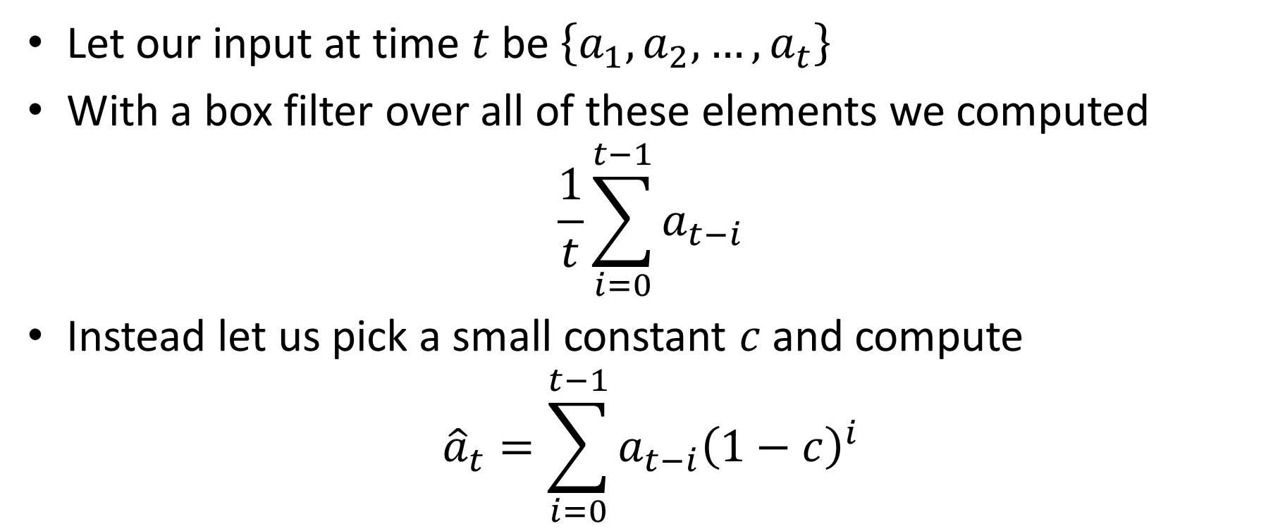
Decaying windows
Let our input at time $t$ be $\left\{a_{1},a_{2},…, a_{t}\right\}$
With a box filter over all of these elements we computed
$$\frac{1}{t}\sum_{i=0}^{t−1}{a_{t−i}}$$
Instead let us pick a small constant $c$and compute
$${\hat{a}}_{t}=\sum_{i=0}^{t−1}{a_{t−i}{\left(1−c\right)}^{i}}$$

Slide 15
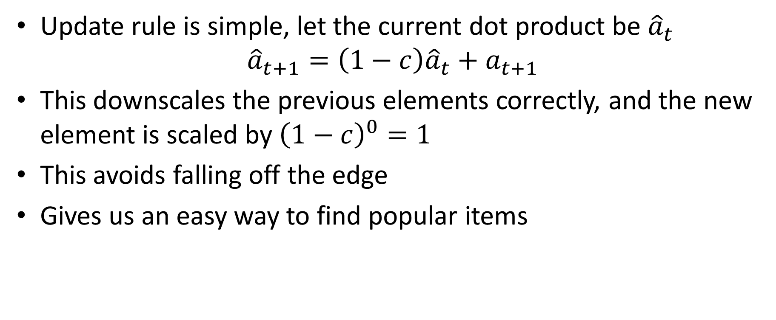
Easy to update this
Update rule is simple, let the current dot product be ${\hat{a}}_{t}$
$${\hat{a}}_{t+1}=\left(1−c\right){\hat{a}}_{t}+a_{t+1}$$
This downscales the previous elements correctly, and the new element is scaled by ${\left(1−c\right)}^{0}=1$
This avoids falling off the edge
Gives us an easy way to find popular items

Slide 16
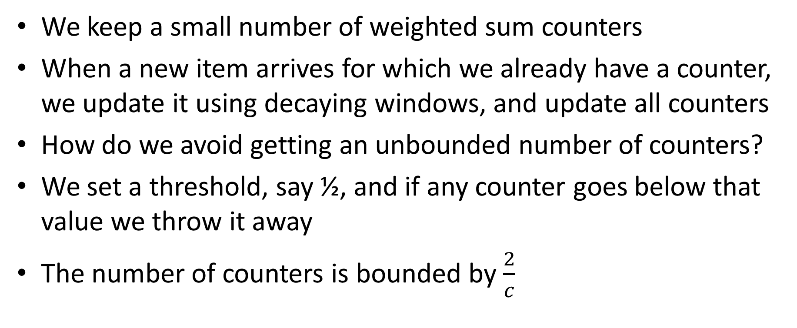
4. Popular items with decaying windows
We keep a small number of weighted sum counters
When a new item arrives for which we already have a counter, we update it using decaying windows, and update all counters
How do we avoid getting an unbounded number of counters?
We set a threshold, say ½, and if any counter goes below that value we throw it away
The number of counters is bounded by $\frac{2}{c}$

Slide 17
How many distinct items are there?
This tells you the size of the histogram, among other things
To solve this problem exactly requires space that is linear in the size of the input stream
Impractical for many applications
Instead we will compute an efficient estimate via hashing

