Slide 1
CS5112: Algorithms and Data Structures for Applications
Lecture 21: Algorithmic issues in tracking
Ramin Zabih
Some content from: Wikipedia/Google image search

Slide 2
Lecture Outline
Applying mean shift to tracking
Expectation maximization
RANSAC
M-estimation
Least squares fitting

Slide 3


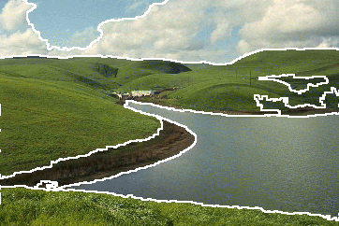
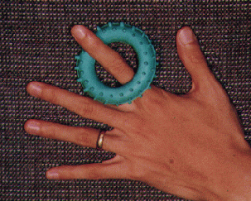
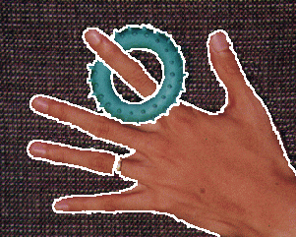
Mean shift segmentations
Notes:
Originally taken from http://www.caip.rutgers.edu/~comanici/MSPAMI/msPamiResults.html

Slide 4
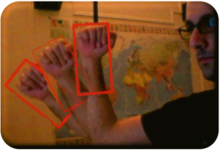
Mean shift tracking example
Notes:
http://www.iro.umontreal.ca/~drarenij/___RESEARCH__/Entries/2007/4/25_Mean-Shift_Tracking.html

Slide 5
Tracking overview
Suppose we want to figure out how fast and what direction (L-R) a robot is moving
We can just run segmentation on consecutive frames
Not too much changes in 1/30 of a second
Usually you can ‘carry over’ some information from previous frame

Slide 6
The ideal robot

Slide 7
The real (lying) robot

Slide 8
Real problem is much worse
Some of the time we will track a different object
This gives us outliers (from other object)
Versus inliers (from the object we want to track)

Slide 9
Simplified tracking problem – Line fitting
Goal: To group a bunch of points into two “best-fit” line segments

Slide 10
“Chicken-egg problem”
If we knew which line each point belonged to, we could compute the best-fit lines.

Slide 11
Chicken-egg problem
If we knew what the two best-fit lines were, we could find out which line each point belonged to.

Slide 12
Expectation-Maximization (EM)
Initialize: Make random guess for lines
Repeat:
Find the line closest to each point and group into two sets. (Expectation Step)
Find the best-fit lines to the two sets (Maximization Step)
Iterate until convergence
The algorithm is guaranteed to converge to some local optima

Slide 13
Example:

Slide 14
Example:

Slide 15
Example:

Slide 16
Example:

Slide 17
Example:
Converged!

Slide 18
Expectation maximization
Standard use case is to separate two gaussians (MOG)
If we knew which data is water and which is beer, we could compute the mean and variance separately
If we know the mean and variance were for beer and water, we could figure out which data is water and which is beer
But we don’t know anything!
So, just like in k-means, we guess and iterate

Slide 19
From P. Smyth
ICML 2001

Slide 20
From P. Smyth
ICML 2001

Slide 21
From P. Smyth
ICML 2001

Slide 22
From P. Smyth
ICML 2001

Slide 23
From P. Smyth
ICML 2001

Slide 24
From P. Smyth
ICML 2001

Slide 25
From P. Smyth
ICML 2001

Slide 26
RANSAC algorithm
Run k times:
(1) draw n samples randomly
(2) fit parameters Θ with these n samples
(3) for each of other N-n points, calculate
its distance to the fitted model, count the
number of inlier points, c
Output Θ with the largest c
How many times?
How big?
Smaller is better
How to define?
Depends on the problem.

Slide 27
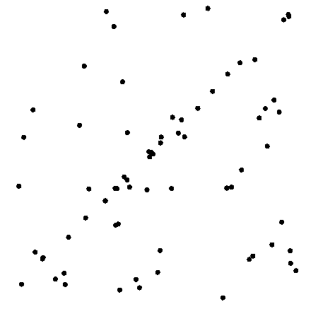
Example: line fitting

Slide 28
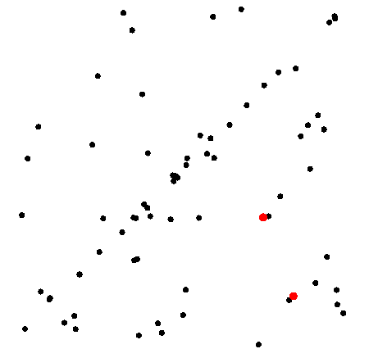
Example: line fitting
n=2

Slide 29
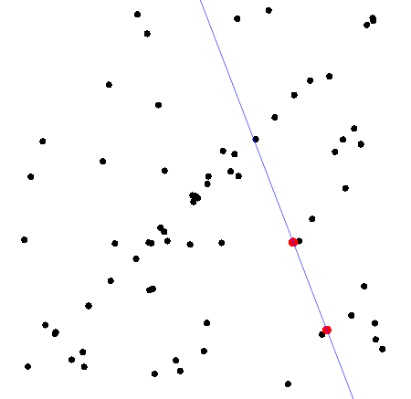
Model fitting

Slide 30
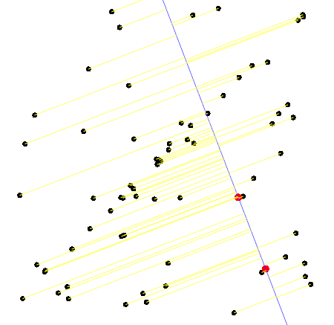
Measure distances

Slide 31
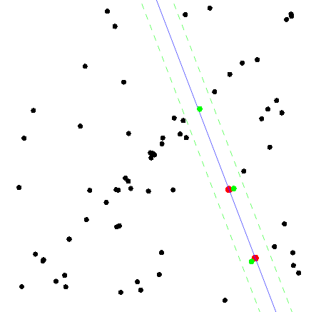
Count inliers
c=3

Slide 32
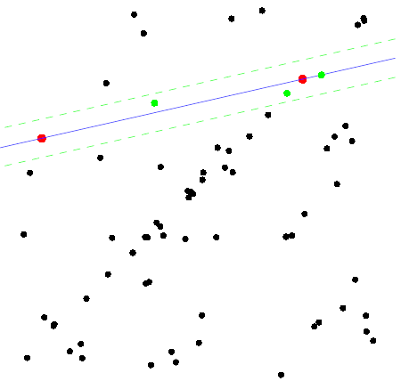
Another trial
c=3

Slide 33
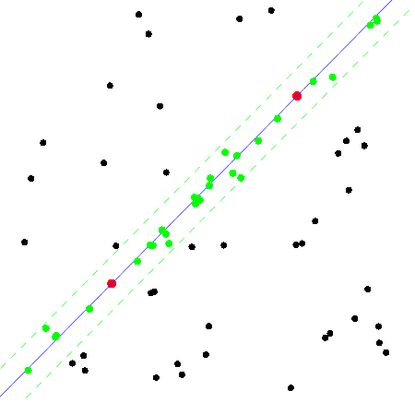
The best model
c=15

Slide 34
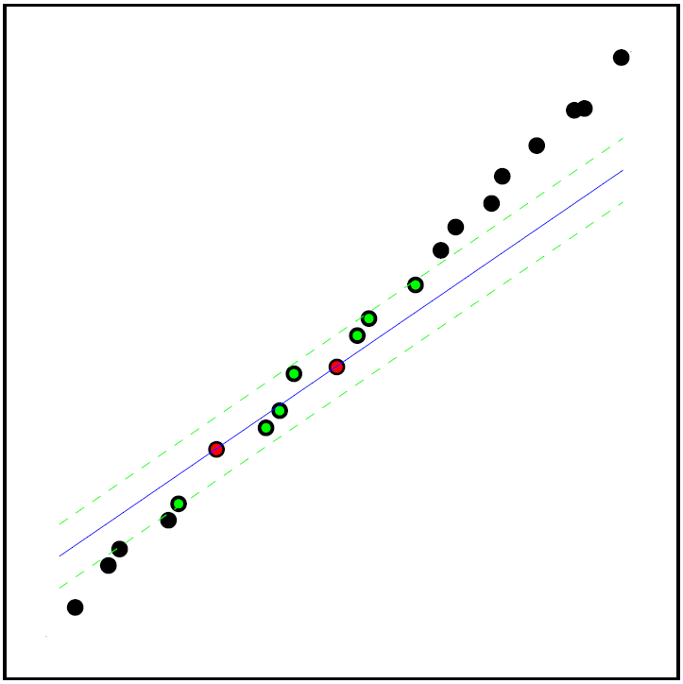
RANSAC failure mode
Not every all-inlier sample gives a model consistent with all inliers

Slide 35
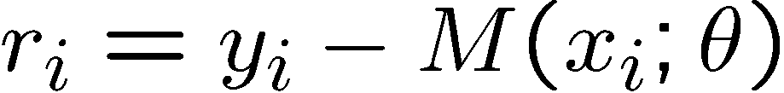
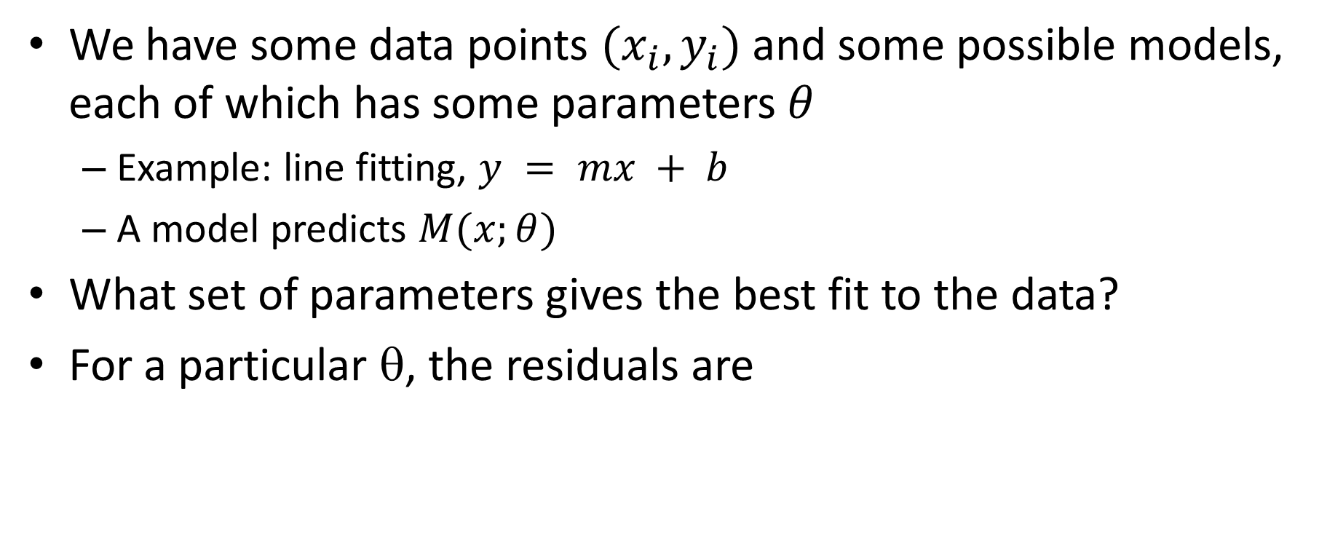
General model fitting problem
We have some data points $(x_{i}, y_{i})$and some possible models, each of which has some parameters $θ$
Example: line fitting, $y = mx + b$
A model predicts $M(x;θ)$
What set of parameters gives the best fit to the data?
For a particular θ, the residuals are

Slide 36
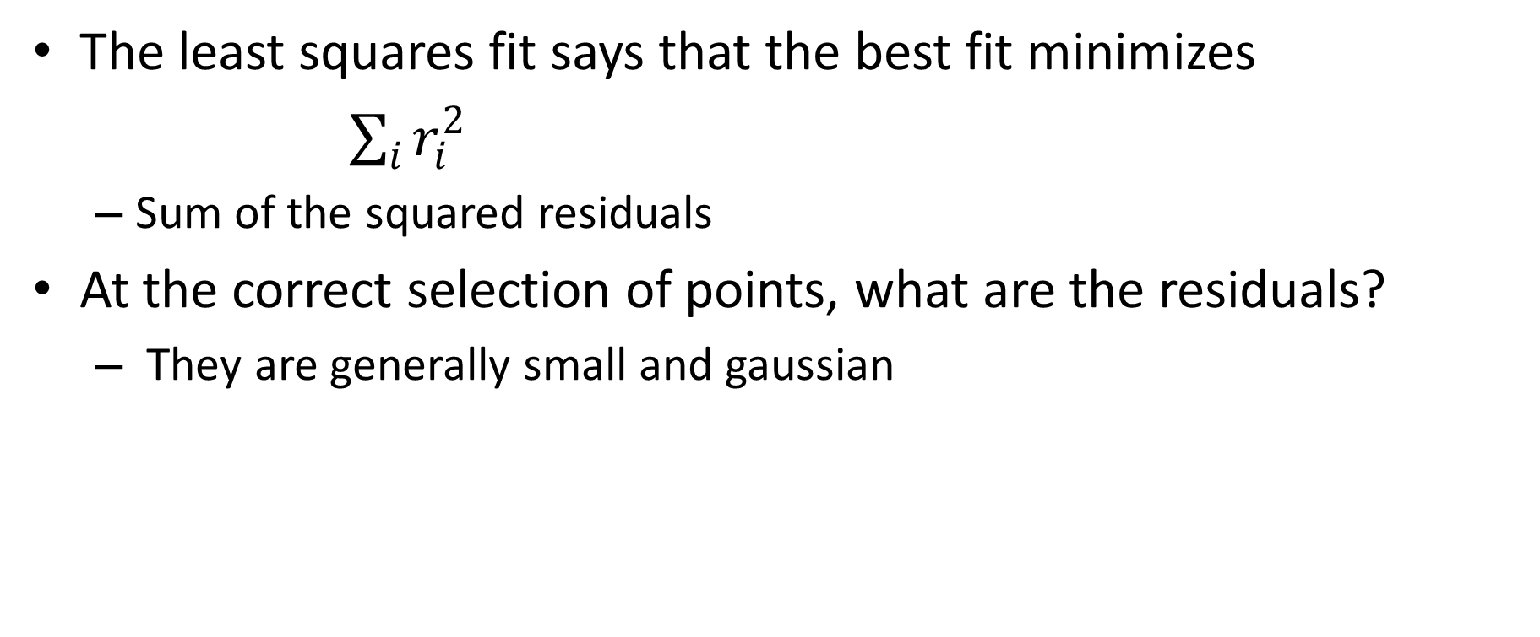
Least squares fit
The least squares fit says that the best fit minimizes
$\sum_{i}{r_{i}^{2}}$
Sum of the squared residuals
At the correct selection of points, what are the residuals?
They are generally small and gaussian

Slide 37
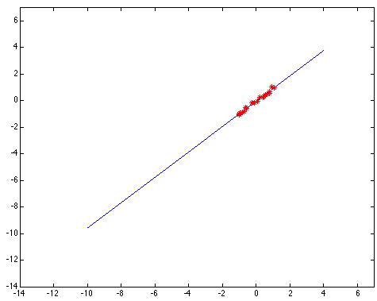
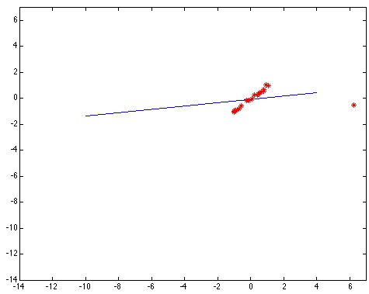
1 bad point can ruin your whole line
Example c/o Kim Boyer, OSU

Slide 38
Problem is subtle
You can’t simply do an LS fit and then declare the worst-fitting point to be “bad”
There are examples where the bad data is fit better than the good data
Robust statistics addresses this problem
A robust fitting method tolerates outliers
Obviously, LS is not robust
Note that in vision, the term “robust” sometimes simply means “good”

Slide 39
Robust model fitting
There are two problems with the LS fit
We square the residuals
We sum up these squares
The main approaches in robust statistics address each of these problems
The problem with squaring the residuals is that the squared values get too large

Slide 40
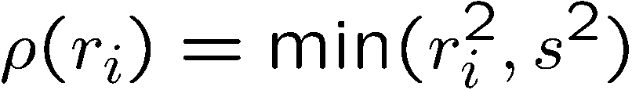
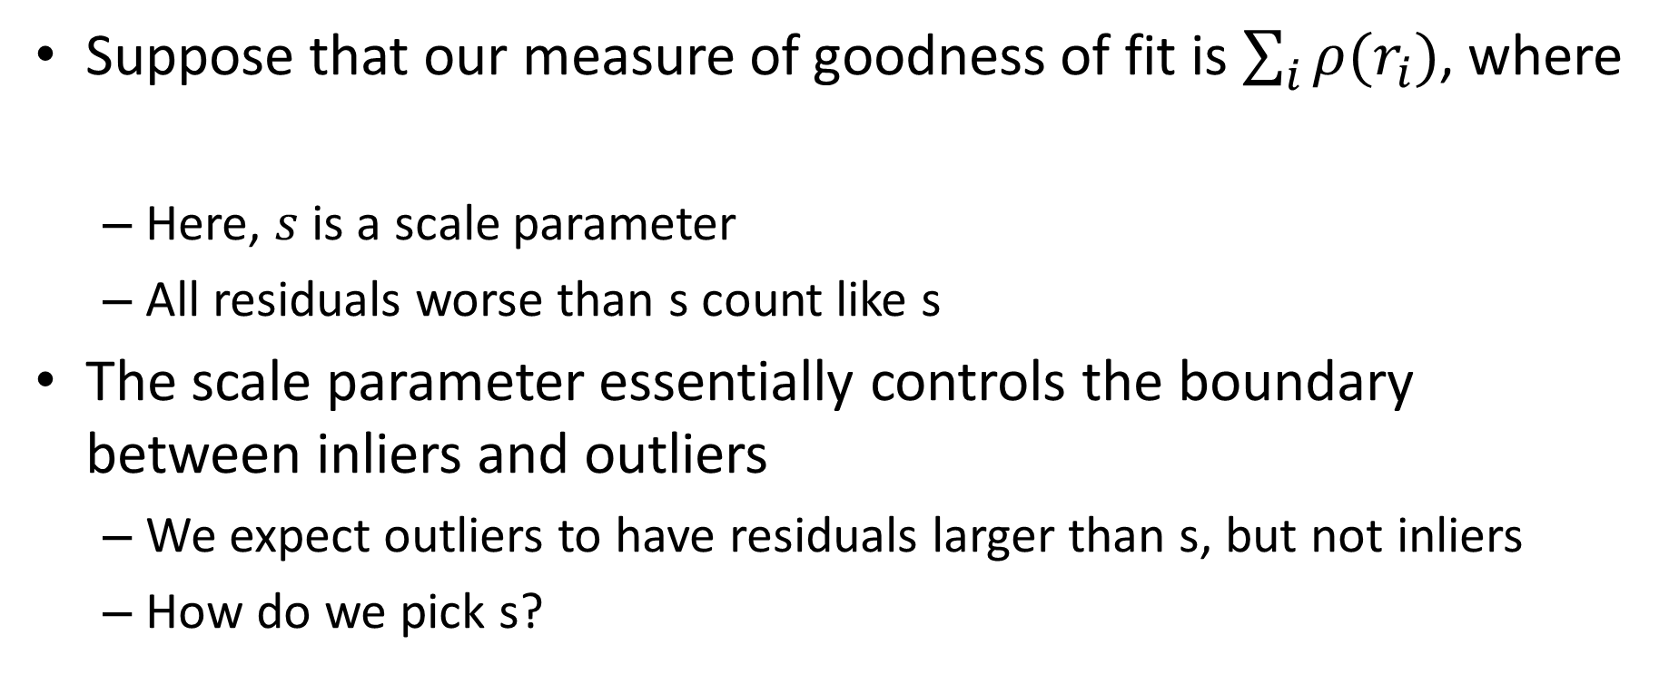
M-estimation
Suppose that our measure of goodness of fit is $\sum_{i}{ρ(r_{i})}$, where
Here, $s$ is a scale parameter
All residuals worse than s count like s
The scale parameter essentially controls the boundary between inliers and outliers
We expect outliers to have residuals larger than s, but not inliers
How do we pick s?

Slide 41
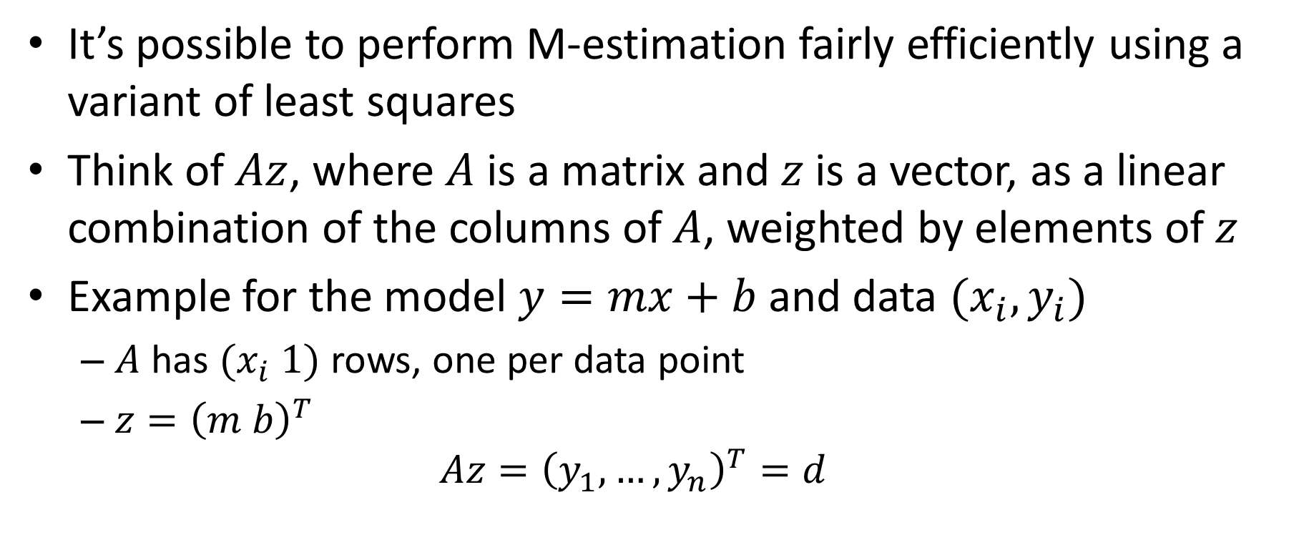
Computing a robust fit
It’s possible to perform M-estimation fairly efficiently using a variant of least squares
Think of $Az$, where $A$ is a matrix and $z$ is a vector, as a linear combination of the columns of $A$, weighted by elements of $z$
Example for the model $y=mx+b$ and data $(x_{i},y_{i})$
$A$ has $(x_{i} 1)$ rows, one per data point
$z={\left(m b\right)}^{T}$
$$Az={\left(y_{1},…, y_{n}\right)}^{T}=d$$

Slide 42
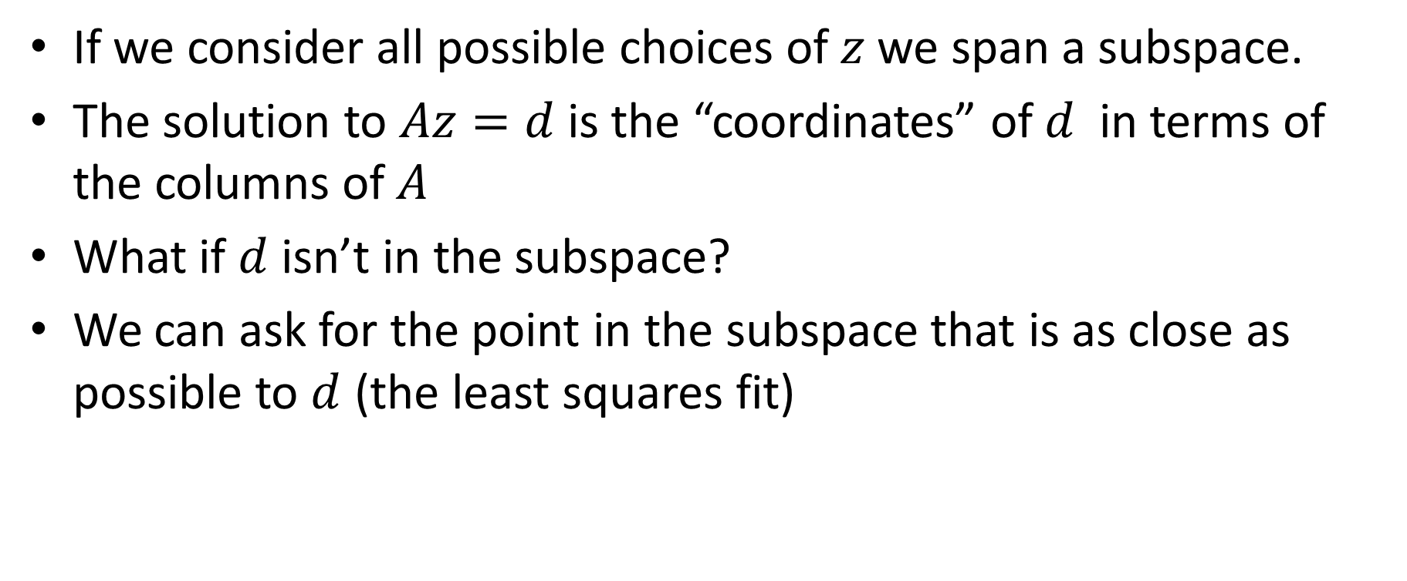
Computing a LS fit
If we consider all possible choices of $z$we span a subspace.
The solution to $Az=d$ is the “coordinates” of $d$ in terms of the columns of $A$
What if $d$ isn’t in the subspace?
We can ask for the point in the subspace that is as close as possible to $d$ (the least squares fit)

Slide 43
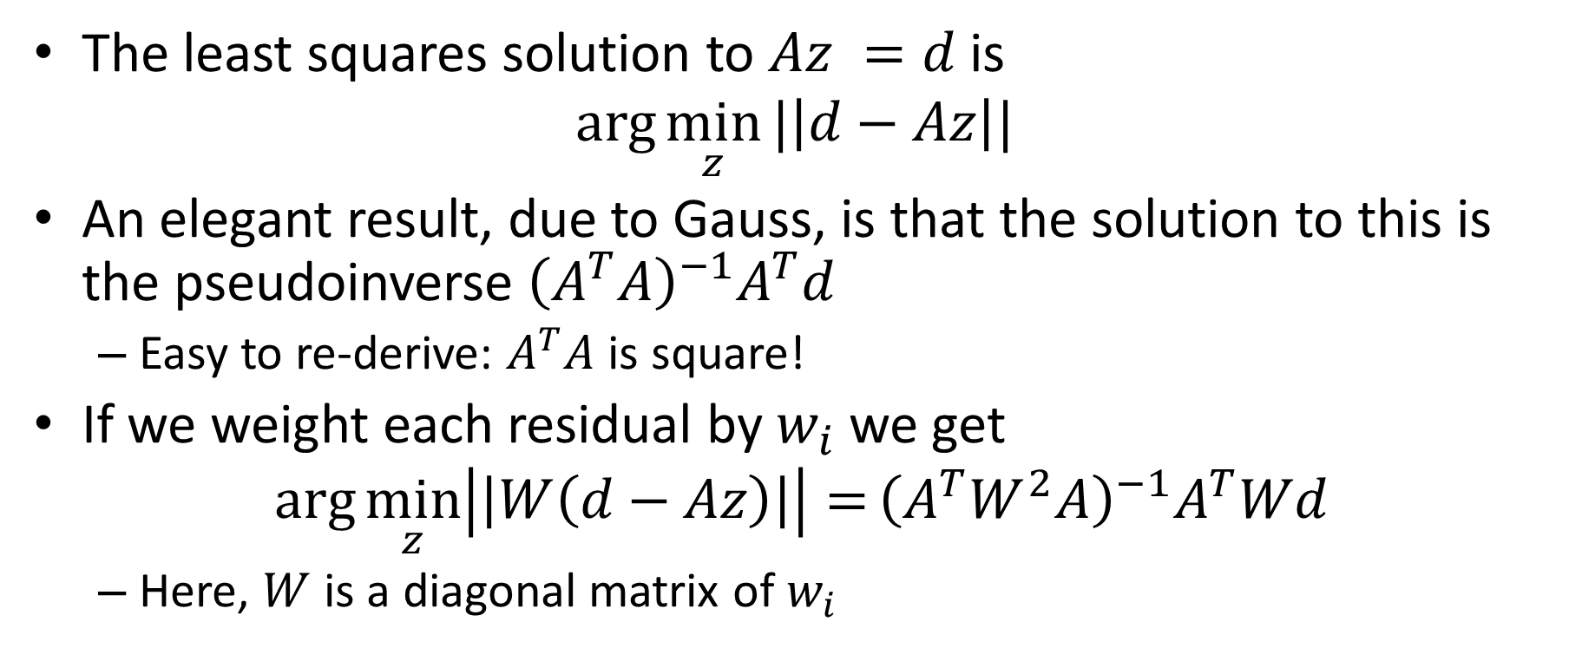
Solving least squares
The least squares solution to $Az =d$is
$$arg\min_{z}{|\left|d−Az\right||}$$
An elegant result, due to Gauss, is that the solution to this is the pseudoinverse ${\left(A^{T}A\right)}^{−1}A^{T}d$
Easy to re-derive: $A^{T}A$ is square!
If we weight each residual by $w_{i}$ we get
$$arg\min_{z}\left|\left|W\left(d−Az\right)\right|\right|={\left(A^{T}W^{2}A\right)}^{−1}A^{T}Wd$$
Here, $W$ is a diagonal matrix of $w_{i}$

Slide 44
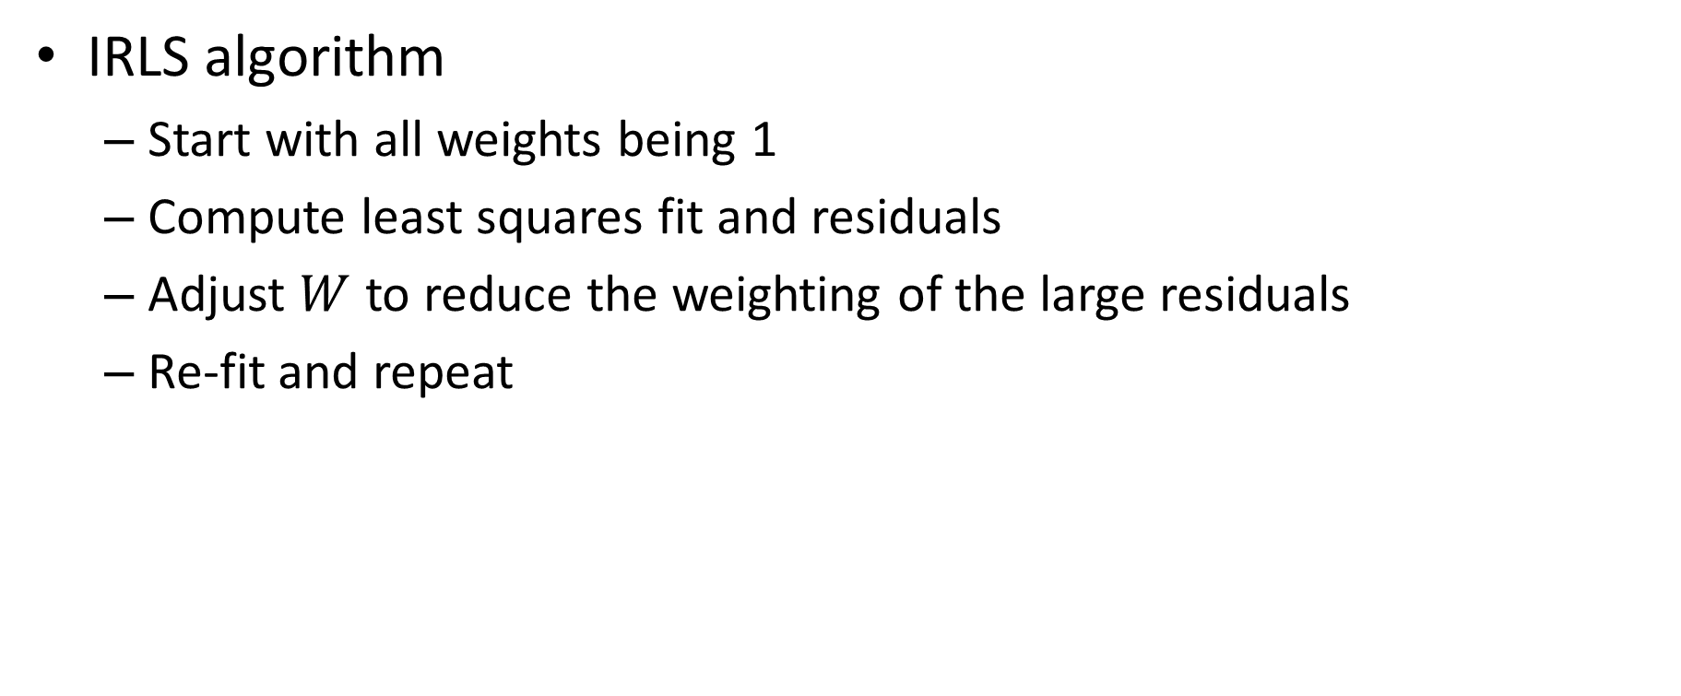
Iterative reweighted least squares
IRLS algorithm
Start with all weights being 1
Compute least squares fit and residuals
Adjust $W$ to reduce the weighting of the large residuals
Re-fit and repeat

