Slide 1
CS5112: Algorithms and Data Structures for Applications
Lecture 10: From hashing to machine learning
Ramin Zabih
Some figures from Wikipedia/Google image search

Slide 2
Administrivia
HW comments and minor corrections on Slack
HW3 coming soon
Non-anonymous survey coming re: speed of course, etc.

Slide 3
Office hours
Prof Zabih: after lecture or by appointment
Tuesdays 11:30-12:30 in Bloomberg 277 with @Julia
Wednesdays 2:30-3:30 in Bloomberg 277 with @irisz
Wednesdays 3:30-4:30 in Bloomberg 277 with @Ishan
Thursdays 10-12 in Bloomberg 267 with @Fei Li

Slide 4
Today
Universal hashing
Recap: randomized quicksort
From universal to perfect
Learning to hash
Nearest neighbor search

Slide 5
Quick impossibility proof
Generally, proofs that there is no algorithm that can do X are quite complicated
There is a simple one that follows naturally from Richard’s lecture last Thursday on compression
Do (lossless) compression algorithm always work?
I.e., reduce the size of a file?

Slide 6
Perfect & minimal hashing
Choice of hash functions is data-dependent!
Let’s try to hash 4 English words into the buckets 0,1,2,3
E.g., to efficiently compress a sentence
Words: {“banana”, “glib”, “epic”, “food”}
Can efficiently say sentence like “epic glib banana food” = 3,2,1,0
Can you construct a minimal perfect hash function that maps each of these to a different bucket?
Needs to be efficient, not (e.g.) a list of cases

Slide 7
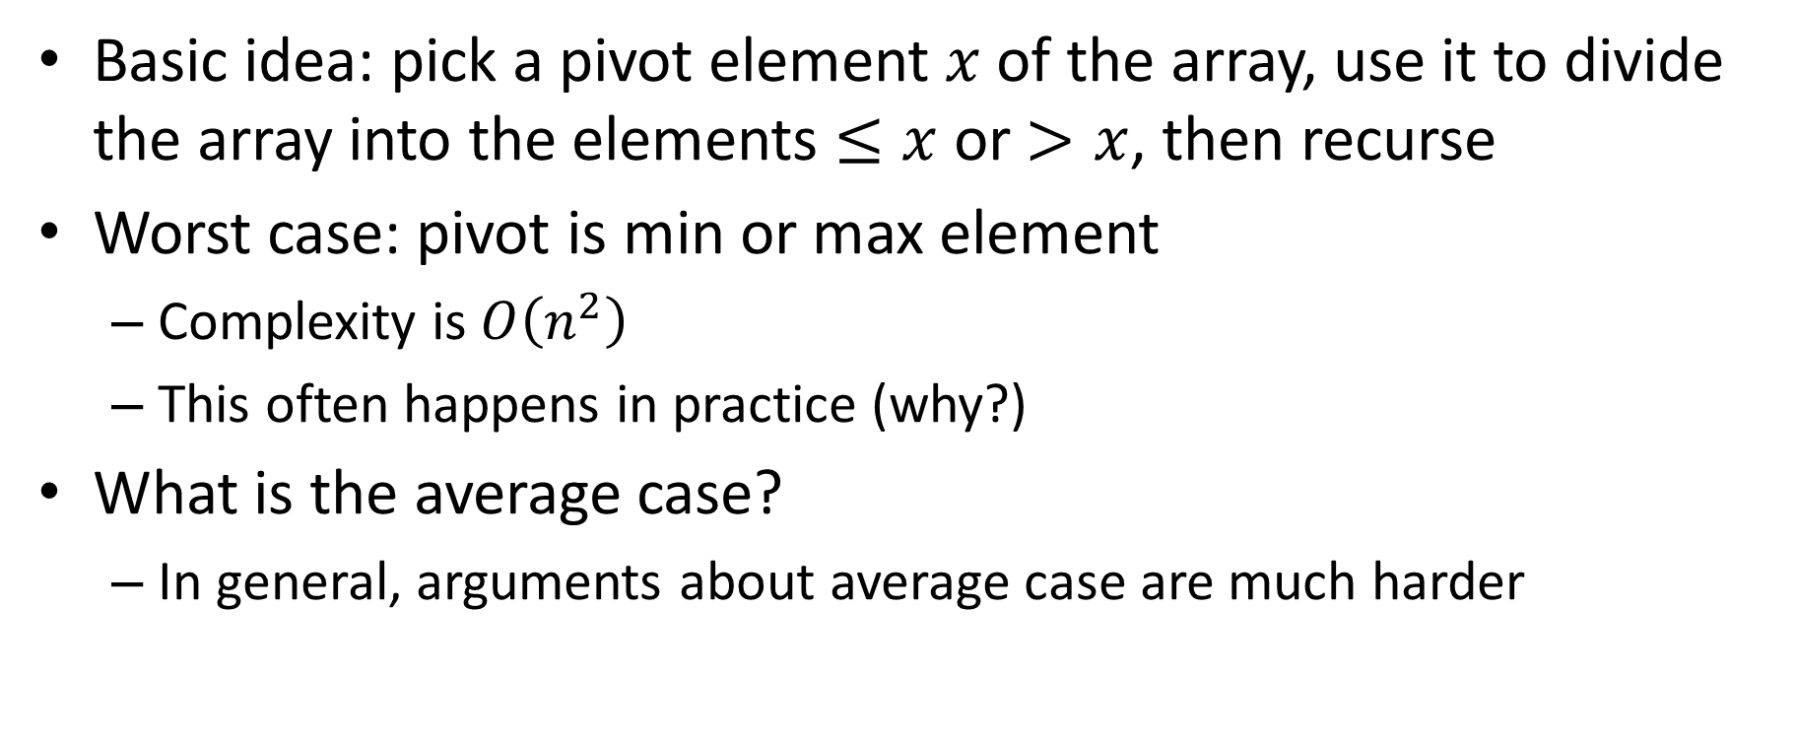
Recall: Quicksort
Basic idea: pick a pivot element $x$of the array, use it to divide the array into the elements $≤x$ or $>x$, then recurse
Worst case: pivot is min or max element
Complexity is $O\left(n^{2}\right)$
This often happens in practice (why?)
What is the average case?
In general, arguments about average case are much harder

Slide 8
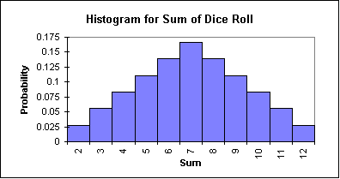
Expectation of random variables
Randomized quicksort: pick a random pivot
Equivalent to randomizing the input then running (usual) quicksort
Recall: a (discrete) random variable has different possible values with different probabilities
Think of a coin, a die, or a roulette wheel
Visualize as a histogram
The expectation of a random variable is the weighted sum, where each value is weighted by its probability
Example: expectation of a 6 sided die is 3.5
Notes:
Image from: https://www.omtexclasses.com/2015/02/the-distribution-of-random-variable.html

Slide 9
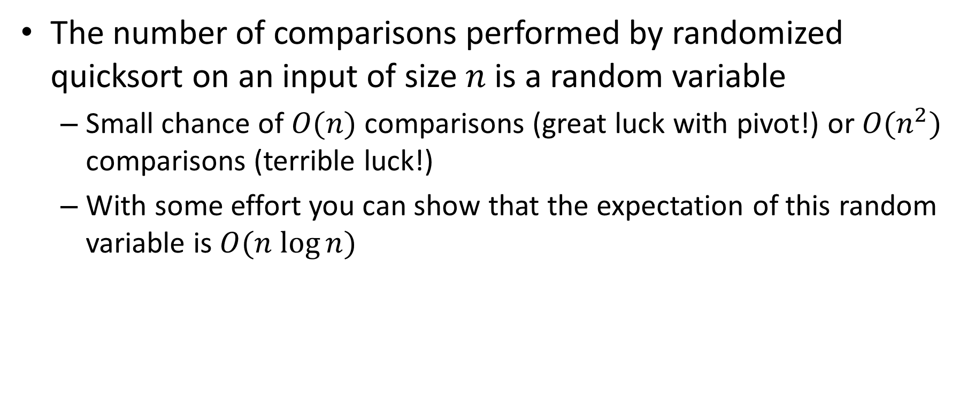
Average case quicksort
The number of comparisons performed by randomized quicksort on an input of size $n$ is a random variable
Small chance of $O(n)$ comparisons (great luck with pivot!) or $O(n^{2})$ comparisons (terrible luck!)
With some effort you can show that the expectation of this random variable is $O(n log⁡n)$

Slide 10
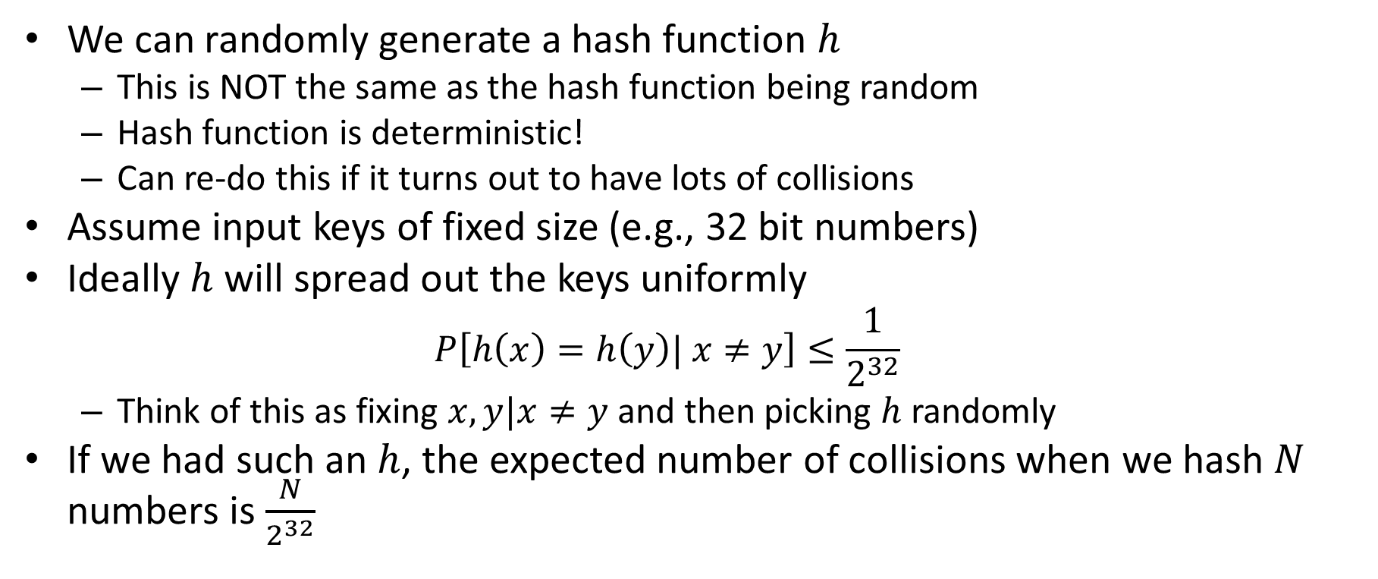
Universal hashing
We can randomly generate a hash function $h$
This is NOT the same as the hash function being random
Hash function is deterministic!
Can re-do this if it turns out to have lots of collisions
Assume input keys of fixed size (e.g., 32 bit numbers)
Ideally $h$ will spread out the keys uniformly
$$P\left[h\left(x\right)=h\left(y\right)| x≠y\right]≤\frac{1}{2^{32}}$$
Think of this as fixing $x,y|x≠y$and then picking $h$randomly
If we had such an $h$, the expected number of collisions when we hash $N$ numbers is $\frac{N}{2^{32}}$

Slide 11
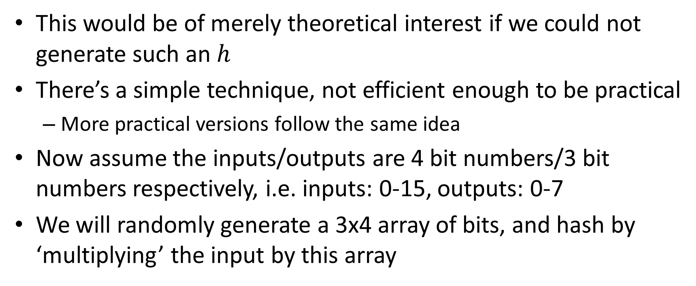
Universal hashing by matrix multiplication
This would be of merely theoretical interest if we could not generate such an $h$
There’s a simple technique, not efficient enough to be practical
More practical versions follow the same idea
Now assume the inputs/outputs are 4 bit numbers/3 bit numbers respectively, i.e. inputs: 0-15, outputs: 0-7
We will randomly generate a 3x4 array of bits, and hash by ‘multiplying’ the input by this array

Slide 12
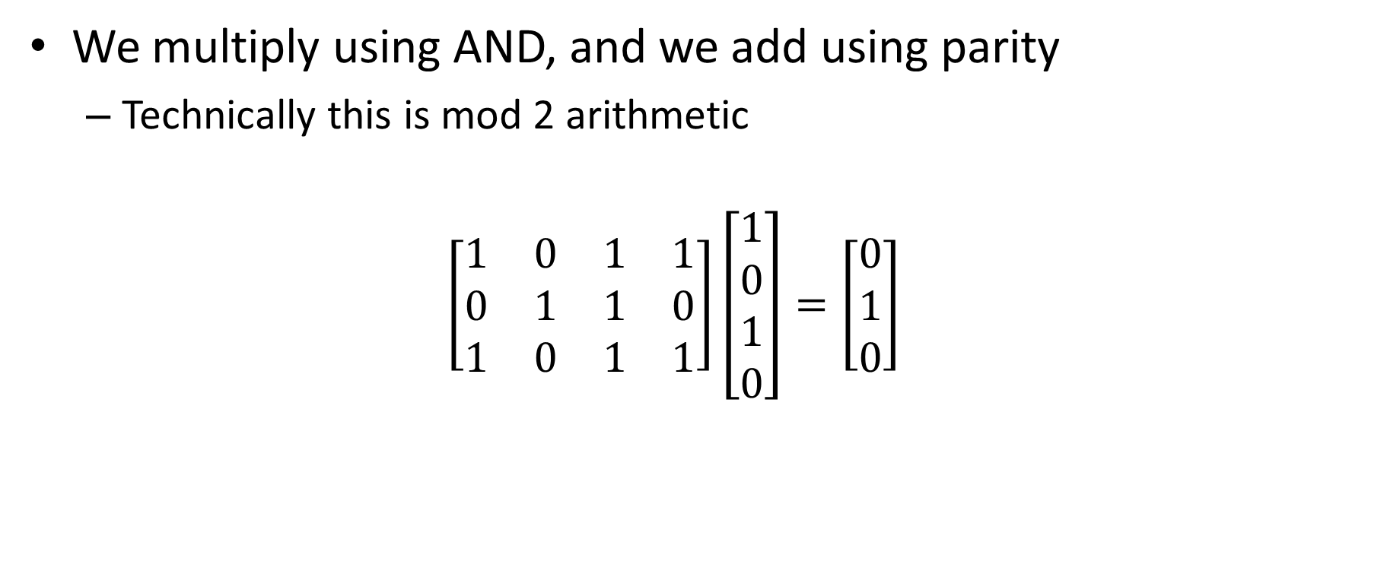
Universal hashing example
We multiply using AND, and we add using parity
Technically this is mod 2 arithmetic
$$\left[\begin{matrix}1 & 0 & 1 & 1 \\ 0 & 1 & 1 & 0 \\ 1 & 0 & 1 & 1\end{matrix}\right]\left[\begin{matrix}1 \\ 0 \\ 1 \\ 0\end{matrix}\right]=\left[\begin{matrix}0 \\ 1 \\ 0\end{matrix}\right]$$

Slide 13
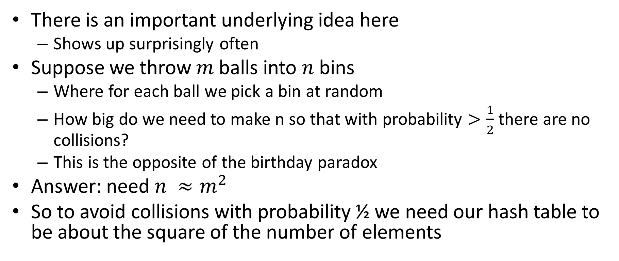
Balls into bins
There is an important underlying idea here
Shows up surprisingly often
Suppose we throw $m$balls into $n$ bins
Where for each ball we pick a bin at random
How big do we need to make n so that with probability $>\frac{1}{2}$ there are no collisions?
This is the opposite of the birthday paradox
Answer: need $n ≈m^{2}$
So to avoid collisions with probability ½ we need our hash table to be about the square of the number of elements

Slide 14
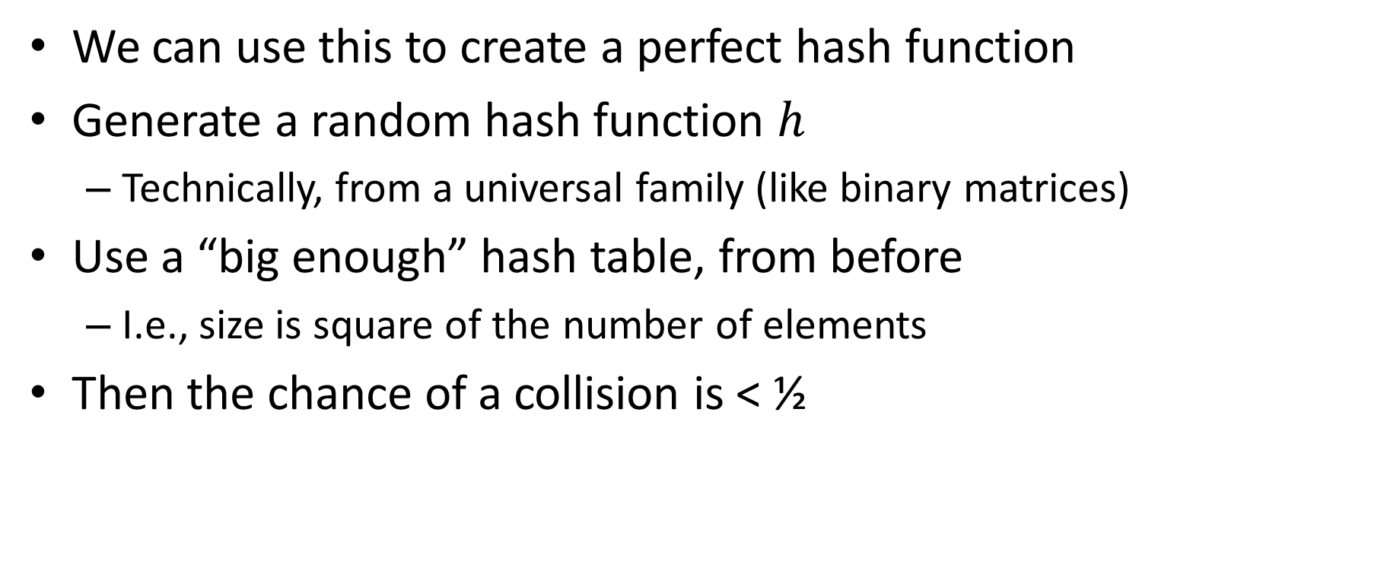
Perfect hashing from universal hashing
We can use this to create a perfect hash function
Generate a random hash function $h$
Technically, from a universal family (like binary matrices)
Use a “big enough” hash table, from before
I.e., size is square of the number of elements
Then the chance of a collision is < ½

Slide 15
Nearest neighbor search
Fundamental problem in machine learning/AI: find something in the data similar to a query
Selected examples: predicting purchases (Amazon/Netflix), avoiding fraudulent credit card transactions, finding undervalued stocks, etc.
Easiest way to do classification (map items to labels)
Important application: density estimation
Exact versus approximate algorithms
Techniques are often classical CS, including hashing

Slide 16
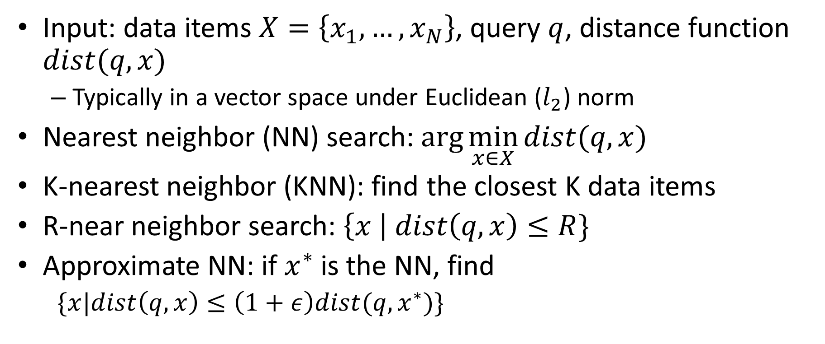
Problem definitions
Input: data items $X=\left\{x_{1},…, x_{N}\right\}$, query $q$, distance function $dist(q,x)$
Typically in a vector space under Euclidean ($l_{2}$) norm
Nearest neighbor (NN) search: $\arg{\min_{x∈X}{dist(q,x)}}$
K-nearest neighbor (KNN): find the closest K data items
R-near neighbor search: $\left\{x \right| dist\left(q,x\right)≤R\}$
Approximate NN: if $x^{∗}$ is the NN, find
$\{x|dist\left(q,x\right)≤\left(1+ε\right)dist(q,x^{∗})\}$

Slide 17
Approximate NN via hashing
Normally collisions make a hash function bad
In this application, certain collisions are good!
Main idea: hash the data points so that nearby items end up in the same bucket
At query time, hash the query and rerank the bucket elements
Most famous technique is Locality Sensitive Hashing (LSH)

Slide 18
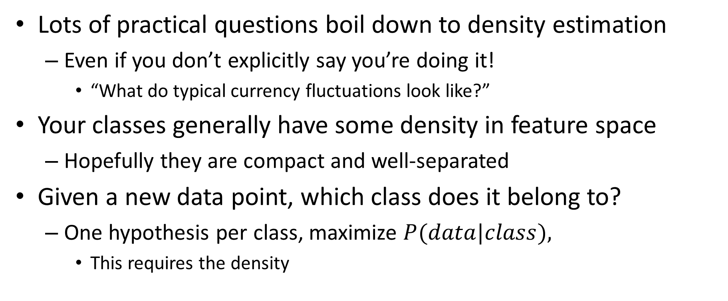
NN Density estimation
Lots of practical questions boil down to density estimation
Even if you don’t explicitly say you’re doing it!
“What do typical currency fluctuations look like?”
Your classes generally have some density in feature space
Hopefully they are compact and well-separated
Given a new data point, which class does it belong to?
One hypothesis per class, maximize $P(data|class),$
This requires the density

