Slide 1
CS5112: Algorithms and Data Structures for Applications
Lecture 3: Hashing
Ramin Zabih
Some figures from Wikipedia/Google image search

Slide 2
Administrivia
Web site is: https://github.com/cornelltech/CS5112-F18
As usual, this is pretty much all you need to know
Quiz 1 out today, due Friday 11:59PM
Very high tech!
Coverage through Greg’s lecture on Tuesday
TA’s and consultants coming shortly
We have a slack channel

Slide 3
Today
Clinic this evening (here), Greg on hashing
Associative arrays
Efficiency: Asymptotic analysis, effects of locality
Hashing
Additional requirements for cryptographic hashing
Fun applications of hashing!
Lots of billion-dollar ideas

Slide 4
Associative arrays
Fundamental data structure in CS
Holds (key,value) pairs, a given key appears at most once
API for associative arrays (very informal!)
Insert(k,v,A)->A’, where A’ has the new pair (k,v) along with A
Lookup(k,A)->v, where v is from the pair (k,v) in A
Lots of details we will ignore today
Avoiding duplication, raising exceptions, etc.
“Key” question: how to do this fast

Slide 5
How computer scientists think about efficiency
Two views: asymptotic and ‘practical’
Generally give the same result, but math vs engineering
Asymptotic analysis, a.k.a. “big O”
Mathematical treatment of algorithms
Worst case performance
Consider the limit as input gets larger and larger

Slide 6
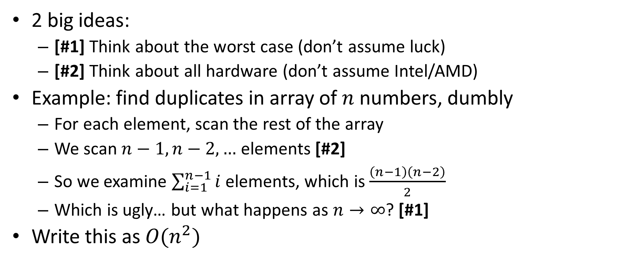
Big O notation: main ideas
2 big ideas:
[#1] Think about the worst case (don’t assume luck)
[#2] Think about all hardware (don’t assume Intel/AMD)
Example: find duplicates in array of $n$ numbers, dumbly
For each element, scan the rest of the array
We scan $n−1, n−2, …$ elements [#2]
So we examine $\sum_{i=1}^{n−1}{i}$ elements, which is $\frac{\left(n−1\right)\left(n−2\right)}{2}$
Which is ugly… but what happens as $n→∞$? [#1]
Write this as $O(n^{2})$

Slide 7
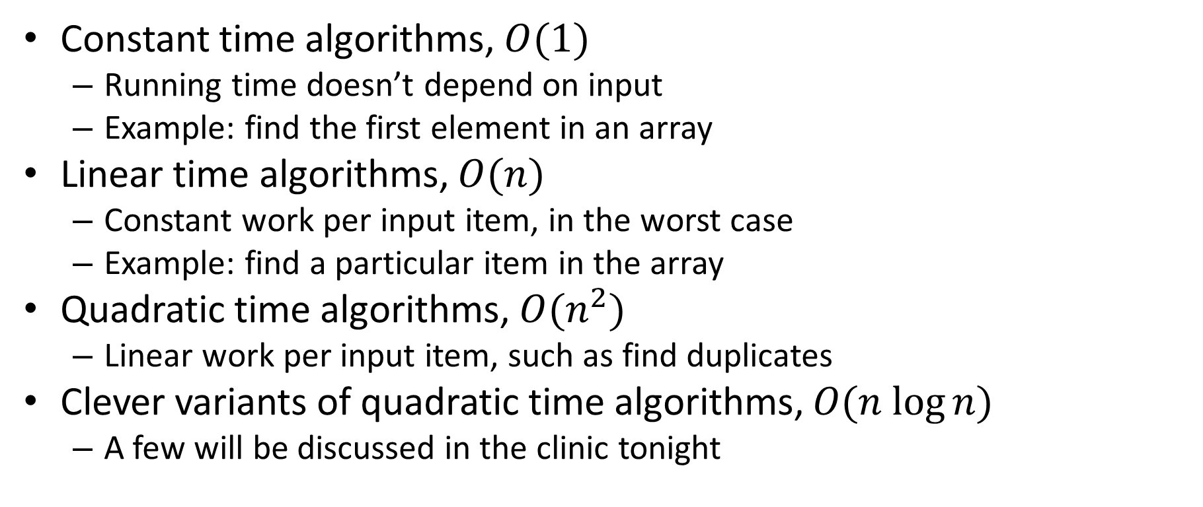
Some canonical complexity classes
Constant time algorithms, $O(1)$
Running time doesn’t depend on input
Example: find the first element in an array
Linear time algorithms, $O(n)$
Constant work per input item, in the worst case
Example: find a particular item in the array
Quadratic time algorithms, $O(n^{2})$
Linear work per input item, such as find duplicates
Clever variants of quadratic time algorithms, $O(n log⁡n)$
A few will be discussed in the clinic tonight

Slide 8
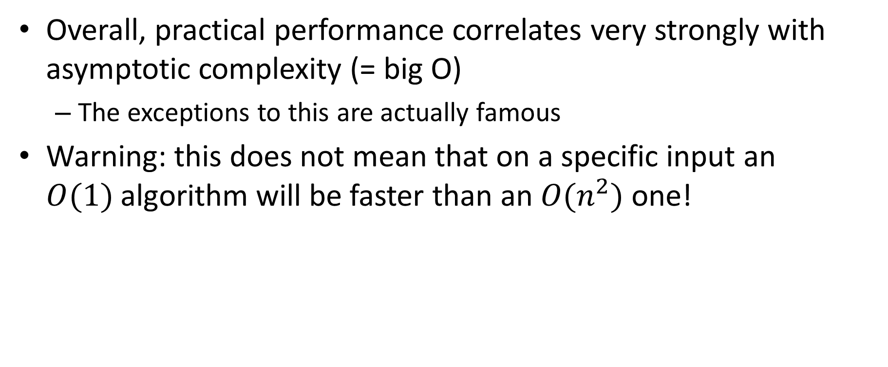
Big O notation and its limitations
Overall, practical performance correlates very strongly with asymptotic complexity (= big O)
The exceptions to this are actually famous
Warning: this does not mean that on a specific input an $O(1)$algorithm will be faster than an $O(n^{2})$ one!

Slide 9
Linked lists
8
4
1
3

Slide 10
Linked lists as memory arrays
We’ll implement linked lists using a memory array
This is very close to what the hardware does
A linked list contains “cells”
A value, and where the next cell is
We will represent cells by a pair of adjacent array entries
1
2
3
4
5
6
7
8
9

Slide 11
Example
8
4
1
3
1
2
3
4
5
6
7
8
9
8
5
1
7
4
3
3
0
0

Slide 12
Locality and efficiency
Locality is important for computation due to physics
The amount of information you can pack into a given area
The hardware is faster when your memory references are local in terms of time and space
Time locality: access the same data repeatedly, then move on
Space locality: access nearby data (in memory)

Slide 13
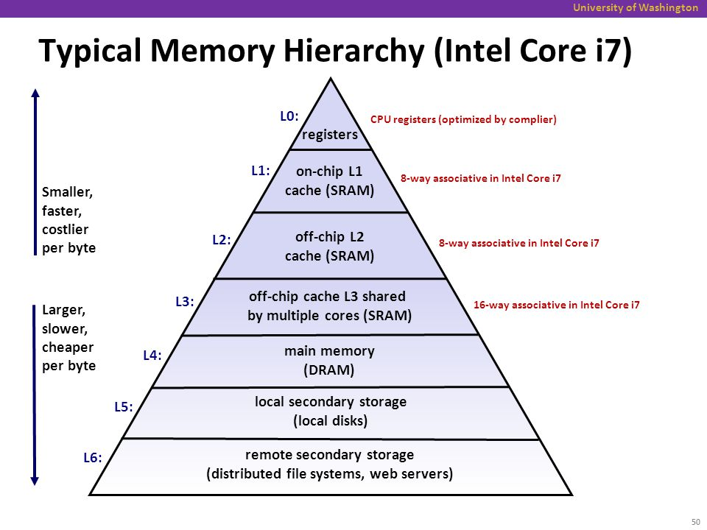
Memory hierarchy in a modern CPU

Slide 14
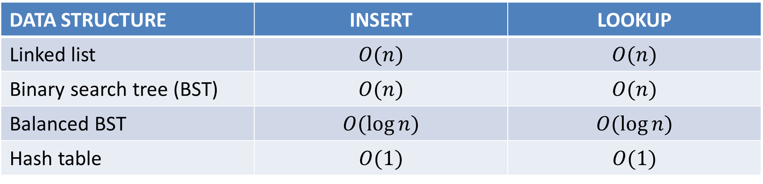
Complexity of associative array algorithms
DATA STRUCTURE | INSERT | LOOKUP
Linked list | $$O(n)$$ | $$O(n)$$
Binary search tree (BST) | $$O(n)$$ | $$O(n)$$
Balanced BST | $$O(log⁡n)$$ | $$O(log⁡n)$$
Hash table | $$O(1)$$ | $$O(1)$$
So, why use anything other than a hash table?

Slide 15
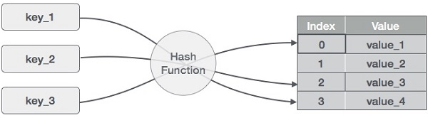
Hashing in one diagram

Slide 16
What makes a good hash function?
Almost nobody writes their own hash function
Like a random number generator, very easy to get this wrong!
Deterministic
Uniform
With respect to your input!
Technical term for this is entropy
(Sometimes) invariant to certain changes
Example: punctuation, capitalization, spaces

Slide 17
Examples of good and bad hash functions
Suppose we want to build a hash table for CS5112 students
Is area code a good hash function?
How about zip code?
Social security numbers?
https://www.ssa.gov/history/ssn/geocard.html
What is the best and worst hash function you can think of?

Slide 18
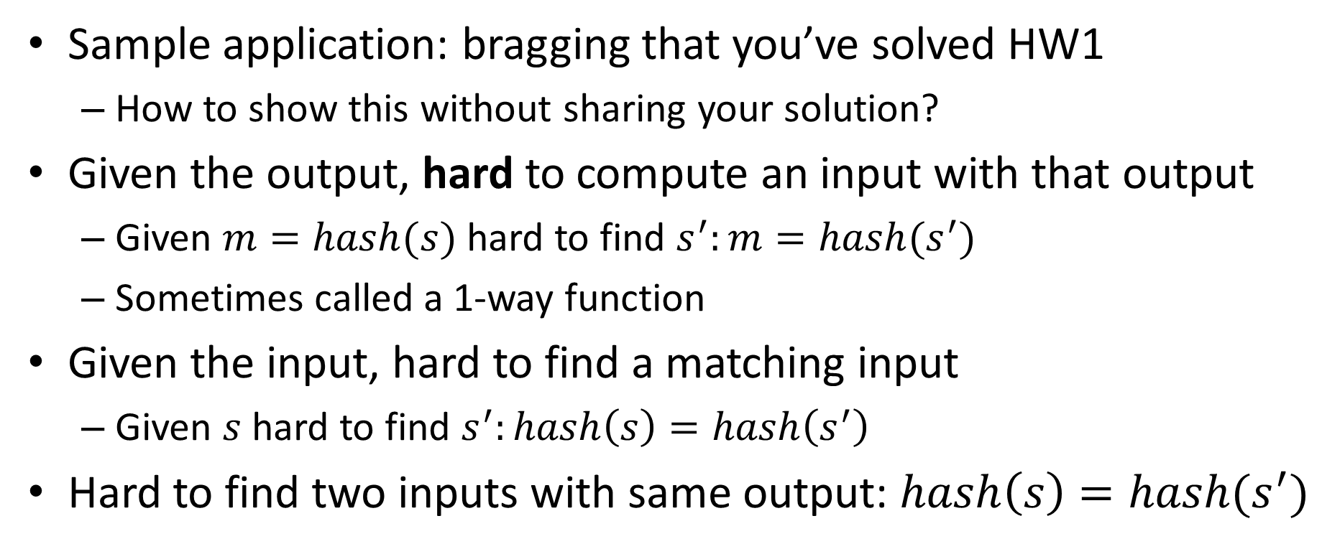
Cryptographic hashing
Sample application: bragging that you’ve solved HW1
How to show this without sharing your solution?
Given the output, hard to compute an input with that output
Given $m=hash(s)$ hard to find $s^{′}:m=hash(s^{′})$
Sometimes called a 1-way function
Given the input, hard to find a matching input
Given $s$ hard to find $s^{′}:hash\left(s\right)=hash\left(s^{′}\right)$
Hard to find two inputs with same output: $hash\left(s\right)=hash(s^{′})$

Slide 19
What does “hard to find” mean?
Major topic, center of computational complexity
Loosely speaking, we can’t absolutely prove this
But we can show that if we could solve one problem, we could solve another problem that is widely believed to be hard
Because lots of people have tried to solve it and failed!
This proves that one problem is at least as hard as another
“Problem reduction”

Slide 20
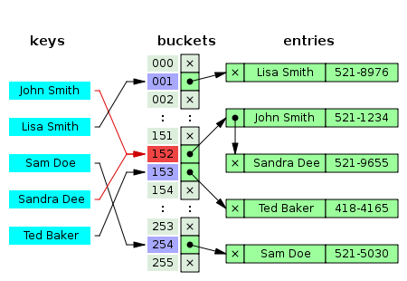
Handling collisions
More common than you think!
Birthday paradox
Example: 1M buckets and 2,450 keys uniformly distributed
95% chance of a collision
Easiest solution is chaining
E.g. with linked lists

Slide 21
Now for the fun part…
What cool stuff can we do with hashing?

Slide 22
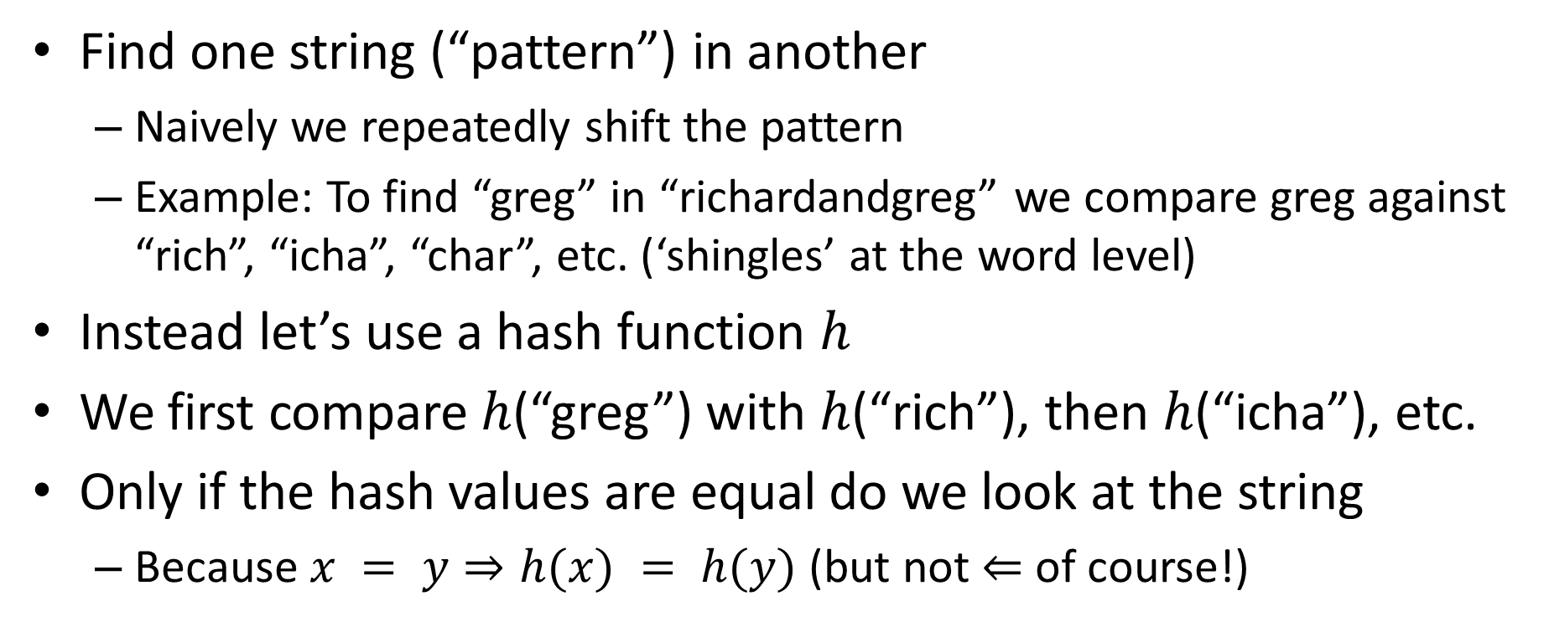
Rabin-Karp string search
Find one string (“pattern”) in another
Naively we repeatedly shift the pattern
Example: To find “greg” in “richardandgreg” we compare greg against “rich”, “icha”, “char”, etc. (‘shingles’ at the word level)
Instead let’s use a hash function $h$
We first compare $h$(“greg”) with $h$(“rich”), then $h$(“icha”), etc.
Only if the hash values are equal do we look at the string
Because $x = y⇒h(x) = h(y)$ (but not $⇐$ of course!)

Slide 23
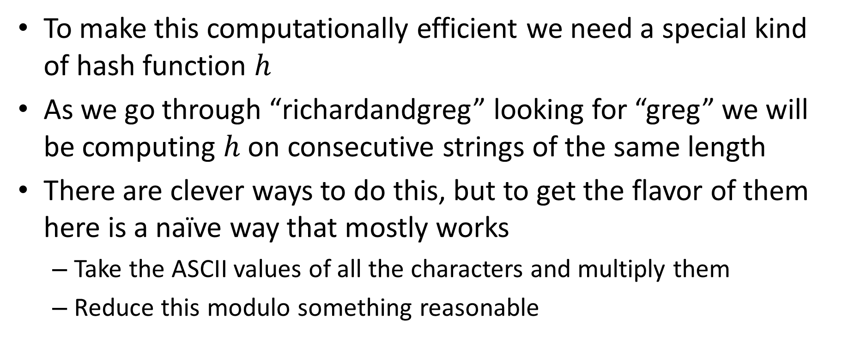
Rolling hash functions
To make this computationally efficient we need a special kind of hash function $h$
As we go through “richardandgreg” looking for “greg” we will be computing $h$ on consecutive strings of the same length
There are clever ways to do this, but to get the flavor of them here is a naïve way that mostly works
Take the ASCII values of all the characters and multiply them
Reduce this modulo something reasonable

Slide 24
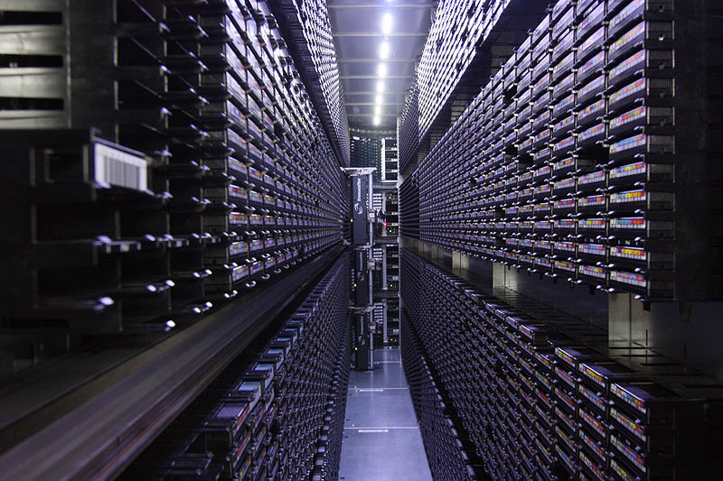
Large backups
How do we backup all the world’s information?
Tape robots!
VERY SLOW access

Slide 25
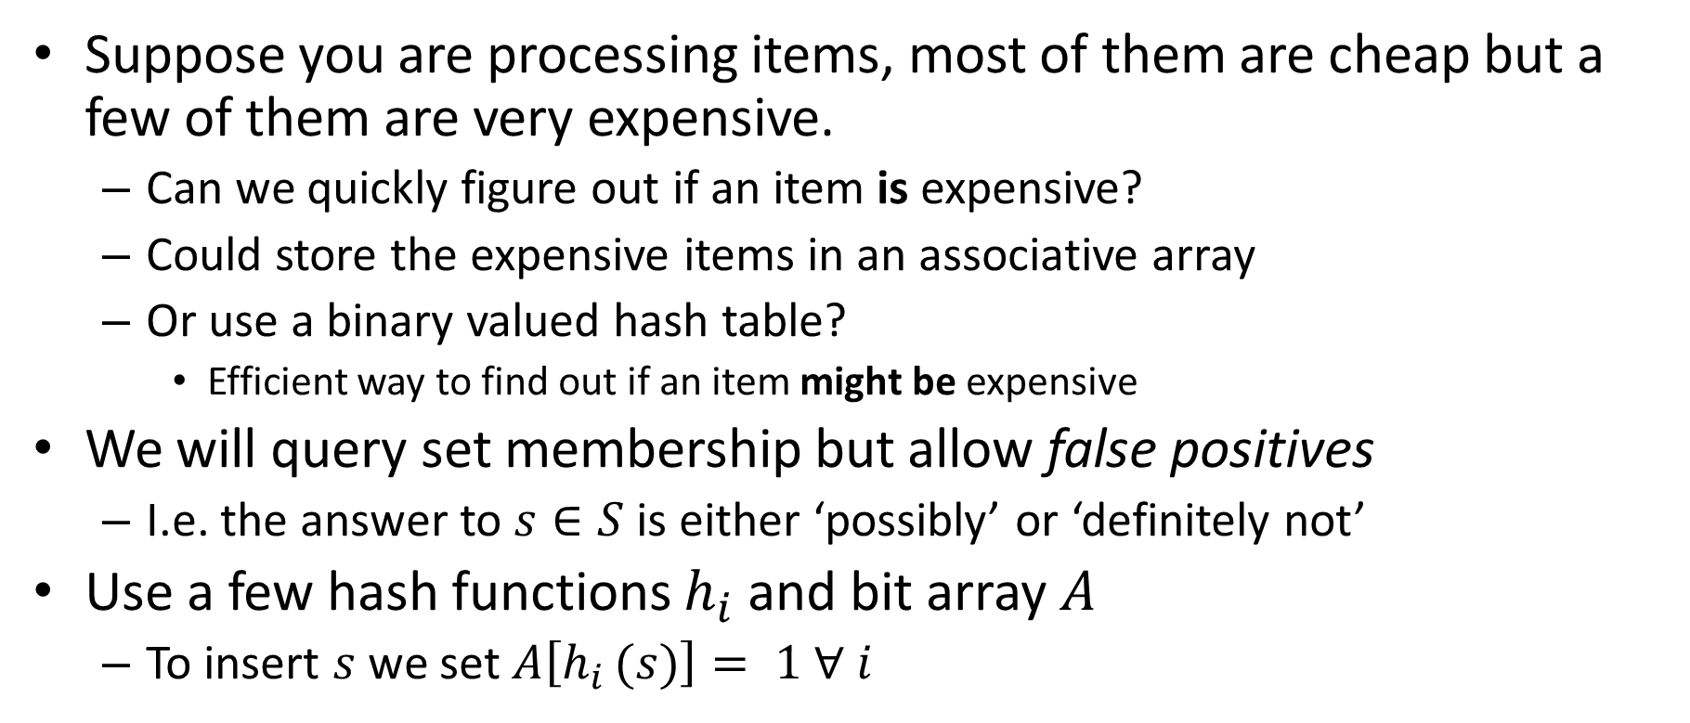
Bloom filters
Suppose you are processing items, most of them are cheap but a few of them are very expensive.
Can we quickly figure out if an item is expensive?
Could store the expensive items in an associative array
Or use a binary valued hash table?
Efficient way to find out if an item might be expensive
We will query set membership but allow false positives
I.e. the answer to $s∈S$ is either ‘possibly’ or ‘definitely not’
Use a few hash functions $h_{i}$ and bit array $A$
To insert $s$ we set $A\left[h_{i }(s)\right]= 1 ∀ i$

Slide 26
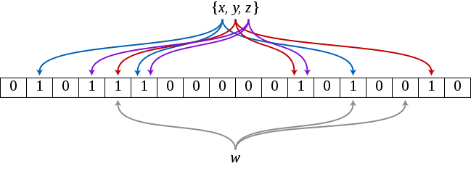

Bloom filter example
Example has 3 hash functions and 18 bit array
$\{x,y,z\}$ are in the set, $w$ is not
Figure by David Eppstein, https://commons.wikimedia.org/w/index.php?curid=2609777

Slide 27
Application: web caching
CDN’s, like Akamai, make the web work (~70% of traffic)
About 75% of URL’s are ‘one hit wonders’
Never looked at again by anyone
Let’s not do the work to put these in the disk cache!
Cache on second hit
Use a Bloom filter to record URL’s that have been accessed
A one hit wonder will not be in the Bloom filter
See: Maggs, Bruce M.; Sitaraman, Ramesh K. (July 2015), "Algorithmic nuggets in content delivery" (PDF), SIGCOMM Computer Communication Review, New York, NY, USA,45 (3): 52–66

Slide 28
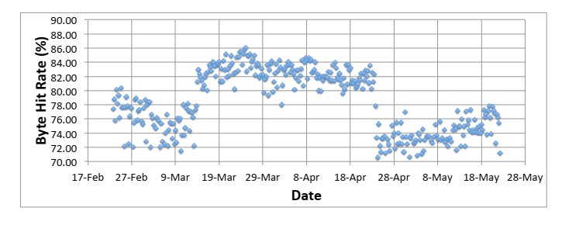
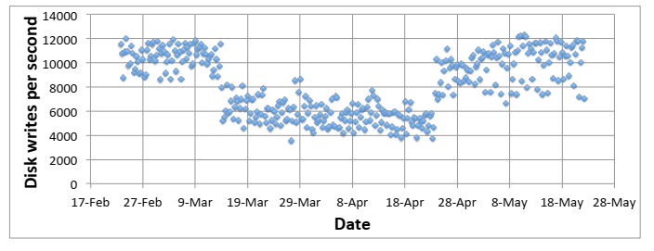
Bloom filters really work!
Figures from: Maggs, Bruce M.; Sitaraman, Ramesh K. (July 2015), "Algorithmic nuggets in content delivery" (PDF), SIGCOMM Computer Communication Review, New York, NY, USA,45 (3): 52–66

Slide 29
Cool facts about Bloom filters
You don’t need to build different hash functions, you can use a single one and divide its output into fields (usually)
Can calculate probability of false positives and keep it low
Time to add an element to the filter, or check if an element is in the filter, is independent of the size of the element (!)
You can estimate the size of the union of two sets from the bitwise OR of their Bloom filters

Slide 30
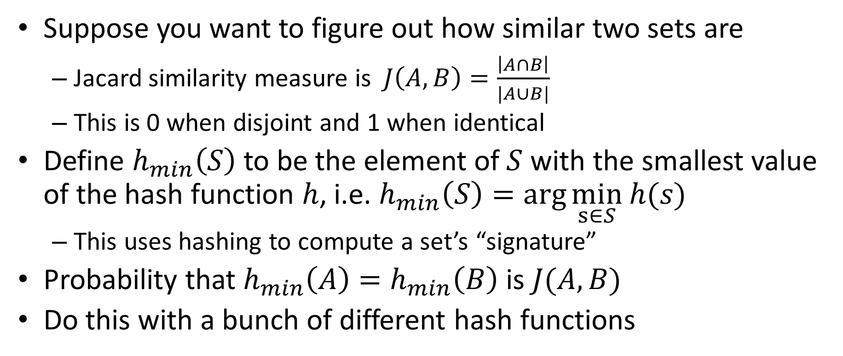
MinHash
Suppose you want to figure out how similar two sets are
Jacard similarity measure is $J\left(A,B\right)=\frac{\left|A∩B\right|}{|A∪B|}$
This is 0 when disjoint and 1 when identical
Define $h_{min}\left(S\right)$ to be the element of $S$ with the smallest value of the hash function $h$, i.e. $h_{min}\left(S\right)=\arg{\min_{s∈S}}$ $h(s)$
This uses hashing to compute a set’s “signature”
Probability that $h_{min}\left(A\right)=h_{min}\left(B\right)$ is $J(A,B)$
Do this with a bunch of different hash functions

Slide 31
MinHash applications
Plagiarism detection in articles
Collaborative filtering!
Amazon, NetFlix, etc.

Slide 32
Distributed hash tables (DHT)
BitTorrent, etc.
Given a file name and its data, store/retrieve it in a network
Compute the hash of the file name
This maps to a particular processor, which holds the file

