Slide 1
CS5112: Algorithms and Data Structures for Applications
Lecture 7: Some distributed algorithms
Ramin Zabih
Some figures from Wikipedia/Google image search

Slide 2
Administrivia
HW comments and minor corrections on Slack
Please keep an eye on it for announcements
Q3 out today, coverage through Tuesday’s lecture
Non-anonymous survey coming re: speed of course, etc.
Next week:
Tuesday lecture by Richard Bowen
Thursday lecture by Prof. Ari Juels
Thursday evening clinic by Richard Bowen

Slide 3
Office hours
Prof Zabih: after lecture or by appointment
Tuesdays 11:30-12:30 in Bloomberg 277 with @Julia
Wednesdays 2:30-3:30 in Bloomberg 277 with @irisz
Wednesdays 3:30-4:30 in Bloomberg 277 with @Ishan
Thursdays 10-12 in Bloomberg 267 with @Fei Li

Slide 4
Today
Hash lists
Merkle trees
A few DHT (BitTorrent) issues
Consistent hashing
Perfect hashing

Slide 5
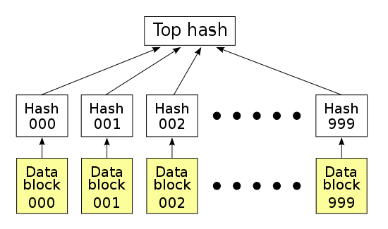
Motivation
Definition of a distributed system
Consider a large file like a video
Blocks of the file are distributed for many reasons
Redundancy, cost, etc.
Different processors have different blocks

Slide 6
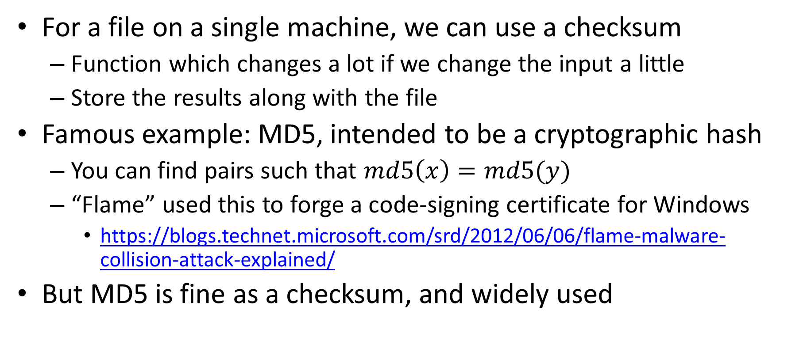
How do we insure integrity?
For a file on a single machine, we can use a checksum
Function which changes a lot if we change the input a little
Store the results along with the file
Famous example: MD5, intended to be a cryptographic hash
You can find pairs such that $md5\left(x\right)=md5(y)$
“Flame” used this to forge a code-signing certificate for Windows
https://blogs.technet.microsoft.com/srd/2012/06/06/flame-malware-collision-attack-explained/
But MD5 is fine as a checksum, and widely used

Slide 7
Hash lists and applications
When the blocks are distributed we need:
Integrity of each block
Robustness to failure of computer holding a given block
Solution: hash each data block
Sounds cool, but is it useful?

Slide 8
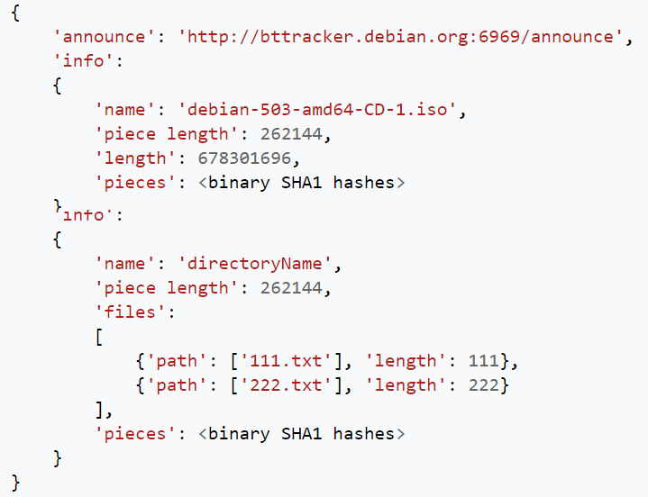
Widely used application of hash lists

Slide 9
Hash trees/Merkle trees
Many applications has the block hashes together
Create a trusted “top hash” by hashing the concatenation

Slide 10
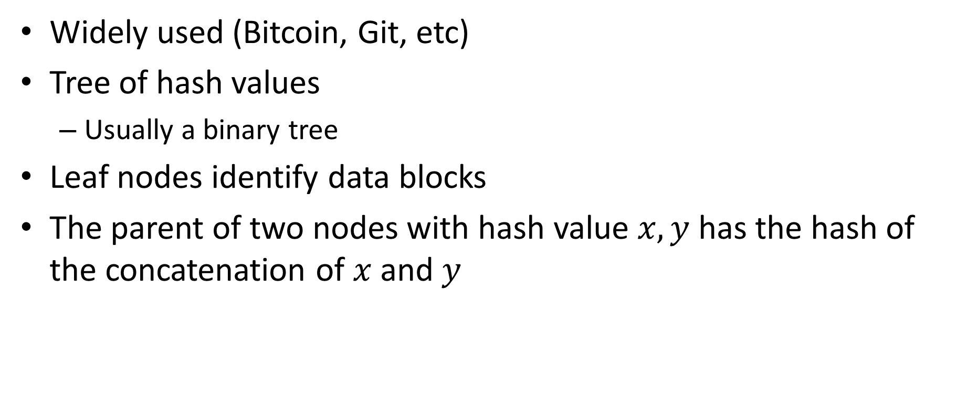
Hash trees/Merkle trees
Widely used (Bitcoin, Git, etc)
Tree of hash values
Usually a binary tree
Leaf nodes identify data blocks
The parent of two nodes with hash value $x,y$ has the hash of the concatenation of $x$ and $y$

Slide 11
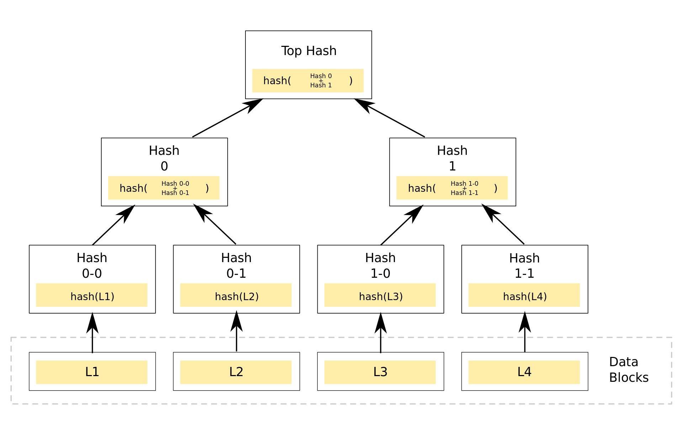
Example
Given the values circled in blue we can quickly verify L2

Slide 12
Distributed hash tables (DHT)
BitTorrent, etc.
Given a file name and its data, store/retrieve it in a network
Compute the hash of the file name
This maps to a particular server, which holds the file
Sounds good! Until the file you want is on a machine that is not responding…
But is this a real issue? Aren’t computers pretty reliable?

Slide 13
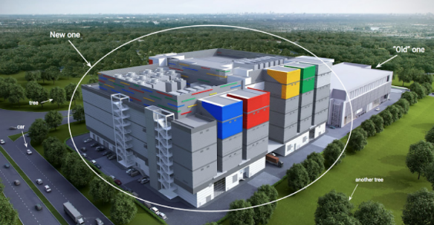

Google datacenter numbers (2008)
In each cluster's first year, it's typical that:
1,000 individual machine failures will occur;
thousands of hard drive failures will occur;
one power distribution unit will fail, bringing down 500 to 1,000 machines for about 6 hours;
20 racks will fail, each time causing 40 to 80 machines to vanish from the network;
5 racks will "go wonky," with half their network packets missing in action;
The cluster will have to be rewired once, affecting 5 percent of the machines at any given moment over a 2-day span.
About a 50 percent chance that the cluster will overheat, taking down most of the servers in less than 5 minutes and taking 1 to 2 days to recover.
Jeff Dean, “Google spotlights data center inner workings”, CNET May 2008

Slide 14
From filename to processor
Typically the result of a hash function is a large number
SHA-1 produces 160 bits (not secure!)
Map into servers with modular arithmetic
Reminder: 4 + 7 = 1 (mod 10)
Mod with powers of 2 is just the low-order bits
Sneak preview: next lecture will be on bits
How do we handle a server crashing or rejoining??

Slide 15
Consistent hashing
Effectively the hash table itself is resized
Note that this is an important operation in general!
With naïve hash functions, resizing is a disaster
Everything needs to be shuffled between buckets/servers
Key idea is to give add state
Traditional hash functions are stateless/functional

Slide 16
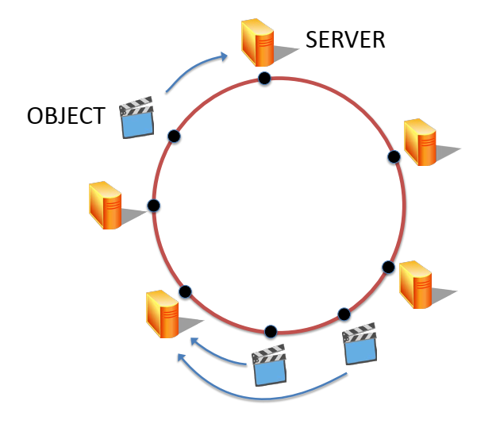
Hashing into the circle
Let’s convert the output of our hash function into a circle
For example, using the low-order 8 bits of SHA-1
We map both servers and data onto the circle
For a server, hash of IP address or something similar
Data is stored in the “next” server on the circle
By convention we will move clockwise
Figure from Maggs, Bruce M.; Sitaraman, Ramesh K. (July 2015), "Algorithmic nuggets in content delivery" (PDF), SIGCOMM Computer Communication Review, New York, NY, USA,45 (3): 52–66

Slide 17
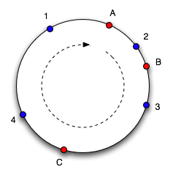
Example of consistent hashing
Data 1,2,3,4 stored on computers A,B
Servers->data (good quiz/exam question):
A->1,4
B->2
C->3
If C crashes, we just move 3 to A
Diagram taken from Tom White based on original article

Slide 18
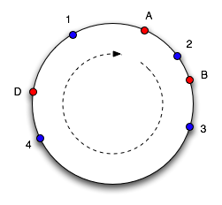
Gracefully adding/removing a server
Add server D after C crashes
Takes 3,4 from A
Servers->data:
A->1
B->2
D->3,4
This is a lot faster!
Naively, going from 3 to 4 servers moves 75% of data
With consistent hashing we move 25% of data
Advantage gets even larger for more servers
Diagram taken from Tom White based on original article

Slide 19
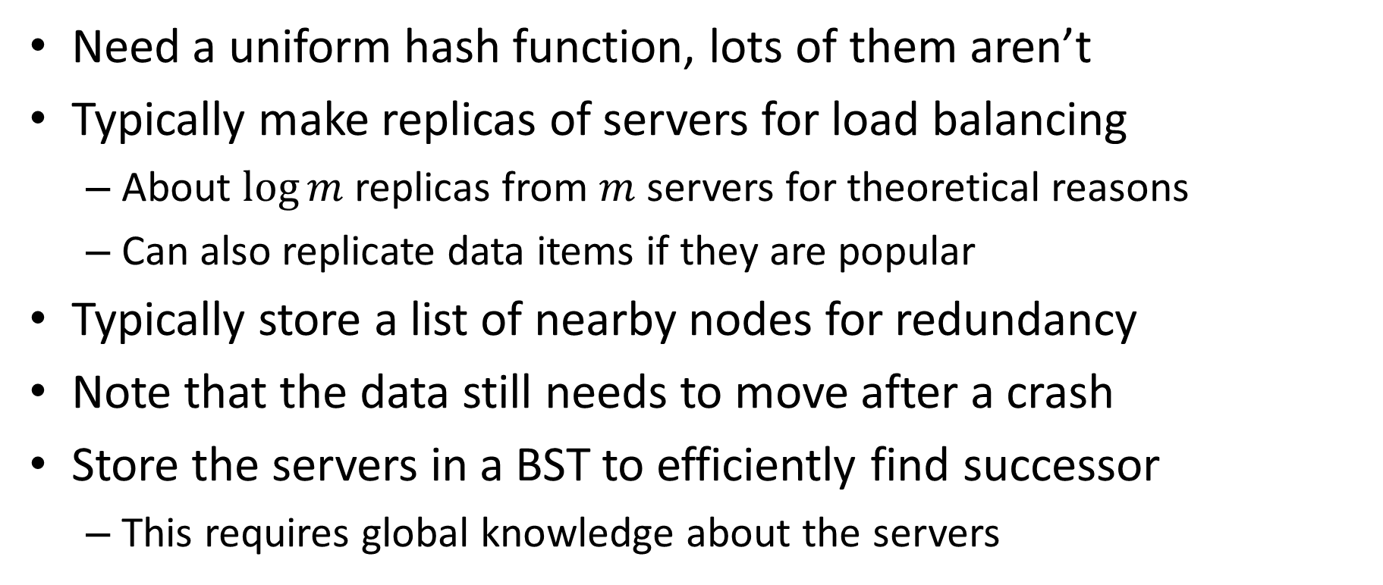
Improving consistent hashing
Need a uniform hash function, lots of them aren’t
Typically make replicas of servers for load balancing
About $\log{m}$ replicas from $m$servers for theoretical reasons
Can also replicate data items if they are popular
Typically store a list of nearby nodes for redundancy
Note that the data still needs to move after a crash
Store the servers in a BST to efficiently find successor
This requires global knowledge about the servers

Slide 20
Handling popular objects
Each object can have its own hash function
Basically, it’s view of the unit circle
Ensures that you are very unlikely to have 2 popular objects share the same server

Slide 21
Perfect & minimal hashing
Choice of hash functions is data-dependent!
Let’s try to hash 4 English words into the buckets 0,1,2,3
E.g., to efficiently compress a sentence
Words: {“banana”, “glib”, “epic”, “food”}
Can efficiently say sentence like “epic glib banana food” = 3,2,1,0
Can you construct a minimal perfect hash function that maps each of these to a different bucket?
Needs to be efficient, not (e.g.) a list of cases

Slide 22
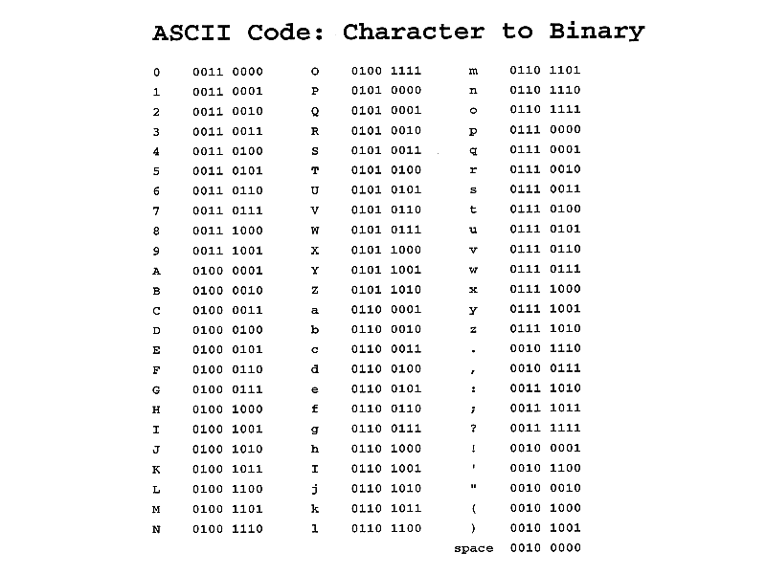
Perfect hashing example
For this particular example, it is easy

Slide 23
Recall: bitwise masking
Bitwise AND operation:
AND(1,1) = 1
AND(0,1) = AND(1,0) = AND(0,0) = 0
Note that AND(x,0) = 0 and AND(x,1) = x
An AND with a binary number (mask) zeros out the bits where the mask is 0
Lets through the bits where the mask is 1
So our perfect hash function is: AND with 3 = 0b11

