Slide 1
CS5112: Algorithms and Data Structures for Applications
Lecture 11: Density estimation with nearest neighbors
Ramin Zabih
Some figures from Wikipedia/Google image search

Slide 2
Administrivia
Reminder: HW comments and minor corrections on Slack
HW3 coming soon
Anonymous survey coming re: speed of course, etc.

Slide 3
Today
NN for machine learning problems
Density estimation to classify cats versus dogs
Continuous versus discrete random variables

Slide 4
NN for machine learning
Nearest neighbors is a fundamental ML technique
Used for classification, regression, etc.
We will study (and implement!) NN algorithms
Exact algorithms on Tuesday next week
Approximate algorithms starting Thursday
Today we will focus on understanding the use of NN

Slide 5
Classification and NN algorithms
Suppose the height/weight of your query animal is very similar to the cats you have seen, and unlike the dogs you have seen, then it’s probably a cat
There’s actually a lot going on in the sentence above:
“very similar”
“the cats you have seen”
“probably”
You can classify directly from NN

Slide 6
NN and k-NN classification
Find the animal you’ve seen that’s most similar to your query
NN classification
What can go wrong?
More robustly, look at the k most similar animals and take the mode (most common label)
k-NN classification
Choice of k?

Slide 7
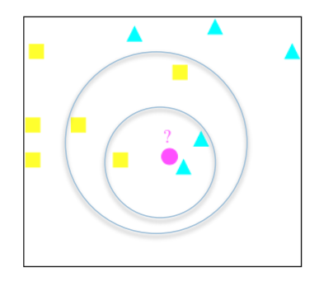
k-NN classifier small example
Slide credit: https://www.cs.rit.edu/~rlaz/PatternRecognition/, Richard Zanibbi

Slide 8
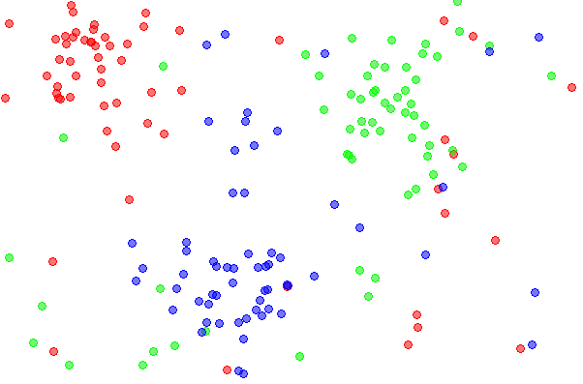
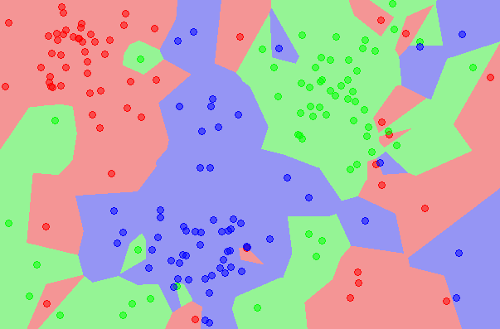
(k-)NN classifier example
Notes:
By Agor153 - Own work, CC BY-SA 3.0, https://commons.wikimedia.org/w/index.php?curid=24350614

Slide 9
Classification and NN algorithms
For many applications it’s way more useful to have the density
Tells you a lot more about your data
To classify we need to estimate the density
Good way to do this is from nearest neighbors
Lots of other algorithms also but NN is very popular
Basic intuition: most of the cats are where the cat density is high, and vice-versa
“When you hear hoofbeats, think of horses not zebras”

Slide 10
Cats versus dogs (simple version)
Suppose we want to classify based on a single number
Such as weight
Simple case: cats and dogs have their weights described by a Gaussian (normal) distribution
Cats occur about as frequently as dogs in our data
We just need to estimate the density for cats vs dogs
This allows us to build our classifier

Slide 11
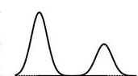
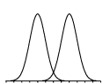
Cat vs dog classification from weight
“Simple” case
A not so simple case

Slide 12
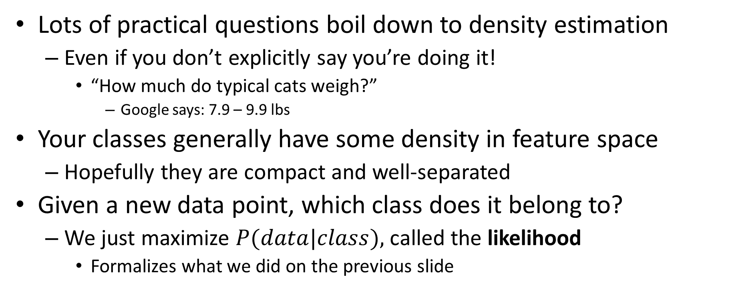
NN Density estimation
Lots of practical questions boil down to density estimation
Even if you don’t explicitly say you’re doing it!
“How much do typical cats weigh?”
Google says: 7.9 – 9.9 lbs
Your classes generally have some density in feature space
Hopefully they are compact and well-separated
Given a new data point, which class does it belong to?
We just maximize $P(data|class),$called the likelihood
Formalizes what we did on the previous slide

Slide 13
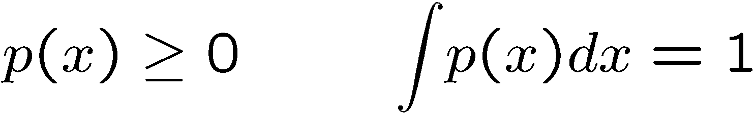


What is a density?
Consider an arbitrary function p where
Can view it as a probability density function
The PDF for a real-valued random variable
If we weighed ∞ cats, what frequency of weights would we get?

Slide 14

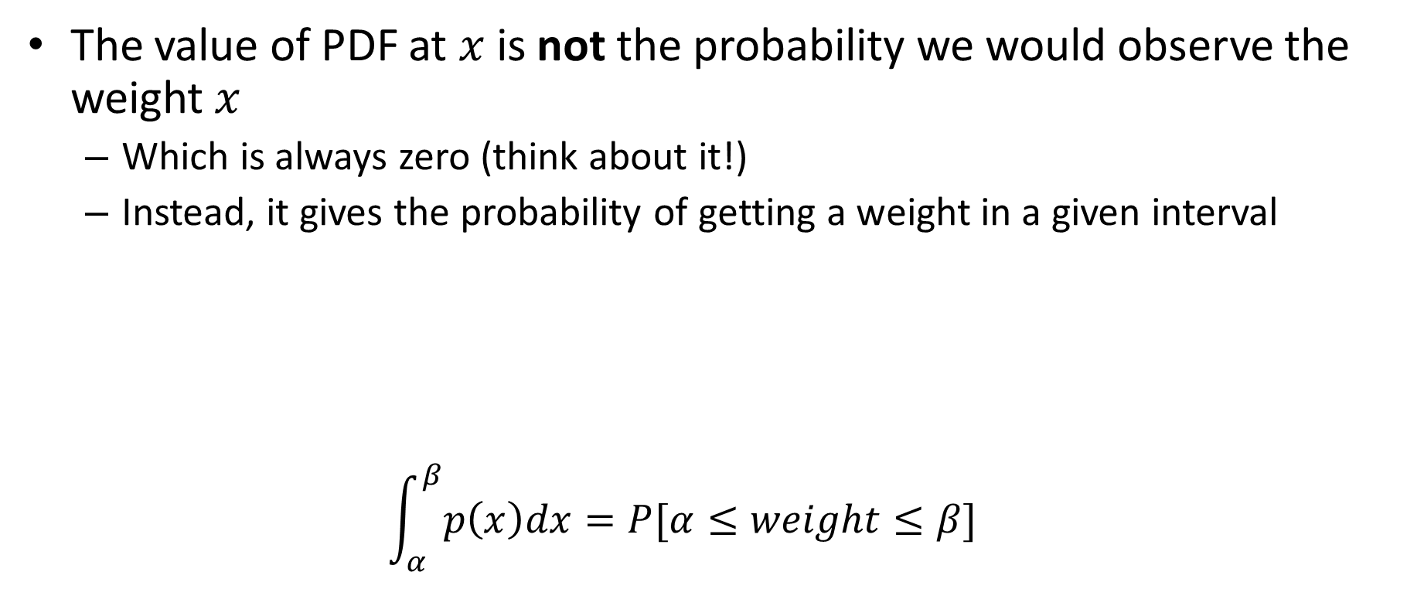
A pitfall of interpreting densities
The value of PDF at $x$is not the probability we would observe the weight $x$
Which is always zero (think about it!)
Instead, it gives the probability of getting a weight in a given interval
$$\int_{α}^{β}{p\left(x\right)dx=P[α≤weight≤β]}$$

Slide 15
Discrete case is easier
Sometimes the values of the random variable are discrete
Instead of a PDF you have a probability mass function (PMF)
I.e., a histogram whose entries sum to 1
No bucket has a value greater than 1
This is the true relative frequencies
i.e., what we would get in the limit as we weigh more and more cats

Slide 16
Sampling from a PDF
Suppose we weigh a bunch of cats
This generates our sample (data set)
How does this relate to the true PDF?
It simplifies life considerably to assume:
All cats have their weights from the same PDF (identical distributions)
No effect between weighing one cat and another (independence)

Slide 17
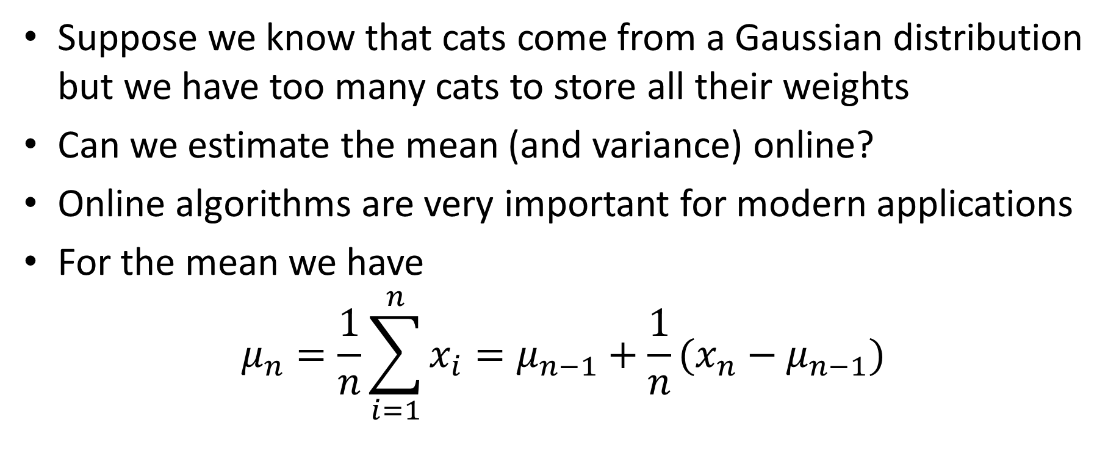
Welford’s online mean algorithm
Suppose we know that cats come from a Gaussian distribution but we have too many cats to store all their weights
Can we estimate the mean (and variance) online?
Online algorithms are very important for modern applications
For the mean we have
$$μ_{n}=\frac{1}{n}\sum_{i=1}^{n}{x_{i}}=μ_{n−1}+\frac{1}{n}(x_{n}−μ_{n−1})$$

Slide 18
Non-parametric approach
We knew the underlying distribution
All we needed was to estimate the parameters
Obviously, this gives bad results when the true distribution isn’t what we think it is
Non-Gaussian distributions are in general rare, and hard to handle
But they occur a lot in some areas
Box’s law: All models are wrong but some are useful

Slide 19
Is there a free lunch?
Suppose we simply plot the data points
Assume 1-D for the moment (cat weights)
How to compute density from data?
True density

Slide 20
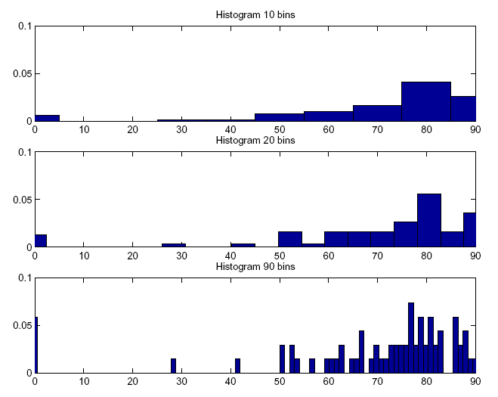
Histogram representation

Slide 21
Bin-size tradeoffs
Fewer, larger bins give a smoother but less accurate answer
Tend to avoid “gaps”
i.e., places where the density is declared to be 0
More, smaller bins have opposite property
If you don’t know anything in advance, there’s no way to predict bin size
Also, note that this method isn’t a great idea in high dimensions

Slide 22
Histogram-based estimates
You can use a variety of fitting techniques to produce a curve from a histogram
Lines, polynomials, splines, etc.
Also called regression/function approximation
Normalize to make this a density
If you know quite a bit about the underlying density you can compute a good bin size
But that’s rarely realistic
And defeats the whole purpose of the non-parametric approach!

Slide 23
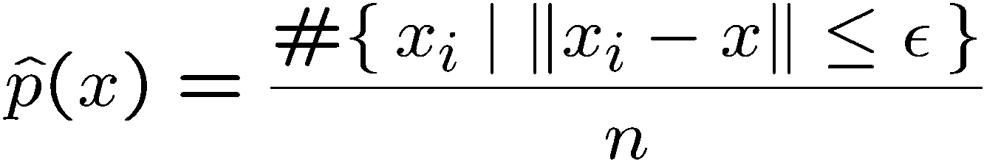
Nearest-neighbor estimate
To estimate the density, count number of nearby data points
Like histogramming with sliding bins
Avoid bin-placement artifacts
Can fix epsilon and compute this quantity, or we can fix the quantity and compute epsilon

Slide 24
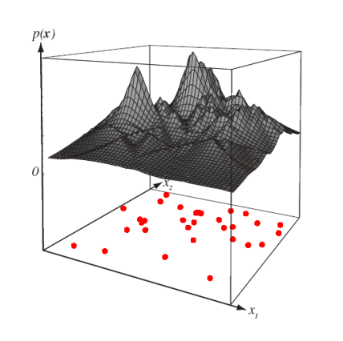
NN density estimation
Slide credit: https://www.cs.rit.edu/~rlaz/PatternRecognition/, Richard Zanibbi

Slide 25
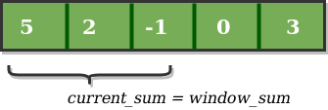
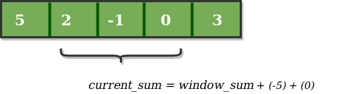
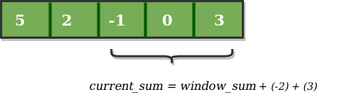
Sliding sums
Suppose we want to “smooth” a histogram, i.e. replace the values by the average over a window
How can we do this efficiently?
Notes:
https://www.geeksforgeeks.org/window-sliding-technique/

