Slide 1

https://n.ethz.ch/~kklier/download/zkp/

Slide 2
Zero-Knowledge Proofs
Exercises Week 5: Circom/SnarkJS Part I

Slide 3
Today: Play around with SNARKs
Succinct
Non-Interactive
Argument
Of Knowledge
ZCash: SNARK-based crypto currency
Communication-Efficiency
roll_up: scaling up Ethereum
P
V
Dark Forest: zkSNARK space warfare
π

Slide 4


Goal: Play Provably Secure “Battleships”
(x, y) ∈ [10]²
hit/miss
https://www.publicdomainpictures.net/pictures/150000/velka/ship-at-sea-1455511625jcd.jpg
https://c4.wallpaperflare.com/wallpaper/4/181/81/artwork-classic-art-painting-sailing-ship-wallpaper-preview.jpg

Slide 5
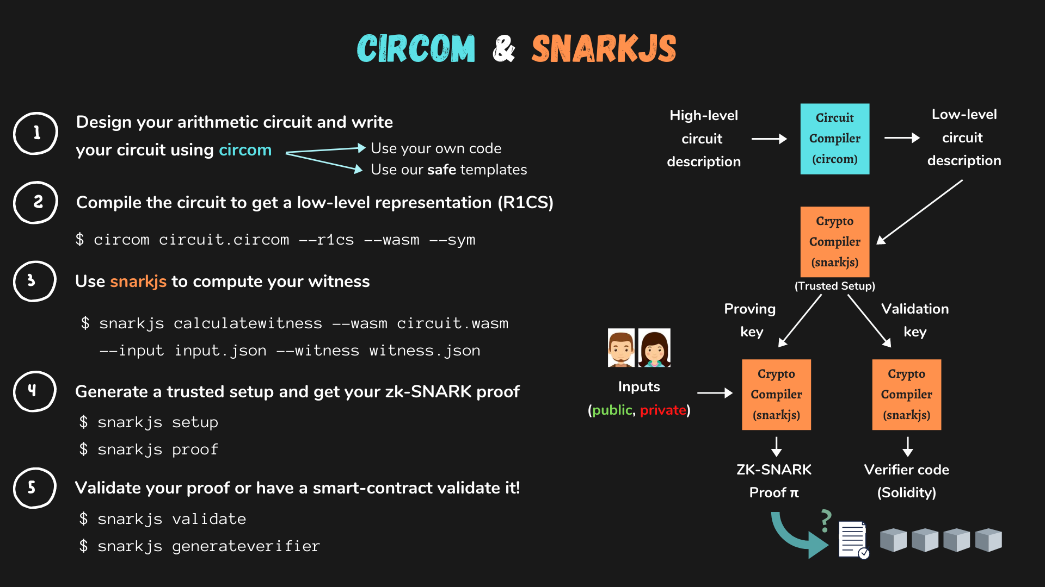
Source: https://docs.circom.io/

Slide 6
For Your Convenience
Docker Image (snarkjs.1.1.0.dockerimage)
compose.yml
README.html
https://n.ethz.ch/~kklier/download/zkp/

Slide 7
Roadmap for Today
Set Up Docker Image
Tiny Multiplication Circuit
https://n.ethz.ch/~kklier/download/zkp/
IsEqual.circom
IsBinary.circom
Powers-of-Tau
IsBinaryRepr.circom
Generate and Verify Proof

Slide 8
Solutions

Slide 9
1. Multiplication
template Multiply() {
signal input in1;
signal input in2;
signal output out;
out <== in1*in2;
}
out
X
in1
in2

Slide 10
2. IsEqual
out
template IsEqual() {
signal input in[2];
signal output out;
component iszero = IsZero();
iszero.in <== in[0] - in[1];
out <== iszero.out;
}
== 0?
–
in[0]
in[1]

Slide 11
3. IsBinary
out
template IsBinary() {
signal input in;
signal output out;
component is0 = IsEqual();
is0.in[0] <== in;
is0.in[1] <== 0;
component is1 = IsEqual();
is1.in[0] <== in;
is1.in[1] <== 1;
out <== is0.out + is1.out;
}
+
==
==
0
1
in

Slide 12
4. IsBinaryRepresentation
out
template IsBinaryRepr(len) {
signal input in;
signal input repr[len];
signal output out;
component isBinary[len];
for (var i = 0; i < len; i += 1){
isBinary[i] = IsBinary();
isBinary[i].in <== repr[i];
isBinary[i].out === 1;
}
signal intermediate[len];
intermediate[0] <== repr[0];
for (var i = 1; i < len; i += 1){
intermediate[i] <== 2*intermediate[i-1] + repr[i];
}
component isEq = IsEqual();
isEq.in[0] <== intermediate[len-1];
isEq.in[1] <== in;
out <== isEq.out;
}
==
+
=1
=1
x2
IsBin
IsBin
in
repr[0]
repr[len]

