Slide 1

You can already start working!
https://n.ethz.ch/~kklier/download/zkp/

Slide 2
Zero-Knowledge Proofs
Exercises Week 5: Circom/SnarkJS Part II

Slide 3
Last Time: Designing Circuits
template IsBinaryRepr(len) {
signal input in;
signal input repr[len];
signal output out;
component isBinary[len];
for (var i = 0; i < len; i += 1){
isBinary[i] = IsBinary();
isBinary[i].in <== repr[i];
isBinary[i].out === 1;
}
signal intermediate[len];
intermediate[0] <== repr[0];
for (var i = 1; i < len; i += 1){
intermediate[i] <== 2*intermediate[i-1] + repr[i];
}
component isEq = IsEqual();
isEq.in[0] <== intermediate[len-1];
isEq.in[1] <== in;
out <== isEq.out;
}
out
==
+
=1
=1
x2
IsBin
IsBin
in
repr[0]
repr[len]

Slide 4
Circuit Validation
SNARK → circuit does the thing right
But does the circuit do the right thing?

Slide 5

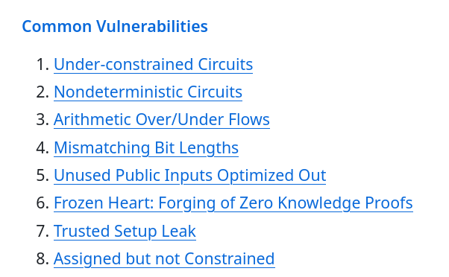
Circuit Validation: Bugs in the Wild
https://cointelegraph.com/news/researchers-identify-key-circuit-layer-vulnerabilities-snark-systems
https://github.com/0xPARC/zk-bug-tracker:

Slide 6
Circuit Validation: Approaches
Manual circuit design only by experts
Circuit compiled from C code
  Good compiler → circuit no worse than code
Testing, e.g. with circom-test
“Pair-Programming”
For formally defined properties, use SAT-solver

Slide 7
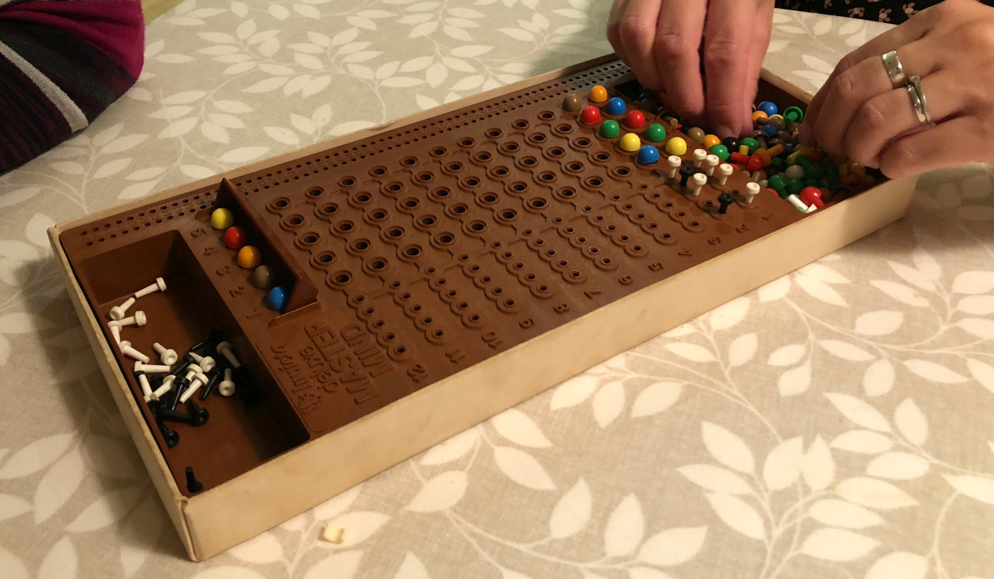
Today: Circuit for Mastermind
http://pennyplays.co.uk/wp-content/uploads/2018/09/Deluxe-Master-Mind-4-1.jpg

Slide 8
For Your Convenience
Files from last time (e.g. Docker Image)
Template files for Mastermind circuit
CircomLib
README.html
https://n.ethz.ch/~kklier/download/zkp/

Slide 9
Roadmap for Today
Optional: Form groups of 2–3 people
Copy files to mycircuits/ from last time
Complete templates in mastermind.circom
Play the game :D
https://n.ethz.ch/~kklier/download/zkp/

Slide 10
Solutions

Slide 11
1. Sum
template Sum(N) {
signal input in[N];
signal output out;
if (N == 0){
out <== 0;
}
else{
component S = Sum(N-1);
for (var i = 0; i < N-1; i += 1){
S.in[i] <== in[i];
}
out <== S.out + in[N-1];
}
}

Slide 12
2. IsInSet
template IsInSet (N, set){
signal input in;
signal output out;
if (N == 0){
out <== 0;
} else{
var set_minus_1[N-1];
for (var i = 0; i < N-1; i += 1){
set_minus_1[i] = set[i];
}
component iis = IsInSet(N-1, set_minus_1);
iis.in <== in;
component ie = IsEqual();
ie.in[0] <== in;
ie.in[1] <== set[N-1];
out <== iis.out + ie.out;
}
}

Slide 13
3. CheckColors
template Mastermind_CheckColors(N_colors, colors, len_sequence){
signal input in[len_sequence];
signal output out;
component iis[len_sequence];
component sum = Sum(len_sequence);
for (var i = 0; i < len_sequence; i += 1){
iis[i] = IsInSet(N_colors, colors);
iis[i].in <== in[i];
sum.in[i] <== iis[i].out;
}
component eq = IsEqual();
eq.in[0] <== sum.out;
eq.in[1] <== len_sequence;
out <== eq.out;
}

Slide 14
4. Commit
template Commit(len_sequence){
signal input sequence[len_sequence];
signal input r;
signal output out;
component P = Poseidon(len_sequence+1);
for (var i = 0; i < len_sequence; i += 1){
P.inputs[i] <== sequence[i];
}
P.inputs[len_sequence] <== r;
out <== P.out;
}

Slide 15
5. Mastermind
// Verifying/Computing Commitment
// ------------------------------
component Com = Commit(len_sequence);
Com.sequence <== in_solution;
Com.r <== in_r;
out_C <== Com.out;
// Compute Number of Correct Positions
// -----------------------------------
component eq[len_sequence];
component sum = Sum(len_sequence);
for (var i = 0; i < len_sequence; i += 1){
eq[i] = IsEqual();
eq[i].in[0] <== in_guess[i];
eq[i].in[1] <== in_solution[i];
sum.in[i] <== eq[i].out;
}
out_correct <== sum.out;
}
template Mastermind (N_colors, colors, len_sequence){
signal input in_guess[len_sequence];
signal input in_solution[len_sequence];
signal input in_r;
signal output out_C;
signal output out_correct;
// Check that sequences are valid colors
// -------------------------------------
component checkColors_guess = Mastermind_CheckColors(N_colors, colors, len_sequence);
checkColors_guess.in <== in_guess;
checkColors_guess.out === 1;
component checkColors_solution = Mastermind_CheckColors(N_colors, colors, len_sequence);
checkColors_solution.in <== in_solution;
checkColors_solution.out === 1;

