Slide 1
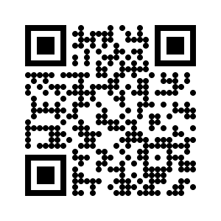
You can already start working!
https://n.ethz.ch/~kklier/download/zkp/

Slide 2
Zero-Knowledge Proofs
Exercises Week 13: Circom/SnarkJS Part III

Slide 3
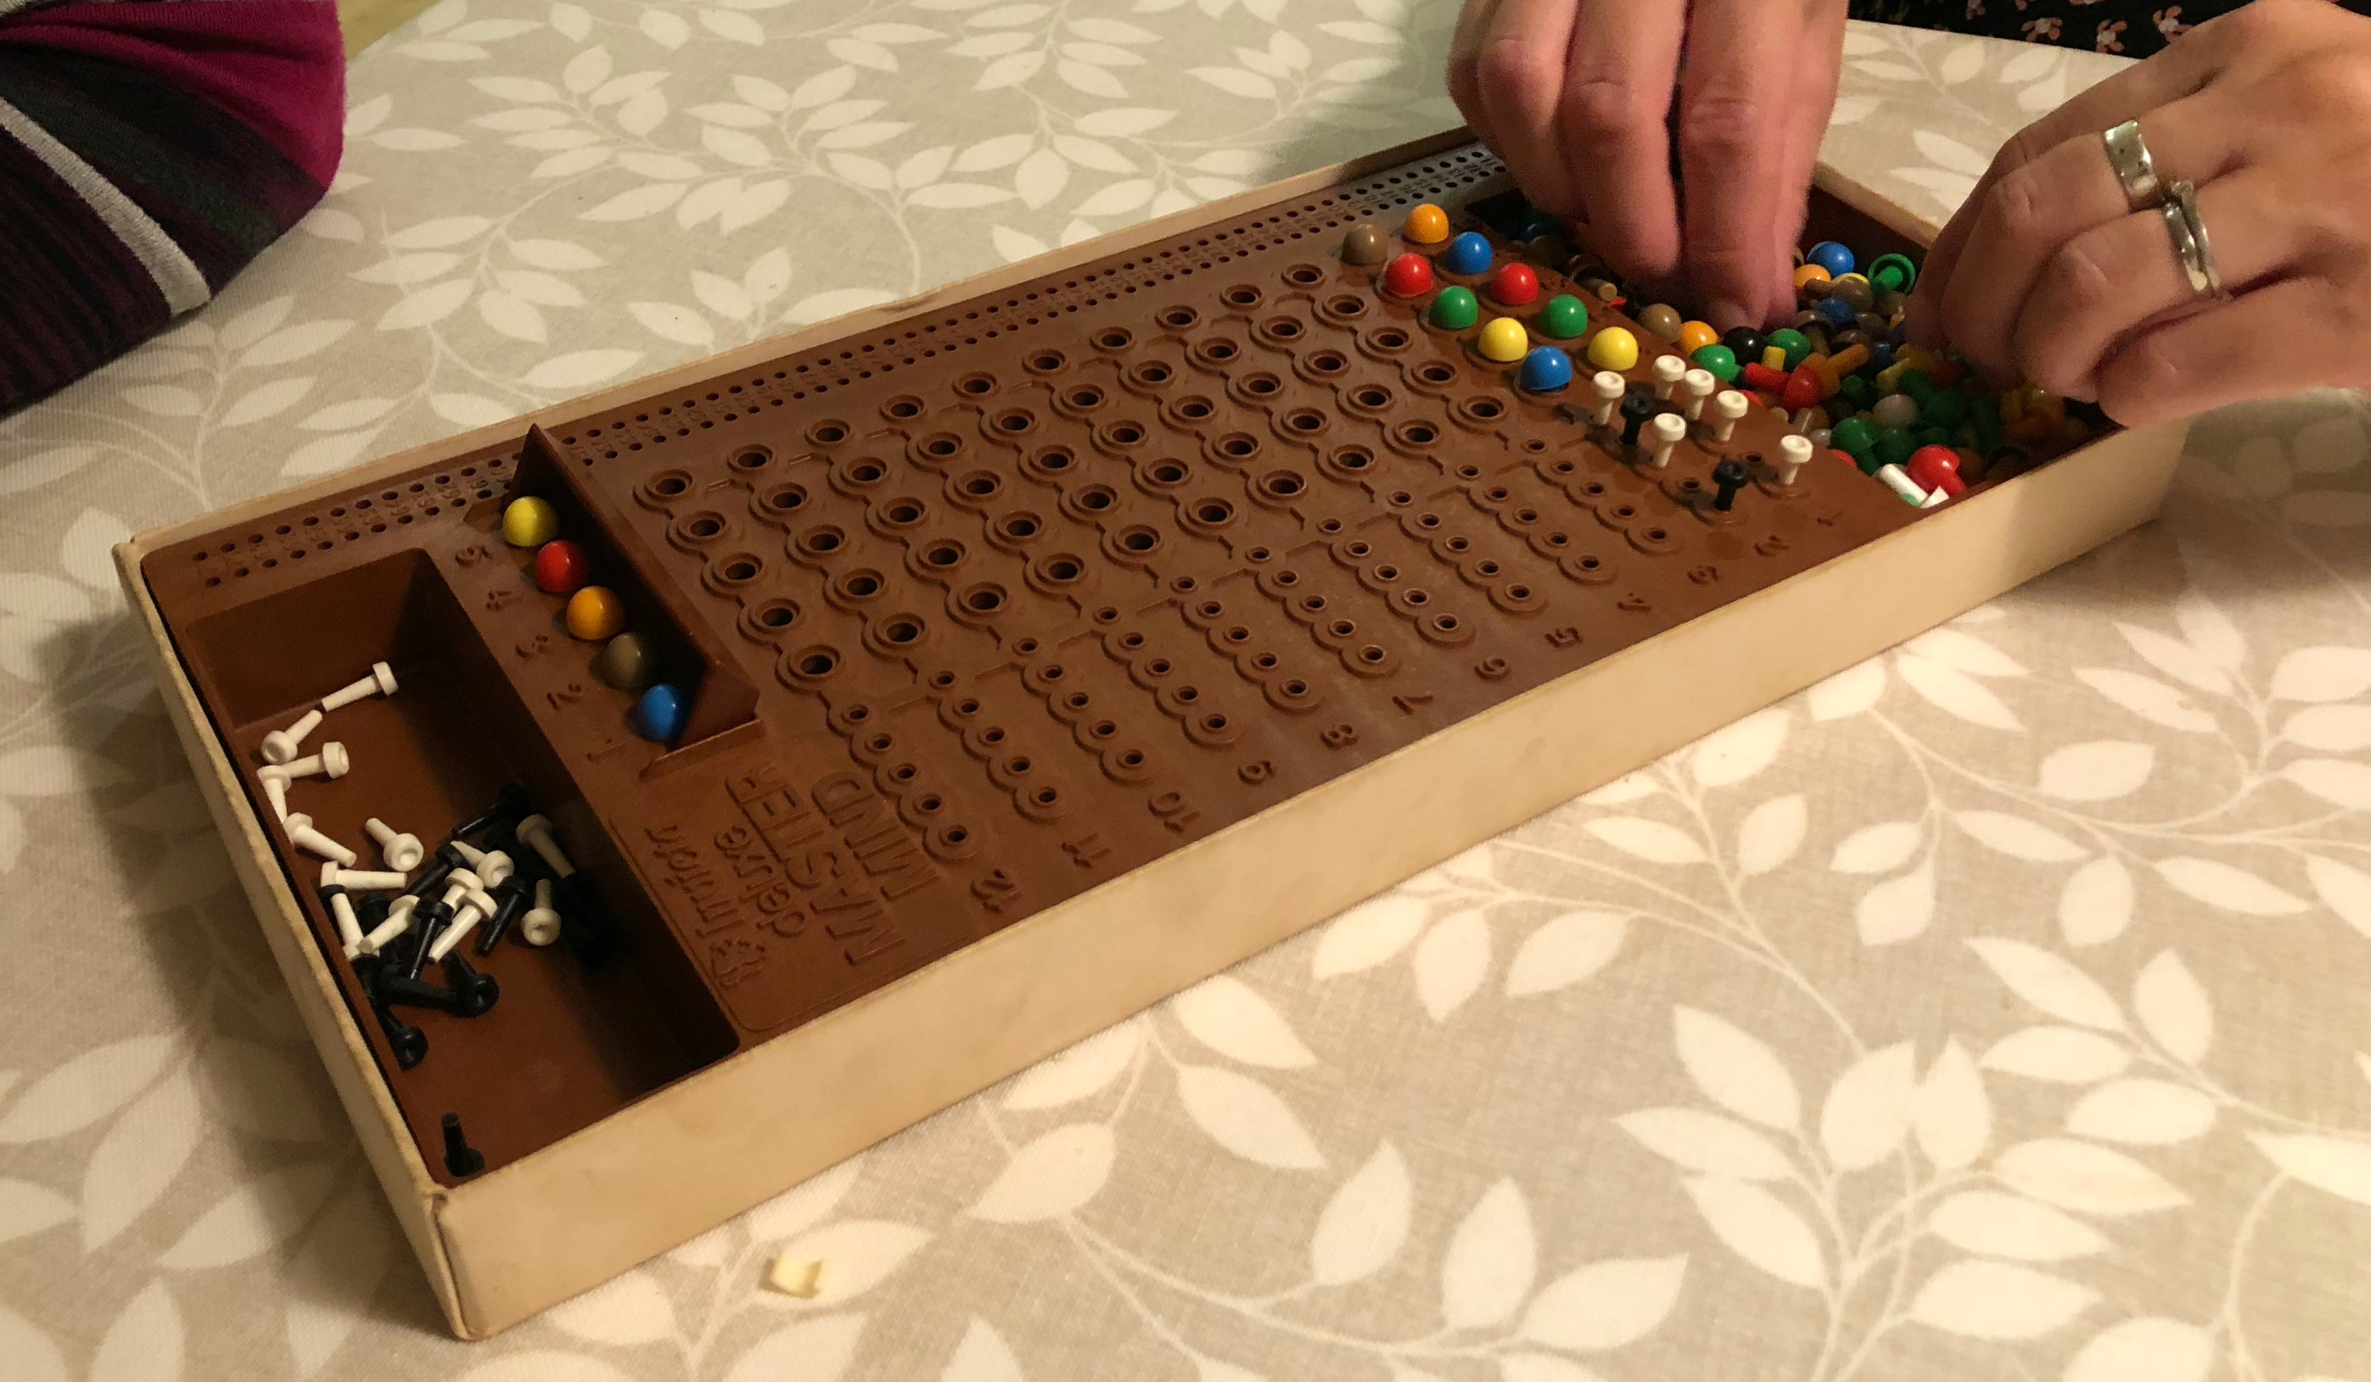
Last Time: Designing a Circuit for Mastermind

Slide 4
Today: App for Playing the Game
Usage: mastermind [options] [command]
App for playing provably secure Mastermind
Options:
-V, --version output the version number
-h, --help display help for command
Commands:
set_zkey_file <file> Takes a path to the zkey file (circuit
specific)
set_vkey_file <file> Takes a path to the verification key file
(circuit specific)
init Initializes the game by setting the random
color sequence and committing to it.
compute_proof <guess...>
verify <proof> <publicSignals> takes a proof and public signals als
stringified JSON objects and verifies the
SNARK
help [command] display help for command

Slide 5
For Your Convenience
Files from last time (e.g. Docker Image)
Template files for Mastermind NodeJS App
README.html
https://n.ethz.ch/~kklier/download/zkp/

Slide 6

Roadmap for Today
Optional: Form groups of 2–3 people
Copy mastermind_app/ to local files
Complete templates in index.js
Play the game :D
https://n.ethz.ch/~kklier/download/zkp/

