Slide 1
CHCCA Treasurer’s Report
October 19, 2024

Slide 2
Agenda
Highlights of FY24
Statement of Activities and Changes in Net Cash Balances (note – we have not yet had a sense of the value of our units/property for a true financial asset assessment)
Proposed FY25 Budget (10/1/2024 - 9/30/2025)

Slide 3
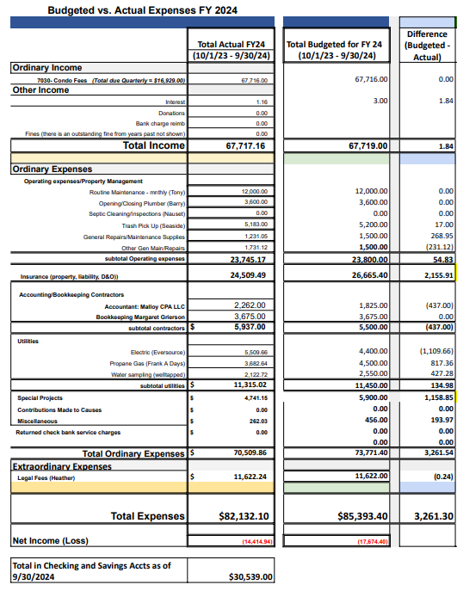

Slide 4
Financial Highlights from FY24
All condo fees were collected (a small portion this year’s collected end of last FY)
Insurance, which went up 18% between FY23 and FY24 has just gone up 26%
Per our broker, we should expect at least another 26% increase or more FY26 and years beyond.
Regarding our current coverage. $3.26M. Each unit has a cap based on a contractor assessment of value for the upper cottages, a plug for the SLW units and all cut back a bit to keep us under the $3.26M amount. We had budgeted $2K to have the cottages valued but we did not do this. We are proposing it for this FY. (We will also see where the values come out using our broker’s valuation algorithm). It is recommended that we have a contractor value all of them since it was last done in 2022 AND our current coverage is capped by unit and it is not clear how much below value each cap might be. We are also getting a quote for an overall increase in our coverage if this total and the caps by cottage are too low.
Our broker says to anticipate major increases – we budgeted 8500/YR each year.
Our gas and electric estimates continue to be a bit off and flip flop and we are not sure why.
Water sampling – we have a new company Welltapped and Toby negotiated a good rate
Special project spending was down but misleading as the budgeted handrail extension on the beach stairs was not done.
Miscellaneous also slightly lower than projected but this was primarily due to too much of a bump up last year after we had paid to replace fire extinguishers and the costs came back down.
Overall, given the budgeted items we did not purchase our budget was just about right on.

Slide 5
Proposed New and Necessary Expenses & Line Changes
Tony of On Time Property Management has Requested a raise of $200/month and we have included this in the budget. We had paid $12,000 annually and the increase raises his routine maintenance for the year to $14,400. We believe that while it reflects a 5% increase per year – we think that it is a reasonabl request and we would like to honor it for the following reasons:
Tony has been extremely hard working and dependable and after the first year when we needed to prompt him to provide his time and checklist, he has provided this reqularly.
We believe that his price is quite reasonable and see no need nor have no desire to try out a new unknown entity.
In addition, he has not had a raise in four years and agreed on the rate that we are paying him now after initially seeking more.
Also, he regularly incurs expenses overseeing the opening and closings that are not technically billed for and his help has been incredibly important.
We have perceived that the practice of having two lines for maintenance and repairs and supplies seems unnecessary so we have combined the lines. Also, our total for these items is about $500 less this coming year.
Insurance costs are climbing exponentially and we no longer have sufficient funds in the bank or in what we collect with our current condo fees and thus we have built in condo fee increases into the budget. We have projected our financial situation out three years in anticipation of steady increases and have prepared three possible scenarios for us to discuss. We have to have an increase in FY25.

Slide 6
Condo Fee Increase Proposals in Anticipation of Significant Insurance Increases And Associated FY 25 Budget Proposals

Slide 7
End bank account balances under each of scenarios 1, 2 and 3
 |  |  |  | Option 1 increase scenario |  |  |  | Option2 increase scenario |  |  |  | Option 3 increase scenario
Condo Fees (sum of Qrtly Pymts:) |  |  |  | FY26 |  | FY 27 |  | FY26 |  | FY 27 |  | FY26 |  | FY 27
 |  |  |  | $92,219 |  | $92,219 |  | $100,003 |  | $100,003 |  | $112,219 |  | $112,219
Expenses
OnTime Property Mgt. LLC Monthly Fee (Tony Cleary) |  |  |  | 18,000.00 |  | 18,000.00 |  | 18,000.00 |  | 18,000.00 |  | 18,000.00 |  | 18,000.00
Opening / Closings Plumbing |  | $3,600 | $3,600
Tony Cleary |  | $14,400 | $14,400
General Repairs/Maintenance/Supplies |  |  |  | 2,500.00 |  | 2,500.00 |  | 2,500.00 |  | 2,500.00 |  | 2,500.00 |  | 2,500.00
Septic: cleaning and inspections Nauset Septic (once every 3 years - done in Sprint 2023) |  |  |  | 3800 |  | 0 |  | 3800 |  | 0 |  | 3800 |  | 0
Trash Pick Up (Seaside) |  |  |  | 5,800.00 |  | $5,800.00 |  | $5,800.00 |  | $5,800.00 |  | $5,800.00 |  | $5,800.00
Insurance (Property, Liability and D & O 3 dif companies) |  |  |  | 42,925.00 |  | 51,510.00 |  | 42,925.00 |  | 51,510.00 |  | 42,925.00 |  | 51,510.00
Accountant (Moriarity Troyer & Malloy LLC (CPA) |  |  |  | 2,300.00 |  | 2,300.00 |  | 2,300.00 |  | 2,300.00 |  | 2,300.00 |  | 2,300.00
Bookkeeping (Margaret Grierson) |  |  |  | 3,675.00 |  | 3,675.00 |  | 3,675.00 |  | 3,675.00 |  | 3,675.00 |  | 3,675.00
Utilities: Electric (Eversource) |  |  |  | 5,500.00 |  | 5,500.00 |  | 5,500.00 |  | 5,500.00 |  | 5,500.00 |  | 5,500.00
Utilities: Propane Gas (Frank A Days) |  |  |  | 3,800.00 |  | 3,800.00 |  | 3,800.00 |  | 3,800.00 |  | 3,800.00 |  | 3,800.00
Utilities: Water Sampling (Well Tapped) |  |  |  | 2,300.00 |  | 2,300.00 |  | 2,300.00 |  | 2,300.00 |  | 2,300.00 |  | 2,300.00
Special Projects |  |  |  | 5,000.00 |  | 5,000.00 |  | 5,000.00 |  | 5,000.00 |  | 5,000.00 |  | 5,000.00
Contributions: Truro Rescue |  |  |  | 0 |  | 0 |  | 0 |  | 0 |  | 0 |  | 0
Misc: Fire Extinguisher insp., fees, postage, etc. |  |  |  | 300 |  | 300 |  | 300 |  | 300 |  | 300 |  | 300
Total Ordinary Expenses Budgeted (excl legal fees) |  |  |  | 95,900.00 |  | 100,685.00 |  | 95,900.00 |  | 100,685.00 |  | 95,900.00 |  | 100,685.00
Projected Net Income (Loss) Before Extraordinary Items |  |  |  | -3,681.00 |  | -8,466.00 |  | 4,103.00 |  |  |  | 16,319.00 |  | 11,534.00
Extraordinary Item: Legal Fee final amt due in FY26 |  |  |  | 11,622.00 |  | 0 |  | 11,622.00 |  | 0 |  | 11,622.00 |  | 0
Total Projected Net/Loss |  |  |  | $10,318 |  | $1,852 |  | $25,886 |  | $25,204 |  | $50,318 |  | $61,852
 | Total Starting Balance for FY26 and then FY 27 |  |  | $25,621 |  | $10,318 |  | $33,405 |  | $25,886 |  | $45,621 |  | $50,318
 | Total Balance at End of FY26 (start FY 27) |  |  | $10,318 |  |  |  | $25,886 |  |  |  | $50,318
 |  |  | Total Balance at End of FY27 |  |  | $1,852 |  |  |  | $25,204 |  |  |  | $61,852

