Slide 1


FAMILY-OWNED IN SPRING LAKE, MICHIGAN
MICHIGAN
SHIPPERS
S U P P L Y
The Brand Bible
Custom labels that help small brands get noticed.
Printed by hand, by family, since 1959.
EDITION 01 · 2026 · 67 YEARS IN BUSINESS · INTERNAL & PARTNER USE

Slide 2
01 / The Company
WHO WE ARE
A family business built on
people, not just presses.
Anyone can sell you a roll of labels. We help you build a brand, and we've done it for 67 years.
01
02
The one-liner
What we sell
A family-owned custom label printer in Spring Lake, Michigan. We design and print the labels that turn small products into real brands, since 1959.
Not just ink on a roll. A label that does its job: looks like the quality inside, passes the rules, and makes a maker proud to put it on the shelf.
03
04
Who we serve
Why it matters
Startups, makers, and growing brands across Michigan, Indiana, Ohio, and Illinois. Food, beverage, candy, wine, plus retail barcode needs.
We're a small business too, so we get it. Small enough to care about your first run, experienced enough to handle your biggest order.
1959
In-House
2
4
Family-owned since
Design team
Print methods
States served

Slide 3
02 / Positioning
WHERE WE STAND
The label partner the big
self-serve sites can't be.
The market is crowded with cheap click-to-order sites and big printers that want big minimums. We win in the middle, where real brands get built.
What we are
What we are not
The affordable, experienced, regional label partner for small and growing brands. Real design help, flexible runs, and compliance know-how, without big-printer pricing or scary minimums.
Not the cheapest faceless upload-and-pray website, and we don't pretend to be. We compete on getting your label, and your brand, genuinely right.
Edge 01
Edge 02
Edge 03
Heritage
Flexibility
Closeness
Family-owned and operated since 1959. A trust asset almost none of our competitors can claim.
Two presses under one roof, so the short startup run and the long production run both get the right method.
An in-house design team and a dedicated specialist who learn your business. Regional and responsive.

Slide 4



03 / The Logo
THE MARK
The logo
An isometric box, lined like a fresh print and grounded by a press-blue base. It reads as a package and a printed label at once. Keep it confident, square, and clear.
Stacked · on paper
Knockout · on navy
The mark · alone
ALWAYS
NEVER
Lead with the full lockup for first impressions.
Use the knockout version on navy and dark grounds.
Keep the print lines and blue base intact.
Give it room to breathe.
Recolor the mark or swap the press blue.
Stretch, skew, rotate, or add shadows.
Rebuild the wordmark in another typeface.
Crowd it on a busy photo.

Slide 5
04 / Color
THE PALETTE
Color
Three families. Heritage neutrals are the paper and ink. Press Blue is the signature, from the mark. White-Glove Gold is a rare premium accent for the managed program only.
Heritage neutrals
paper, ink, and the grounds we build on
Heritage Cream
Cool Mist
Brand Navy ★
Steel Grey
#F4F1EA
#E9EBEE
#1C2C3E
#6C7A85
Primary paper
Alternate panels
Headlines / dark
Muted text
Press Blue
the signature, from the logo's base
Press Blue ★
Deep Press
Sky Tint
Slate Ink
#2F7DC1
#215E93
#7BB6E6
#222E39
Primary accent
Links / buttons
Accent on navy
Body text
White-Glove Gold
premium accent, used sparingly
Glove Gold
Light Gold
Deep Gold
Rule Line
#CDA85E
#ECD6A4
#B58A3C
#D7D3CA
Program accent
Gold on navy
Edges & shadow
Hairlines
Gold is a guest, not a host. Reserve it for the White-Glove program. Everyday materials lead with Press Blue on Heritage Cream, anchored by Brand Navy.

Slide 6
05 / Type
THE TYPE SYSTEM
Typography
Two typefaces do all the work, and they're built into every device. Serif for heritage and headlines, sans for clean, plain talk.
DISPLAY · HEADLINES · THE WORDMARK
Georgia
ABCDEFGHIJKLMNOPQRSTUVWXYZ · 0123456789
Headlines, the wordmark, big statements, and pull quotes. It carries the 67 years. Navy, bold.
BODY · LABELS · EVERYTHING READABLE
Helvetica / System Sans
ABCDEFGHIJKLMNOP abcdefghijklmnop · 0123456789
Body copy, captions, forms, and the SUPPLY · EST. 1959 line. Weights 400 to 800. The voice talking plainly.
One rule above all: don't mix in random fonts. Georgia and the system sans cover every job.

Slide 7
06 / Voice
HOW WE TALK
Brand voice
We talk like a neighbor who happens to be the expert: warm, plain, and never pushy.
TONE
SIGNATURE MOVES
Warm · Plain-spoken · Reassuring · Proud of the work · Helpful, not salesy · Never corporate.
Explain flexo vs. digital in human terms · Lead with heritage · Reassure on compliance · Tasteful ALL-CAPS for emphasis.
WE SAY
WE DON'T SAY
“We're a small business too, so we get it.” “Small enough to care about your first run.” “Never an upsell.”
No hype, no jargon, no pressure. We don't call ourselves cheap, we say fair. We never make a maker feel small for ordering small.
A label does three jobs: earn attention on a crowded shelf, meet the rules, and build the brand. Sell the job, not the ink.

Slide 8
07 / Capabilities
WHAT WE PRINT
Labels for every product you make
Designed and printed in house, on the right press for the job. From a first short run of candy labels to long production rolls and the foil lids most printers won't touch.
Product labels
Wine, beer & beverage
Candy
Shelf-ready labels that look like the quality inside.
Premium bottle and can labels, batch after batch.
A named niche we've printed for years.
Food & packaging
Foil lids & tin
Barcode & shipping
Built right for FDA and regulatory compliance.
Keurig-compatible foil lids, plus metal and tin.
Retail and warehouse ID, with your brand on it.
LONG RUNS
SHORT RUNS
Flexographic press
Digital press
Efficient and consistent for larger production runs. The workhorse for growing and established brands.
Fast turns, variable data, and friendly minimums for startups and quick jobs. No big upfront commitment.
We give every customer the right method for the job, never an upsell, plus an in-house design team that can start from a sketch, an idea, or nothing at all.

Slide 9
08 / White-Glove
THE PREMIUM PROGRAM
Never wait. Never compromise.
Our flagship managed program is the one part of the brand that wears gold. White-glove from day one, the partnership the big self-serve printers can't offer.
★ MANAGED INVENTORY & JUST-IN-TIME PRINTING
White-glove label management, built around one business, yours.
Keep only a day's or a week's supply on the shelf. We hold the rest and print to real demand, in real time, so a customer frees up cash and space, skips big upfront runs, and never runs out.
Dedicated specialist
Zero downtime
One point of contact who knows your products, timing, and standards.
Stock is held and ready, so production never pauses waiting on labels.
Printed on demand
No compromise
Produced in real time to actual usage. No overruns, no dead stock.
Full custom quality on every batch, exactly to spec, every time.
Brand rule: gold and white-glove language belong to this program only. Used everywhere, it would mean nothing. Used here, it signals the highest level of attention, with zero wasted downtime, ever.

Slide 10

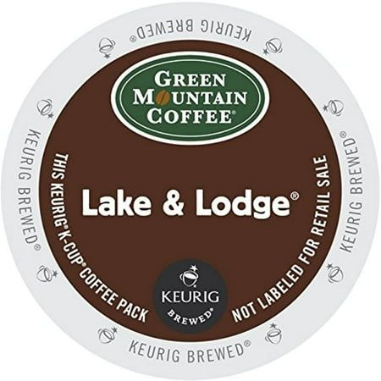
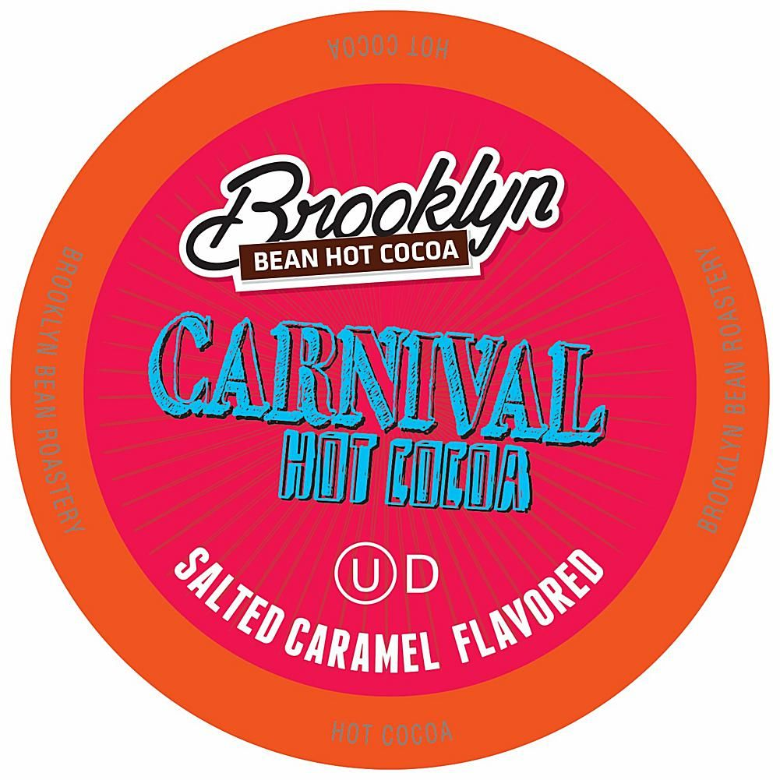


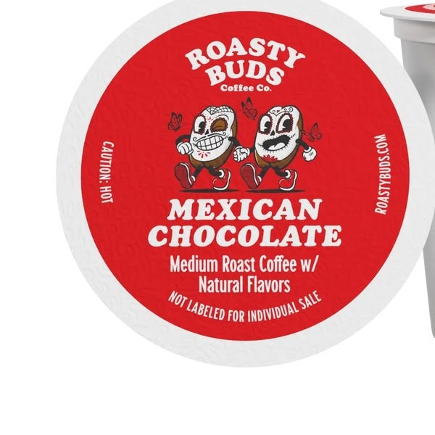
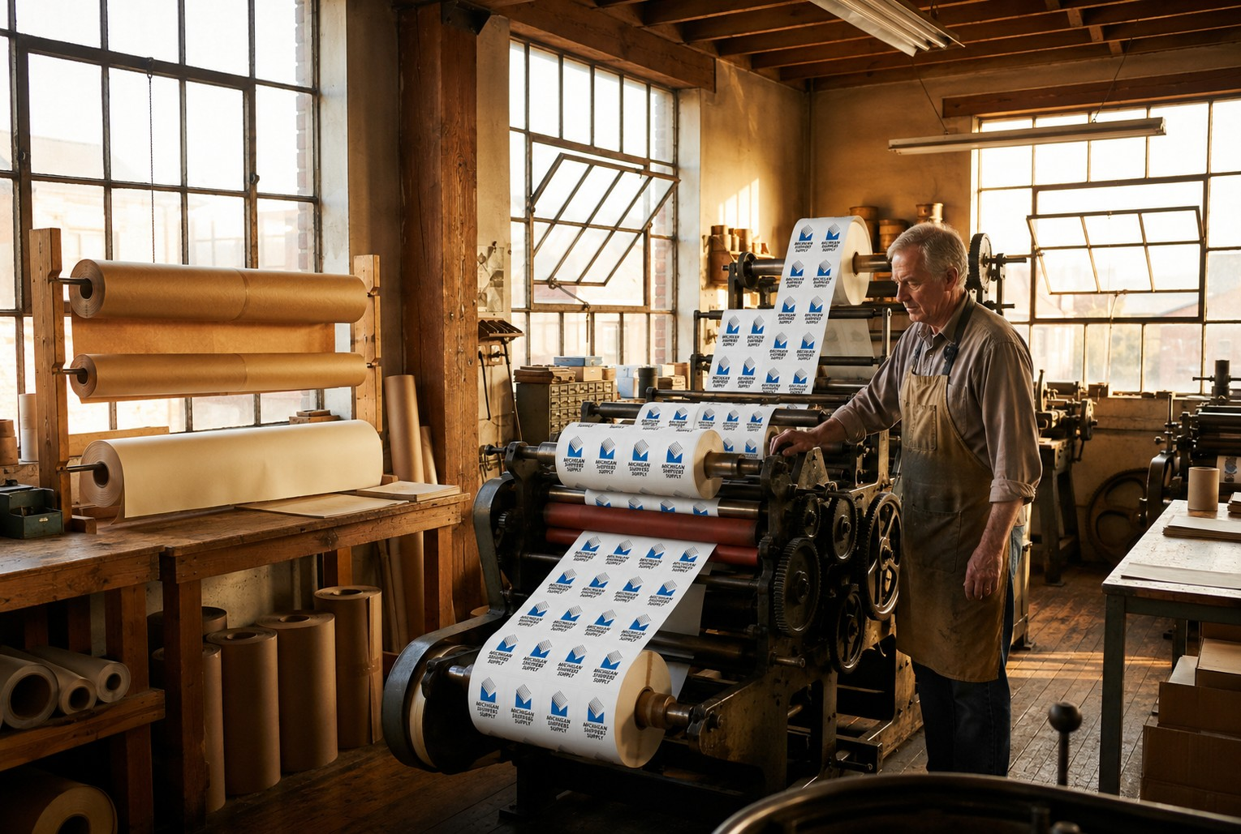
09 / Proof
BRANDS WE PRINT FOR
You've seen our work on the shelf
A few of the brands that trust us to print their single-serve coffee and cocoa lids. When we show proof, we show the real product, never stock mockups.
Crazy Cups · Chocolate Raspberry Truffle
Green Mountain Coffee · Lake & Lodge
Brooklyn Bean · Carnival Hot Cocoa
Mucho Gusto · Chocolate con Leche
Crazy Cups · Island Rum Coconut
Roasty Buds · Single-Serve Coffee
Two presses, one standard: excellent. Short runs digital, long runs flexographic.

Slide 11
10 / Standards
THE RULES
Do & don't
The shortlist that keeps every quote, label, web page, and conversation unmistakably Michigan Shippers Supply.
✓ ALWAYS
✕ NEVER
Lead with heritage: family-owned since 1959.
Press Blue on Heritage Cream, anchored by navy.
Georgia for headlines, system sans for the rest.
Talk plainly and reassure on compliance.
Show real printed product as proof.
Give the right press, never an upsell.
Reserve gold for the White-Glove program.
Sound corporate, hypey, or high-pressure.
Recolor, stretch, or rebuild the logo.
Compete on being the cheapest click.
Use gold or white-glove language off-program.
Mix in random fonts or stock mockups.
Run inconsistent name, address, or phone.
Make a maker feel small for ordering small.
On the name: public/marketing name is Michigan Shippers Supply (no apostrophe), matching the logo and domain. The legal name, Michigan Shippers' Supply, Inc., keeps its apostrophe for contracts.

Slide 12
11 / Contact
THE ESSENTIALS
One company, one set of facts.
Use these exactly as written, on the website, in listings, on every label and invoice. Consistency is a brand asset.
Email
Call
sales@michiganshippers.com
(616) 935-6680 · Toll-free (800) 442-4639
Visit / Mail
Hours
17369 Taft Rd, Spring Lake, MI 49456
Monday to Friday, 9:00 AM to 5:00 PM

Slide 13
Small enough to care. Experienced enough to deliver.
MICHIGAN SHIPPERS SUPPLY · SPRING LAKE, MICHIGAN
CUSTOM LABEL PRINTING SINCE 1959 · EDITION 01 · 2026

