Slide 1
Presentation Title
Generated with python-pptx

Slide 2
Overview
This is a sample presentation created with python-pptx.
It demonstrates text, charts, and combined layouts.
The library provides powerful PPTX generation capabilities.

Slide 3
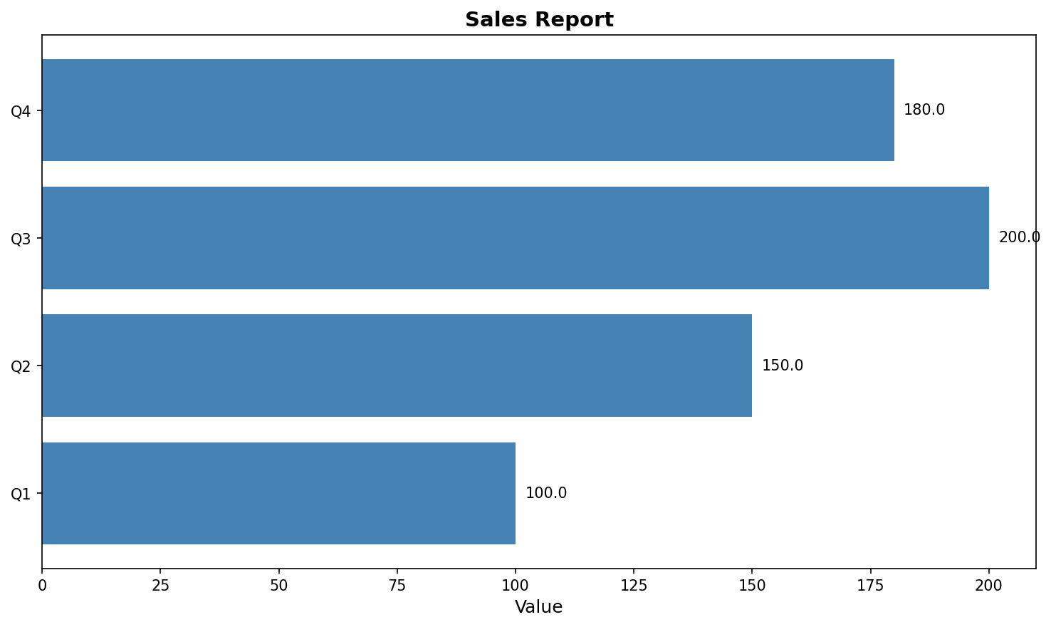
Sales Data
Data:
Q1: 100
Q2: 150
Q3: 120
Q4: 180

Slide 4
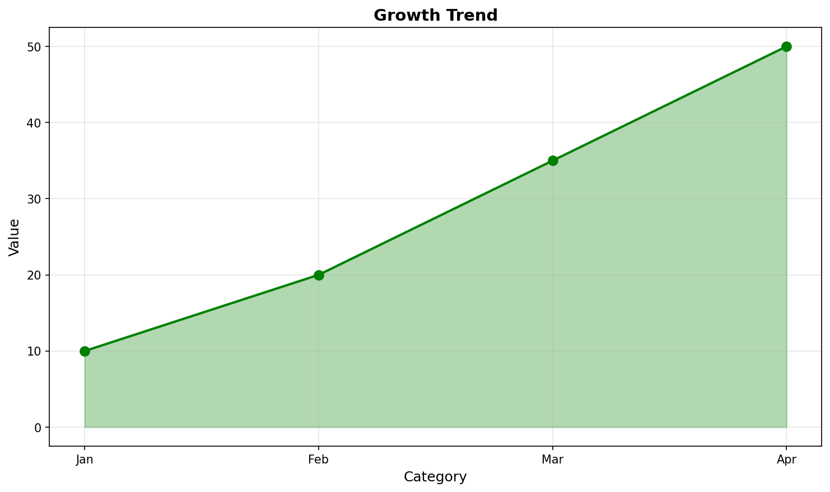
Performance Analysis
Q4 showed the highest growth.
Overall trend is positive.
Target exceeded by 20%.

