Slide 1
Amiko Pay
A decentralized network for secure, instant, off-blockchain transactions

Slide 2
The block chain
T
T
T
T
T
T
T
T
T
T
T
T
T
T
T

Slide 3
The block chain
T
T
T
T
T
T
T
T
T
T
T
T
T
T
T
T
T
T

Slide 4
The block chain
T
T
T
T
T
T
T
T
T
T
T
T
T
T
T
T
T
T

Slide 5
The block chain
T
T
T
T
T
T
T
T
T
T
T
T
T
T
T
T
T
T

Slide 6
Centralized off-blockchain transactions
T
B
B
T
B
B

Slide 7
Centralized off-blockchain transactions
T
B
B
T
B
B

Slide 8
Decentralized off-blockchain transactions

Slide 9
Decentralized off-blockchain transactions

Slide 10
Micro-transaction channels
T0:
1 BTC to A
Alice
Bob

Slide 11
Micro-transaction channels
T0:
1 BTC to A
Alice
Bob
Time-locked
T1:
1 BTC from T0
1 BTC to A+B
T2:
1 BTC from T1
1 BTC to A

Slide 12
Micro-transaction channels
T0:
1 BTC to A
Alice
Bob
T1:
1 BTC from T0
1 BTC to A+B
T2:
1 BTC from T1
1 BTC to A
T2:
1 BTC from T1
1 BTC to A
B
B

Slide 13
Micro-transaction channels
T0:
1 BTC to A
T1:
1 BTC from T0
1 BTC to A+B
A
Alice
Bob
T1:
1 BTC from T0
1 BTC to A+B
T2:
1 BTC from T1
1 BTC to A
T2:
1 BTC from T1
1 BTC to A
A
B
B

Slide 14
Micro-transaction channels
T0:
1 BTC to A
T1:
1 BTC from T0
1 BTC to A+B
A
Alice
Bob
T1:
1 BTC from T0
1 BTC to A+B
T2:
1 BTC from T1
1 BTC to A
T2:
1 BTC from T1
1 BTC to A
A
B
B
T3:
1 BTC from T1
0.9 BTC to A
0.1 BTC to B
T3:
1 BTC from T1
0.9 BTC to A
0.1 BTC to B
A
A

Slide 15
Micro-transaction channels
T0:
1 BTC to A
T1:
1 BTC from T0
1 BTC to A+B
T3:
1 BTC from T1
0.9 BTC to A
0.1 BTC to B
A
A
B
Alice
Bob
T1:
1 BTC from T0
1 BTC to A+B
T2:
1 BTC from T1
1 BTC to A
T2:
1 BTC from T1
1 BTC to A
A
B
B
T3:
1 BTC from T1
0.9 BTC to A
0.1 BTC to B
T3:
1 BTC from T1
0.9 BTC to A
0.1 BTC to B
A
A
B

Slide 16
Micro-transaction channels
T0:
1 BTC to A
T1:
1 BTC from T0
1 BTC to A+B
T2:
1 BTC from T1
1 BTC to A
A
A
B
Alice
Bob
T1:
1 BTC from T0
1 BTC to A+B
T2:
1 BTC from T1
1 BTC to A
T2:
1 BTC from T1
1 BTC to A
A
A
B
B
T3:
1 BTC from T1
0.9 BTC to A
0.1 BTC to B
T3:
1 BTC from T1
0.9 BTC to A
0.1 BTC to B
A
A
B

Slide 17
Bi-directional micro-transaction channels
Credit goes to Alex Akselrod (user “blueadept” on bitcointalk.org):
https://bitcointalk.org/index.php?topic=814770.msg9185225#msg9185225

Slide 18
Bi-directional micro-transaction channels
Alice
Bob
T1:
1 BTC from T0
1 BTC to A+B
T2:
1 BTC from T1
1 BTC to A
T2:
1 BTC from T1
1 BTC to A
A
B
B
T3:
1 BTC from T1
0.6 BTC to A
0.4 BTC to B
0.4 BTC
T3:
1 BTC from T1
0.6 BTC to A
0.4 BTC to B
A
A
T4:
1 BTC from T1
0.8 BTC to A
0.2 BTC to B
0.2 BTC
T4:
1 BTC from T1
0.8 BTC to A
0.2 BTC to B
B
B

Slide 19
Bi-directional micro-transaction channels
Alice
Bob
A
1 BTC
A
1 BTC
A
0.6 BTC
B
0.4 BTC
0.4 BTC
A
0.6 BTC
B
0.4 BTC
A
0.8 BTC
B
0.2 BTC
0.2 BTC
A
0.8 BTC
B
0.2 BTC

Slide 21
Lock; Commit
A
0.7 BTC
B
0.3 BTC
A
0.7 BTC
B
0.3 BTC
A
0.4 BTC
A+B
0.3 BTC
B
0.3 BTC
Lock 0.3 BTC
A
0.4 BTC
A+B
0.3 BTC
B
0.3 BTC
A
A
A
0.4 BTC
B
0.6 BTC
Commit
A
0.4 BTC
B
0.6 BTC
A
A

Slide 22
Lock; Rollback
A
0.7 BTC
B
0.3 BTC
A
0.7 BTC
B
0.3 BTC
A
0.4 BTC
A+B
0.3 BTC
B
0.3 BTC
Lock 0.3 BTC
A
0.4 BTC
A+B
0.3 BTC
B
0.3 BTC
A
A
A
0.7 BTC
B
0.3 BTC
Rollback
A
0.7 BTC
B
0.3 BTC
B
B

Slide 23
Token (T) and Hash (H)
H
H
H
H
H
T = random()
H = hash(T)

Slide 24
Lock
Lock
Lock
Lock
Lock
T = random()
H = hash(T)

Slide 25
Commit conditions
If commit message was sent:
Commit
Else if rollback message was sent:
Rollback
Else if T is present in blocks a..b:
Commit
Else:
Rollback

Slide 26
Commit
Commit: T
T
T
Commit
Commit
Commit
Commit
T
T = random()
H = hash(T)
T

Slide 27
Rollback
Rollback
Rollback
Rollback
Rollback
T = random()
H = hash(T)

Slide 28
Time-out → now what?
Commit: T
Commit
???
T = random()
H = hash(T)
T

Slide 29
T not in blocks → Rollback
Commit
Rollback
Commit
Rollback
Rollback
T = random()
H = hash(T)

Slide 30
T in blocks → Commit
Commit
T
Commit
Commit
Commit
Commit
T = random()
H = hash(T)

Slide 31
Progress
2011: merge Ripple and Bitcoin concepts
January 2013: release of paper; start of software implementation
December 2014: first Amiko transactions through micro-transaction channel (sort of)

Slide 32
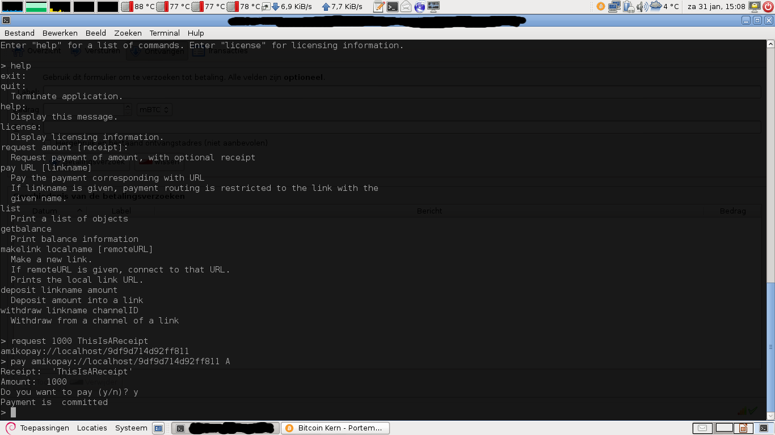

Slide 33
Bitcoin needs Amiko Pay
Amiko Pay needs YOU!!!

Slide 34
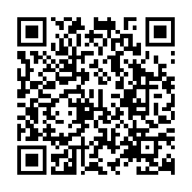
Thank you
1Cj3pyT1VDGK1g4DF5epbG4DL7rXAvzFwe
You know what to do :-)

Slide 35
Very rough storage estimate
$10 000 savings per person
$1 per small transaction
___ /
10 000 unspent transactions per person
10 billion people
___ x
10¹⁴ unspent transactions
100 bytes per transaction
___ x
10¹⁶ bytes = 10 000 TByte = block chain size
(when using block chain pruning!)

Slide 36
Very rough bandwidth estimate
1 transaction per person per day
10 billion people
___ x
10¹⁰ transactions per day
100 bytes per transaction
___ x
10¹² bytes per day
10⁵ seconds per day
___ /
10⁷ bytes per second = 100 Mbit/s

