Slide 1

Election
Buzz
Behind The Scene of Pilkada DKI Jakarta 2017
SOCIAL MEDIA ANALYTICS
dedicated by
Hasyim Y A
Yusrina B W
VVVV

Slide 2
Background Internet in RealTime
2

Slide 3
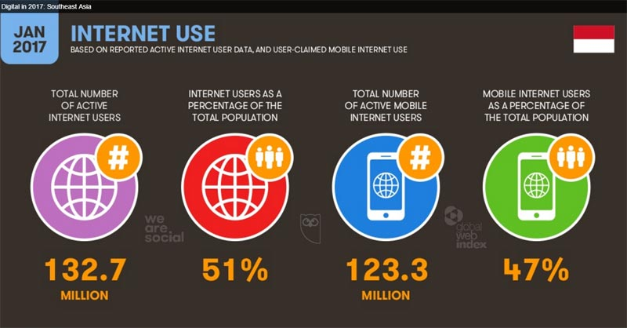
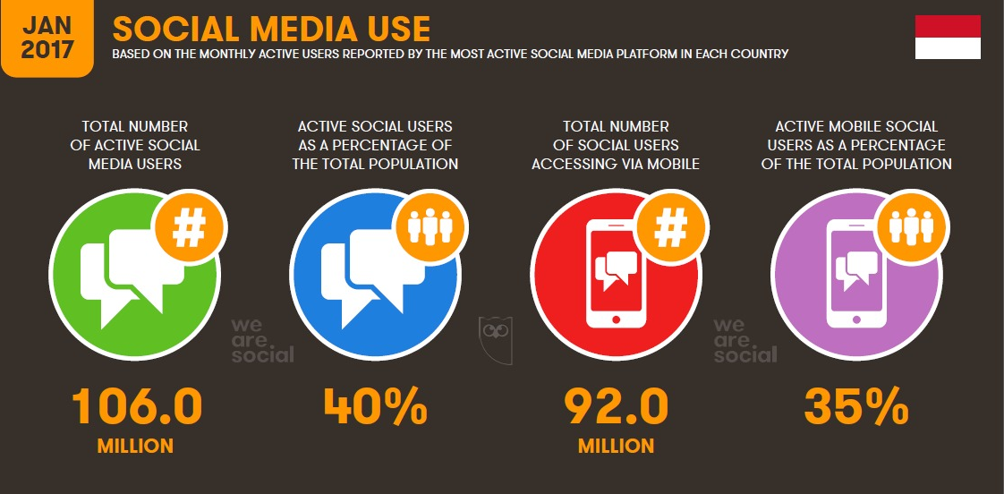
Background Indonesia Internet Landscape
3
+ 50,6%
+ 92,4%
+ 34,2%
+ 39,4%
% annual
growth

Slide 4
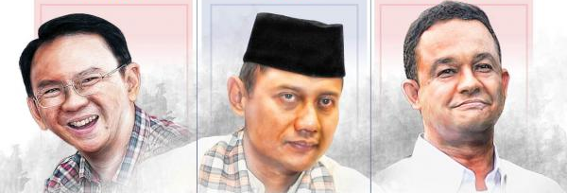
Pilkada DKI Jakarta
4
Background Pilkada DKI Jakarta
Pilkada DKI Jakarta is one of governor election that has become center of public attention in Indonesia and global in terms of competition until other issues

Slide 5
Problem Statement Election Buzz PILKADA DKI JAKARTA social media analytics
5
How to measure
branding effectiveness based on social media
Case of Election Buzz Pilkada DKI Jakarta

Slide 6
What Is Our Purposes Election Buzz PILKADA DKI JAKARTA social media analytics
6
Analyze
Upgrade
Explore
Analyze effectiveness branding of election buzz and public figure
Increase people’s awareness of Governor election in DKI Jakarta
Explore voice of customer based on social media

Slide 7
Our Benefits Election Buzz PILKADA DKI JAKARTA social media analytics
7
Brand Monitor
Monitoring brand in social media and listening to customer conversations on twitter
Social Life Research
Getting an overview of real life customer
Competitor Analysis
Monitoring competitor activity in social media especially twitter
Interest Classification
Understanding the various interests of users twitter

Slide 8
Proposed framework Election Buzz PILKADA DKI JAKARTA social media analytics
8
Kathy Lee Diana Palsetia Ramanathan
2011
The classification process twitter trending topics into 18 categories, such as sports politics technology and others
Bag of Words approach for text classification and network based
Experiment shows accuracy reaches 65% - 70% by using methods that have been mentioned
Marco Pennacchiotti Ana Maria Popescu
2011
Twitter user classification process into several categories, such as ethnicity or political orientation
Gradient Boosted Decision Trees GBDT
Classification of users into 3 categories Results found with the Linguistic features especially on the topic based that highly reliable
Elly Susilowati Mira Kania Sabariah Alfian Akbar Gozali
2015
Information on the media traffic is not effective and separately
Support Vector Machine
Classification tweet on twitter road conditions

Slide 9
Methodology Election Buzz PILKADA DKI JAKARTA social media analytics
9
Preparation
Crawling
Data Modelling
Validation
Research keyword about candidate of Pilkada DKI Jakarta)
Labelling keyword to category (candidate of Pilkada DKI Jakarta)
Crawling data from twitter based on keywords that have been assigned
Text Based Modelling TF IDF
Apply classification Model to classify sentiment for each tweet.
Descriptive statistics
Word CLoud
Cross Validation about sentiment classification

Slide 10

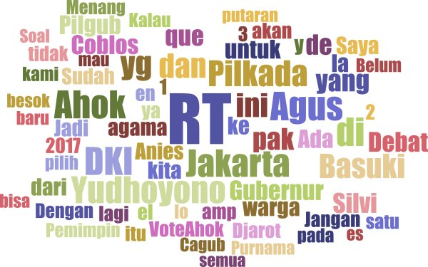
Analysis and Results Election Buzz PILKADA DKI JAKARTA social media analytics
10
Sentiment
Word Cloud
13M
Circles
5M
Followers
Insights
Ahok was the most controvertional candidat
Anies could control his image

Slide 11
Analysis and Results Election Buzz PILKADA DKI JAKARTA social media analytics
11
Voting
Election Interest
86%
say it is important
to vote
82%
77%
and
75%
plan to vote
are insterested in governor election
Candidates
one word to describe
Top Issues
AGUS
AHOK
ANIES
ECONOMY
AND JOB
RELIGION
RELOCATION
AND EVICTION
VVVV

Slide 12

12

