Slide 1
unLibra
The decentralized 0-conf stablecoin

Slide 2
Cross-border payments
Libra solves that problem perfectly, as it:
  Avoids regulation (and thus compliance with the regulatory framework of every single country it wants to operate on)
  Opts-out of the current payment system and thus doesn’t have to integrate with everything
  Is built in social networks → Gets a huge network effect

Slide 3
Why not use Libra?
Because you can’t (and won’t be able for a few years):
“Libra raises many serious concerns regarding privacy, money laundering, consumer protection and financial stability.”- US Federal Reserve Chairman
“Libra could potentially pose a challenge to Chinese cross-border payments, monetary policy and even financial sovereignty.” - Director of the China’s central bank
“it would be a private cryptocurrency and that’s not something we have been comfortable with.” - India’s Finance Secretary

Slide 4
Also, unLibra is more decentralized

Slide 5
Tenets

Slide 6
Built on social networks
Integrated into current social networks
This lets us piggyback on the huge networks of users present on Facebook, twitter…
Makes it extremely easy to use

Slide 7
Stable
Uses DAI, a decentralized stablecoin as the currency for all transactions
DAI maintains it’s USD peg via a collateral-based mechanism → No central party

Slide 8
Fast & free (as in beer)
Adapts layer 2 bitcoin protocol (Statechains) to Ethereum
All transactions will be performed offchain and thus will be instant and cost-free
Cons: We lose some decentralization

Slide 9
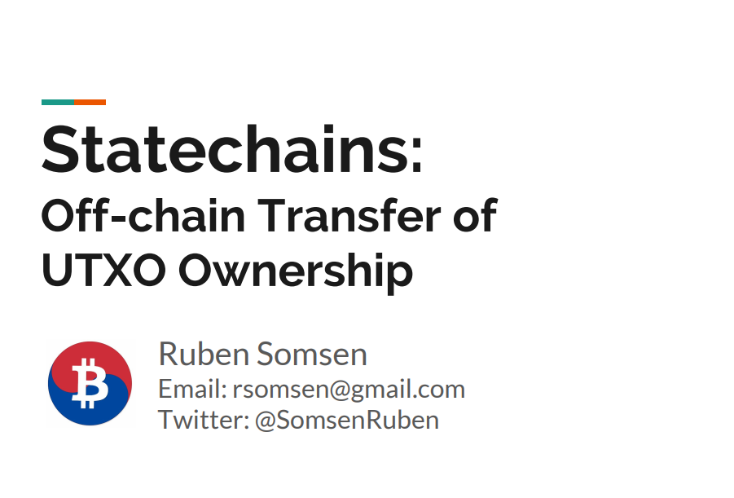
D

Slide 10
Demo

Slide 11


