Slide 1


Coronavirus Epidemic Forecasting
7 March 2020
CA-ANG/SG
This material is shared in the hope that it may prove helpful to some. It is in no way endorsed by, or the official policy of, the Department of Defense, the Air National Guard, or the California Military Department.
Notes:
L5-5-2
1415A050/0599

Slide 2
Summary (1)
Predictions:
  Epidemic will end some time after 60% of population is infected
  That could be before summer or after summer
  But infection rate could shoot to 90%
  Epidemic will last about three to five months
Above predictions apply if public health measures are ineffective
  Substantial improvement possible if public health measures are effective
  Most difficult and impactful decision: when to relax public health measures

Slide 3
Summary (2)
Covid-19 is a socially non-neutral disease
Especially bad for:
  Elderly
  Sick
  Health workers
If similar to 1918 influenza spread
  Will be worse in areas of high population density and high illiteracy
  “Illiteracy” in 1918 was a marker for general poverty

Slide 4
Question to Answer:
Where is Epidemic Going?
All epidemics are a math problem
All epidemics are a medical problem
All epidemics are a social problem
All epidemics are a political problem ← Won’t discuss this one!
This briefing is not for busy leadership
This briefing is for planners with time to dig in deeper

Slide 5
Math
Key reference: The effect of public health measures on the 1918 influenza pandemic in U.S. cities. PNAS. 2007; 104: 7588.

Slide 6
Math Overview
Math tells us exactly how far the epidemic will go and when it will end
Proves false this corrosive misbelief:
  “It doesn’t matter what we do, we’re all going to get infected”
Proves that our public health actions are supremely important
  Not just what actions to apply and when
  Also how long to maintain them ← The more difficult aspect

Slide 7
Math Basics
Key parameter of any virus:
  R0 = “R-naught” = “basic reproduction number”
  Average number of cases that result from a single case
Key equation:
  F = Fraction of population ultimately infected = 1 – (1/R0)
F determines two critical behaviors of an epidemic…

Slide 8
First Key Meaning of “F”
Is the fraction of the population that ends up being infected
  [ Not completely true, because virus usually overshoots, but assume true for now ]
Estimates of R0 for Covid-19 virus
  R0 = 1.5 F = 1-(1/1.5) = 0.33 = 33% of population
  R0 = 2 F = 1-(1/2) = 0.5 = 50% of population
  R0 = 2.5 F = 1-(1/2.5) = 0.6 = 60% of population ← We assume
  R0 = 3 F = 1-(1/3) = 0.67 = 67% of population
So, is false to say “We’re all going to get infected.”

Slide 9
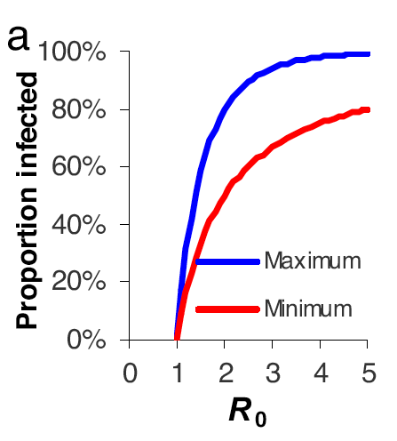
How Big is the Overshoot?
Max Overshoot
At R0=2.5: F=60% → overshoots to 90%
At R0=1.5: F=33% → overshoots to 60%
These results are based on a mathematical model
  “Deterministic susceptible-infected-recovered” (SIR) model
So, estimate that 60-90% of population will get infected with coronavirus R0=2.5
  If we do nothing
Predicted
By equation

Slide 10
Second Key Meaning of “F”
Is when the epidemic stops
Mathematically, an epidemic stops when either:
  (a) R0 becomes less than 1
  (b) Fraction of resistant population reaches F
    ”Herd immunity” kicks in when F fraction of population is resistant
    At this fraction, sustained transmission of the virus becomes impossible
    Assumes: People become resistant after recovering from infection
    Assumes: People become resistant after being vaccinated (not currently an option)
For this meaning we use the calculated F, not the overshoot F
  At R0=2.5: F=60% → epidemic peters out soon after 60% of population infected
  At R0=1.5: F=33% → epidemic peters out soon after 33% of population infected

Slide 11
Medical / Public Health

Slide 12
How to Relate R0 and F to Real World?
R0 is not a fixed property of the virus
R0 depends on the interaction between virus + people + environment
R0 can be lowered by public health interventions
  Less mathematically: Lowering the number of people whom each case infects will shrink the total size of the epidemic
  This is not obvious to lots of physicians (proof available on request)
  Impact is substantial. Recall previous data:
    R0 = 2.5 requires infection of 60% of population before epidemic ends
    R0 = 1.5 requires infection of 33% of population before epidemic ends
    So our actions could spare on-the-order-of 27% of the population from infection

Slide 13
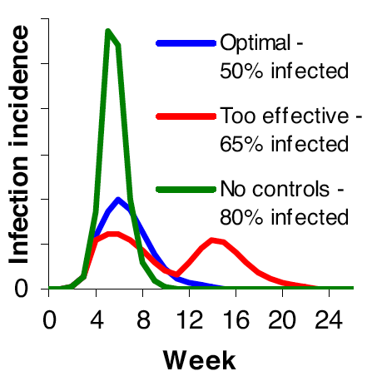
Good Strategies and Bad Strategies
No public health controls → 80% infected (includes overshoot)
(Blue) Optimal. Controls ↓ R0 by 32%.
Controls stop on day 110.
Minimum overall epidemic size.
Over-effective. R0 initially ↓ by 40%.
Controls relaxed too early (day 75).
Second wave occurs because R0 has
bounced back up, and F % of population
is not yet resistant, and so sustained
transmission re-ignites.
Mathematical model

Slide 14
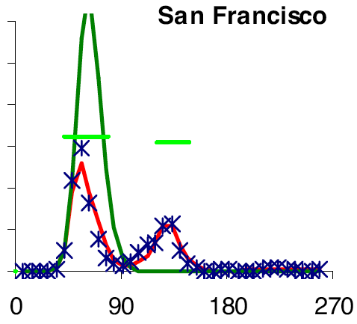
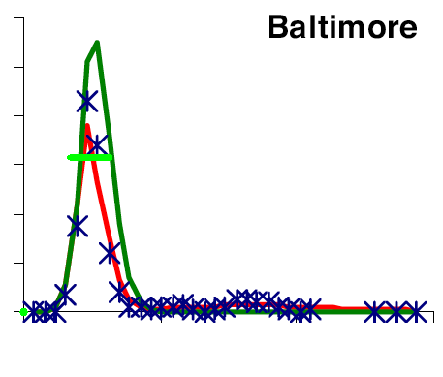
Real-World Confirmation
1918
Predicted
1918
Predicted
Period of public
health controls
X = actual
|
Deaths Per Week
Ineffective controls.
Initial peak mostly unaffected.
Relaxation of controls
had little effect.
Effective controls.
Initial peak lowered.
BUT
Controls relaxed early.
Second peak occurred.
Days
Days
Actual data

Slide 15
Key Question for Planners
Long-term, what R0 will the population be able to sustain?
  Example: Suppose closing schools reduces R0 from 2.0 (F=50%) to 1.5 (F=33%). Huge benefit, but closing schools until a vaccine appears is not a viable long term option.
  If 33% of the population is infected and schools are closed and the epidemic has ceased, when the schools re-open, R0 will increase back to 2.0 and another wave of infections will occur, to bring F up to 50% (or higher, with overshoot).
With a Covid-19 vaccine predicted to be 18 months away, optimal strategy *for general population* is to apply only enough controls to reduce R0 to a level sustainable for 18 months.

Slide 16
Caveats
These are principles only.
Not possible to know change in R0 for each control.
Individual behaviors are large components of any change in R0.
Summertime may have a different R0 than spring and fall.
“Over-effective” (two-wave) strategy may prolong pain, but would also reduce peak demand on health care system.

Slide 17
Social Non-Neutrality

Slide 18
R0 is Not the Same Everywhere
Based on 1918 influenza data…
  R0 is higher where population density is higher
  R0 is higher where poverty is higher
Scenarios of very high virus transmission in Covid-19 epidemic
  Korean psychiatric ward: 99 of 101 contract the disease
  Diamond Princess cruise ship: 700 cases
  Homes: data from China suggests most secondary transmission is at home

Slide 19
R0 is Not the Whole Story
R0 refers only to spread of disease
Does not refer to consequences of disease
  Older – high mortality
  Sick – comorbities, including hypertension + other common diseases, raise mortality
  Health care workers
    Dire consequences for health care system.
    Also seem to have higher mortality. Reasons are wholly unclear.

Slide 20
Conclusion
Course of the epidemic is not pre-ordained by biology
Our actions will be a large determinant of the ultimate outcome
Mathematics is helpful for proving a framework to think about actions
  But is not a rigid guide

